Slide 1
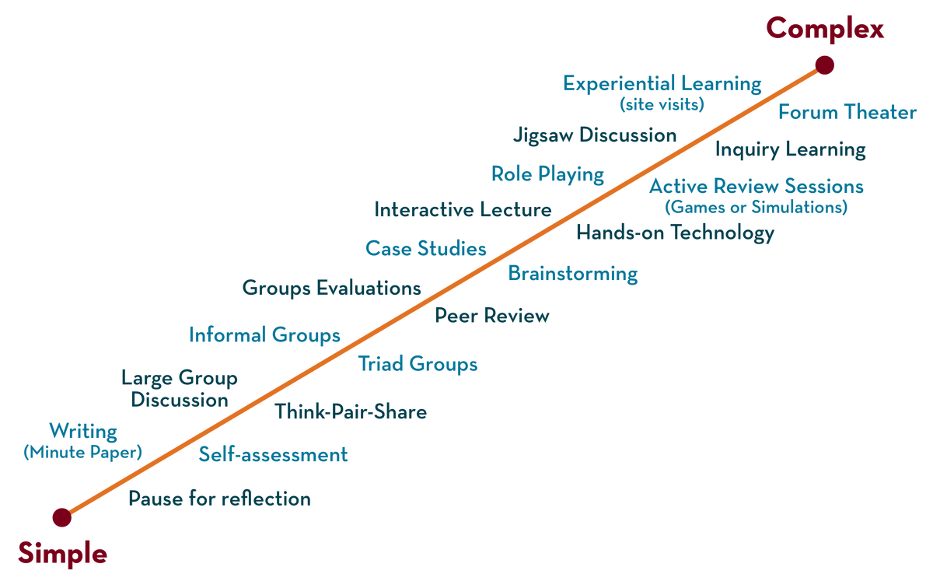

Department of CSE
Deep Learning
20CS3269AA
Topic:
Parameter sharing & Tying, Injecting noise at input
Session - 13

Slide 2



AIM OF THE SESSION
To familiarize students with the basic concept of
INSTRUCTIONAL OBJECTIVES
This Session is designed to:
Demonstrate Parameter sharing & Tying, Injecting noise at input
LEARNING OUTCOMES
At the end of this session, you should be able to:
Define Parameter sharing & Tying
Describe how to add Gaussian noise to the input
Summarize advantages of and applications of parameter sharing & Tying, injecting noise

Slide 3
SESSION INTRODUCTION
Parameter sharing & Tying
Deep neural networks may contain millions, even billions, of parameters or weights, making storage and computation significantly expensive and motivating a large body of work to reduce their complexity
Parameter sharing and parameter tying is another well-known approach for controlling the complexity of Deep Neural Networks by forcing certain weights to share the same value.
Parameter tying is a regularization technique.
We divide the parameters or weights of a machine learning model into groups by leveraging prior knowledge, and all parameters in each group are constrained to take the same value.
In simple terms, we want to express that specific parameter should be close to each other

Slide 4
SESSION INTRODUCTION
Parameter sharing & Tying
Approach was used for regularizing the parameters of one model, trained as a supervised classifier, to be close to the parameters of another model, trained in an unsupervised paradigm.
Parameter sharing is where we – force sets of parameters to be equal
Because we interpret various models or model components as sharing a unique set of parameters, only a subset of the parameters needs to be stored in memory
Applications:
Most extensive use of parameter sharing is in convolutional neural networks (CNNs)

Slide 5
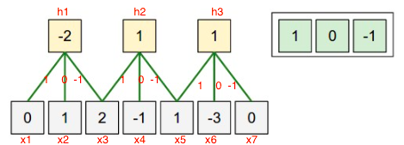
SESSION DESCRIPTION
Parameter sharing & Tying
Shared weights simply means that use same weight vector to do the convulations. The main motivation for this is limit the number of parameters.
We can dramatically reduce down our parameters by one intuitive assumption that if one feature is important to compute at one point so it is on another point. Example: if detecting an edge is important at particular position. So, it is for all positions that edge repeat itself due to the translationally-invariant structure of images. This will lead to faster convergence. Also, we have limited the flexibility which can also act a regularization mechanism avoiding overfitting. Consider the case where we want to process two sets of images in parallel, but also want columns to share parameters.

Slide 6
SESSION INTRODUCTION
Injecting noise at input
We know that there are mainly two problems in the case of building or training a neural network:
over-fitting and
under-fitting.
Well, we know that the concept of overfitting is that the model is overtrained on the given input samples. Thus, this leads to around 100% accuracy of the model. But this results in showing less accuracy in the test data.
In order to reduce this problem, we have some methodologies like generalization techniques.
Along with them, the new concept of noise injection is added to reduce the problem of overfitting.

Slide 7
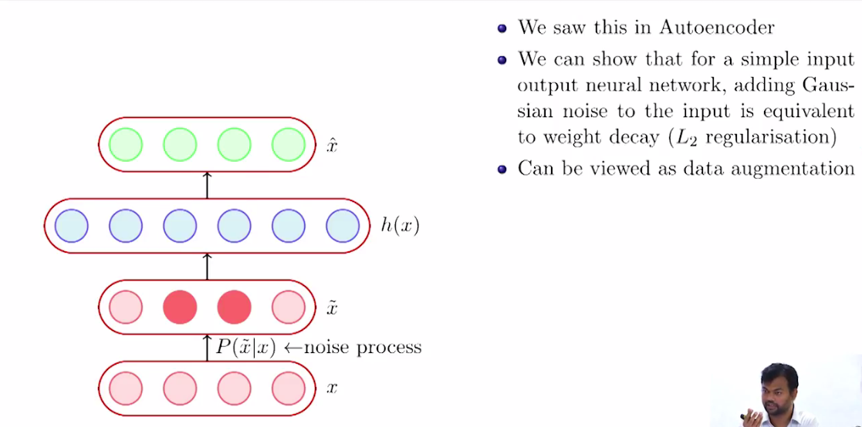

SESSION DESCRIPTION
Injecting noise at input

Slide 8
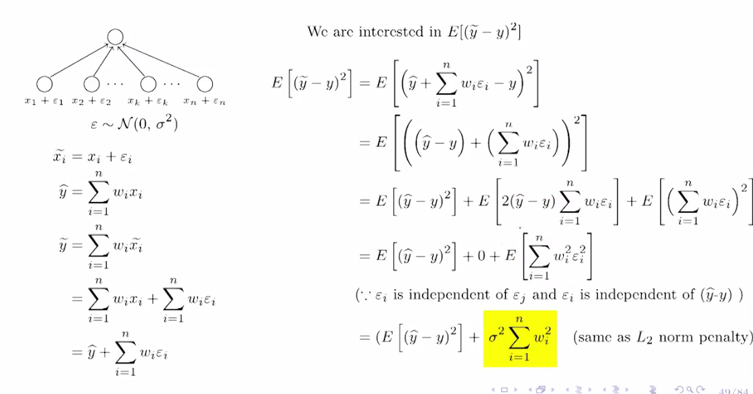
SESSION DESCRIPTION (Cont..)

Slide 9
SESSION DESCRIPTION (Cont..)
Thus, adding noise expands the training dataset size.
Each time when a training sample is exposed to the model, some random noise is added to the input variables making them different every time it is exposed to the model.
The most common noise added during the training of the model is Gaussian noise or white noise.
The main advantage of Gaussian noise is that we can have a look at the standard deviation of the random Noise, and thus can control it by the amount of spread it.
The major point is that we need to add noise only during the training stage, like adding noise to activations, weights, gradients, and outputs.

Slide 10
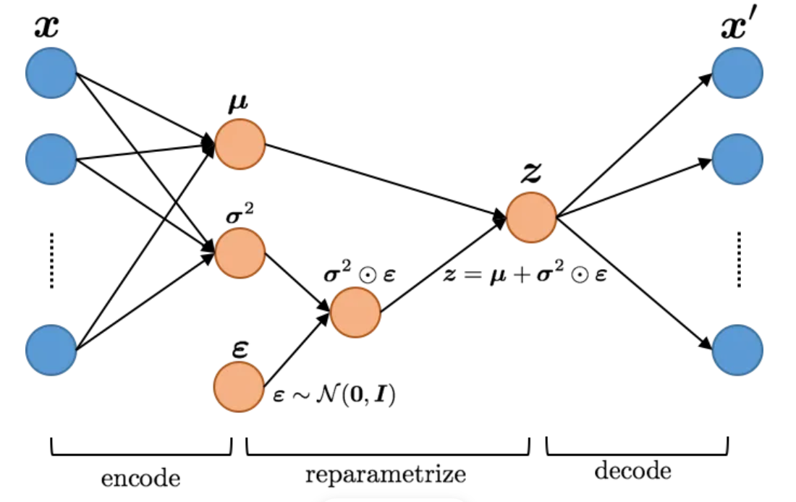
EXAMPLES
Adding Gaussian noise to hidden layers Example

Slide 11
SUMMARY
Convolution Neural Networks have a couple of techniques known as parameter sharing and parameter tying. Parameter sharing is the method of sharing weights by all neurons in a particular feature map. Therefore, helps to reduce the number of parameters in the whole system, making it computationally cheap.
Parameter approach is used for regularizing the parameters of one model, trained as a supervised classifier, to be close to the parameters of another model, trained in an unsupervised paradigm (to capture the distribution of the input data)
The main reason we are adding noise is that the dataset is small, and this causes an overfitting problem. Thus, to eliminate this, we add noise. Adding noise will smoothen the mapping function of a neural network, thus improving generalization.

Slide 12
TERMINAL QUESTIONS
Describe how to derive sharing, within the first convolutional layer of two popular CNN architectures: LeNet and AlexNet
2. List out the benefits of parameter sharing in CNNs and Why is sharing parameters a good idea.
3. What are the benefits of parameter sharing in CNNs?
4. Does weight sharing occur in Recurrent Neural networks?

Slide 13
REFERENCES FOR FURTHER LEARNING OF THE SESSION
Reference Books:
1. Ian Goodfellow, Yoshua Bengio, Aaron Courville - Deep Learning (2017, MIT)
Sites and Web links:
1. https://studyglance.in/dl/display.php?tno=13&topic=Parameter-Tying-and-Sharing
2. https://towardsdatascience.com/how-to-use-noise-to-your-advantage-5301071d9dc3
3. https://www.codingninjas.com/codestudio/library/parameter-sharing-and-tying
4. https://www.codingninjas.com/codestudio/library/noise-injection-in-neural-networks

Slide 14
THANK YOU
Team –DPL

