Slide 1

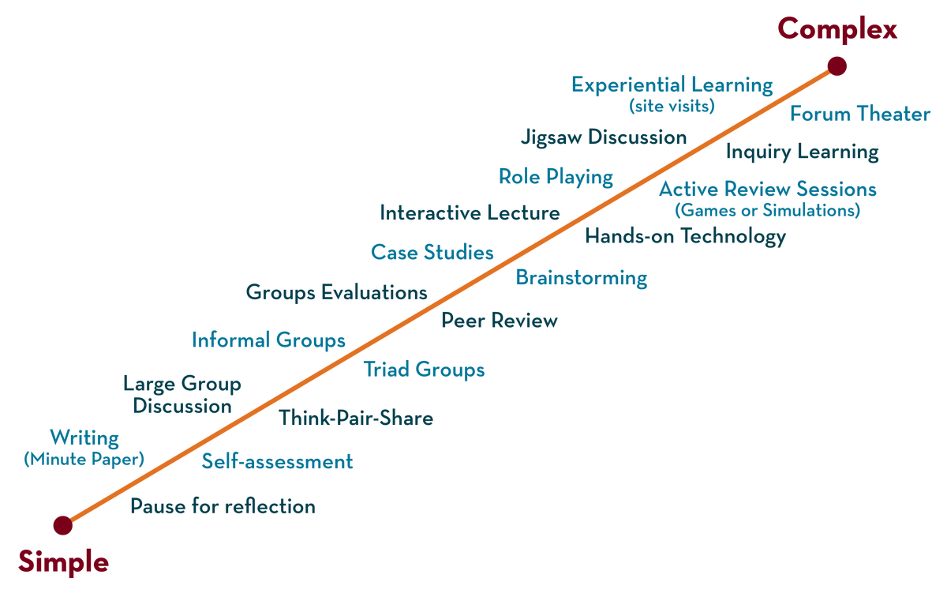
Department of ---
Deep Learning
20CS3269AA
Topic:
DropOUT, Early stopping
Session - 14

Slide 2



AIM OF THE SESSION
To familiarize students with the basic concept of
INSTRUCTIONAL OBJECTIVES
This Session is designed to:
Demonstrate the concepts of Early stopping, Dropout
Describe how Early stopping reduces overfitting
List out the advantages of Early stopping
LEARNING OUTCOMES
At the end of this session, you should be able to:
Define Early stopping, Dropout
Describe advantage of Early stopping and Dropout

Slide 3
SESSION INTRODUCTION
Early Stopping
In machine learning, early stopping is one of the most widely used regularization techniques to combat the overfitting issue.
Early Stopping monitors the performance of the model for every epoch on a held-out validation set during the training and terminate the training conditionally on the validation performance.
Early Stopping is a very different way to regularize the machine learning model.
The way it does is to stop training as soon as the validation error reaches a minimum.
Notes:
<number>

Slide 4
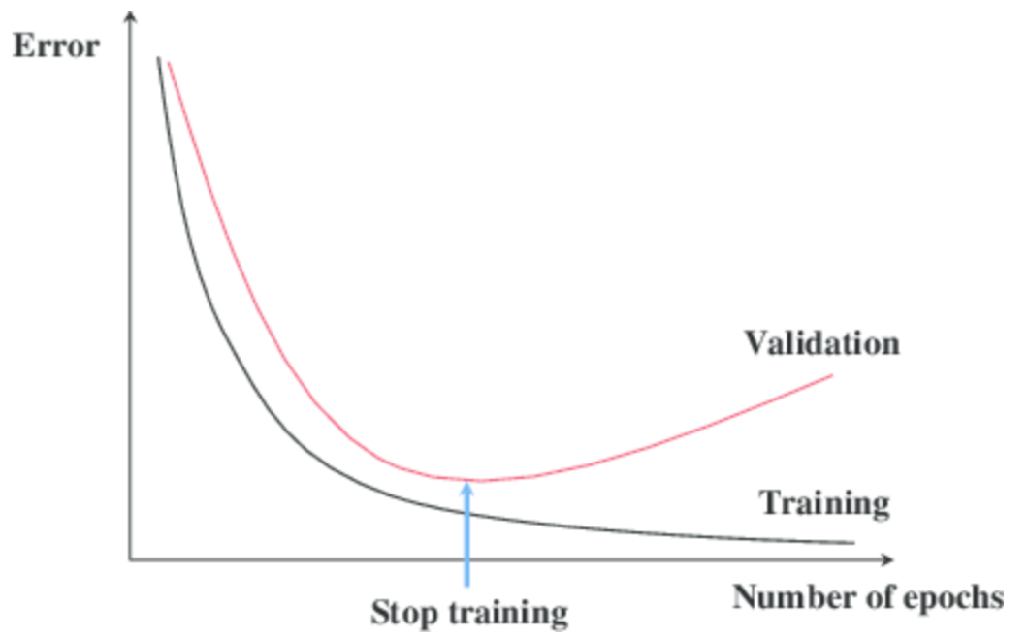
SESSION DESCRIPTION
The figure below shows a model being trained.

Slide 5
SESSION DESCRIPTION (Cont..)
As the epochs go by, the algorithm leans and its error on the training set naturally goes down, and so does its error on the validation set.
However, after a while, the validation error stops decreasing and starts to go back up.
This indicates that the model has started to overfit the training data.
With Early Stopping, you just stop training as soon as the validation error reaches the minimum.

Slide 6
SESSION INTRODUCTION
Dropout
Dropout layers have been the go-to method to reduce the overfitting of neural networks.
The term “dropout” refers to dropping out the nodes (input and hidden layer) in a neural network.
All the forward and backwards connections with a dropped node are temporarily removed, thus creating a new network architecture out of the parent network.
The nodes are dropped by a dropout probability of p.

Slide 7
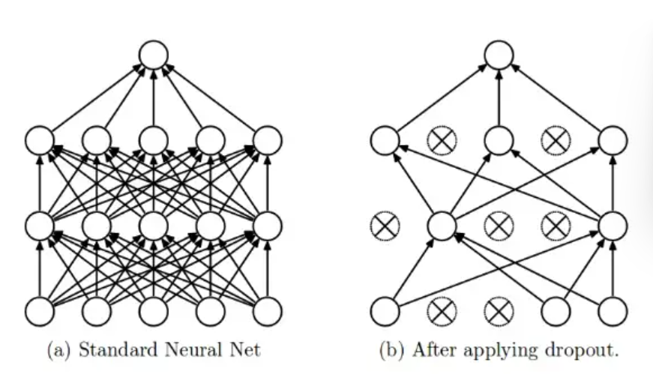
EXAMPLES

Slide 8
EXAMPLES
Let’s try to understand with a given input x: {1, 2, 3, 4, 5} to the fully connected layer. We have a dropout layer with probability p = 0.2 (or keep probability = 0.8).
During the forward propagation (training) from the input x, 20% of the nodes would be dropped, i.e., the x could become {1, 0, 3, 4, 5} or {1, 2, 0, 4, 5} and so on. Similarly, it applied to the hidden layers.
For instance, if the hidden layers have 1000 neurons (nodes) and a dropout is applied with drop probability = 0.5, then 500 neurons would be randomly dropped in every iteration

Slide 9
SESSION DESCRIPTION (Cont..)
Dropout, applied to a layer, consists of randomly dropping out (setting to zero) a number of output features of the layer during training.
The dropout rate is the fraction of the features that are zeroed out; it’s usually set between 0.2 and 0.5
At test time, no units are dropped out; instead, the layer’s output values are scaled down by a factor equal to the dropout rate, to balance for the fact that more units are active than at training time.

Slide 10
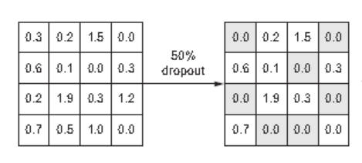
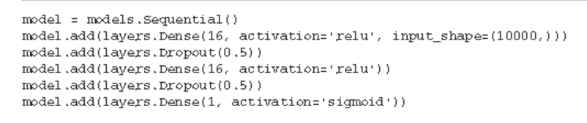
EXAMPLES
Dropout applied to an activation matrix at training time, with rescaling happening during training. At test time, the activation matrix is unchanged.

Slide 11
SUMMARY
Dropout is one of the most effective and most commonly used regularization techniques for neural networks, developed by Geoff Hinton and his students at the University of Toronto.
To recap, these are the most common ways to prevent overfitting in neural networks:
Get more training data.
Reduce the capacity of the network.
Add weight regularization.
Add dropout.
Dropout, applied to a layer, consists of randomly dropping out (setting to zero) several output features of the layer during training

Slide 12
SELF-ASSESSMENT QUESTIONS
Dropout layers have been the go-to method to reduce the underfitting of neural networks
Yes
No
Which of the following statement is false with reference to Dropout.
The dropout rate is the fraction of the features that are zeroed out
At test time, some units are dropped out.
Drop rate is usually set between 0.2 and 0.5
Dropout is applied during training time

Slide 13
TERMINAL QUESTIONS
1. What Dropout is and how it works
2. How you can use Dropout on your own deep learning models
3. List out methods of Regularization
4. When to stop training a deep learning model

Slide 14
REFERENCES FOR FURTHER LEARNING OF THE SESSION
Reference Books:
Deeplearningwithpython by François Chollet
Deep Learning by Andrew W.task
Ian Goodfellow, Yoshua Bengio, Aaron Courville - Deep Learning (2017, MIT)
.
Sites and Web links:
1. https://towardsdatascience.com/a-practical-introduction-to-early-stopping-in-machine-learning-550ac88bc8fd
2. https://towardsdatascience.com/dropout-in-neural-networks-47a162d621d9

Slide 15
THANK YOU
Team – DPL

