Slide 1

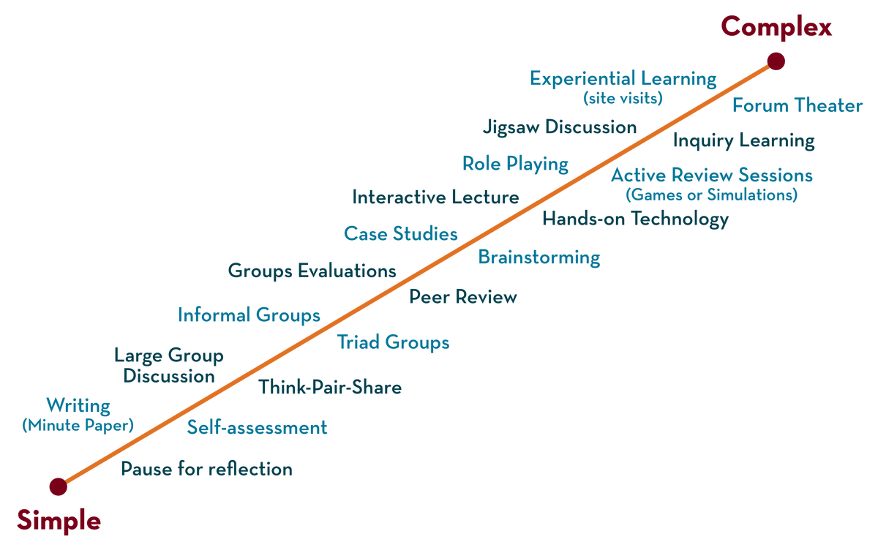
Greedy Layer wise
Pre-training
Department of ---
Deep Learning
20CS3269AA
Topic:
Greedy Layer wise
Pre-training
Session - 15

Slide 2



AIM OF THE SESSION
To familiarize students with the basic concept of greedy layer pre training
INSTRUCTIONAL OBJECTIVES
This Session is designed to:
Introduce the greedy layer pre training
LEARNING OUTCOMES
At the end of this session, you should be able to understand that
Greedy layer-wise pretraining provides a way to develop deep multi-layered neural networks whilst only ever training shallow networks.

Slide 3
SESSION INTRODUCTION
pre-training
pre-training a neural network refers to first training a model on one task or dataset.
Then using the parameters or model from this training to train another model on a different task or dataset.
This gives the model a head-start instead of starting from scratch.

Slide 4
SESSION DESCRIPTION
Nee for pretraining
Training deep neural networks was traditionally challenging as the vanishing gradient
In this case weights in layers close to the input layer were not updated in response to errors calculated on the training dataset.
To overcome this problem greedy layer-wise pretraining was adopted by researchers.

Slide 5
Greedy Layer-Wise Pretraining
As the number of hidden layers is increased, the amount of error information propagated back to earlier layers is dramatically reduced.
This means that weights in hidden layers close to the output layer are updated normally,
Whereas weights in hidden layers close to the input layer are updated minimally or not at all.
Generally, this problem prevented the training of very deep neural networks and was referred to as the vanishing gradient problem.
Greedy layer-wise pretraining is introduce to the development of deeper neural network models also referred to as “pretraining.”

Slide 6
Layer wise Pre-training
Pretraining involves successively adding a new hidden layer to a model and refitting,
Pretraining allows the newly added model to learn the inputs from the existing hidden layer,
the weights for the existing hidden layers are always fixed.
This technique is called as “layer-wise” as the model is trained one layer at a time.
The technique is referred to as “greedy” because the piecewise or layer-wise approach to solving the harder problem of training a deep network.
As an optimization process, dividing the training process into a succession of layer-wise training processes is seen as a greedy shortcut that likely leads to an aggregate of locally optimal solutions

Slide 7
Approaches of –pre training
There are two main approaches to pretraining; they are:
Supervised greedy layer-wise pretraining.
Unsupervised greedy layer-wise pretraining.
supervised pretraining
Adds hidden layers to a model trained on a supervised learning task.
Unsupervised pretraining
It uses the greedy layer-wise process to build up an unsupervised autoencoder model
Later to this a supervised output layer is later added

Slide 8
Greedy Layer wise
Pre-training
Department of ---
Deep Learning
20CS3269AA
Topic:
Better activation functions
Session - 16

Slide 9
AIM OF THE SESSION
To familiarize students with the basic concept of activation functions and better weight initialization methods
INSTRUCTIONAL OBJECTIVES
This Session is designed to:
Introduce Better activation functions,
better weight initialization methods
LEARNING OUTCOMES
At the end of this session, you should be able to understand that
.what are the better activation and weight initialization techniques.

Slide 10
activation functions
A neural network without an activation function is essentially just a linear regression model.
we use a non linear transformation to the inputs of the neuron .
non-linearity in the network is introduced by an activation function.

Slide 11
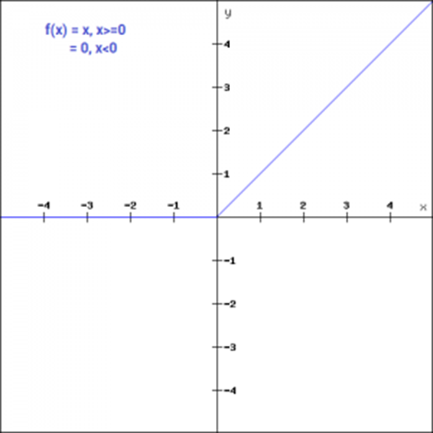
Better activation functions
ReLU
The ReLU function is non-linear activation function that has gained popularity in the deep learning domain.
ReLU stands for Rectified Linear Unit. The main advantage of using the ReLU function over other activation functions is that it does not activate all the neurons at the same time.
This means that the neurons will only be deactivated if the output of the linear transformation is less than 0
f(x)=max(0,x)

Slide 12
sigmoid
. It is one of the most widely used non-linear activation function.
Sigmoid transforms the values between the range 0 and 1.
the mathematical expression for sigmoid-
f(x) = 1/(1+e^-x)

Slide 13

Softmax
Softmax function is often described as a combination of multiple sigmoids.
sigmoid returns values between 0 and 1, which can be treated as probabilities of a data point belonging to a particular class.
Thus sigmoid is widely used for binary classification problems.
The softmax function can be used for multiclass classification problems.
This function returns the probability for a datapoint belonging to each individual class.
Here is the mathematical expression is

Slide 14
Which function ? When ?
• Sigmoid functions and their combinations generally work better in the case of classifiers
• Sigmoids and tanh functions are sometimes avoided due to the vanishing gradient problem
• ReLU function is a general activation function and is used in most cases these days
• If we encounter a case of dead neurons in our networks the leaky ReLU function is the best choice
• ReLU function should only be used in the hidden layers
•

Slide 15
Initilization methods
•
Zero initialization :
Random initialization :
Xavier/Glorot Initialization

Slide 16
Zero initialization
Zero initialization :
In general practice biases are initialized with 0 and weights are initialized with random numbers

Slide 17
SUMMARY
Random initialization :
Assigning random values to weights is better than just 0 assignment.
Random Uniform: The weights are initialized from values in a uniform distribution.
Random Normal: The weights are initialized from values in a normal distribution.
Xavier/Glorot Initialization often termed as Xavier Uniform Initialization:
is suitable for layers where the activation function used is Sigmoid.

Slide 18
SELF-ASSESSMENT QUESTIONS
Yes
No

Slide 19
TERMINAL QUESTIONS
What are activation functions used in deep learning?
Define zero initilization?
2. what are the various types of weight initialization methods

Slide 20
REFERENCES FOR FURTHER LEARNING OF THE SESSION
Reference Books:
Deeplearningwithpython by François Chollet
Deep Learning by Andrew W.task
Ian Goodfellow, Yoshua Bengio, Aaron Courville - Deep Learning (2017, MIT)
.
Sites and Web links:
1. https://towardsdatascience.com/a-practical-introduction-to-early-stopping-in-machine-learning-550ac88bc8fd
2. https://towardsdatascience.com/dropout-in-neural-networks-47a162d621d9

