Slide 1

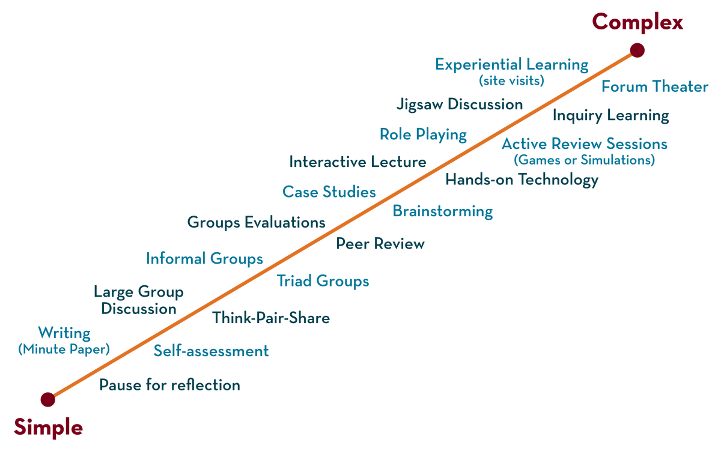
Greedy Layer wise
Pre-training
Department of ---
Deep Learning
20CS3269AA
Topic:
Normalization
Session - 17

Slide 2



AIM OF THE SESSION
To familiarize students with the basic concept of normalization
INSTRUCTIONAL OBJECTIVES
This Session is designed to:
Introduce normalization and its methods
LEARNING OUTCOMES
At the end of this session, you should be able to understand that
.normalization techniques.

Slide 3
What is normalization
Normalization is a pre-processing technique used to standardize data.
For ex., having different sources of data inside the same range.
Not normalizing the data before training can cause problems in our network,
It makes drastically harder to train and decrease its learning speed.

Slide 4
What is Batch normalization
Batch normalization, it is a process to make neural networks faster and more stable through adding extra layers in a deep neural network.
Batch Norm is a normalization technique done between the layers of a Neural Network instead of in the raw data.
The new layer performs the standardizing and normalizing operations on the input of a layer coming from a previous layer.

Slide 5
Batch normalization
It is a technique for training very deep neural networks that normalizes the contributions to a layer for every mini-batch.
This has the impact of settling the learning process and drastically decreasing the number of training epochs required to train deep neural networks
Batch Norm is just another network layer that gets inserted between a hidden layer and the next hidden layer.
Its job is to take the outputs from the first hidden layer and normalize them before passing them on as the input of the next hidden layer.
It allows us to use much higher learning rates, which further increases the speed at which networks train.
It makes weights easier to initialize
.

Slide 6

What is Batch Norm
normalization formula of Batch Norm is
Ex:
Model = Sequential([
Dense(16, input_shape=(1,5), activation='relu'),
BatchNormalization(),
Dense(32, activation='relu'),
BatchNormalization(),
Dense(2, activation='softmax')
])
Where m _{z} is the mean of the neurons’ output and
s_z the standard deviation of the neurons’ output.

Slide 7
REFERENCES FOR FURTHER LEARNING OF THE SESSION
Reference Books:
Ian Goodfellow, Yoshua Bengio, Aaron Courville - Deep Learning (2017, MIT)
Deeplearning with python by François Chollet
Deep Learning by Andrew W.
.

