Slide 1

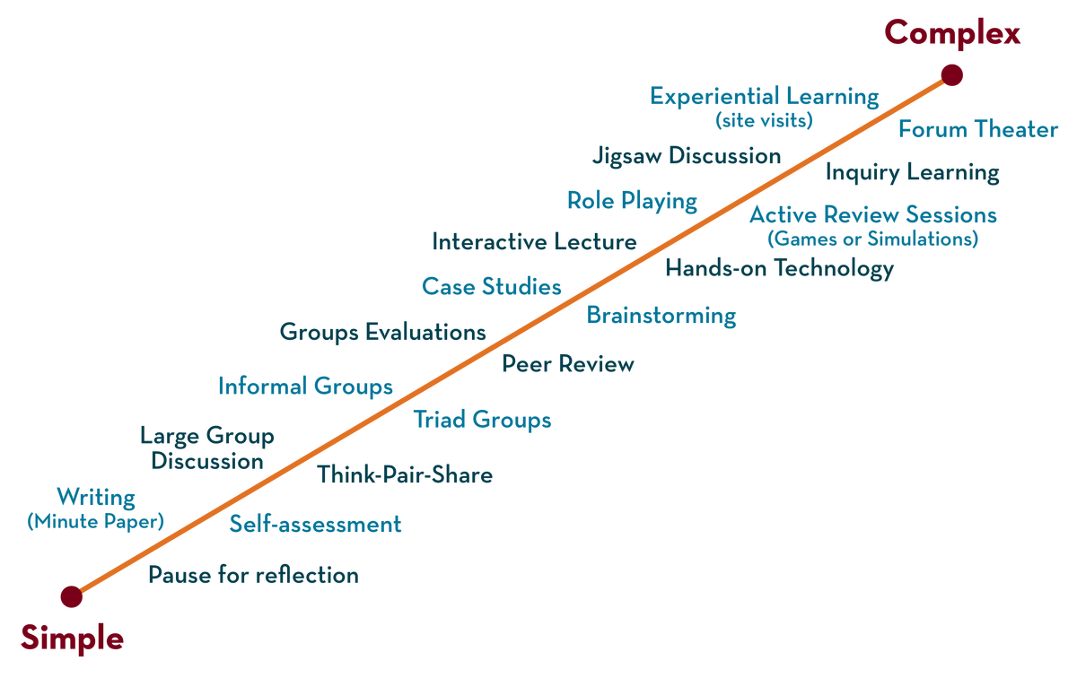
Department of CSE
Deep Learning
20CS3269AA
Topic:
CNN
Session - 18

Slide 2



AIM OF THE SESSION
To familiarize students with the concept of CNN
INSTRUCTIONAL OBJECTIVES
This Session is designed to:
CNN application
CNN architecture
LEARNING OUTCOMES
At the end of this session, you should be able to:
Able to understand CNN learning model

Slide 3
SESSION Introduction
The topics covered in the session are
What is need for CNN
Differences between CNN and ANN
CNN architecture
Convolution operation
Pooling techniques

Slide 4

What is CNN?
Convolutional Neural Networks (CNN) is a feed forward neural network that is generally used for Image recognition and object classification.
CNNs are inspired from the visual cortex of the brain and have been widely applied in image and speech recognition.
Cnn represent a huge breakthrough in image recognition

Slide 5
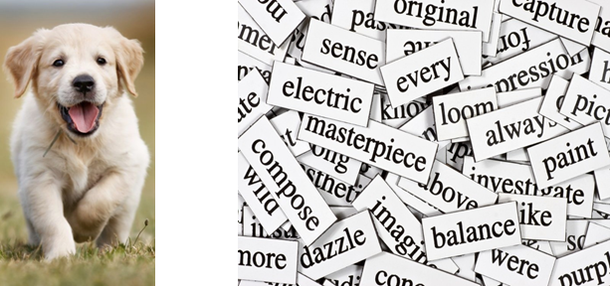
Why CNN
Until quite recently, computers were not good at tasks like recognizing puppy in a picture or recognizing spoken words, which humans excel at.
The CNN is essential when it comes to image classification problems since it has such a high degree of accuracy.
Prior to training an Artificial Neural Network, a 2D image is converted into a 1-dimensional vector.
Furthermore, as the image size increases, the number of training parameters increases exponentially, leading to storage loss.
ANNs do not capture the sequence information that sequence data requires.

Slide 6
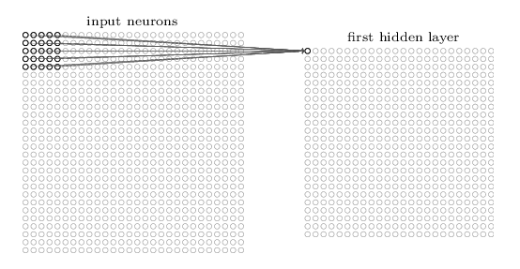
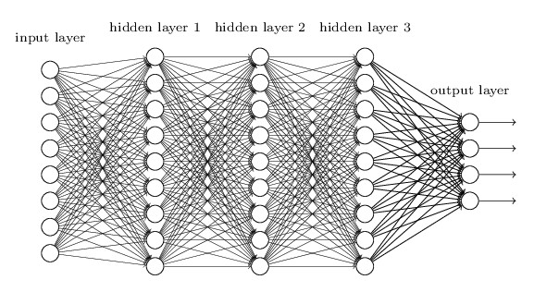
CNN vs ANN
1.
2 For small images it might work, but for large images the no of pixels are so many leading to millions of connections between neurons, leading to intractable solutions
2. No of features /pixels are reduced thru convolution and pooling operations
In an ANN, each neuron in the network is connected to every other neuron in the adjacent hidden layers.
1. In a CNN, each neuron in the hidden layer is connected to a small region of the input neurons.
Notes:
https://the-learning-machine.com/article/optimization/stochastic-gradient-descent

Slide 7
Applications of CNN
Automatic video classification systems
Self- driving cars
Voice recognition
Natural language processing
Image search
CNN Applications
Notes:
Face book photo tagging

Slide 8
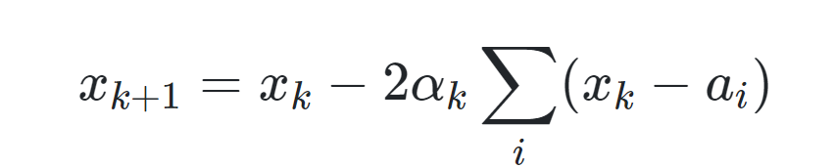
CNN architecture
CNN architecture has the following configuration:
Convolutional Layer
Pooling Layer
Fully connected Layer
Most normal configuration is convolutional layer, followed by ReLU layer, followed by a pooling layer. The sets then keep repeating.
The final layer is the fully connected layer, which precedes the final image classification

Slide 9
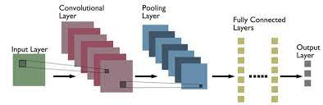
Cnn architecture

Slide 10
CNN Architecture: Types of Layers
Convolutional layer
a “filter” passes over the image, scanning a few pixels at a time and creating a feature map that predicts the class to which each feature belongs.
Pooling layer (downsampling)
reduces the amount of information in each feature obtained in the convolutional layer while maintaining the most important information .
there are usually several rounds of convolution and pooling.

Slide 11
CNN Architecture: Types of Layers
Fully connected input layer (flatten)
It takes the output of the previous layers, “flattens” them and turns them into a single vector that can be an input for the next stage.
The first fully connected layer takes the inputs from the feature analysis and applies weights to predict the correct label.
Fully connected output layer gives the final probabilities for each label.

Slide 12
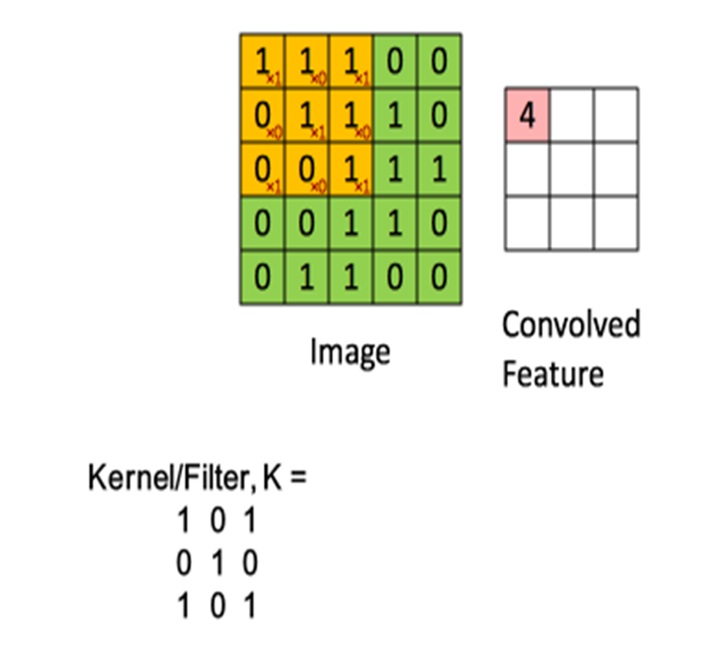
CONVOLUTION PROCESS
Assume the filter/kernel is weight matrix w_{k}. For example lets assume a 3 x 3 wighted matrix.
The kernel is a filter to extract some particular features from the original images.
It could be for extracting curves , identifying a specific colour, or recognizing a particular voice.

Slide 13
Convolution operation
Kernel/Filter, K =
1 0 1 0 1 0 1 0 1
Ex. For the first feature element
(1*1+ 0*1 +1*1) +(0*0+1*1+0*1)+(1*0+0*0+1*1)=4

Slide 14
Process of Convolution (Contd.)
EXAMPLE
As the filter/kernel is slided across the input layer, the convolved layer is obtained by adding the values obtained by element wise multiplication of the weight matrix.
81 | 2 | 209 | 44 | 71 | 58
24 | 56 | 108 | 98 | 12 | 112
91 | 0 | 189 | 65 | 79 | 232
12 | 0 | 0 | 5 | 1 | 71
2 | 32 | 23 | 58 | 8 | 209
49 | 98 | 81 | 112 | 54 | 9
0 | 1 | 1
1 | 0 | 0
1 | 0 | 1
515
Input layer
Filter/Kernel (Weighted matrix)
Output
For example, when the weighted matrix starts from the top left corner of the input layer, the output value is calculated as:
(81x0+2x1+209x1)+(24x1+56x0+108X0)+(91x1+0x0+189x1) = 515

Slide 15
Process of Convolution (Contd.)
EXAMPLE
The filter then moves by 1 pixel to the next cell and the process is repeated. The output layer obtained after the filter slides over the entire image would be a 4X4 matrix.This is called an activation map/ feature map.
81 | 2 | 209 | 44 | 71 | 58
24 | 56 | 108 | 98 | 12 | 112
91 | 0 | 189 | 65 | 79 | 232
12 | 0 | 0 | 5 | 1 | 71
2 | 32 | 23 | 58 | 8 | 209
49 | 98 | 81 | 112 | 54 | 9
0 | 1 | 1
1 | 0 | 0
1 | 0 | 1
515 | 374
Filter/Kernel (Weighted matrix)
Output (Activation/Feature Map)
Input layer
Dimension of output=n-f+1
The distance between two consecutive receptive fields is called the stride.
In this example stride is 1 since the receptive field was moved by 1 pixel at a time.

Slide 16
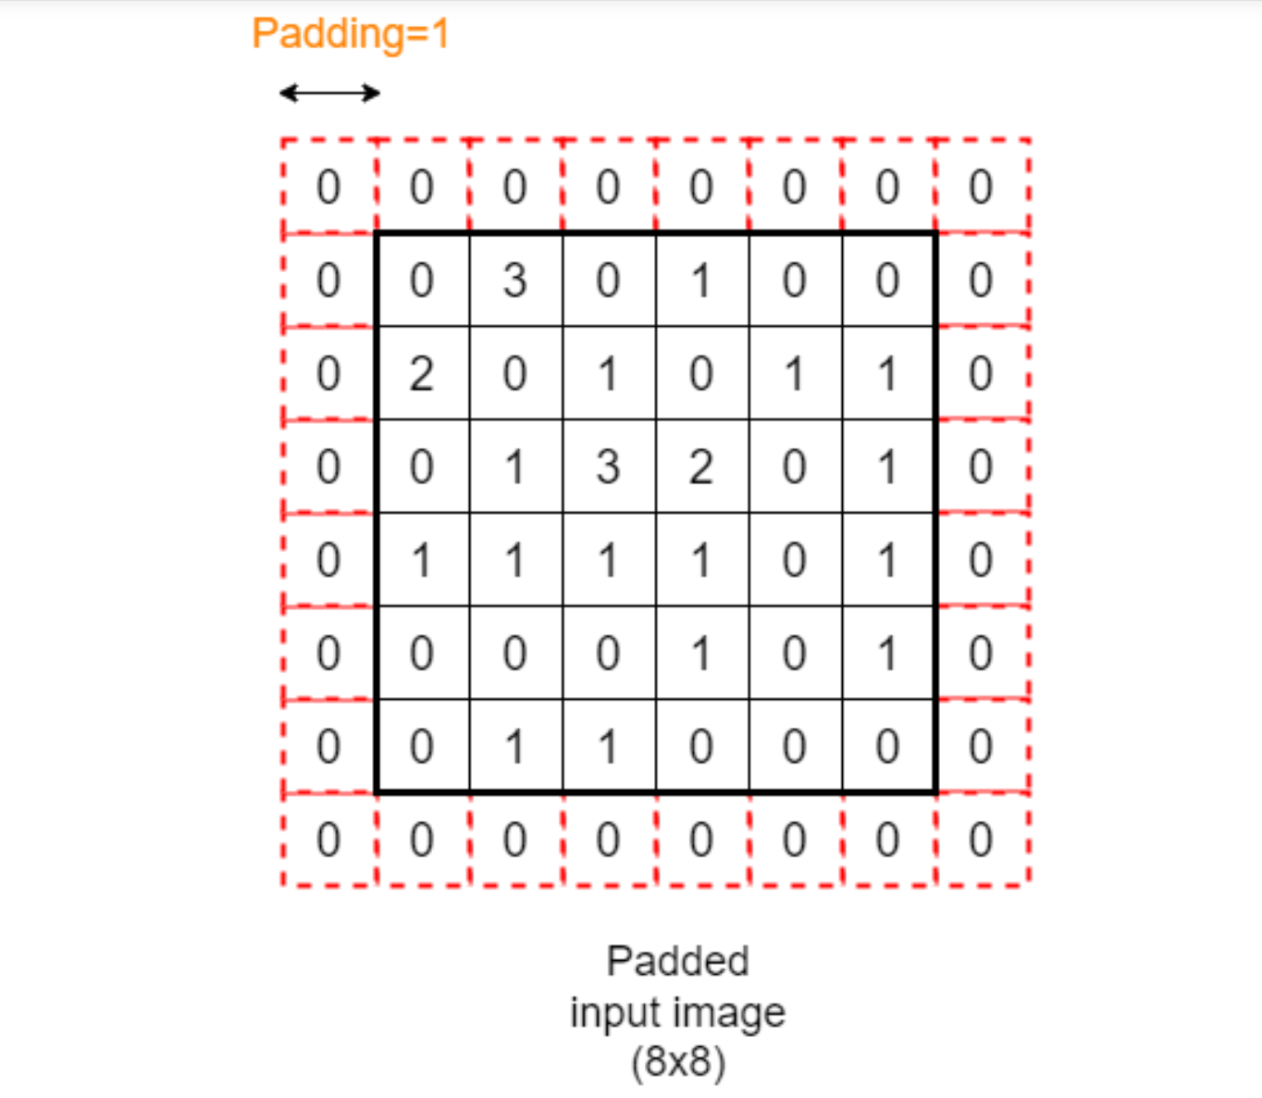
padding

Slide 17
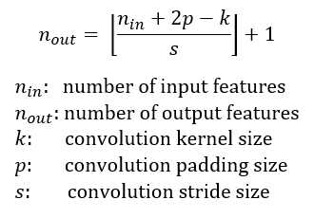
Calculating output dimension of Convolution layer

Slide 18
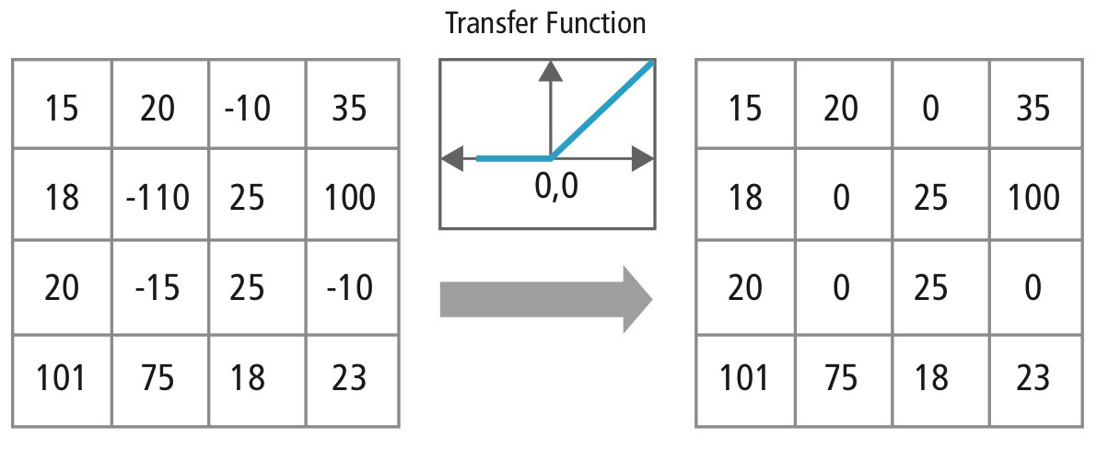
ReLU Layer
ReLU stands for Rectified Linear Unit and is a non-linear operation. ReLU is an element wise operation (applied per pixel) and replaces all negative pixel values in the feature map by zero.
Output = Max(zero, Input)

Slide 19
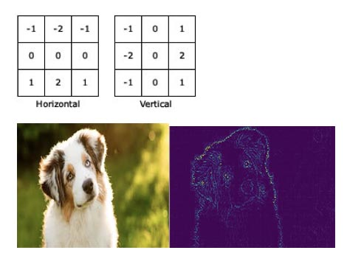
sobel filters -edge detection

Slide 20
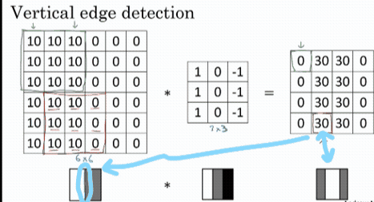
Vertical edge detection with fileter

Slide 21
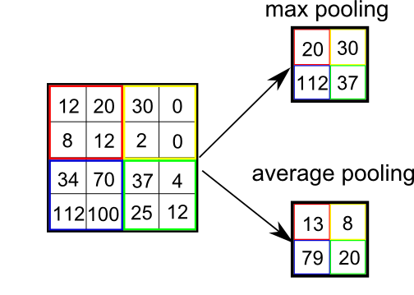
Pooling Layer (Sub-sampling or Down-sampling)
Pooling layer reduce the size of feature maps by using some functions to summarize sub-regions, such as taking the average or the maximum value

Slide 22
Fully connected layer
After completion of series of convolutional, nonlinear and pooling layers, it is necessary to attach a fully connected layer.
This layer takes the output information from convolutional networks.
Attaching a fully connected layer to the end of the network results in an N dimensional vector, where N is the amount of classes from which the model selects the desired class.

Slide 23
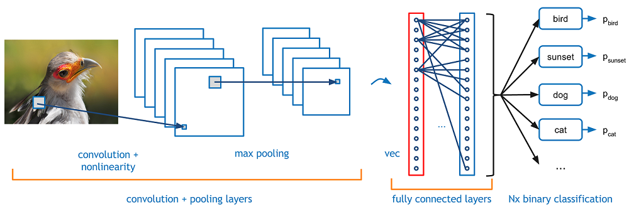
example

Slide 24
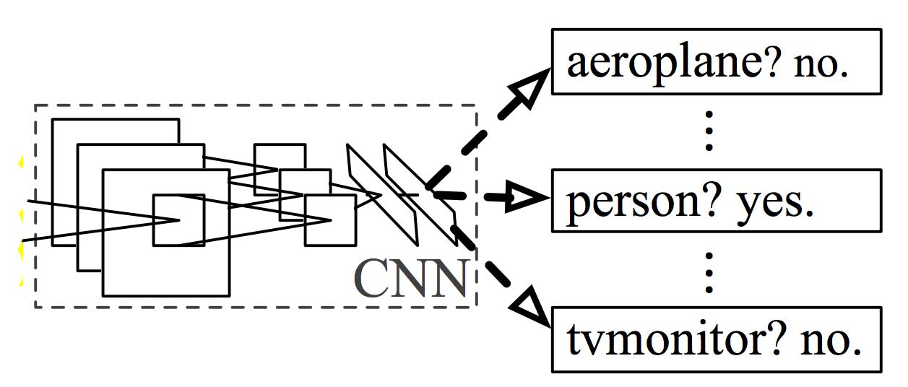
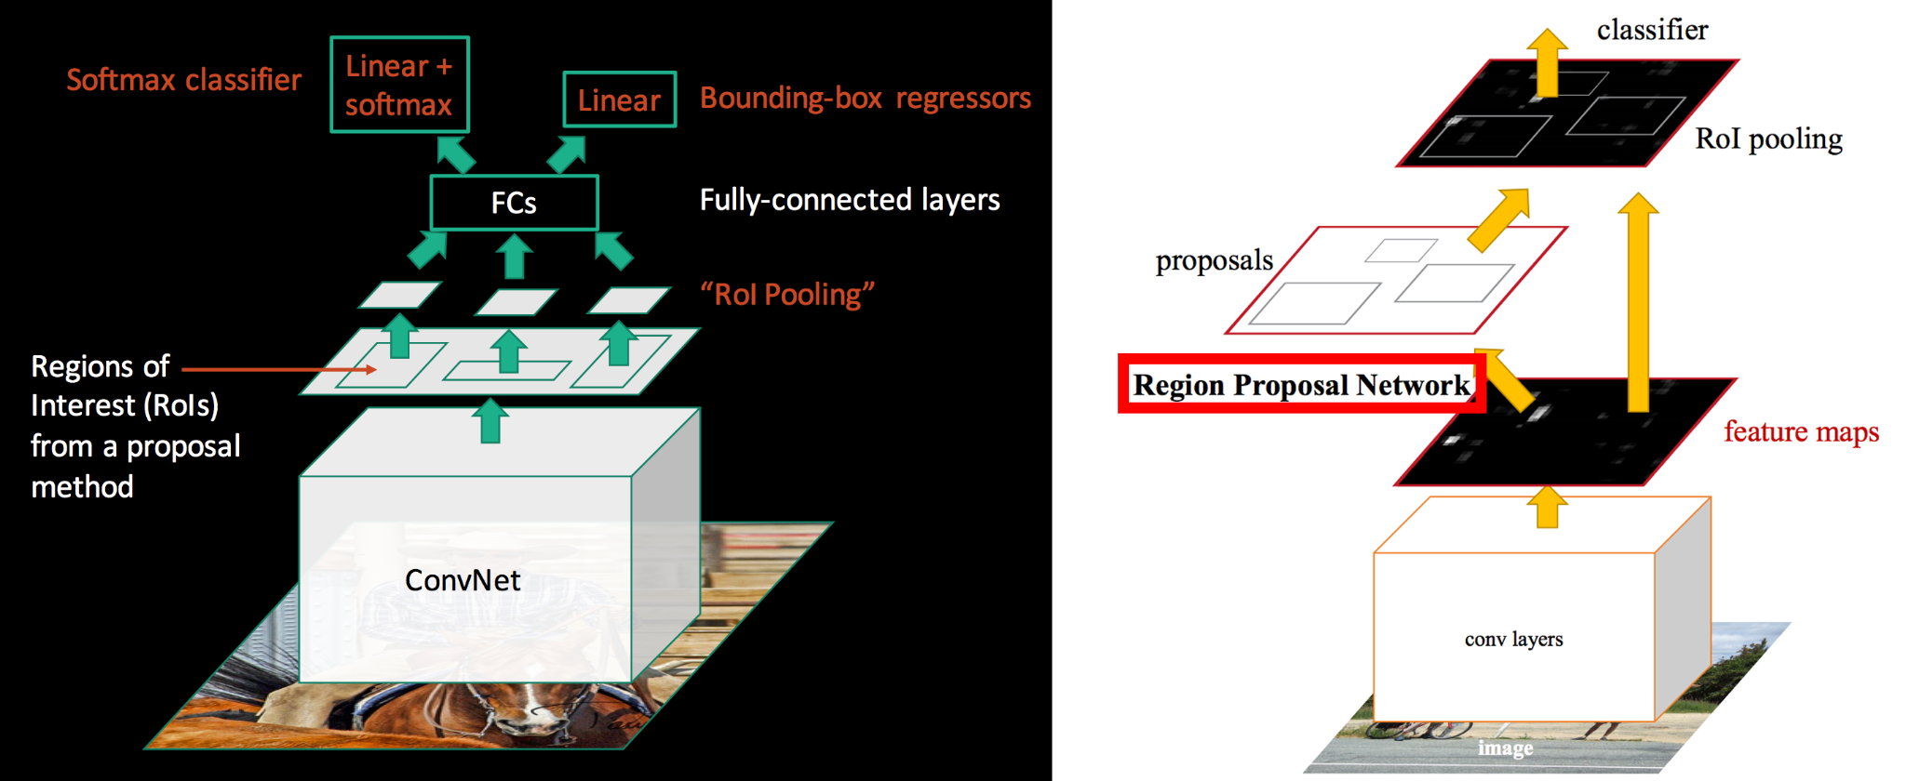
R-CNN and Fast R-CNN
The basic R-CNN consists of an SVM classifier to segregate different objects into their class.
Faster R-CNN uses a region proposal method to create the sets of regions.
Faster R-CNN possesses an extra CNN for gaining the regional proposal, which we call the regional proposal network.
In the training region, the proposal network takes the feature map as input and outputs region proposals.
And these proposals go to the ROI pooling layer for further procedure.

Slide 25
Other Architectures of CNN
Over the years, many variants of this basic architecture have been developed such as:
LeNet-5 (1998)
AlexNet (2012)
ZFNet (2013)
GoogLeNet (2014)
VGGNet(2014)
ResNet (2015)
These models can be used in applications by developers.

Slide 26
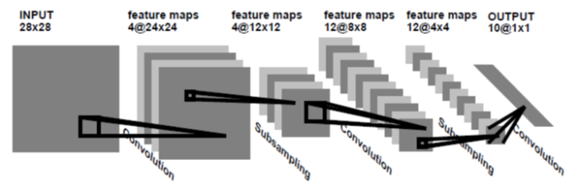
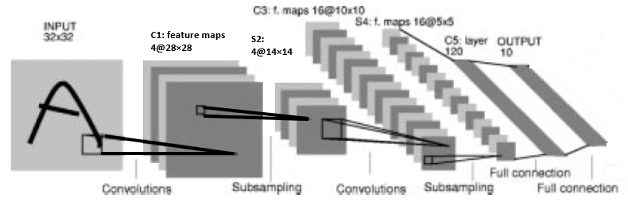
LeNet-1
LeNet-4

Slide 27
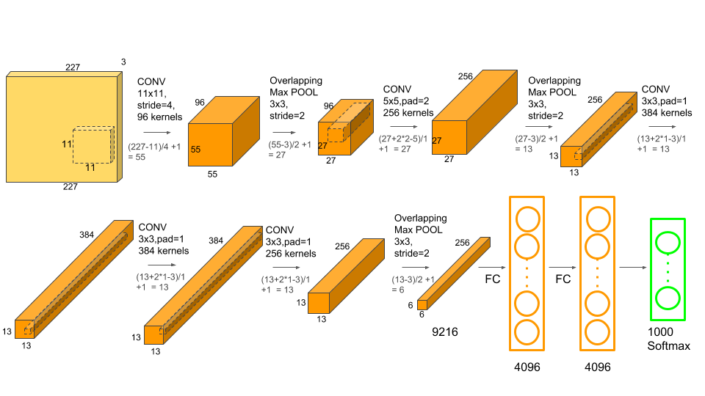
AlexNet consists of 5 Convolutional Layers and 3 Fully Connected Layers

Slide 28
SELF-ASSESSMENT QUESTIONS
A CNN is faster to train than a DNN because of the following reason.
a.Partially Connected Layers. b. Reusability of weights. c. Both A and B
ANS: C
2.T/F: CNN's are able to generalize much better that DNN's for image processing tasks such as classification using fewer training examples.
Ans : True

Slide 29
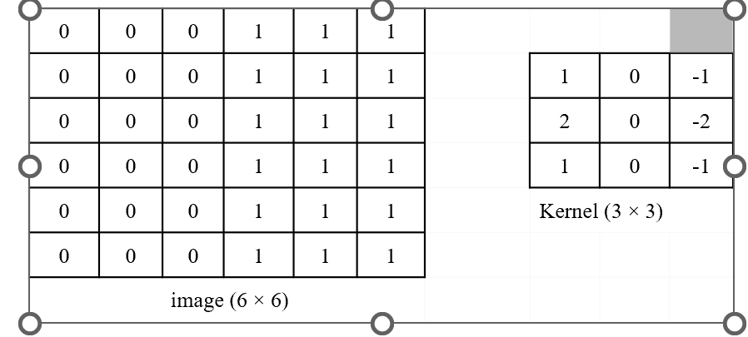
TERMINAL QUESTIONS
Q1) Derive the convolutional image for the given above 6 × 6 gray image applied to 3 × 3 kernel with Padding P=0 and Stride S=1
Q2) How pooling is used as feature reduction? What are the various types of Pooling methods.
Q3) Illustrate the two major steps of CNN: Feature Learning and Classification

Slide 30
REFERENCES FOR FURTHER LEARNING OF THE SESSION
Books:
1 Ian Goodfellow and Yoshua Bengio and Aaron Courville (2016) Deep Learning Book

