Slide 1
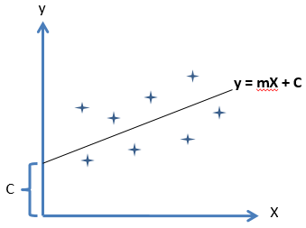
Polynomial Regression
Y = b₀+b₁x¹+b₂x²
Simple linear Regression : y = a+bx
X
Multiple linear Regression : y = a+bx₁+cx₂+dx₃
Polynomial Linear Regression: Y = b₀+b₁x¹+b₂x²+…+b_{n}x^{n}

Slide 2
Why Polynomial Regression
y
y
y = mX + C
X
X
If the data follows a linear tend the cure that fits it has less deviations from the points and linear regression holds good
If the data is no linear the cure that fits it has larger deviations from the points and linear regression does not hold good

Slide 3
Polynomial Regression fits
y
Y = b₀+b₁x¹+b₂x²
The cure fits the data almost with negligible deviations.
The type of data is the factor for use to decide which regression analysis to be used.
E.g. Spread of urban Population.
Epidemic etc..
X

Slide 4
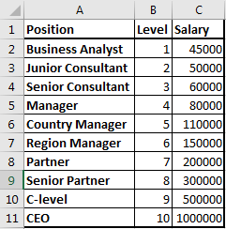
Polynomial Regression
Problem Statement: Identifying weather if the salary declared by a new employee in his previous company is true or false
Given: data Set of Positions experience level and salaries of 10 different positions at different expertise level.
Expectation of the regression: To develop a Regression model which would help the Employer to estimate the salary for his level of experience & decide on the honesty of his new employee about his salary

Slide 5
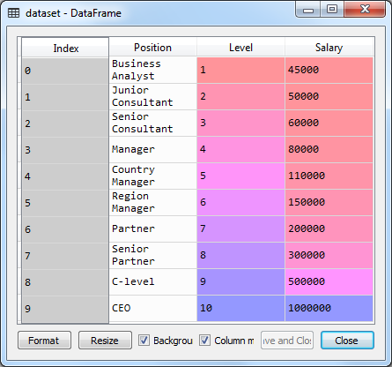
Polynomial Regression
# Polynomial Regression
"""
Created on Tue Jan 15 15:01:59 2019
@author: sashila
"""
# Importing the libraries
import numpy as np
import pandas as pd
# Importing the dataset
dataset = pd.read_csv('Position_Salaries.csv')

Slide 6
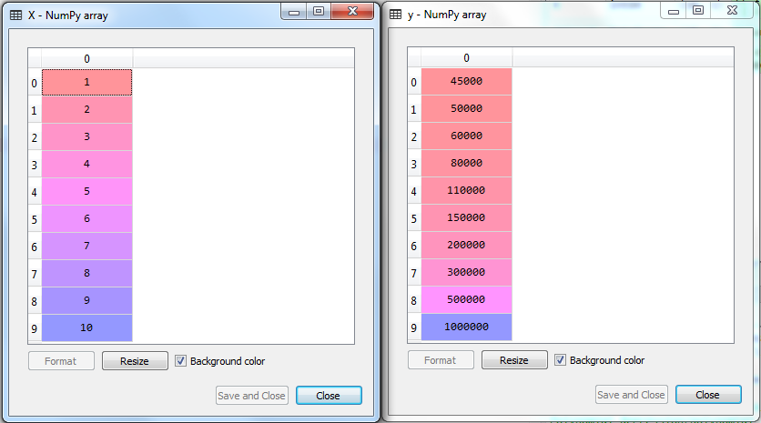
Polynomial Regression Importing the dataset
# Polynomial Regression
"""
Created on Tue Jan 15 15:01:59 2019
@author: sashila
"""
# Importing the libraries
import numpy as np
import pandas as pd
# Importing the dataset
dataset = pd.read_csv('Position_Salaries.csv')
X = dataset.iloc[:, 1:2].values
y = dataset.iloc[:, 2].values

Slide 7
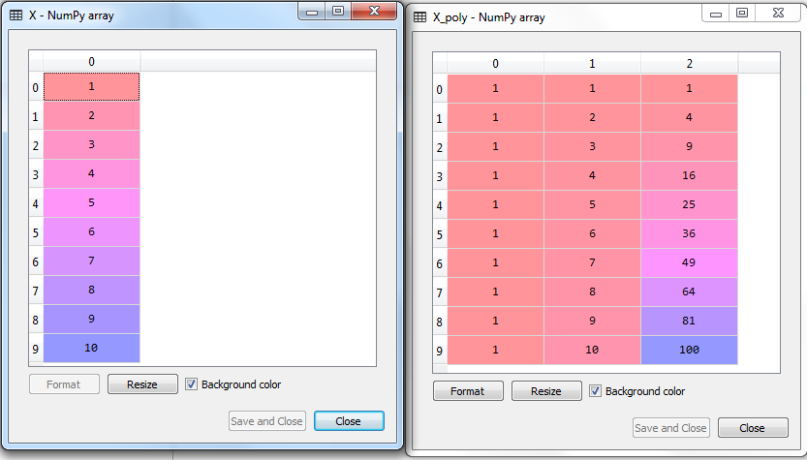
Fitting Polynomial Regression to the dataset
# Polynomial Regression
"""
Created on Tue Jan 15 15:01:59 2019
@author: sashila
"""
# Importing the libraries
import numpy as np
import pandas as pd
# Importing the dataset
dataset = pd.read_csv('Position_Salaries.csv')
X = dataset.iloc[:, 1].values
y = dataset.iloc[:, 2].values
# Fitting Linear Regression to the dataset
from sklearn.linear_model import LinearRegression
lin_reg = LinearRegression()
lin_reg.fit(X, y)
# Fitting Polynomial Regression to the dataset
from sklearn.preprocessing import PolynomialFeatures
poly_reg = PolynomialFeatures(degree = 2)
X_poly = poly_reg.fit_transform(X)
poly_reg.fit(X_poly, y)
lin_reg_2 = LinearRegression()
lin_reg_2.fit(X_poly, y)

Slide 8
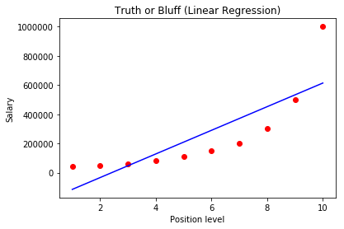
Fitting Polynomial Regression to the dataset
# Importing the libraries
import numpy as np
import matplotlib.pyplot as plt
import pandas as pd
# Importing the dataset
dataset = pd.read_csv('Position_Salaries.csv')
X = dataset.iloc[:, 1:2].values
y = dataset.iloc[:, 2].values
# Fitting Linear Regression to the dataset
from sklearn.linear_model import LinearRegression
lin_reg = LinearRegression()
lin_reg.fit(X, y)
# Fitting Polynomial Regression to the dataset
from sklearn.preprocessing import PolynomialFeatures
poly_reg = PolynomialFeatures(degree = 2)
X_poly = poly_reg.fit_transform(X)
poly_reg.fit(X_poly, y)
lin_reg_2 = LinearRegression()
lin_reg_2.fit(X_poly, y)
# Visualising the Linear Regression results
plt.scatter(X, y, color = 'red')
plt.plot(X, lin_reg.predict(X), color = 'blue')
plt.title('Truth or Bluff (Linear Regression)')
plt.xlabel('Position level')
plt.ylabel('Salary')
plt.show()

Slide 9
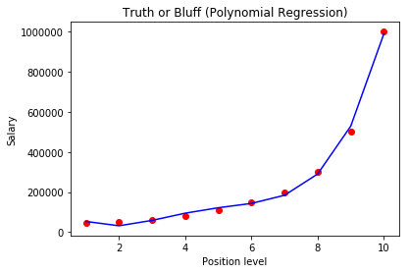
Visualising the Polynomial Regression results
# Visualising the Polynomial Regression results
plt.scatter(X, y, color = 'red')
plt.plot(X, lin_reg_2.predict(poly_reg.fit_transform(X)), color = 'blue')
plt.title('Truth or Bluff (Polynomial Regression)')
plt.xlabel('Position level')
plt.ylabel('Salary')
plt.show()

Slide 10
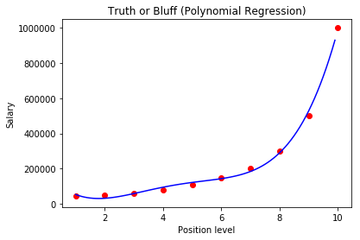
Visualising the Polynomial Regression results (smoother curve)
# Visualising the Polynomial Regression results (for higher resolution and smoother curve)
X_grid = np.arange(min(X), max(X), 0.1)
X_grid = X_grid.reshape((len(X_grid), 1))
plt.scatter(X, y, color = 'red')
plt.plot(X_grid, lin_reg_2.predict(poly_reg.fit_transform(X_grid)), color = 'blue')
plt.title('Truth or Bluff (Polynomial Regression)')
plt.xlabel('Position level')
plt.ylabel('Salary')
plt.show()

Slide 11
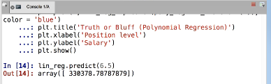
# Visualising the Polynomial Regression results (for higher resolution and smoother curve)
X_grid = np.arange(min(X), max(X), 0.1)
X_grid = X_grid.reshape((len(X_grid), 1))
plt.scatter(X, y, color = 'red')
plt.plot(X_grid, lin_reg_2.predict(poly_reg.fit_transform(X_grid)), color = 'blue')
plt.title('Truth or Bluff (Polynomial Regression)')
plt.xlabel('Position level')
plt.ylabel('Salary')
plt.show()
# Predicting a new result with Linear Regression
lin_reg.predict(6).reshape(1,-1)

