Slide 1
Random Forest Regression
1
Pick at Random K data points From the Training set
2
Build the decision tree associated to these K data points
3
Choose the number Ntree of trees we want to build and then repeat 1 & 2
4
For any data point, make each one of the Ntree trees predict the value of Y and then the average of all the predicted Y values will be the predicted value for the desired data point

Slide 2
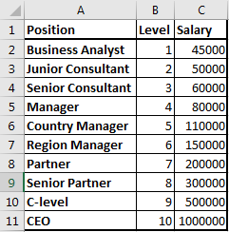
Random Forest Regression
Problem Statement: Identifying weather if the salary declared by a new employee in his previous company is true or false
Given: data Set of Positions experience level and salaries of 10 different positions at different expertise level.
Expectation of the regression: To develop a Regression model which would help the Employer to estimate the salary for his level of experience & decide on the honesty of his new employee about his salary

Slide 3
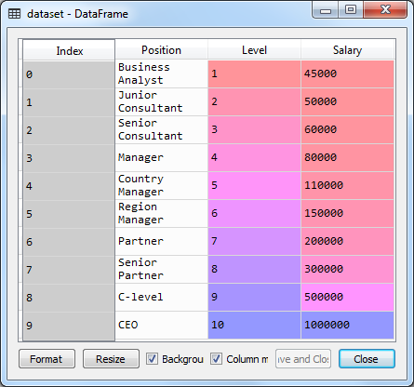
Random Forest Regression
# -*- coding: utf-8 -*-
"""
Created on Thu Jan 17 11:24:27 2019
@author: sashila
"""# Importing the libraries
import numpy as np
import pandas as pd
# Importing the dataset
dataset = pd.read_csv('Position_Salaries.csv')

Slide 4
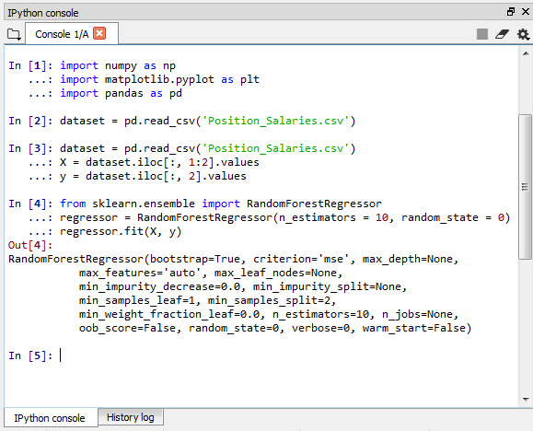
Random Forest Regression - Fitting Random Forest Regression to the dataset
# Fitting Random Forest Regression to the dataset
from sklearn.ensemble import RandomForestRegressor
regressor = RandomForestRegressor(n_estimators = 10, random_state = 0)
regressor.fit(X, y)

Slide 5
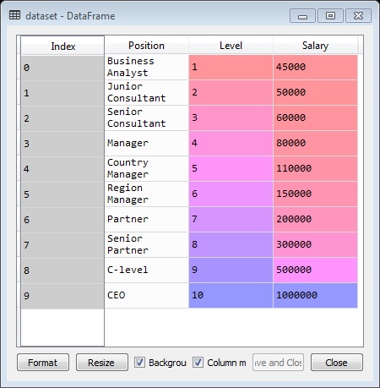
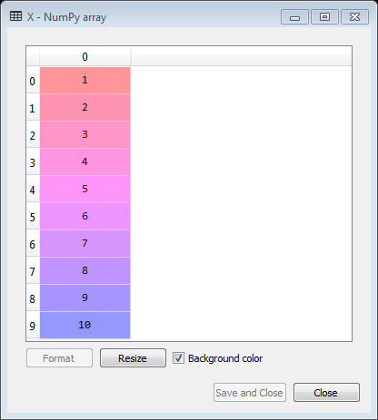
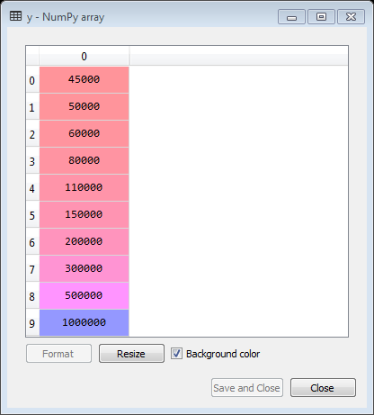
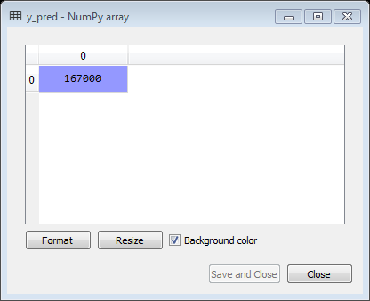
Random Forest Regression – Predicting the value
import numpy as np
import matplotlib.pyplot as plt
import pandas as pd
# Importing the dataset
dataset = pd.read_csv('Position_Salaries.csv')
X = dataset.iloc[:, 1:2].values
y = dataset.iloc[:, 2].values.reshape(-1,1)
# Fitting Random Forest Regression to the dataset
from sklearn.ensemble import RandomForestRegressor
regressor = RandomForestRegressor(n_estimators = 10, random_state = 0)
regressor.fit(X, y)
y_pred = regressor.predict([[6.5]])
Predicted salary

Slide 6
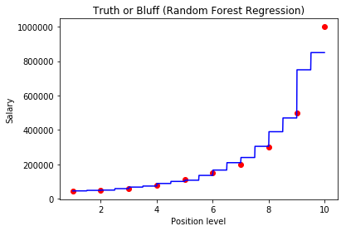
Random Forest Regression - Visualizing the Random Forest Regression results
# Visualizing the Random Forest Regression results (higher resolution)
X_grid = np.arange(min(X), max(X), 0.01)
X_grid = X_grid.reshape((len(X_grid), 1))
plt.scatter(X, y, color = 'red')
plt.plot(X_grid, regressor.predict(X_grid), color = 'blue')
plt.title('Truth or Bluff (Random Forest Regression)')
plt.xlabel('Position level')
plt.ylabel('Salary')
plt.show()

