Slide 1
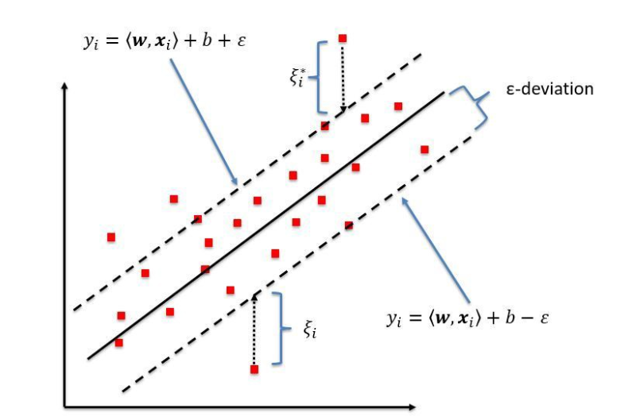
Support vector Regression
In simple regression we try to minimize the error rate. While in SVR we try to fit the error within a certain threshold. This might be a bit confusing but let me explain.

Slide 2
Support vector Regression
Support Vector Machines support linear and nonlinear regression that we can refer to as SVR
Instead of trying to fit the largest possible street between two classes while limiting margin violations, SVR tries to fit as many instances as possible on the street while limiting margin violations.
The width of the street is controlled by a hyper parameter Epsilon.

Slide 3
Support vector Regression
SVR performs linear regression in a higher (dimensional space).
We can think of SVR as if each data point in the training represents it's own dimension. When you evaluate your kernel between a test point and a point in the training set the resulting value gives you the coordinate of your test point in that dimension.
The vector we get when we evaluate the test point for all points in the training set, k'' is the representation of the test point in the higher dimensional space.
Once you have that vector you the use it to perform a linear regression.

Slide 4
Requirements-Support vector Regression
It Requires a traing set : T = {X,Y} which covers the domain of interest and is accomplained by solutions on that domain.
The work of the SVM is to approximate the function we used to generate the training set F(X) = Y

Slide 5
Support vector Regression
In a classification problem, the vectors X are used to define a hyperplane that separates the two different classes in your solution.
These vectors are used to perform linear regression.
The vectors closest to the test point are referred to as support vectors. We can evaluate our function anywhere so any vectors could be closest to our test evaluation location.

Slide 6
Support vector Regression
Building a SVR
Collect a training set T = {X, Y}
Choose a kernel and it's parameters as well as any regularization needed.
Form the correlation matrix, K
Train your machine, exactly or approximately, to get contraction coefficients a = {a_{i}}
Use those coefficients, create your estimator f (I, a, x*) = y*

Slide 7
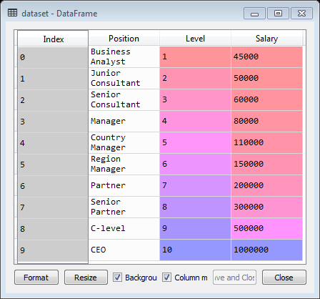
Support vector Regression
import numpy as np
import pandas as pd
dataset = pd.read_csv('Position_Salaries.csv')

Slide 8
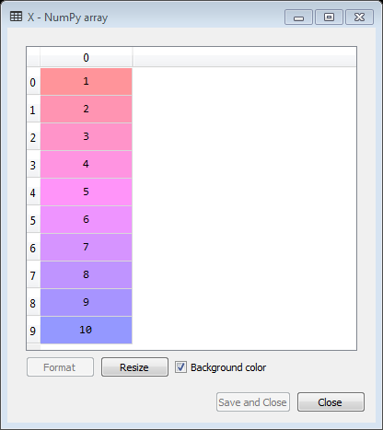
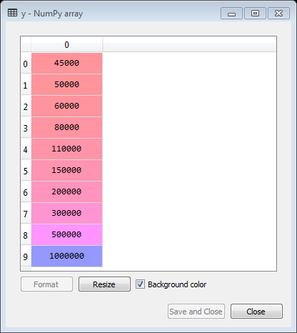
Support vector Regression- Importing the dataset
# Importing the libraries
import numpy as np
import pandas as pd
# Importing the dataset
dataset = pd.read_csv('Position_Salaries.csv')
X = dataset.iloc[:, 1:2].values
y = dataset.iloc[:, 2].values

Slide 9
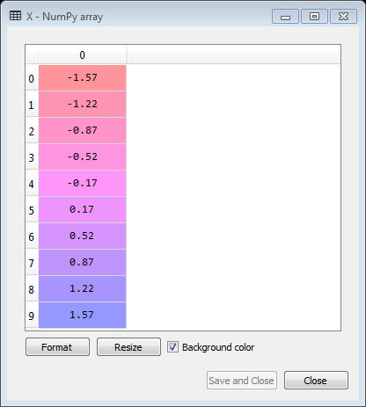
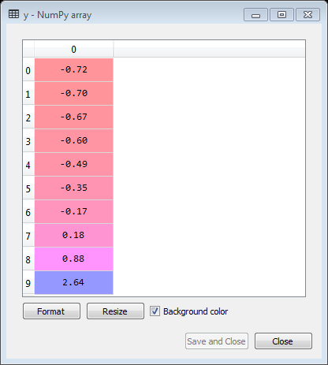
Support vector Regression
# Importing the libraries
import numpy as np
import pandas as pd
# Importing the dataset
dataset = pd.read_csv('Position_Salaries.csv')
X = dataset.iloc[:, 1:2].values
y = dataset.iloc[:, 2].values.reshape(-1,1)
# Feature Scaling
from sklearn.preprocessing import StandardScaler
sc_X = StandardScaler()
sc_y = StandardScaler()
X = sc_X.fit_transform(X)
y = sc_y.fit_transform(y)

Slide 10
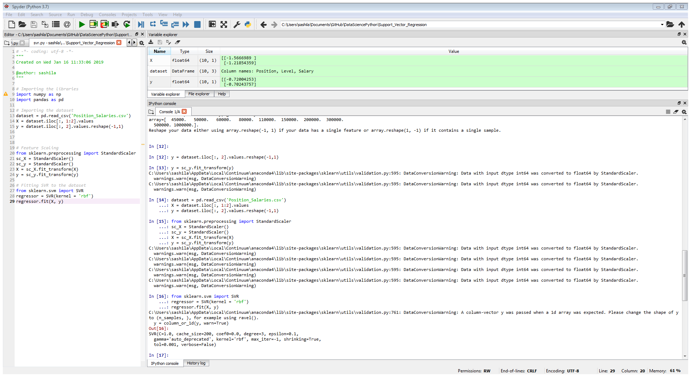
Support vector Regression
# Fitting SVR to the dataset
from sklearn.svm import SVR
regressor = SVR(kernel = 'rbf')
regressor.fit(X, y)

Slide 11
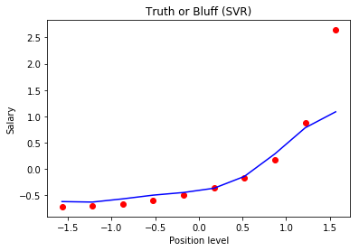
Support vector Regression - Visualizing the SVR results
# Visualizing the SVR results
plt.scatter(X, y, color = 'red')
plt.plot(X, regressor.predict(X), color = 'blue')
plt.title('Truth or Bluff (SVR)')
plt.xlabel('Position level')
plt.ylabel('Salary')
plt.show()

Slide 12
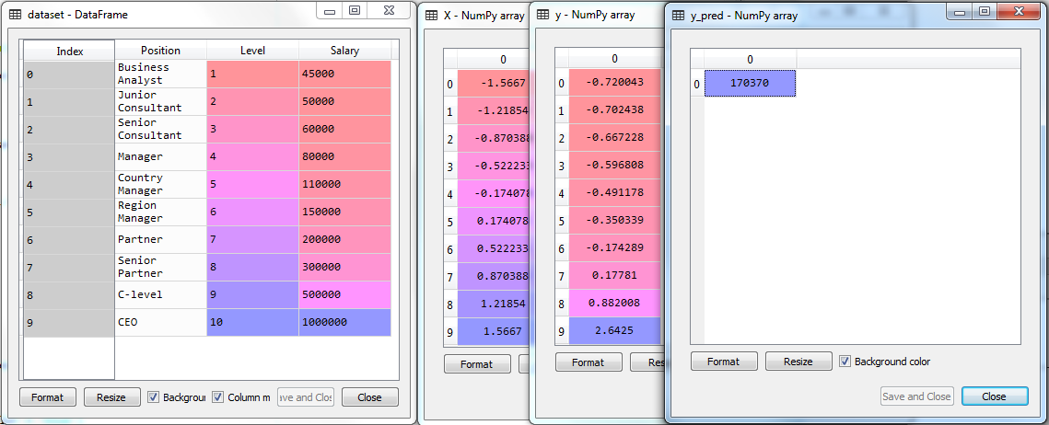
Support vector Regression - Visualizing the SVR results
# Importing the libraries
import numpy as np
import matplotlib.pyplot as plt
import pandas as pd
# Importing the dataset
dataset = pd.read_csv('Position_Salaries.csv')
X = dataset.iloc[:, 1:2].values
y = dataset.iloc[:, 2].values.reshape(-1,1)
# Feature Scaling
from sklearn.preprocessing import StandardScaler
sc_X = StandardScaler()
sc_y = StandardScaler()
X = sc_X.fit_transform(X)
y = sc_y.fit_transform(y).reshape(-1,1)
# Fitting SVR to the dataset
from sklearn.svm import SVR
regressor = SVR(kernel = 'rbf')
regressor.fit(X, y)
a = [[6.5]]
# Predicting a new result
y_pred = sc_y.inverse_transform(regressor.predict(sc_X.transform(np.array([[6.5]]))))
# Visualising the SVR results
plt.scatter(X, y, color = 'red')
plt.plot(X, regressor.predict(X), color = 'blue')
plt.title('Truth or Bluff (SVR)')
plt.xlabel('Position level')
plt.ylabel('Salary')
plt.show()

Slide 13

Visualizing the SVR results
# Visualizing the SVR results (for higher resolution and smoother curve)
X_grid = np.arange(min(X), max(X), 0.01)
X_grid = X_grid.reshape((len(X_grid), 1))
plt.scatter(X, y, color = 'red')
plt.plot(X_grid, regressor.predict(X_grid), color = 'blue')
plt.title('Truth or Bluff (SVR)')
plt.xlabel('Position level')
plt.ylabel('Salary')
plt.show()
# Visualising the SVR results
plt.scatter(X, y, color = 'red')
plt.plot(X, regressor.predict(X), color = 'blue')
plt.title('Truth or Bluff (SVR)')
plt.xlabel('Position level')
plt.ylabel('Salary')
plt.show()

