Slide 1
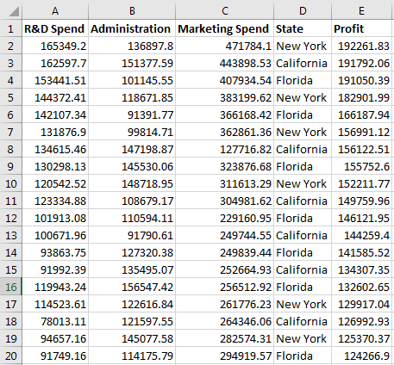
Multiple linear Regression
Problem Statement: For a venture capitalist to decide which type of investments from a given set of investments would lead to the highest profits.
Given: data Set of 50 startup companies established at different locations with their corresponding expenditures and profits.
Expectation of the regression: To develop a model which would help the investor to decide which investments whould lead him to the best profists and which whould also help him to determine what amount of profit he would gain with the type of investment he decides on.

Slide 2
Multiple linear Regression

Slide 3
Multiple linear Regression

Slide 4
Multiple linear Regression

