Slide 1
Linear Regression
y
y = mX + C
Where y is independent variable.
X is the variable parameter.
C is the intercept of y at the Origin.
C
X

Slide 2
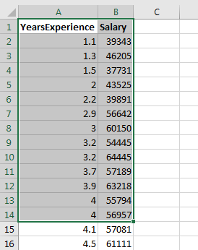
Linear Regression
Problem Statement: To estimate the salary of the employee for a give particular years of experience based on the trend followed.
Given: data of level of experience and corresponding salaries as shown below
Expectation of the regression: To estimate the salary for any given experience level.

Slide 3
Linear Regression – Graphical View Of data
Salary
Salary = m(years of experience) + C
m is the regression coefficient
C the intercept indicates the salary of an entry level employee.
years

Slide 4
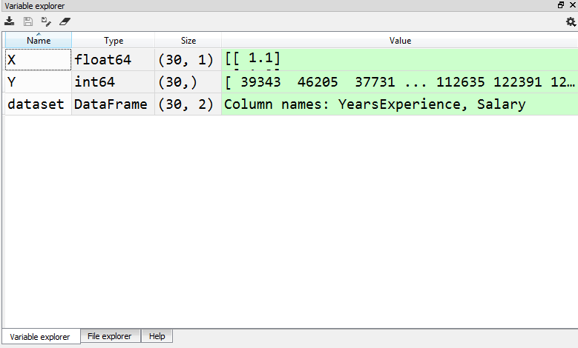
Linear Regression – importing the data set
import numpy as np
import pandas as pd
#Importing the data
dataset = pd.read_csv('Salary_Data.csv')
X = dataset.iloc[:,:-1].values
Y = dataset.iloc[:,1].values

Slide 5
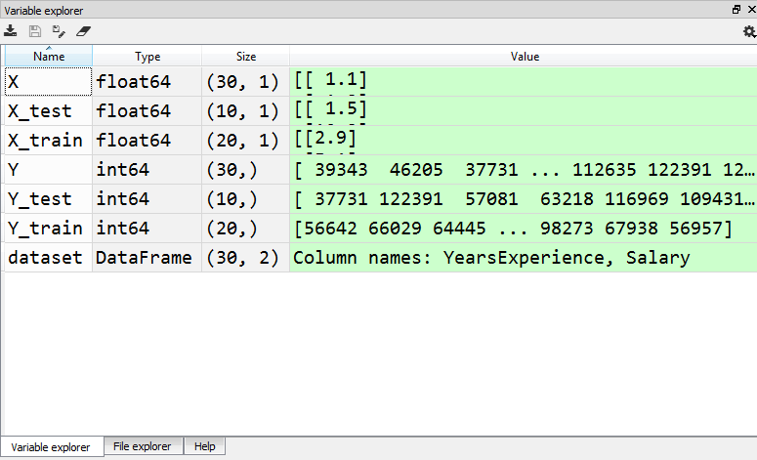
Linear Regression
# Splitting the dataset into the training set and test set
from sklearn.model_selection import train_test_split
X_train , X_test , Y_train , Y_test =
train_test_split(X,Y, test_size = 1/3, random_state = 0)

Slide 6
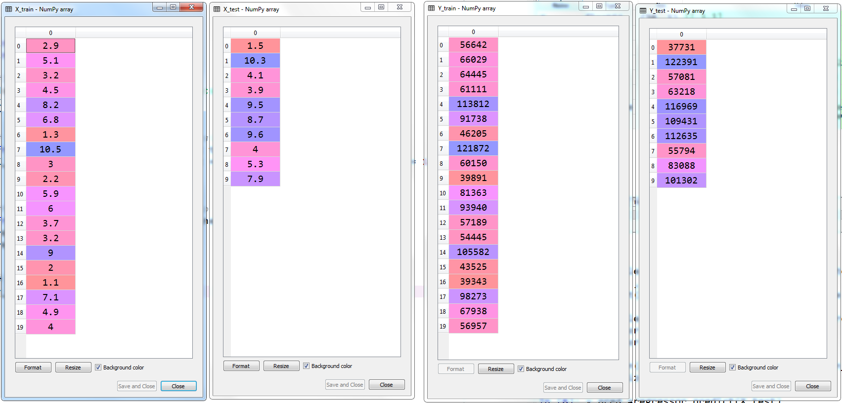
Linear Regression
Splitting the data into training and test Sets

Slide 7
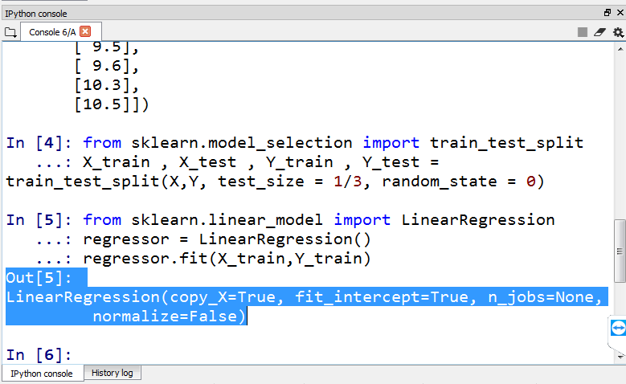
Linear Regression
#Fitting Simple Linear Regression to the Training set
from sklearn.linear_model import LinearRegression
regressor = LinearRegression()
regressor.fit(X_train,Y_train)

Slide 8
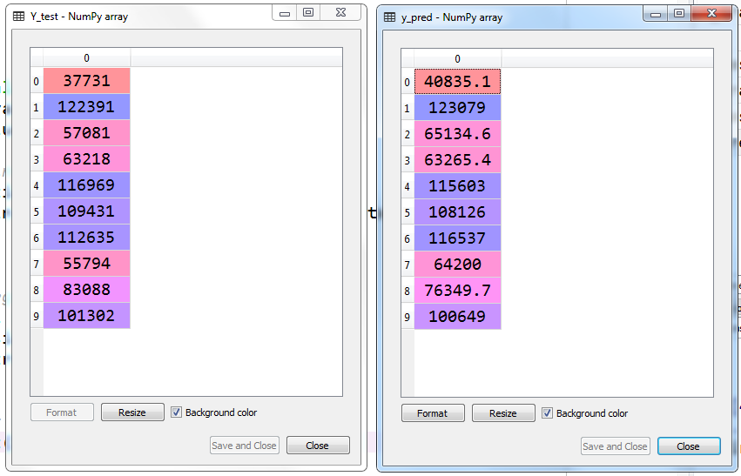
Linear Regression
# Predecting the Test set Results
y_pred =regressor.predict(X_test)

Slide 9
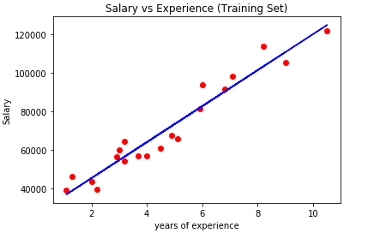
Linear Regression
#visualising the Training set results
plt.scatter(X_train, Y_train, color='red')
plt.plot(X_train, regressor.predict(X_train), color = 'blue')
plt.title('Salary vs Experience (Training Set)')
plt.xlabel('years of experience')
plt.ylabel('Salary')
plt.show()

Slide 10
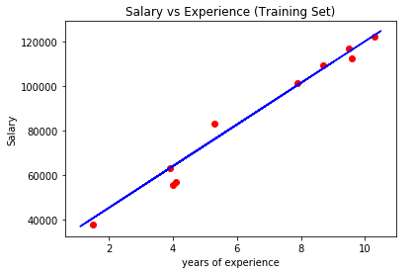
Linear Regression
#visualising the Test set results
plt.scatter(X_test, Y_test, color='red')
plt.plot(X_train, regressor.predict(X_train), color = 'blue')
plt.title('Salary vs Experience (Training Set)')
plt.xlabel('years of experience')
plt.ylabel('Salary')
plt.show()

Slide 11
Linear Regression

