Slide 1
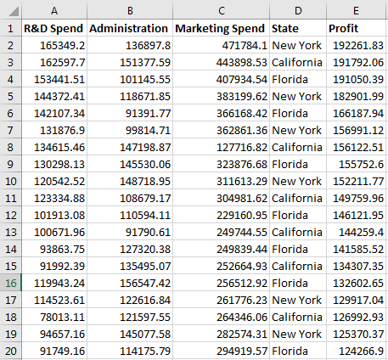
Multiple linear Regression
Problem Statement: For a venture capitalist to decide which type of investments from a given set of investments would lead to the highest profits.
Given: data Set of 50 startup companies established at different locations with their corresponding expenditures and profits.
Expectation of the regression: To develop a model which would help the investor to decide which investments would always lead him to the best profits and which would also help him to determine what amount of profit he would gain with the type of investment he decides on.

Slide 2
Multiple linear Regression

Slide 3
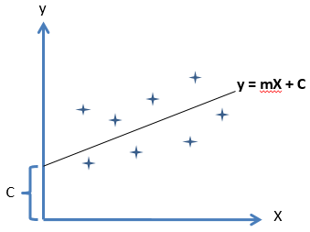
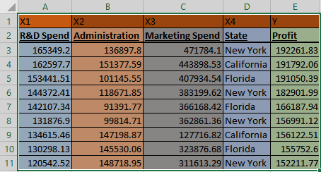
Multiple linear Regression
Simple linear Regression : y = a+bx
Multiple linear Regression : y = a+bx₁+cx₂+dx₃
Where x1 ,x2 ,x3 are the independent variable and y is dependent variable.
Assumptions Of a Linear Regression:
Linearity
Homoscedasticity
Multivariate normality
Independence of errors
Lack of Multicollinearity

Slide 4
Multiple linear Regression
Slides about the explanations of
assumptions and
P values
Null hypothesis

Slide 5

Dummy Variables
Y | X1 | X2 | X3 | X4
Profit | R&D Spend | Administration | Marketing Spend | State
192261.83 | 165349.2 | 136897.8 | 471784.1 | New York
191792.06 | 162597.7 | 151377.59 | 443898.53 | California
191050.39 | 153441.51 | 101145.55 | 407934.54 | Florida
182901.99 | 144372.41 | 118671.85 | 383199.62 | New York
166187.94 | 142107.34 | 91391.77 | 366168.42 | Florida
156991.12 | 131876.9 | 99814.71 | 362861.36 | New York
156122.51 | 134615.46 | 147198.87 | 127716.82 | California
155752.6 | 130298.13 | 145530.06 | 323876.68 | Florida
152211.77 | 120542.52 | 148718.95 | 311613.29 | New York
State : Categorical variable
Dummy variables to replace the categorical variables.

Slide 6
Dummy Variables
Y | X1 | X2 | X3 | X4
Profit | R&D Spend | Administration | Marketing Spend | State
192261.83 | 165349.2 | 136897.8 | 471784.1 | New York
191792.06 | 162597.7 | 151377.59 | 443898.53 | California
191050.39 | 153441.51 | 101145.55 | 407934.54 | Florida
182901.99 | 144372.41 | 118671.85 | 383199.62 | New York
166187.94 | 142107.34 | 91391.77 | 366168.42 | Florida
156991.12 | 131876.9 | 99814.71 | 362861.36 | New York
156122.51 | 134615.46 | 147198.87 | 127716.82 | California
155752.6 | 130298.13 | 145530.06 | 323876.68 | Florida
152211.77 | 120542.52 | 148718.95 | 311613.29 | New York
New York | California | Florida
1 | 0 | 0
0 | 1 | 0
0 | 0 | 1
1 | 0 | 0
0 | 0 | 1
1 | 0 | 0
0 | 1 | 0
0 | 0 | 1
1 | 0 | 0
Dummy variables
+ b₄*D₁
+ b₅*D₂

Slide 7
Dummy Variables Trap
Y | X1 | X2 | X3 | X4
Profit | R&D Spend | Administration | Marketing Spend | State
192261.83 | 165349.2 | 136897.8 | 471784.1 | New York
191792.06 | 162597.7 | 151377.59 | 443898.53 | California
191050.39 | 153441.51 | 101145.55 | 407934.54 | Florida
182901.99 | 144372.41 | 118671.85 | 383199.62 | New York
166187.94 | 142107.34 | 91391.77 | 366168.42 | Florida
156991.12 | 131876.9 | 99814.71 | 362861.36 | New York
156122.51 | 134615.46 | 147198.87 | 127716.82 | California
155752.6 | 130298.13 | 145530.06 | 323876.68 | Florida
152211.77 | 120542.52 | 148718.95 | 311613.29 | New York
New York | California | Florida
1 | 0 | 0
0 | 1 | 0
0 | 0 | 1
1 | 0 | 0
0 | 0 | 1
1 | 0 | 0
0 | 1 | 0
0 | 0 | 1
1 | 0 | 0
Dummy variables
D3 = 1-(D1+D2)
So always eleminate one dummy variable
+ b₄*D₁
+ b₅*D₂

Slide 8

Building A Model
To predict a value or we may have many proctors.(i.e X1,x2,x3,x4)
But how much the proctors influence the predictor Is of use.
All the Factors many not have much impact of the required profits.
So few may have to be eliminated.
Few other reasons are from the assumptions.

Slide 9
Building A Model
Methods to Build the models
All –in
Step wise Regression Models
Backward Elimination
Forward Selection
Bidirectional Elimination
Score Comparison

Slide 10
Backward Elimination
1
Select a Significance level (E.g. SL = 0.05
2
Train the regresor with all the predictors
3
Calaculate P values
True
If P>SL
False
5
4
Train the repressor with all the Reaming Predictors
Remove the predictor
Final Regressor is Ready

Slide 11
Forward Selection
1
Select a Significance level (E.g. SL = 0.05
2
Fit all the regression models with all every independent variable(y vs X1,X2,X3..)
Select one with lowest p value
3
Build regressor by adding one predictor and so on
If P < SL
Final Regressor is Ready
True
False

Slide 12
Bi-Directional Elimination
1
Select a Significance level (E.g. SL = 0.05
2
Perform Forward Selection(i.e P<SL )
3
Perform Backward Elimination(i.e P<SL )
Repeat this until there wont be any variable that enters or no variable that can exit

Slide 13
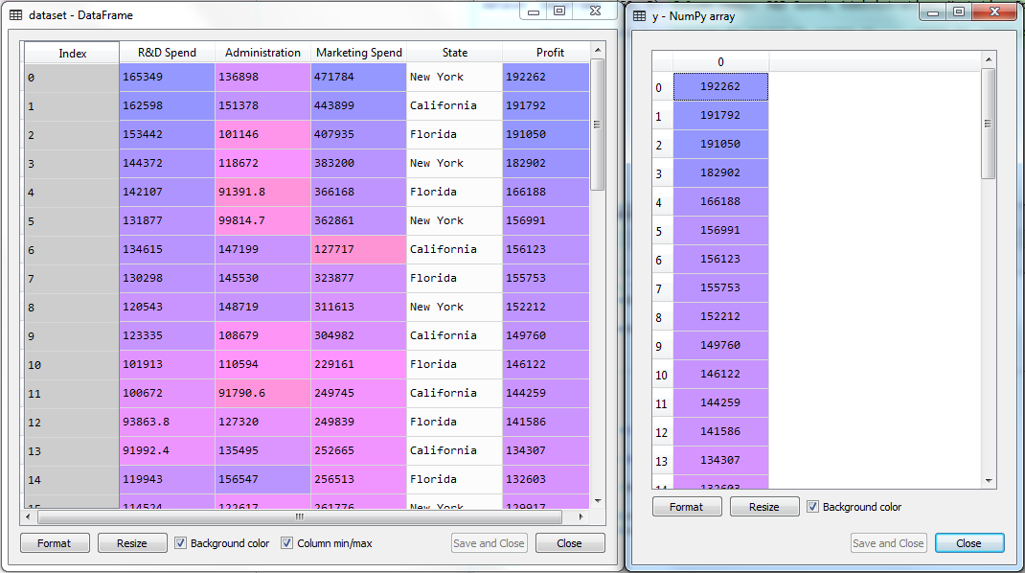
Backward elimination
# Importing the libraries
import numpy as np
import pandas as pd
# Importing the dataset
dataset = pd.read_csv('50_Startups.csv')
X = dataset.iloc[:, :-1].values
y = dataset.iloc[:, 4].values

Slide 14
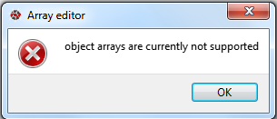
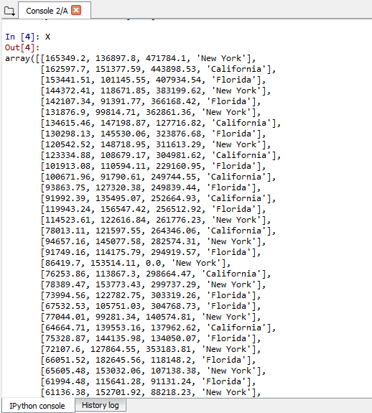
Backward elimination
Try to access X

Slide 15
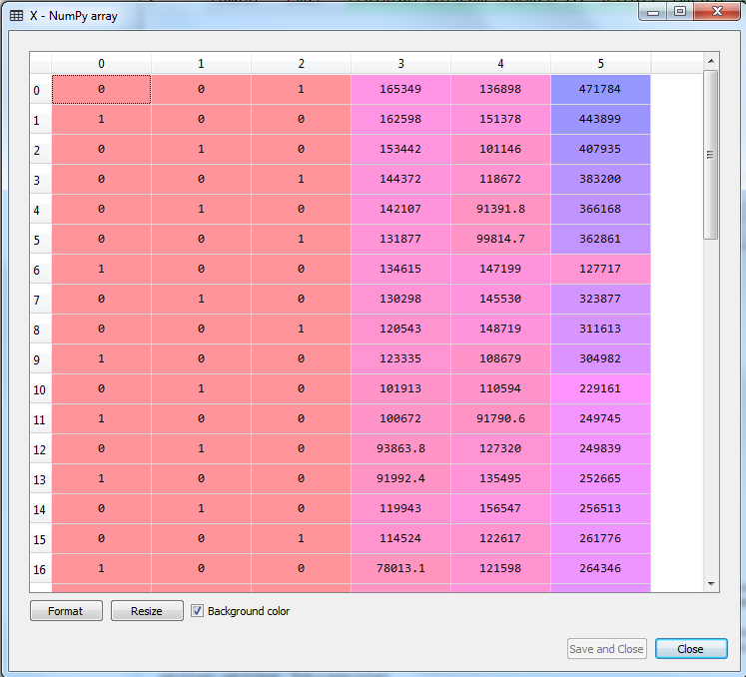
Encoding categorical data
# Encoding categorical data
from sklearn.preprocessing import LabelEncoder, OneHotEncoder
labelencoder = LabelEncoder()
X[:, 3] = labelencoder.fit_transform(X[:, 3])
onehotencoder = OneHotEncoder(categorical_features = [3])
X = onehotencoder.fit_transform(X).toarray()

Slide 16
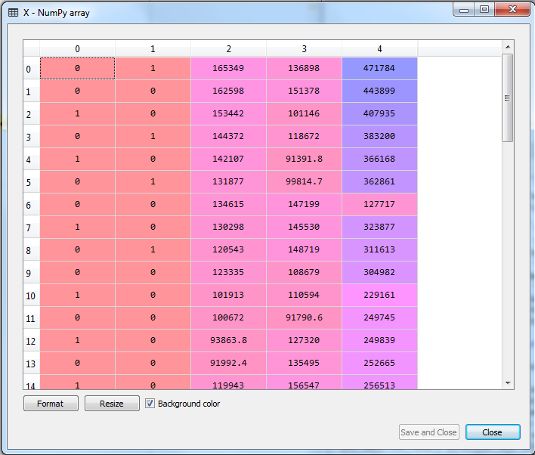
Avoiding the Dummy Variable Trap
# Encoding categorical data
from sklearn.preprocessing import LabelEncoder, OneHotEncoder
labelencoder = LabelEncoder()
X[:, 3] = labelencoder.fit_transform(X[:, 3])
onehotencoder = OneHotEncoder(categorical_features = [3])
X = onehotencoder.fit_transform(X).toarray()
# Avoiding the Dummy Variable Trap
X = X[:, 1:]

Slide 17
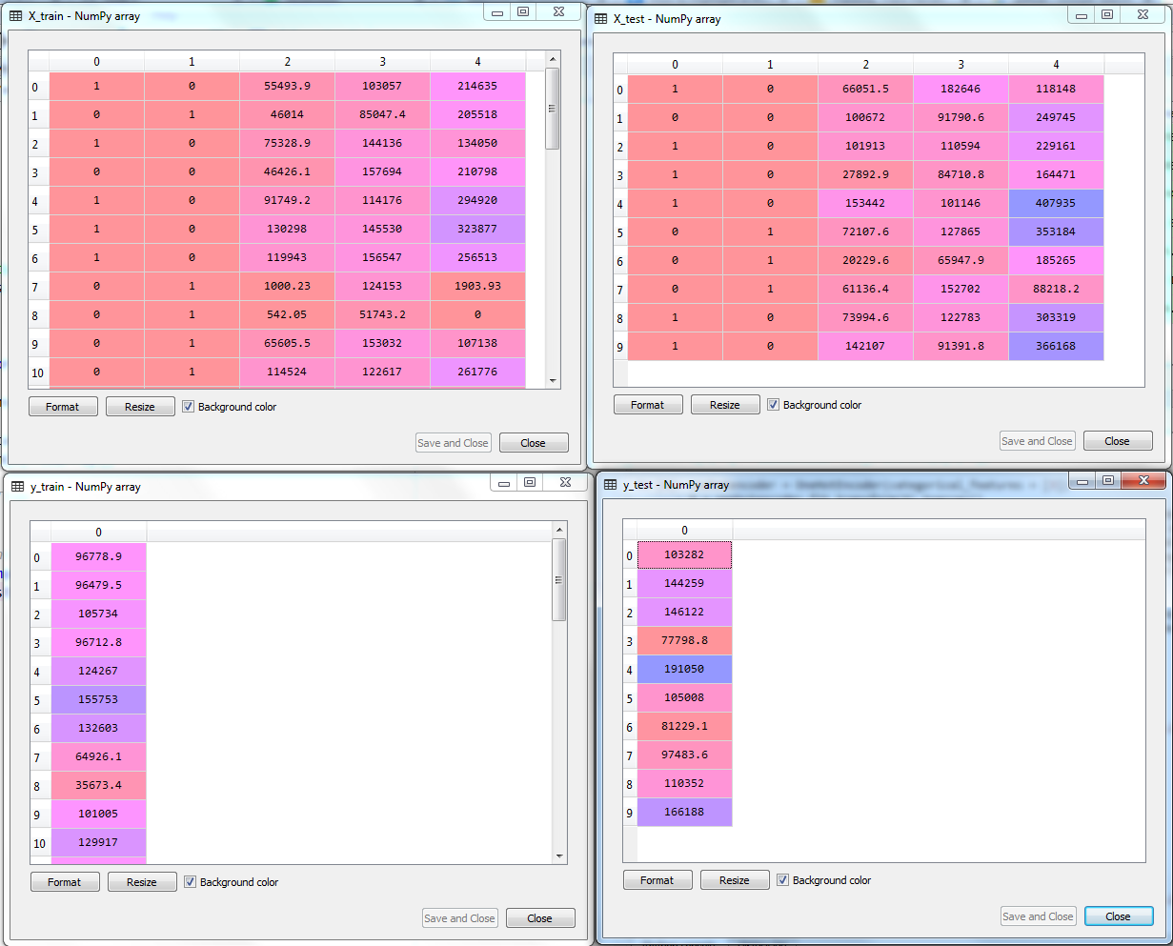
Splitting the dataset into the Training set and Test set
# Splitting the dataset into the Training set and Test set
from sklearn.model_selection import train_test_split
X_train, X_test, y_train, y_test = train_test_split(X, y, test_size = 0.2, random_state = 0)

Slide 18
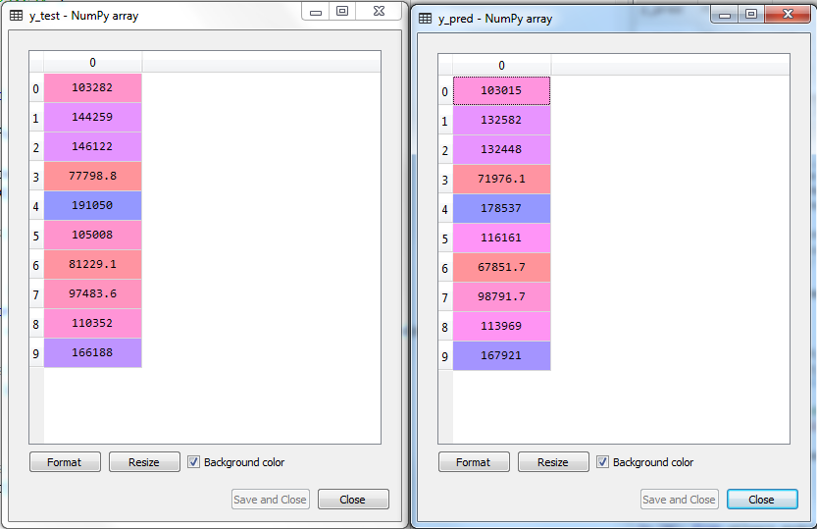
Fitting Multiple Linear Regression to the Training set
# Fitting Multiple Linear Regression to the Training set
from sklearn.linear_model import LinearRegression
regressor = LinearRegression()
regressor.fit(X_train, y_train)

Slide 19
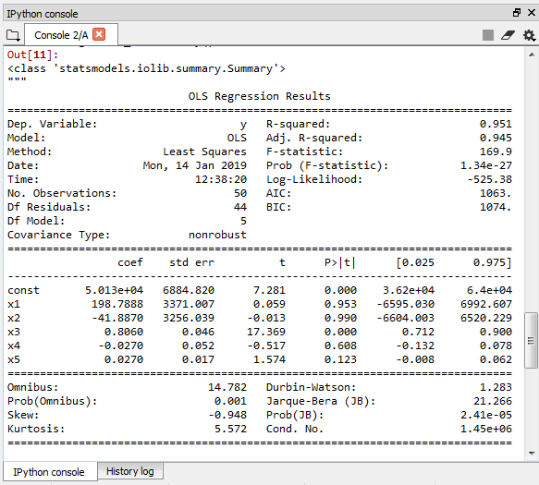
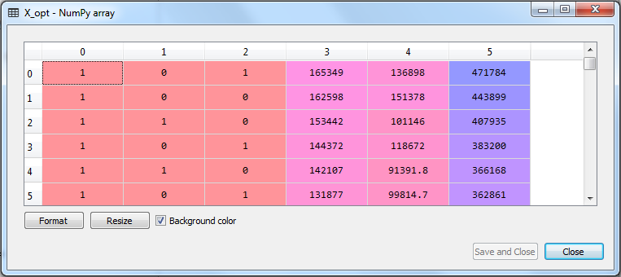
Building the optimal model using Backward Elimination
# Building the optimal model using Backward Elimination
import statsmodels.formula.api as sm
X = np.append(arr = np.ones((50, 1)).astype(int), values = X, axis = 1)
X_opt = X[:, [0, 1, 2, 3, 4, 5]]
regressor_OLS = sm.OLS(endog = y, exog = X_opt).fit()
regressor_OLS.summary()

Slide 20
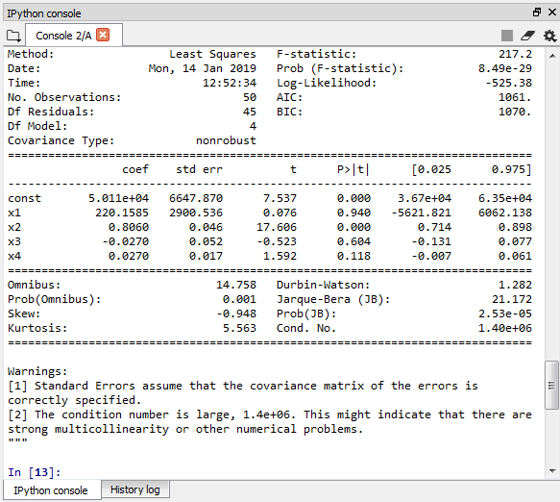
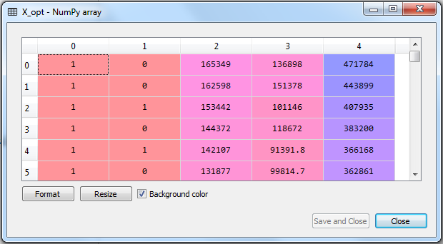
Building the optimal model using Backward Elimination
# Building the optimal model using Backward Elimination
import statsmodels.formula.api as sm
X = np.append(arr = np.ones((50, 1)).astype(int), values = X, axis = 1)
X_opt = X[:, [0, 1, 2, 3, 4, 5]]
regressor_OLS = sm.OLS(endog = y, exog = X_opt).fit()
regressor_OLS.summary()
X_opt = X[:, [0, 1, 3, 4, 5]]
regressor_OLS = sm.OLS(endog = y, exog = X_opt).fit()
regressor_OLS.summary()

Slide 21
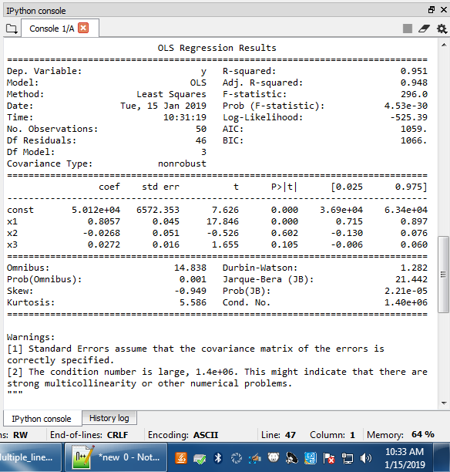
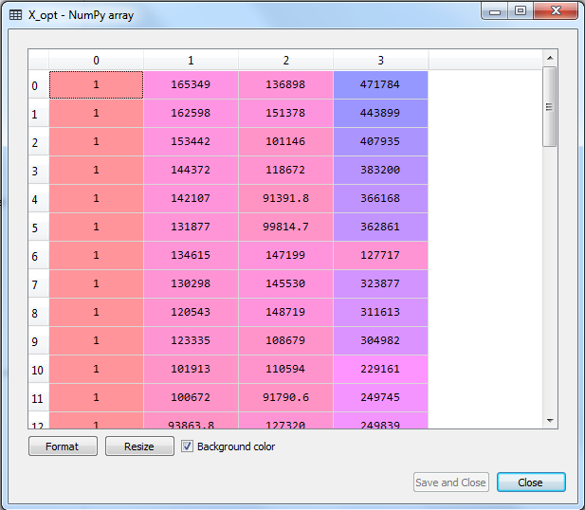
Building the optimal model using Backward Elimination
# Building the optimal model using Backward Elimination
import statsmodels.formula.api as sm
X = np.append(arr = np.ones((50, 1)).astype(int), values = X, axis = 1)
X_opt = X[:, [0, 1, 2, 3, 4, 5]]
regressor_OLS = sm.OLS(endog = y, exog = X_opt).fit()
regressor_OLS.summary()
X_opt = X[:, [0, 1, 3, 4, 5]]
regressor_OLS = sm.OLS(endog = y, exog = X_opt).fit()
regressor_OLS.summary()
X_opt = X[:, [0, 3, 4, 5]]
regressor_OLS = sm.OLS(endog = y, exog = X_opt).fit()
regressor_OLS.summary()

Slide 22
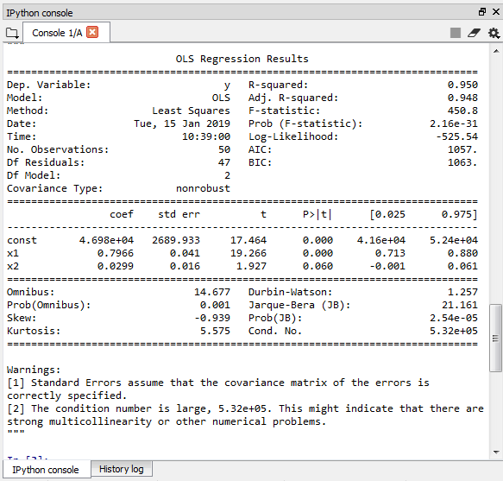
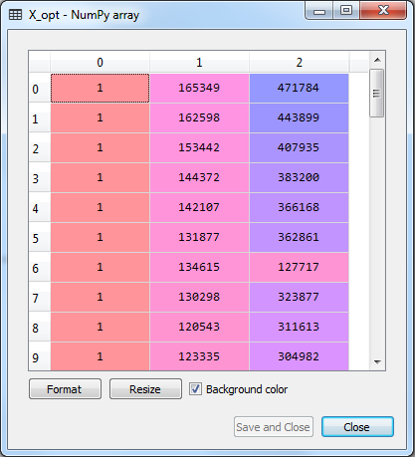
Building the optimal model using Backward Elimination
# Building the optimal model using Backward Elimination
import statsmodels.formula.api as sm
X = np.append(arr = np.ones((50, 1)).astype(int), values = X, axis = 1)
X_opt = X[:, [0, 1, 2, 3, 4, 5]]
regressor_OLS = sm.OLS(endog = y, exog = X_opt).fit()
regressor_OLS.summary()
X_opt = X[:, [0, 1, 3, 4, 5]]
regressor_OLS = sm.OLS(endog = y, exog = X_opt).fit()
regressor_OLS.summary()
X_opt = X[:, [0, 3, 4, 5]]
regressor_OLS = sm.OLS(endog = y, exog = X_opt).fit()
regressor_OLS.summary()
X_opt = X[:, [0, 3, 5]]
regressor_OLS = sm.OLS(endog = y, exog = X_opt).fit()
regressor_OLS.summary()

Slide 23
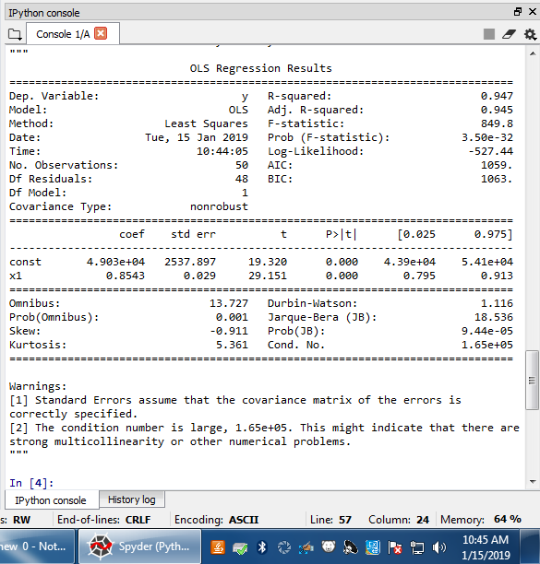
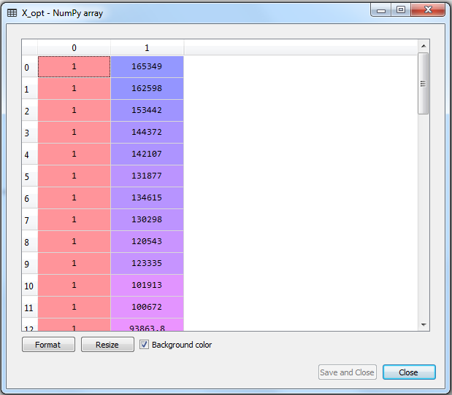
Building the optimal model using Backward Elimination
# Building the optimal model using Backward Elimination
import statsmodels.formula.api as sm
X = np.append(arr = np.ones((50, 1)).astype(int), values = X, axis = 1)
X_opt = X[:, [0, 1, 2, 3, 4, 5]]
regressor_OLS = sm.OLS(endog = y, exog = X_opt).fit()
regressor_OLS.summary()
X_opt = X[:, [0, 1, 3, 4, 5]]
regressor_OLS = sm.OLS(endog = y, exog = X_opt).fit()
regressor_OLS.summary()
X_opt = X[:, [0, 3, 4, 5]]
regressor_OLS = sm.OLS(endog = y, exog = X_opt).fit()
regressor_OLS.summary()
X_opt = X[:, [0, 3, 5]]
regressor_OLS = sm.OLS(endog = y, exog = X_opt).fit()
regressor_OLS.summary()
X_opt = X[:, [0, 3]]
regressor_OLS = sm.OLS(endog = y, exog = X_opt).fit()
regressor_OLS.summary()

