Slide 1
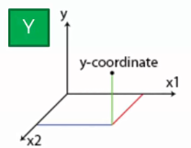
Decision Tree
X2
X1,X2 are the independent variables, and Y the dependent variable is on the third dimension.
The work should be done on these independent variables to build the decision tree.
Then actual prediction of the independent variables is made.
X1

Slide 2
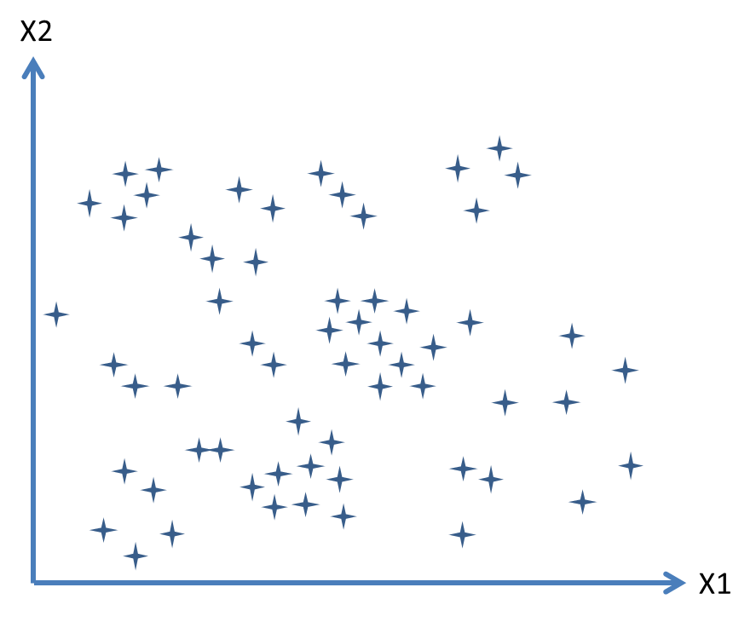
Decision Tree - Splitting the scatter plot to segments
Scatterplot will be split up into segments and -how an algorithm could go about doing that. ?
How and where these splits are conducted is determined by the algorithm.
Is it actually adding some value to our the way that we want to group our points and the algorithm knows when to stop is when there is a certain minimum for the information that needs to be added.
190
170
10
40

Slide 3
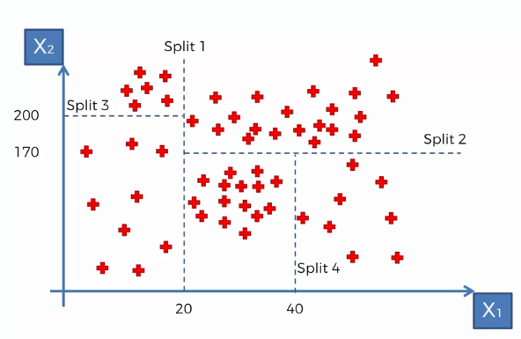
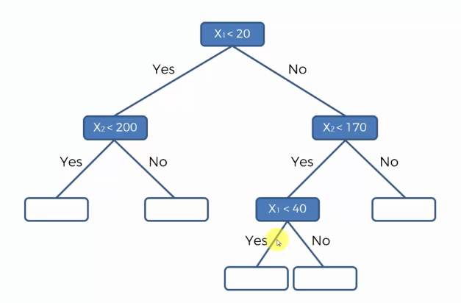
Decision Tree - How an algorithm can do that..?

Slide 4
Decision Tree
For any value that falls in the green block (i.e the independent varibles X1 value ranging between 20 &40 and X2 values between 0&170. will have the avegae value of the all the Y values corresponding to the pints in that split group.

Slide 5
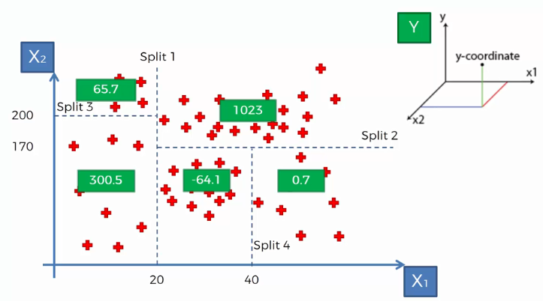
Decision Tree – Algorithm working
Average values of Y in the split
The regular method was to take the average of all data points and that would be our answer.
But now here we split the data and we add additional value to the prediction.

Slide 6
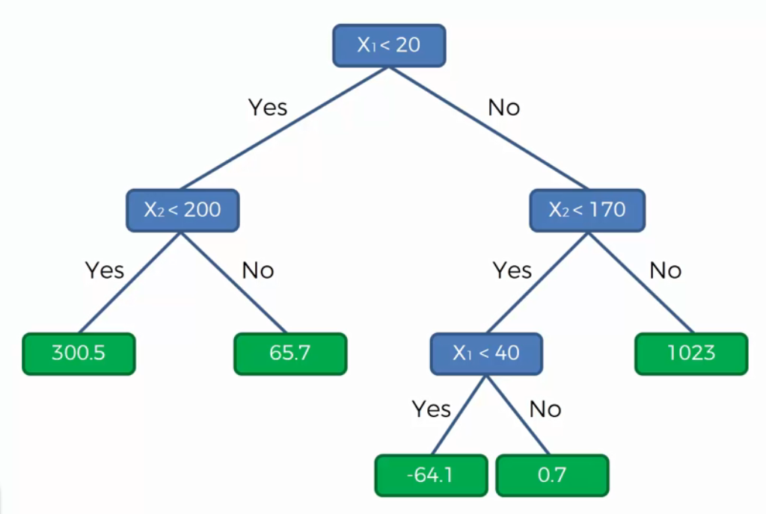
Decision Tree – Algorithm explained

Slide 7
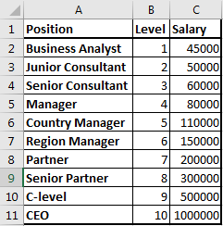
Decision Tree
Problem Statement: Identifying weather if the salary declared by a new employee in his previous company is true or false
Given: data Set of Positions experience level and salaries of 10 different positions at different expertise level.
Expectation of the regression: To develop a Regression model which would help the Employer to estimate the salary for his level of experience & decide on the honesty of his new employee about his salary

Slide 8
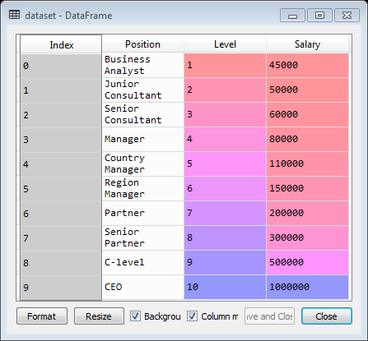
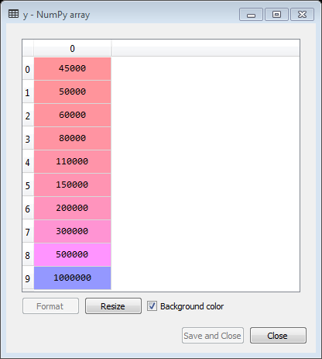
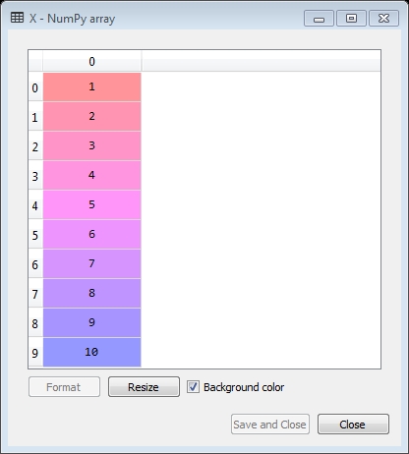
Decision Tree -
import numpy as np
import matplotlib.pyplot as plt
import pandas as pd
# Importing the dataset
dataset = pd.read_csv('Position_Salaries.csv')
X = dataset.iloc[:, 1:2].values
y = dataset.iloc[:, 2].values.reshape(-1,1)

Slide 9
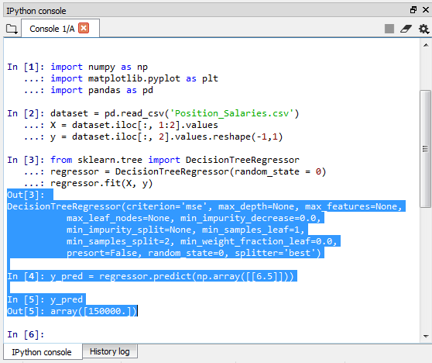
Decision Tree - Fitting Decision Tree Regression to the dataset
# Fitting Decision Tree Regression to the dataset
from sklearn.tree import DecisionTreeRegressor
regressor = DecisionTreeRegressor(random_state = 0)
regressor.fit(X, y)
# Predicting a new result
y_pred = regressor.predict(np.array([[6.5]]))

Slide 10
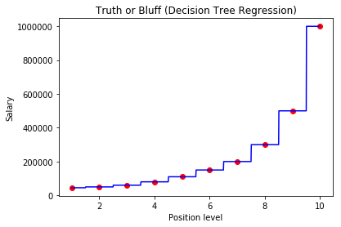
Decision Tree- Visualizing the Decision Tree Regression results
# Visualizing the Decision Tree Regression results (higher resolution)
X_grid = np.arange(min(X), max(X), 0.01)
X_grid = X_grid.reshape((len(X_grid), 1))
plt.scatter(X, y, color = 'red')
plt.plot(X_grid, regressor.predict(X_grid), color = 'blue')
plt.title('Truth or Bluff (Decision Tree Regression)')
plt.xlabel('Position level')
plt.ylabel('Salary')
plt.show()

Slide 11
Decision Tree

Slide 12
Decision Tree

