Slide 1
EARTHEN
How the website works
A walkthrough of the shop and the studio,
from the first visit to sign-out.
Quiet clothes for every day.

Slide 2
THE WEBSITE
Two doors, two logins
A shopper and a member of staff never share a sign-in.
THE SHOP
THE STUDIO
For customers
For staff
Home, search, a piece, the bag, checkout, account.
Anyone can browse. Checkout needs an email, not an account.
An account keeps orders, addresses, the bag, and the wishlist.
Prices are in rupees and include GST.
A separate sign-in at the studio door.
Owner, catalog manager, or order and support.
Each role sees only its own pages.
Orders, stock, coupons, tax, and the look of the shop.
EARTHEN
1 / 16

Slide 3
THE VISIT
What we will walk through
Seven steps for the customer. Staff pick the order up at step four.
01
02
03
04
Arrive
Find a piece
Choose
Pay
Home, announcement, and the promises.
Search, filters, and the grid.
Colour, size, bag, or wishlist.
Address, delivery, coupon, and payment.
05
06
07
Follow
Aftercare
Account
Confirmed through to delivered.
Cancel, return, invoice, or a review.
Profile, orders, wishlist, sign-out.
EARTHEN
2 / 16

Slide 4
THE SHOP
Arriving on the shop
A season name, a headline, and two ways in: Shop the collection, and Our story.
Hero photographs. A live store-wide sale shows its name and the percent off.
Women, Men, and Unisex, then categories, including New in.
A season banner, new arrivals, and up to four recently viewed pieces.
An olive announcement bar. Staff write it, or the site fills in shipping and returns. It can be hidden.
The header carries search, account, and the bag count. On a phone it also opens Our story and Help.
The footer holds policies, contact, the studio address, and GSTIN.
Free shipping
Over the studio threshold
Returns
A set window, pickup arranged
Cash on delivery
When the studio allows it
Secure payment
UPI, cards, net banking
EARTHEN
3 / 16

Slide 5
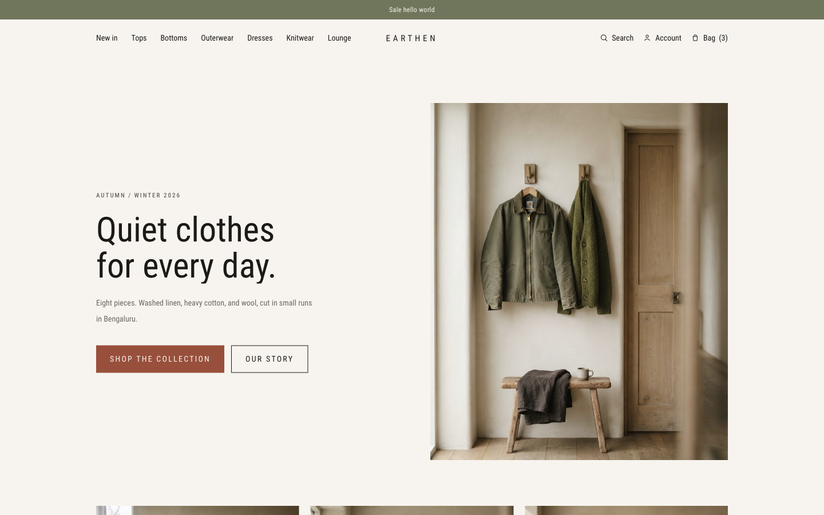
LIVE
The shop
Arriving on the shop
The homepage as it is running now, with the announcement the studio has set.
localhost:3000

Slide 6
THE SHOP
Finding a piece
Search
The grid
Opens over the page as they type.
Matches show the price. A sale price is crossed out.
Popular searches: linen, overshirt, trousers, cardigan, olive.
Looks through name, fabric, origin, description, category, and colour.
A one-letter miss still matches.
Twenty pieces a page, from a category, New in, or an audience.
Sort by newest, popularity, or price.
Filter size, colour, gender, price, and stock.
Women and Men also keep unisex pieces.
Save or add to the bag from the card, without opening the piece.
EARTHEN
4 / 16

Slide 7
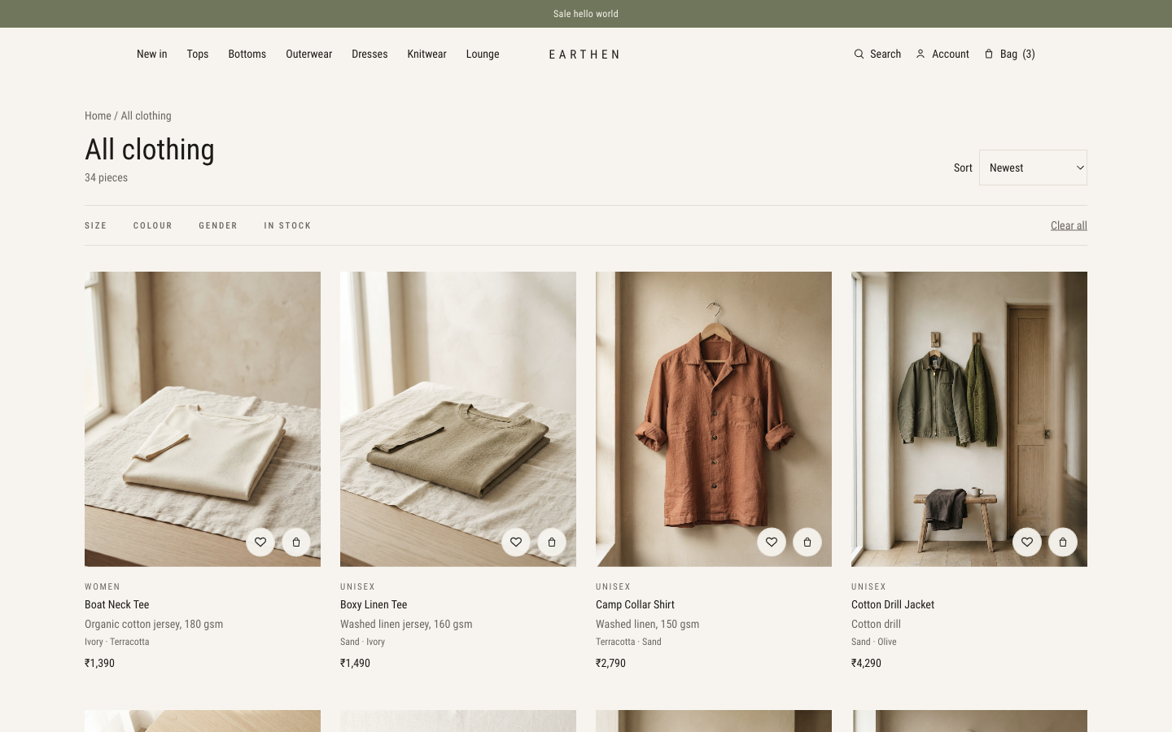
LIVE
The shop
The clothing grid
All clothing, newest first, with size, colour, gender, and stock.
localhost:3000

Slide 8
THE SHOP
On a piece
Drafts and archived pieces stay off the shop. Only active pieces can be bought.
Photographs, price, fabric, stars, and a New in mark.
Who it was photographed on, and how it fits.
Colour and size. A saved usual size is pre-selected.
Gone sizes are struck through. Three or fewer left is said aloud on the page.
A size guide in centimetres, upper or lower body.
Details, origin, fabric, care, shipping, and returns.
Add to bag. A panel offers View bag or Checkout.
Wishlist, and remove it the same way.
Out of stock: leave an email and be written to when it returns.
A review after delivery: stars, fit, and an optional height.
A PIN check, and four related pieces underneath.
EARTHEN
5 / 16

Slide 9
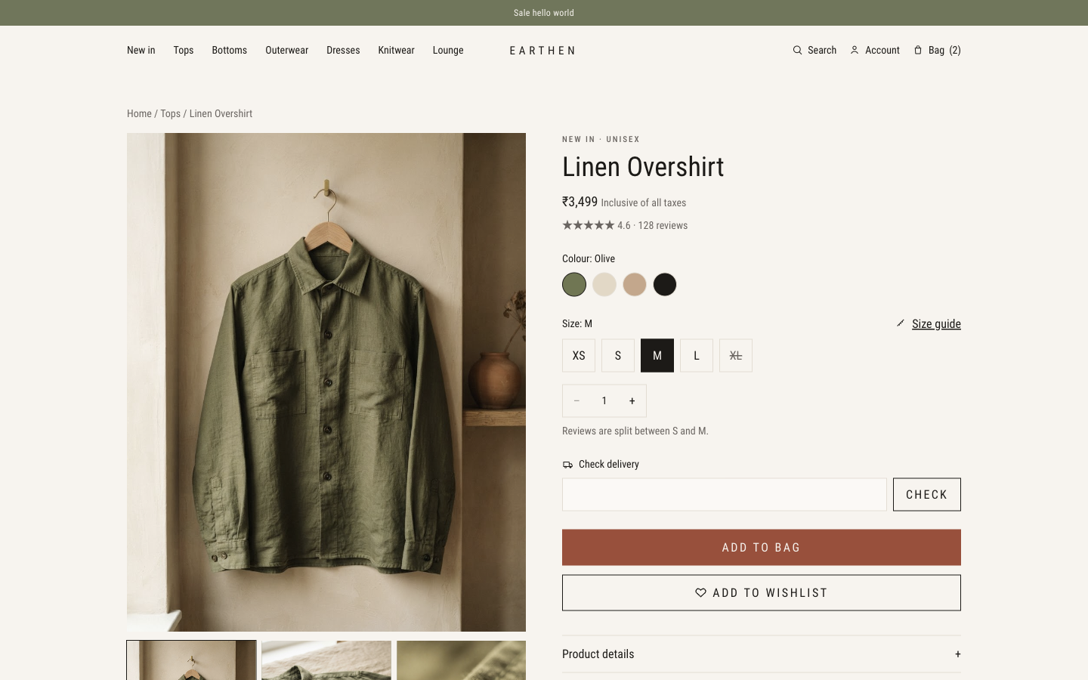
LIVE
The shop
Linen Overshirt
Colour, size, a delivery check, add to bag, and the wishlist.
localhost:3000

Slide 10
THE SHOP
Bag, then checkout
No account is required. The receipt goes to the email on the order.
The bag
Checkout
Colour, size, quantity, and remove.
Type a code, or open Offers for this order.
Each offer shows the saving, the minimum, and why it may not apply.
A bar shows how close they are to free standard delivery.
Subtotal, shipping, discount, and a GST-inclusive total.
Address, a serviceable PIN, and saved addresses when signed in.
Standard or express. A free-shipping code waives either.
Optional gift wrap, a card note, and prices left off the packing slip.
UPI, card, or net banking through Razorpay.
Cash on delivery when it is on, and under the studio limit.
Stock drops as the order is placed. The bag empties.
EARTHEN
6 / 16

Slide 11
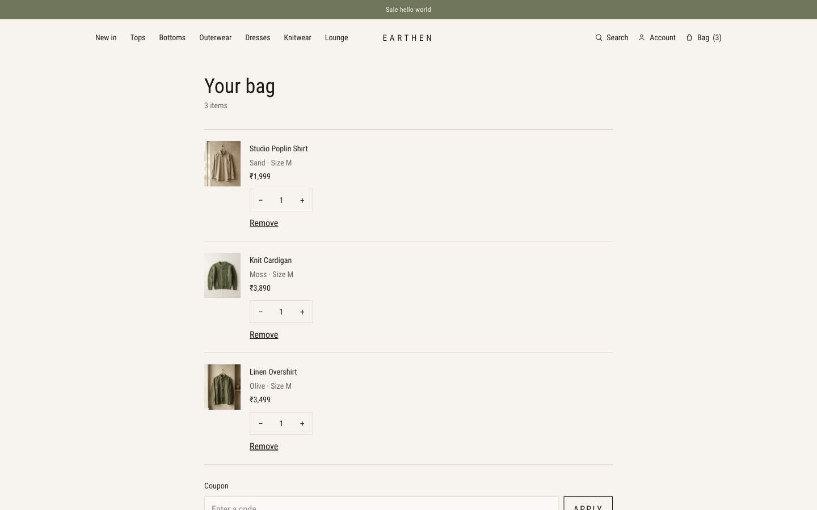
LIVE
The shop
The bag
Three pieces, quantities, and a place for a code.
localhost:3000

Slide 12
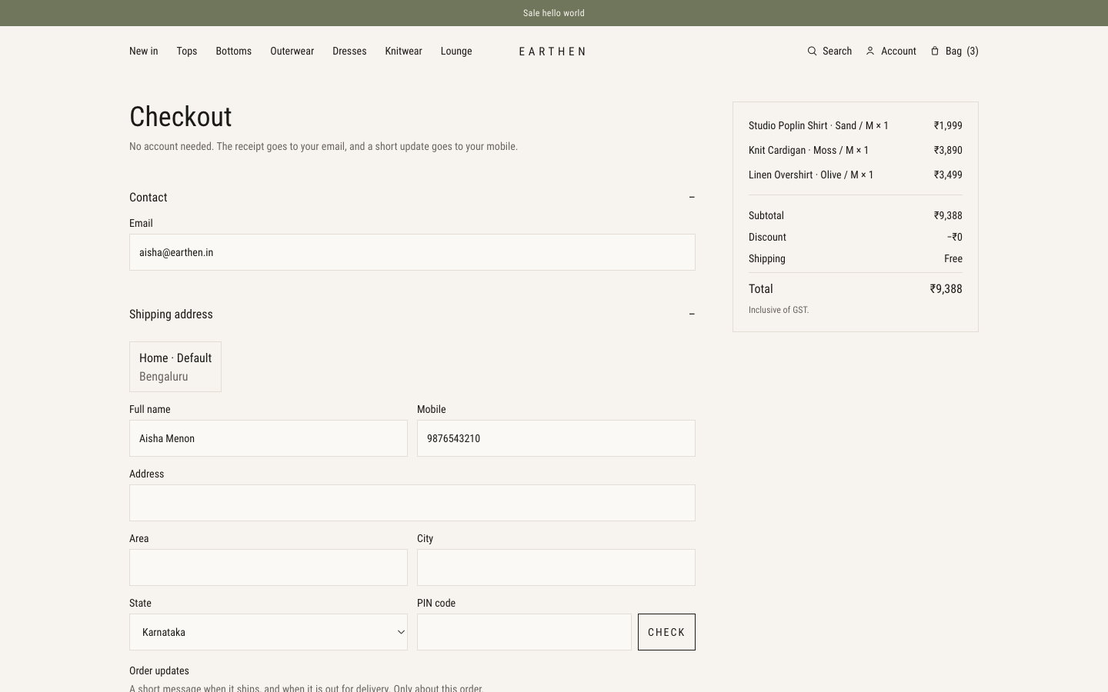
LIVE
The shop
Checkout
Aisha is signed in. On this machine the page still says no payment is taken.
localhost:3000

Slide 13
THE SHOP
After the order is placed
Confirmed
Packed
Shipped
Out for delivery
Delivered
Follow it
Change it
Status, courier tracking once staff add it, payment method, and the city it is going to.
Cancel while it is confirmed or packed. Stock returns. A paid Razorpay order is sent for refund.
Bring it back
Keep the paper
After delivery, inside the studio’s return window: refund or exchange, with pickup from the same address.
A GST invoice to print or save. Review the piece once it has arrived.
EARTHEN
7 / 16

Slide 14
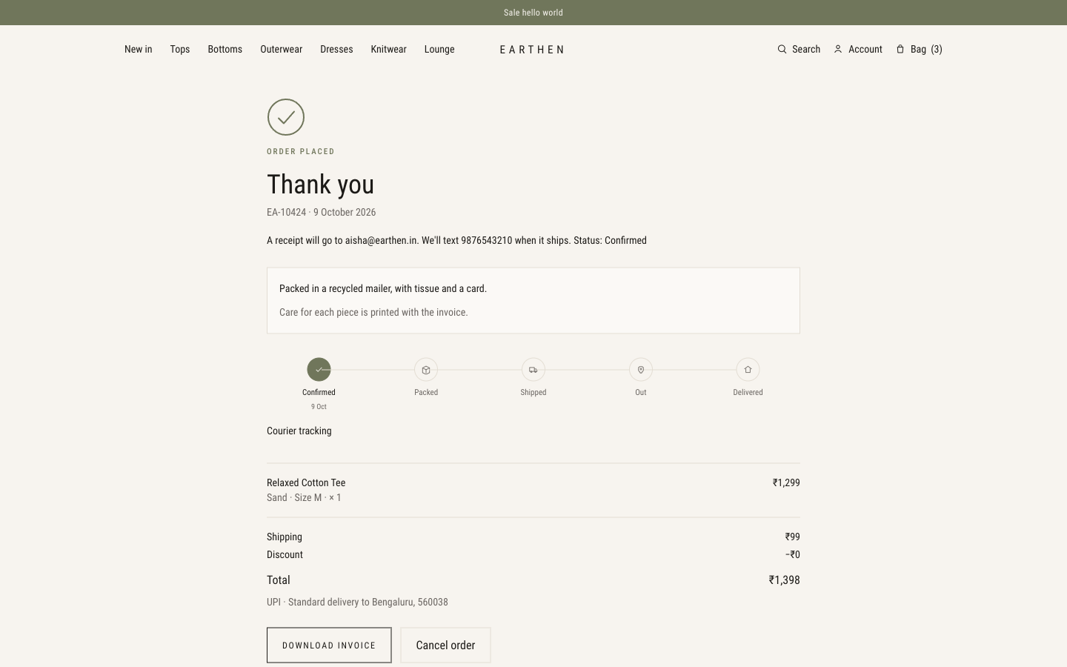
LIVE
The shop
The order, once it is placed
EA-10424 is confirmed. The invoice and cancel are both here.
localhost:3000

Slide 15
THE SHOP
The account, from sign-in to sign-out
Create
Sign in
Overview
Name, email, a 10-digit mobile, and a password of at least 8 characters.
Email and password. A blocked account is refused. Forgot password sends a link that lasts 30 minutes.
Orders, wishlist, addresses, the latest order, and pieces they asked to hear about.
Profile
Orders
Sign out
Name and mobile. A usual size. An address book, with one default.
Number, date, status, and total. Guest orders appear when the email matches.
Ends the session. The shop stays open. The wishlist on a signed-out browser stays on that browser.
EARTHEN
8 / 16

Slide 16
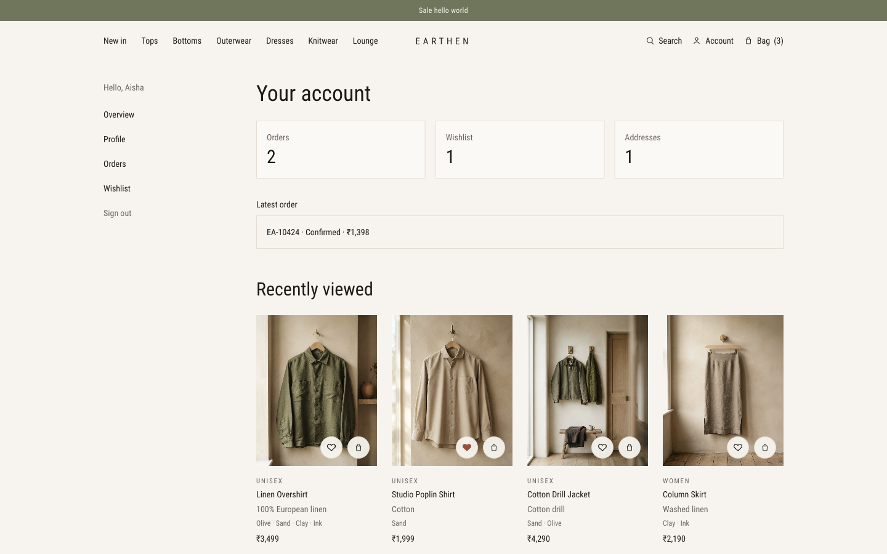
LIVE
The shop
A signed-in account
Orders, the wishlist, a saved address, and what was viewed last.
localhost:3000

Slide 17
THE STUDIO
Who can open what
The menu hides the rest. A direct link outside the role is refused.
Page | Owner | Catalog manager | Order and support
Dashboard | Yes | Yes | Yes
Products | Yes | Yes | ·
Categories | Yes | · | ·
Orders | Yes | · | Yes
Returns | Yes | · | Yes
Customers | Yes | · | Yes
Coupons | Yes | Yes | ·
Reports | Yes | · | Yes
Settings | Yes | · | ·
EARTHEN
9 / 16

Slide 18
THE STUDIO
The morning view
Every role lands here. The links onward appear only when that role can open them.
Revenue today
Orders today
Pending shipments
Low stock
Set against yesterday.
Set against yesterday.
Confirmed and packed, including any from before today.
Active pieces with one to five units left in a colour and size.
A bar of sales for the last seven days.
The latest orders, and an export of the order list.
Low stock names the piece, the colour, and the size.
EARTHEN
10 / 16

Slide 19
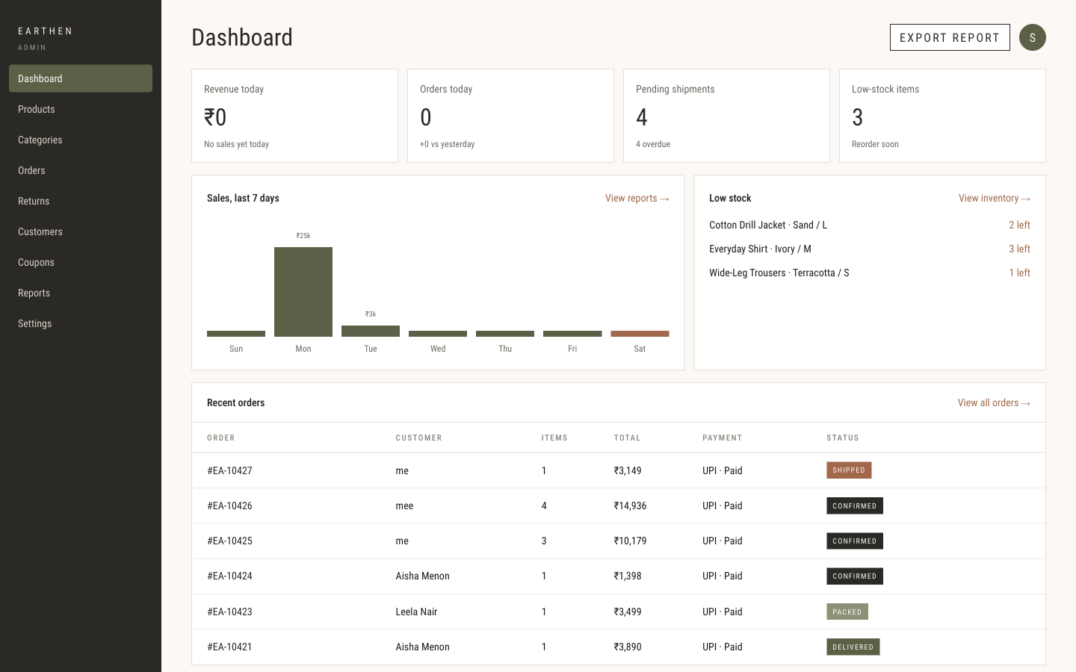
LIVE
The studio
The morning view
Revenue today, open shipments, low stock, and the latest orders.
localhost:3000

Slide 20
THE STUDIO
The catalog
Products
Categories
Search, then filter by status, category, audience, and stock.
Add a piece, or import a spreadsheet. A new piece starts in XS to XL.
Edit name, description, fabric, care, price, and a dated sale price.
Active, draft, or archived. Draft and archived stay off the shop.
Up to eight colours and eight photographs. The first photo is the card.
Stock by colour and size. Restocking emails anyone who asked.
Owner only.
Name, a short line, and a portrait.
Upper-body or lower-body size chart.
How many pieces sit in each.
New in stays a filter, not a category.
The header, home, and shop read this list.
EARTHEN
11 / 16

Slide 21
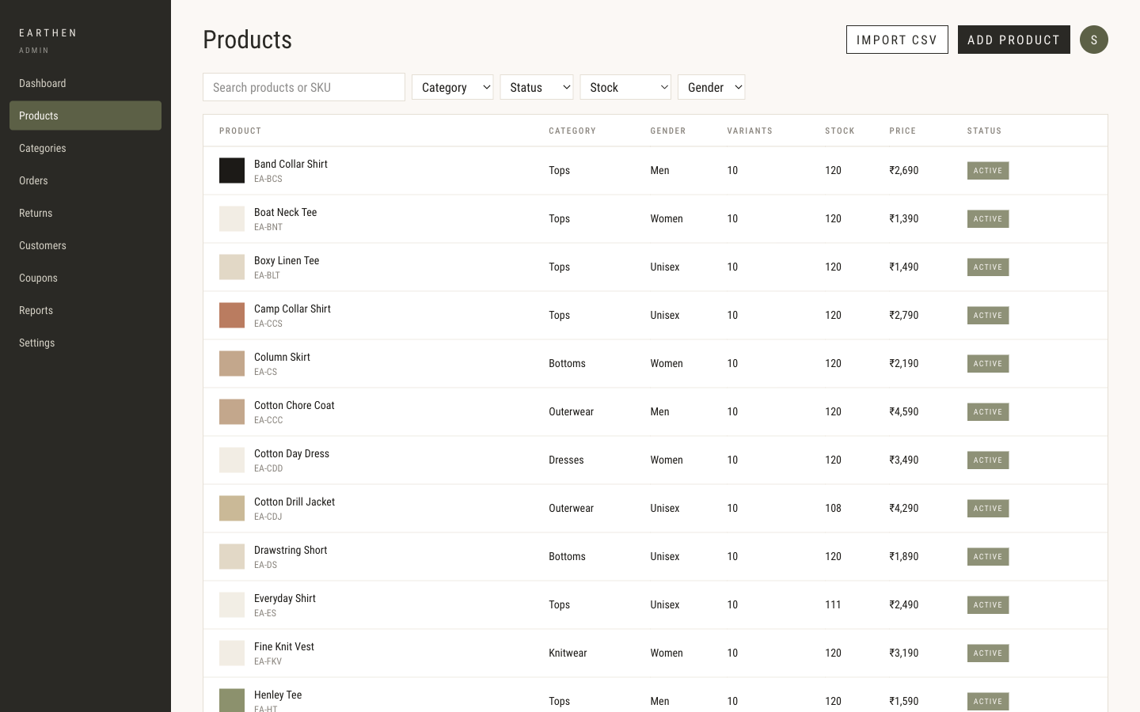
LIVE
The studio
The catalog
Search and filters, a spreadsheet import, and add product.
localhost:3000

Slide 22
THE STUDIO
An order, from the list to the label
Search by number, name, email, or phone.
Filter: all, confirmed, packed, shipped, delivered, cancelled.
Open one order: items, SKU, GST, and the total.
Move the status. The customer is emailed.
A note that only staff can see.
Customer, address, and whether payment is paid or still due.
Create a shipment with a courier and a tracking number.
Print a shipping label, and print the GST invoice.
Cancelling a packed order returns the stock and the coupon use.
A paid Razorpay order is sent for refund.
EARTHEN
12 / 16

Slide 23
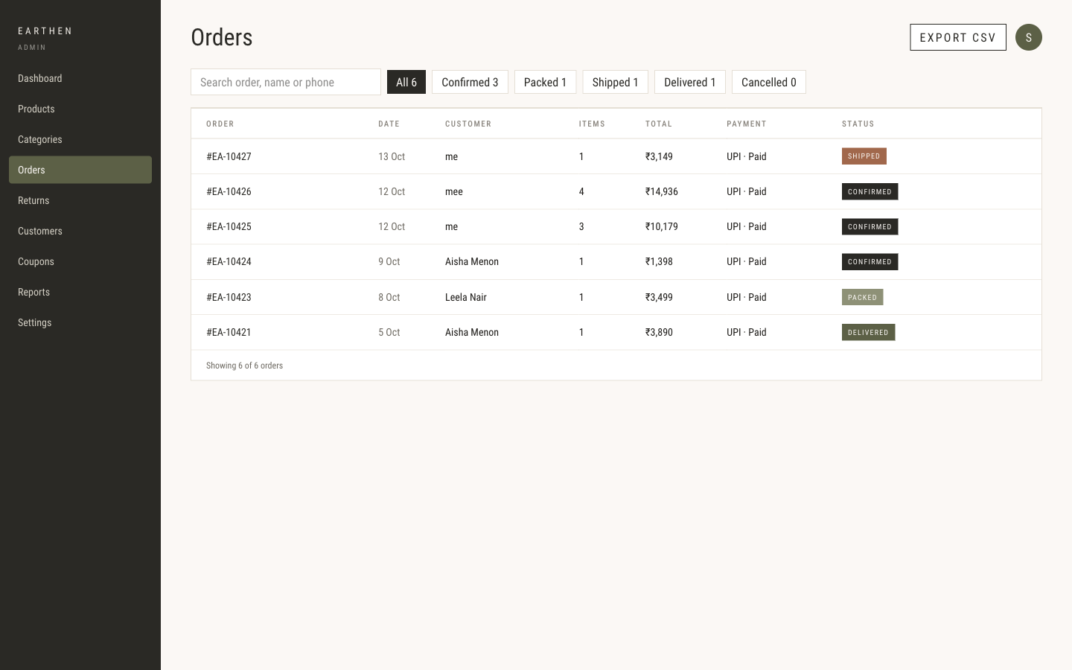
LIVE
The studio
The order list
Search, status filters, and export.
localhost:3000

Slide 24
THE STUDIO
Returns, customers, and coupons
Returns
Customers
Coupons
Waiting, rupees still to refund, the return rate, and days to decide.
Approve or reject.
A refund returns stock and the Razorpay payment.
An exchange is emailed for staff to arrange.
A rejection puts the order back to delivered.
Search name, email, or phone.
Everyone, or repeat buyers only.
Orders, amount spent, and the last order.
Guest checkouts appear by the email used.
Block a person. They cannot sign in or order.
Percent off, a fixed amount, or free shipping.
A minimum order, a use limit, and dates.
Active, scheduled, or expired.
Open a code to edit it.
The shop lists live codes in the bag and at checkout.
EARTHEN
13 / 16

Slide 25
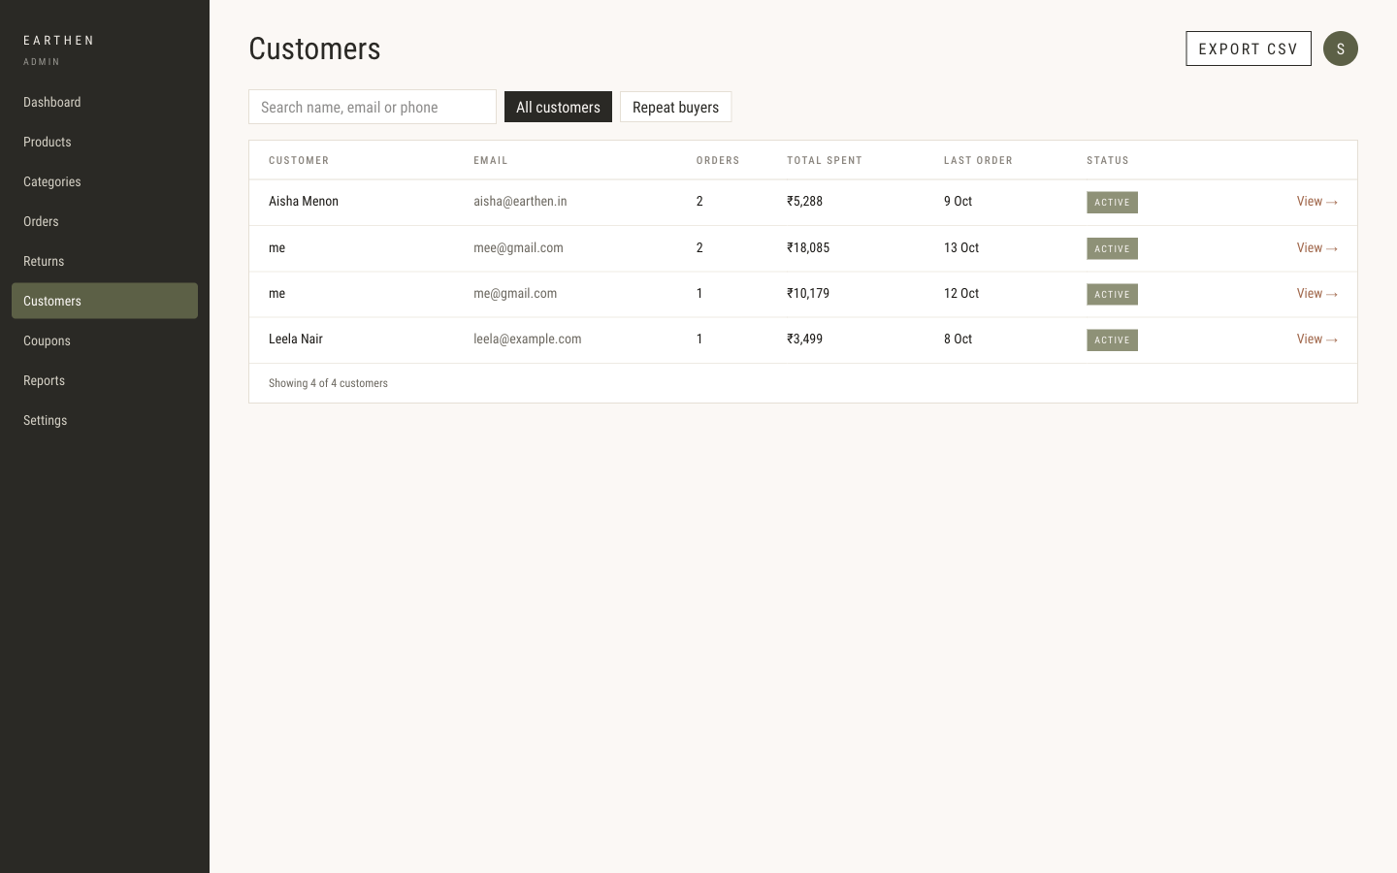
LIVE
The studio
Customers
Orders, amount spent, and who is active. Guest checkouts appear by email.
localhost:3000

Slide 26
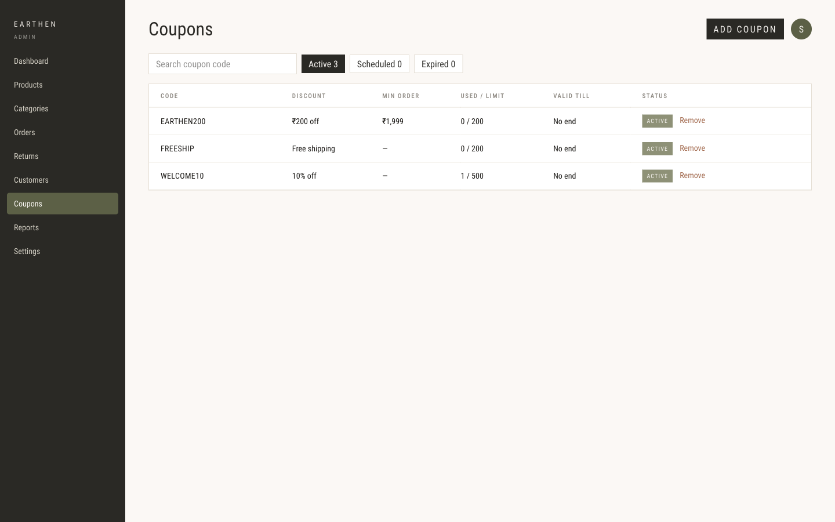
LIVE
The studio
Coupons
EARTHEN200, FREESHIP, and WELCOME10, each with a use limit.
localhost:3000

Slide 27
THE STUDIO
Sales, tax, and how people paid
All time, or the last 30 days. Cancelled orders stay out of the totals.
Sales
Net sales, order count, average order, GST collected, and refunds. Bars for category and for payment method.
GST
Taxable value, CGST, SGST, and IGST, month by month. Karnataka splits CGST and SGST. Other states use IGST.
Payments
UPI, cards, cash on delivery, and net banking, each as a share of sales.
The rate
GST is already in the shelf price. Five percent up to ₹1,000 a piece. Twelve percent above that.
EARTHEN
14 / 16

Slide 28
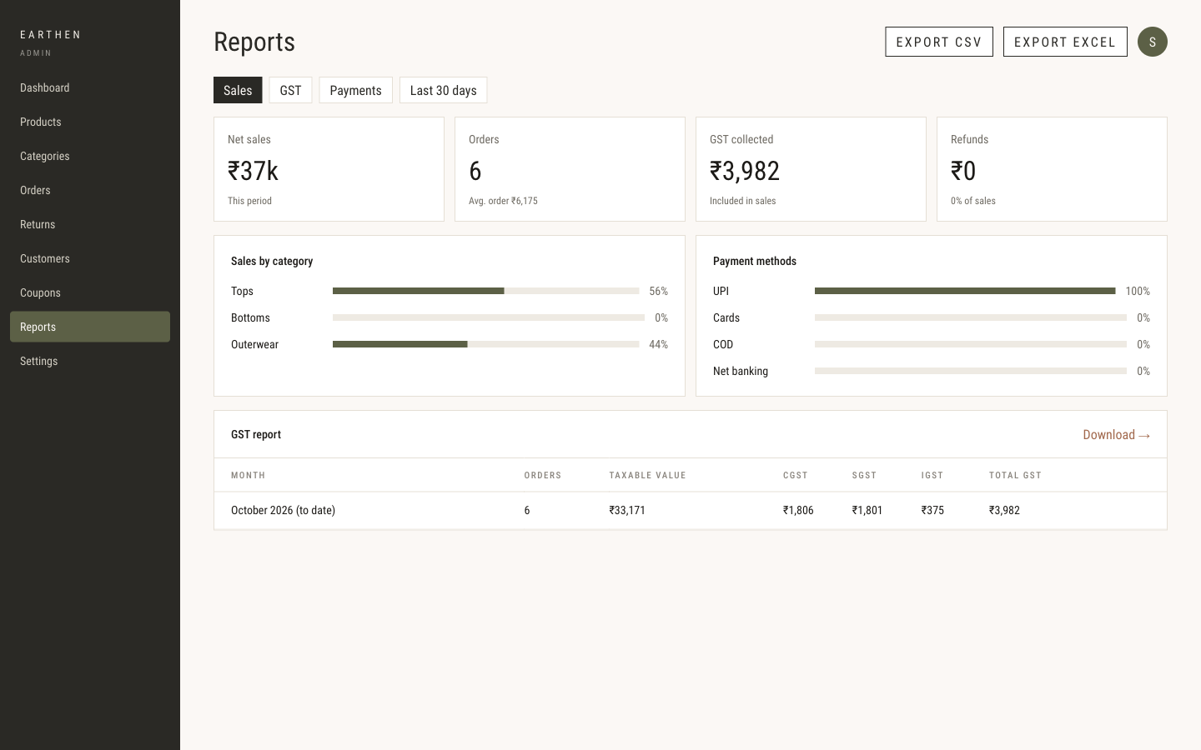
LIVE
The studio
Sales and GST
This period’s sales, how people paid, and the October GST lines.
localhost:3000

Slide 29
THE STUDIO
What the owner can change
Nothing reaches the shop until Save changes. The owner also invites staff.
The shop front
Money
Announcement, homepage words, hero photographs, the season picture, and the Women, Men, and Unisex tiles.
A store-wide sale, shipping rates, the free-shipping line, cash on delivery, and its fee and limit.
After the sale
The paper
Return window in days, and the refund wording. Exchanges can be recorded here.
Business name, GSTIN, prices inclusive of GST, and the studio address on the invoice and the footer.
EARTHEN
15 / 16

Slide 30
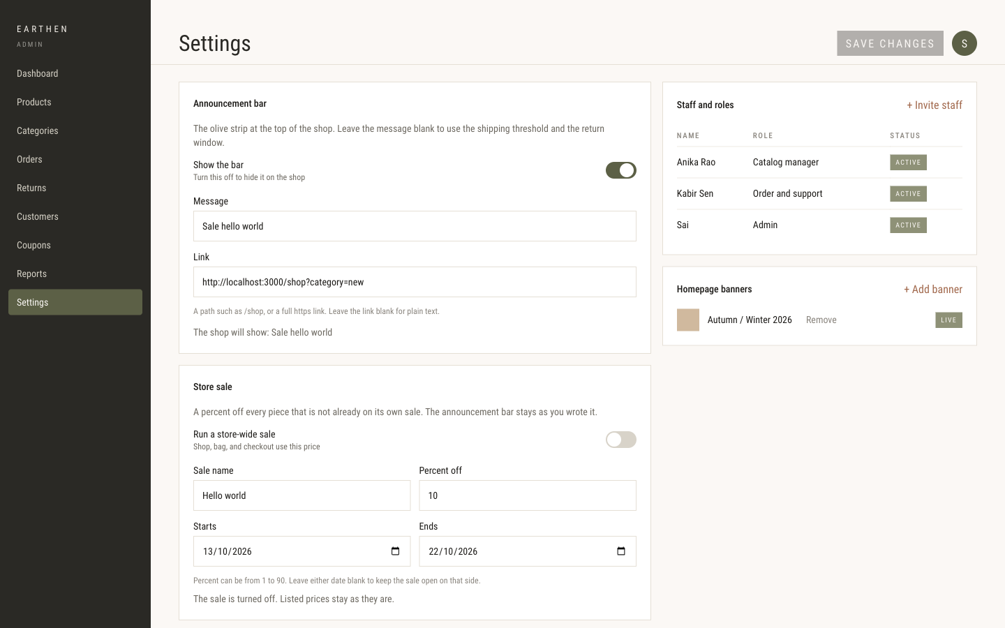
LIVE
The studio
What the owner can change
The announcement, staff, and the store-wide sale. Nothing reaches the shop until Save changes.
localhost:3000

Slide 31
BOTH SIDES
The letters the site sends
These go out when mail is configured.
Account
A password reset. The link expires in 30 minutes.
Back in stock
A note that the request was kept, then a second letter when that colour and size returns, with a link to the piece.
The order
Confirmed, packed, shipped, out for delivery, delivered, and cancelled.
The return
Requested, approved, exchange approved, declined, and returned.
EARTHEN
16 / 16

Slide 32
THE WALK
One customer.
Then one owner.
Show the shop from the homepage to a placed order.
Sign out. Open the studio, and show that same order moving.
Earthen

Slide 33
FOR US · SKIP THIS SLIDE IN THE ROOM
Say these if they come up
Sign-in
Email and password. A one-time code is not part of this build.
Messages
The customer can choose SMS or WhatsApp. The letters that go out today are email.
Contact and the list
Both confirm on the page. They do not yet send to the studio or store the address.
Payment
UPI, cards, and net banking need Razorpay. Without it, the page says no payment is taken. Cash on delivery still places an order.
Two settings
Allow exchanges is saved, and the return form still offers both. Homepage banners are a staff list. The live homepage uses the words and the pictures.

