Slide 1

UBER Simulation
Group 4
Darpankumar Jiyani - 017536623
Sai Prasad Thalluri - 017512781
Manjot Singh - 017557462
Saqib Chowdhury - 017514978

Slide 2
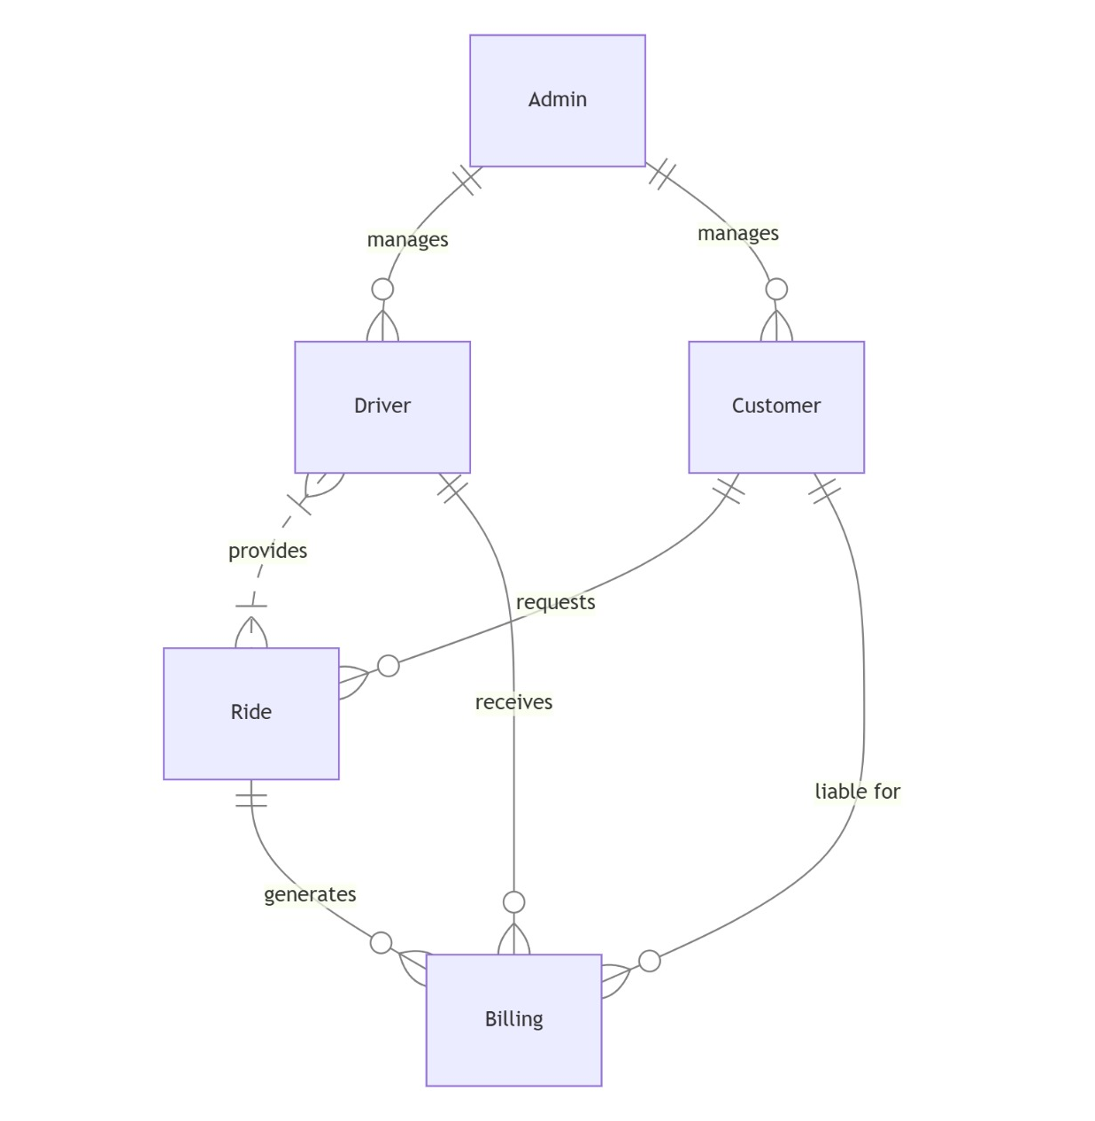
Database Schema

Slide 3
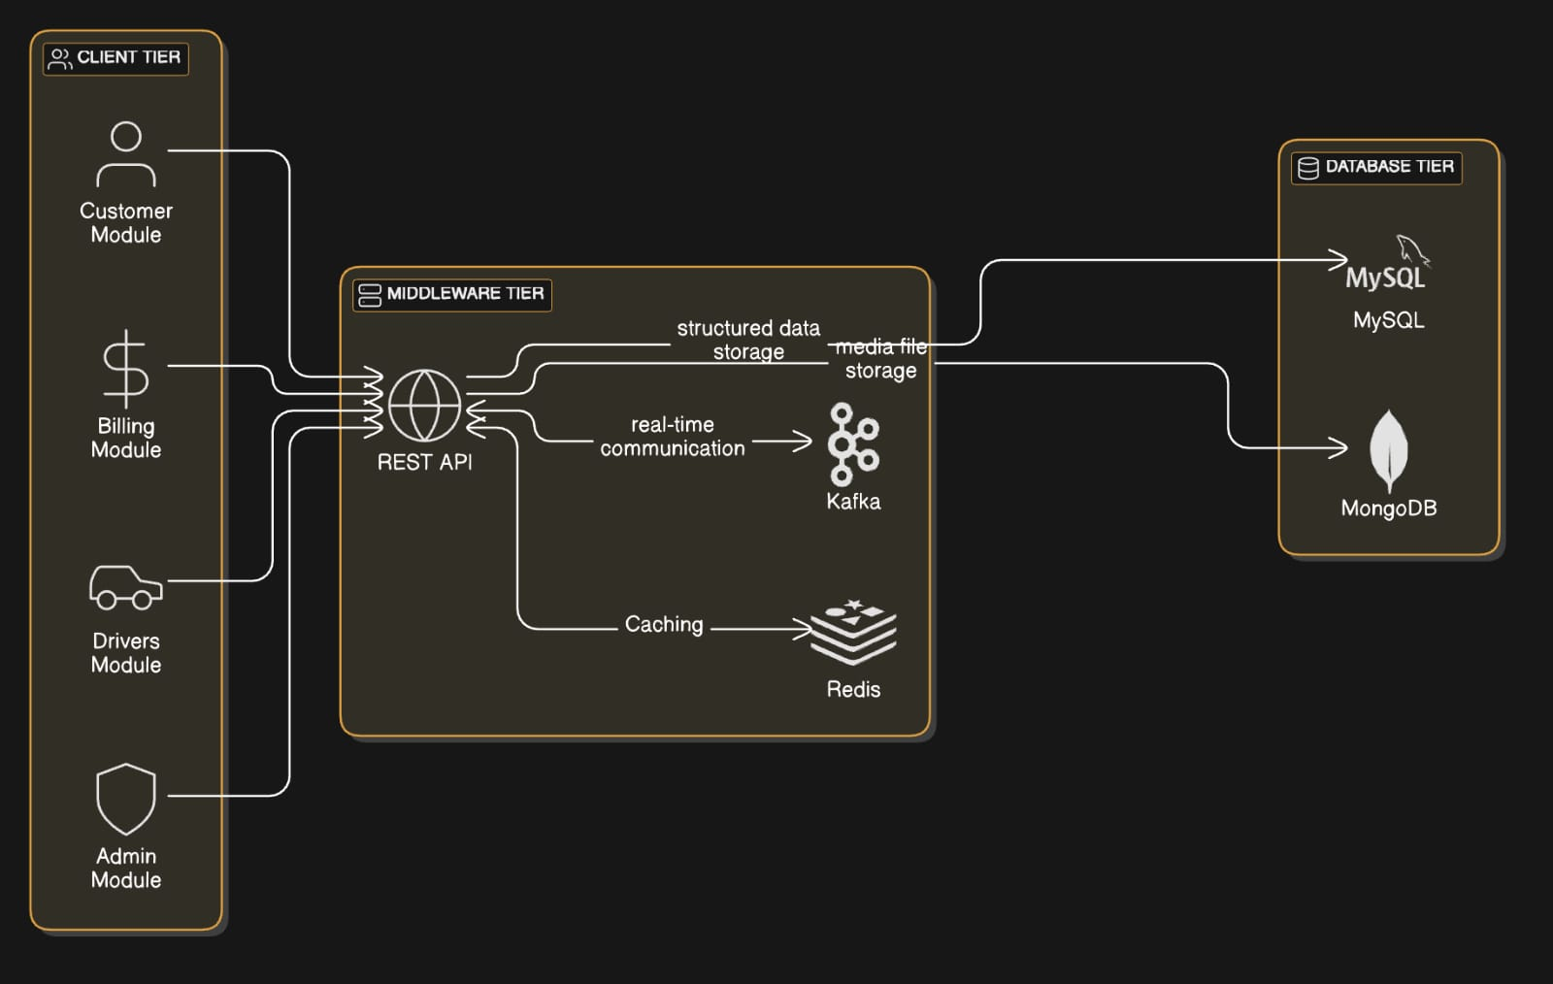
System Architecture Design Diagram

Slide 4
Dynamic Pricing Algorithm
Models Evaluated:
Linear Regression: Used as a baseline; performed poorly due to inability to capture non-linear relationships.
Random Forest Regressor: Best model with lowest MSE (31.87) and highest R² (0.7002); effectively handles non-linear dependencies and outliers.
XGBoost: Runner-up with MSE (33.23) and R² (0.6841); faster and scalable, ideal for large datasets.
Gradient Boosting: Good performance but slightly lower accuracy (MSE: 36.38, R²: 0.6578).
Decision Tree: Moderate performance (MSE: 49.47, R²: 0.5348); prone to overfitting.

Slide 5

Why Random Forest?
It gives accurate and reliable predictions.
It works well with complex, non-linear data.
It avoids overfitting by combining multiple decision trees.
It is robust to outliers and missing data.
It helps in understanding which factors affect pricing the most.

Slide 6
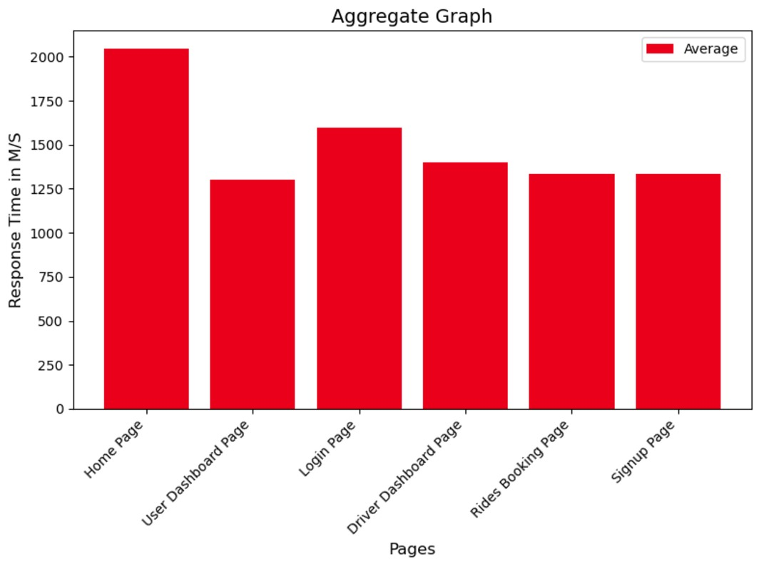
Scalability/Performance
The above Aggregate graph shows average response time for each page/endpoint in milli seconds

Slide 7
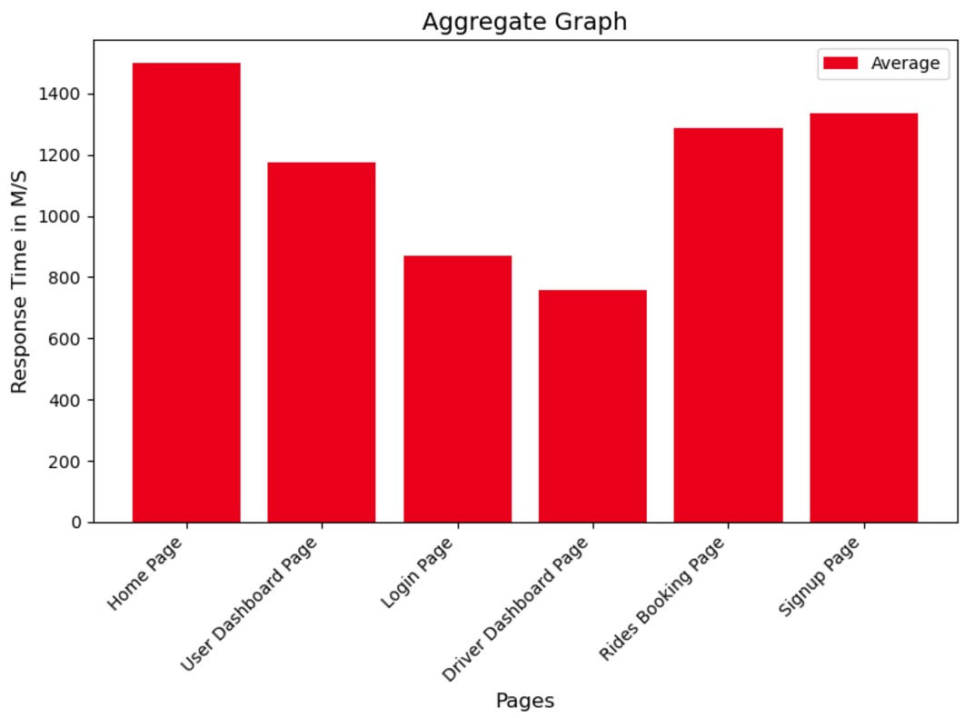
For SQL Caching Redis was used as a Distributed Cache: Redis can improve latencies by serving reads from the cache rather than querying the database for every request.

Slide 8
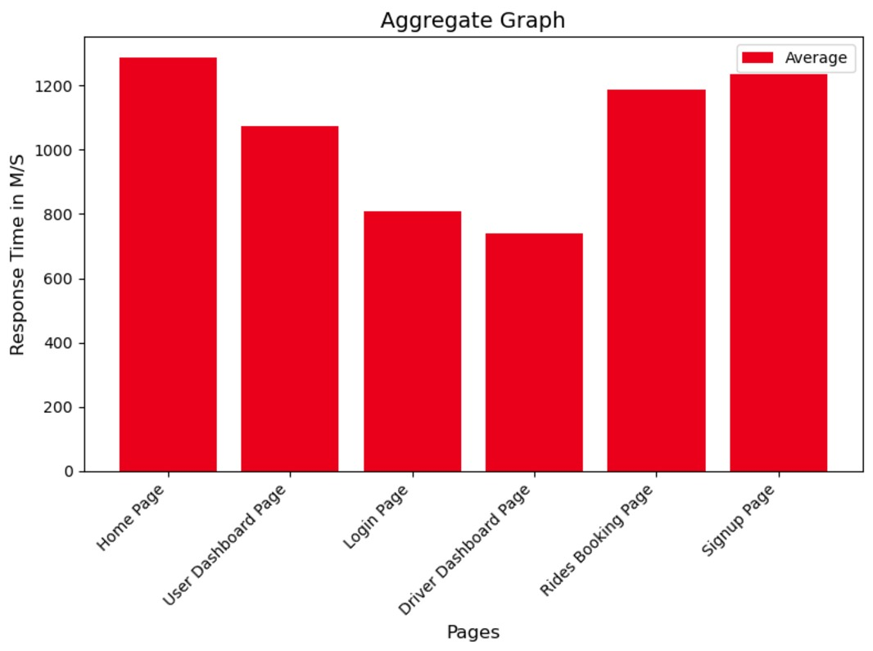
Kafka reduces response time by enabling asynchronous task handling. It ensures that user-facing APIs remain fast and responsive, even under heavy workloads, by offloading non-critical tasks and efficiently managing background processes.

Slide 9

Thank You!

