Slide 1
House Price Analysis and Feature Exploration
Ames Housing · California Housing · King County House Sales
EDA Assignment 2
Notes:
Introduce the three datasets and the goal: understand what drives house prices and how well it can be predicted.

Slide 2
Price is predictable – and location decides how
Ames
King County
California
0.96
0.91
0.85
test R² · Ridge (alpha=10)
test R² · Gradient Boosting
test R² · Gradient Boosting
Quality & size drive price
Latitude is the #1 feature
Income + coordinates lead
Notes:
Best model per dataset on a held-out 20% test set, scored in dollars.

Slide 3
Three datasets, cleaned with care
Dataset | Rows | Columns | Key cleaning steps
Ames | 2,930 → 2,925 | 82 → 92 | ‘NA’ means feature absent → ‘None’; Lot Frontage by neighbourhood; 5 outliers above 4,000 sq ft removed
King County | 21,613 → 21,603 | 21 → 30 | 33-bedroom typo fixed; 10 zero-bathroom rows removed; dates parsed, zipcode as text
California | 20,640 → 20,561 | 10 → 18 | 207 missing bedroom counts imputed; $500k cap flagged; 79 implausible blocks removed
Engineered features: house_age · total_sf · total_bath · price_per_sqft · rooms_per_household · log(price)
Notes:
Decisions follow the meaning of each field – e.g. NA in Pool QC means no pool, not missing information.

Slide 4
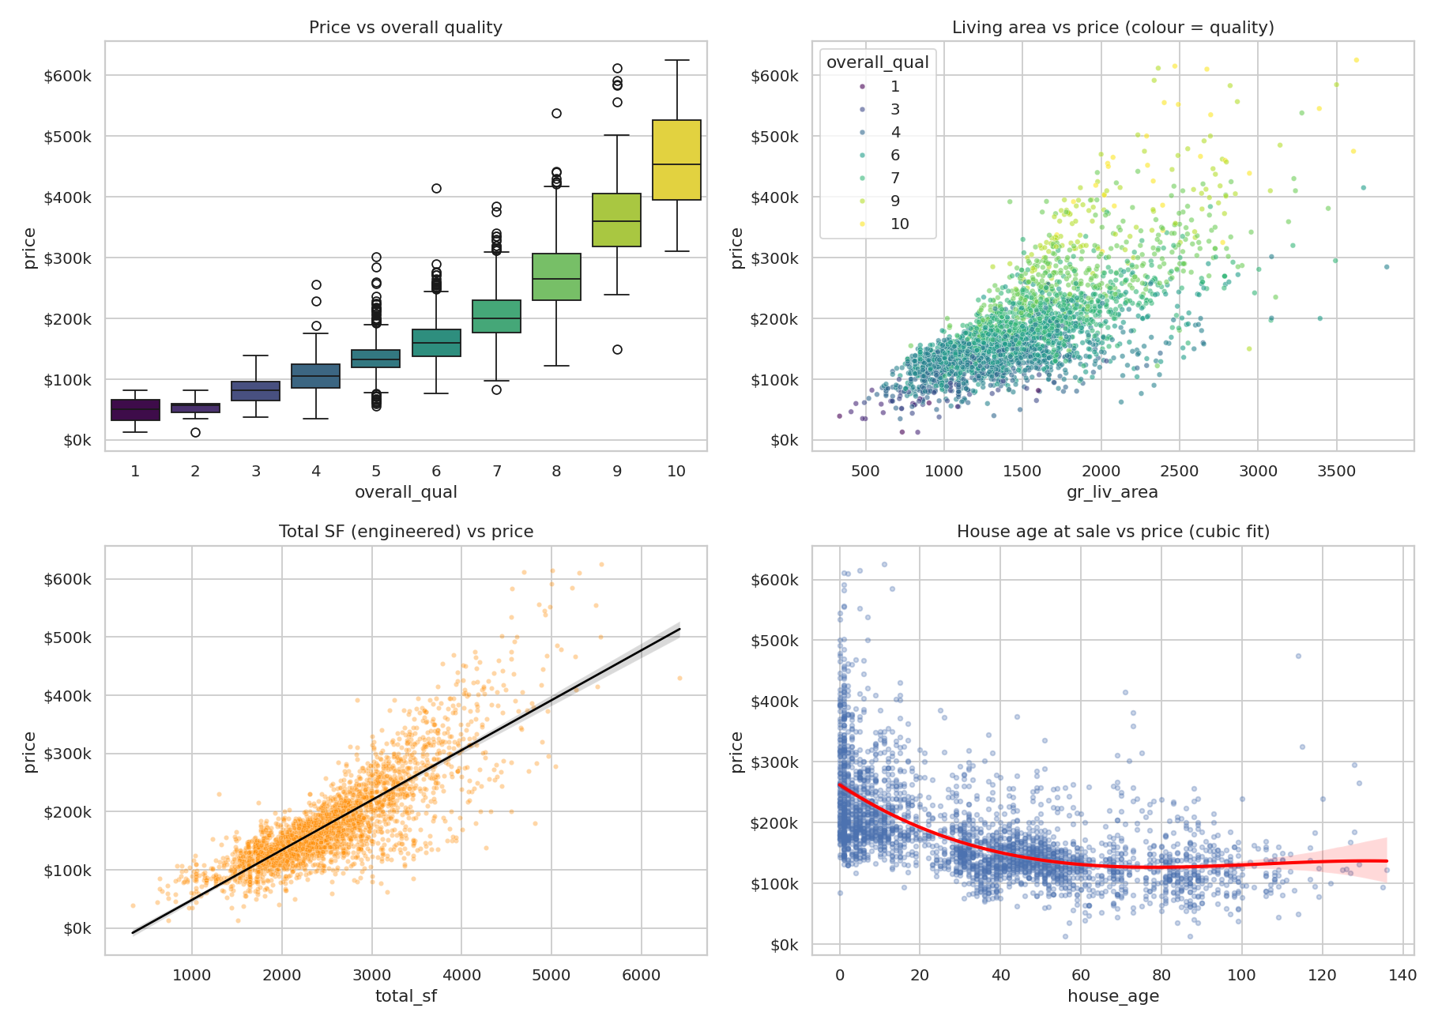
Ames: build quality and size set the price
Overall quality: r = 0.81 with price
Log transform removes the skew (1.59 → −0.04)
StoneBr, NridgHt, NoRidge are the priciest areas (~$300–320k median)
Newer homes sell for more
Notes:
Full set of 11 charts is in the report and charts folder.

Slide 5
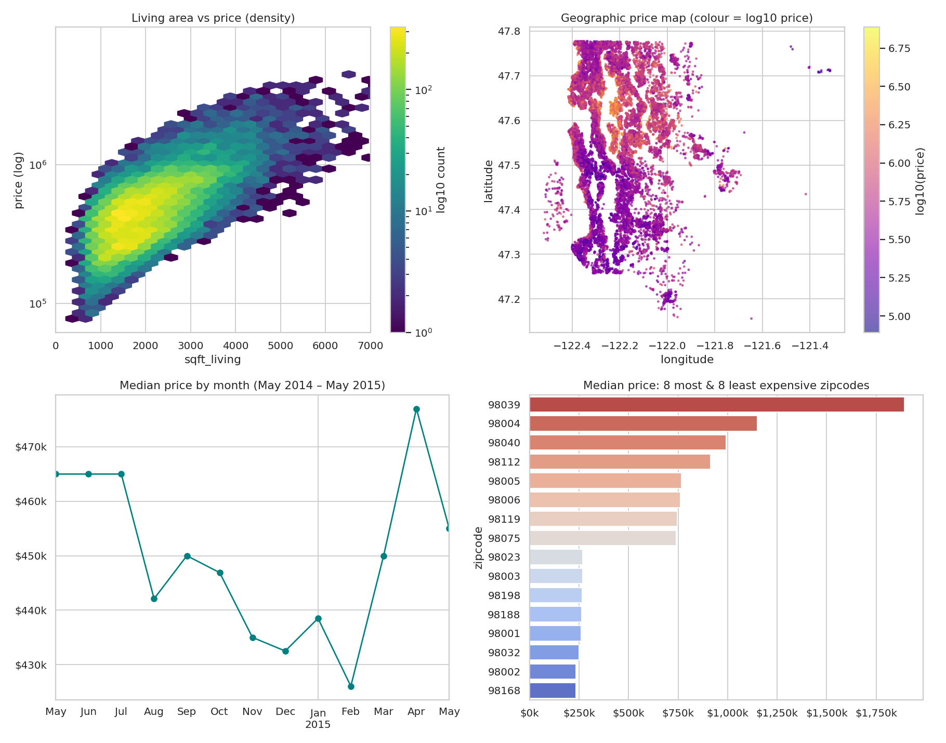
King County: where the house is matters most
Living area r = 0.70, grade r = 0.67
Waterfront median ≈ 3.1× other homes
Seattle–Bellevue and lakefront are the hot zones
Zipcode 98039: median above $1.8M
Notes:
Full set of 11 charts is in the report and charts folder.

Slide 6
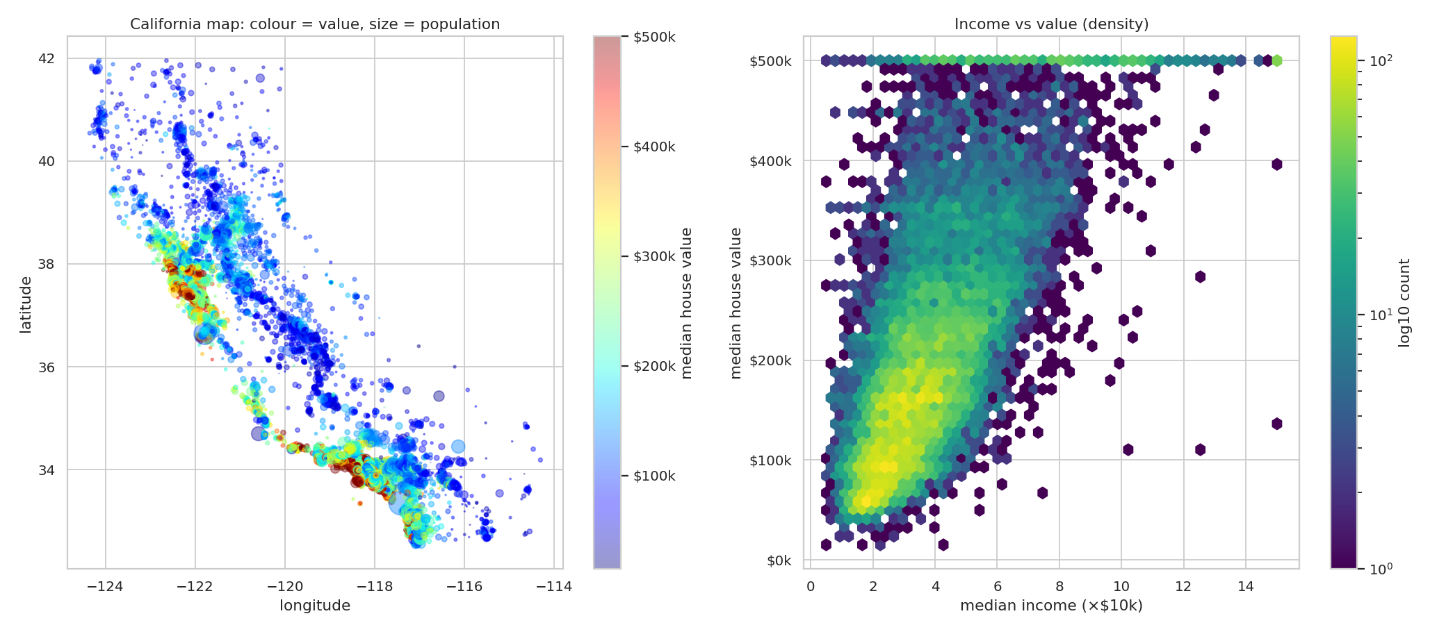
California: income and coast drive value
Median income: r = 0.69 with value
Inland median ≈ $108k vs $215–234k near coast or bay
Pile-up at $500k is a data cap – flagged, not removed
Coastal Bay Area and Los Angeles blocks carry the highest values
Notes:
Full set of 11 charts is in the report and charts folder.

Slide 7
Tree boosting wins where geography matters
Ames: Ridge best (0.96) – small, well-engineered data suits linear models
King County: boosting 0.91 vs 0.70 for linear
California: boosting 0.85 vs 0.57 for linear
Split 80/20, 3-fold CV, log target
Notes:
Non-linear location effects explain the large gap between linear and boosted models in the two geographic datasets.

Slide 8
What the best models rely on
Permutation importance: drop in test R² when a feature is shuffled
Notes:
Latitude alone carries more predictive power in King County than any other feature.

Slide 9
Conclusions and next steps
1
Quality and size matter everywhere; location decides in King County and California
Next steps
Tune hyper-parameters
Add distance-to-coast / downtown features
Model capped targets explicitly
2
Cleaning choices matter: ‘NA’ as absent, flagged caps, fixed typos
3
Log target + engineered features improved every dataset
Notes:
Limitations: different places and years, California is block-group data with a price cap, King County ends May 2015.

