Slide 1

TASK ON
Code Refactoring and Bug Fixing

Slide 2
Above Me
This is Basava.Sai Prasanna
I did complete Bachelor of computer science
Github : Internship/Task-4 at main · saiprasannabasava/Internship (github.com)
Linkdin : https://www.linkedin.com/in/sai-prasanna-basava/

Slide 3
Scenario:
A team of enthusiastic data scientists embarked on a mission to develop on a Note Taking Application using Python. Flask and
HTML. However, Their lack of experience in backend development has led to challenges in making the application fully functional.
Recognizing your proficiency in backend development ,You have been tasked with fixing the broken code and ensuring the application
works seamlessly.
Task:
Refactor the existing codebase and ensure the proper functioning of the Note Taking Application . Document all identified bugs
during the debugging process .Remember, the task is not about recreating the app from scratch. Your goal is to fix the already
existing codebase and make the application work as intended

Slide 4
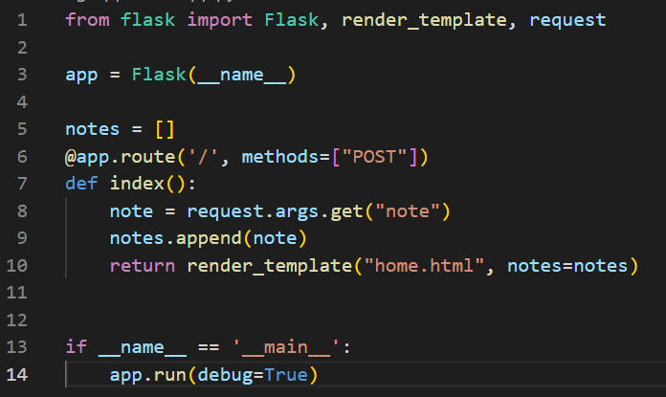
Bug Finding in Application Server
Method is set to be “POST” only. “POST” method used to write data using request. But we also require to Read data from server using request.
Here Data is not transfer using URL. Data is Transfer using HTML Form element.
1
2

Slide 5
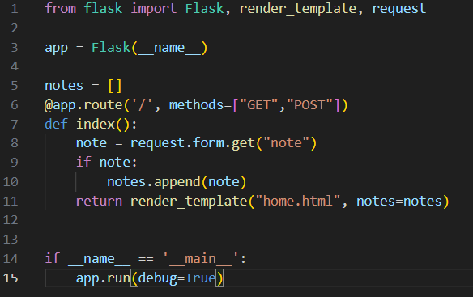
Bug Fixing in Application Server
To add “GET” also in method parameter of route in Python Flask Application Server.
To read data from HTML Form element. Get note using request.form.get(“note”).
If we receive any empty data means it also add with existing Notes. In order to avoid empty data we have to check for notes if it is not empty then add to our database.

Slide 6
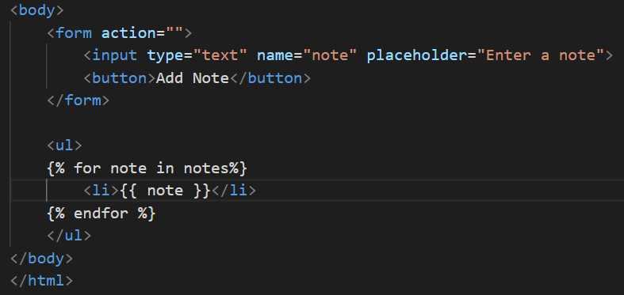

Bug Finding in HTML
2
In Form Element Method is missing.
In Button tag type parameter is missing

Slide 7
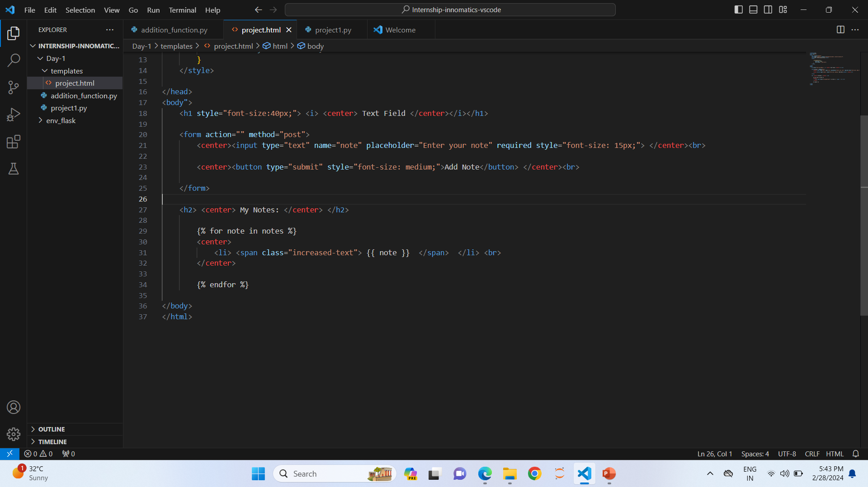
Bug Fixing in HTML
Fill method=“post” in the form element.
Fill type=“submit” in button tag.
If our notes database header is My Notes
The total allignments are in center.

Slide 8
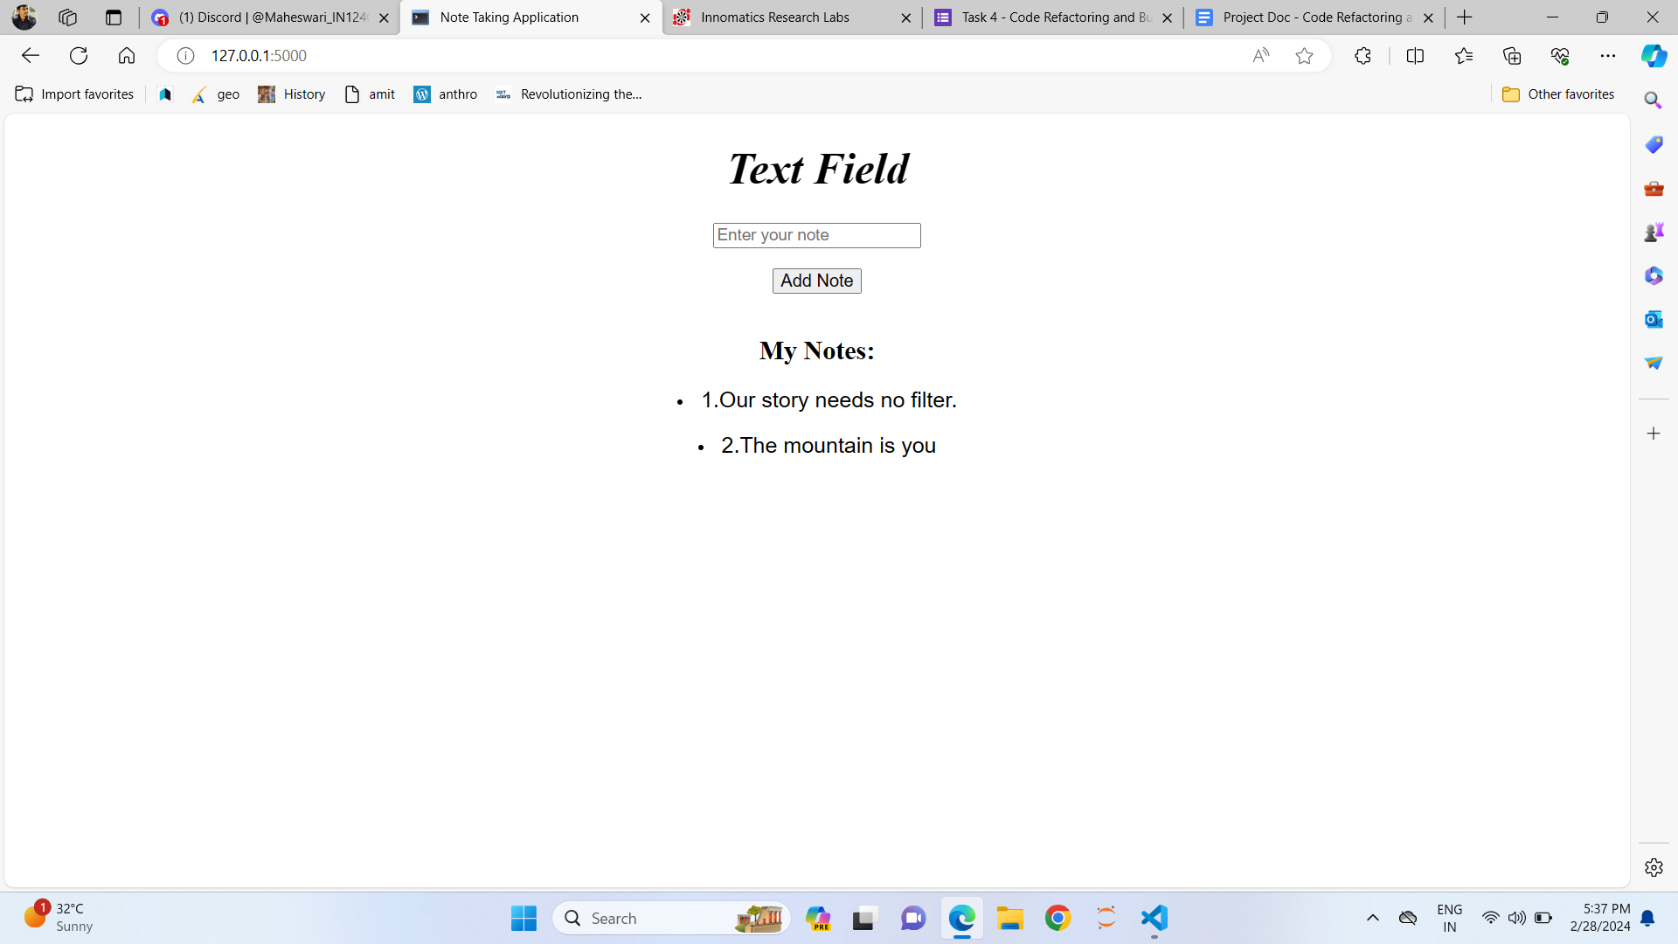
Final Output after Fixing

Slide 9

THANK YOU

