Slide 1

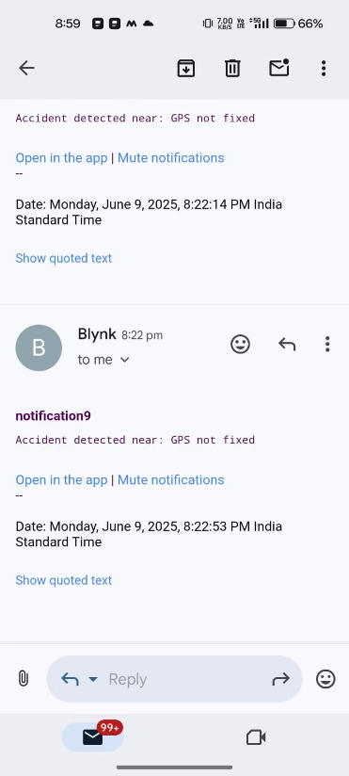
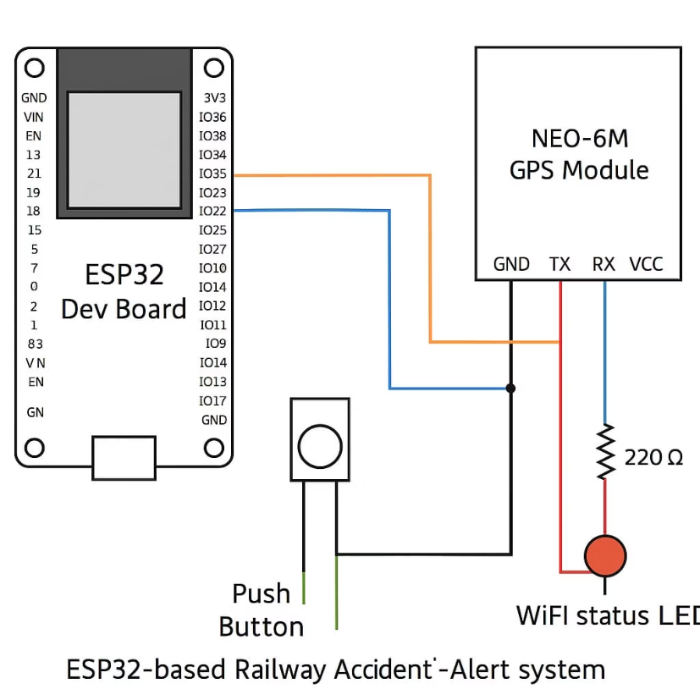
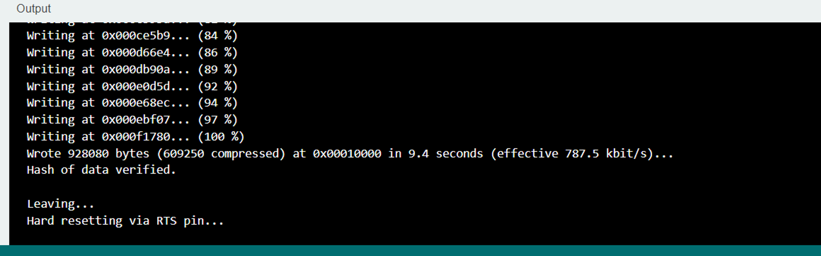

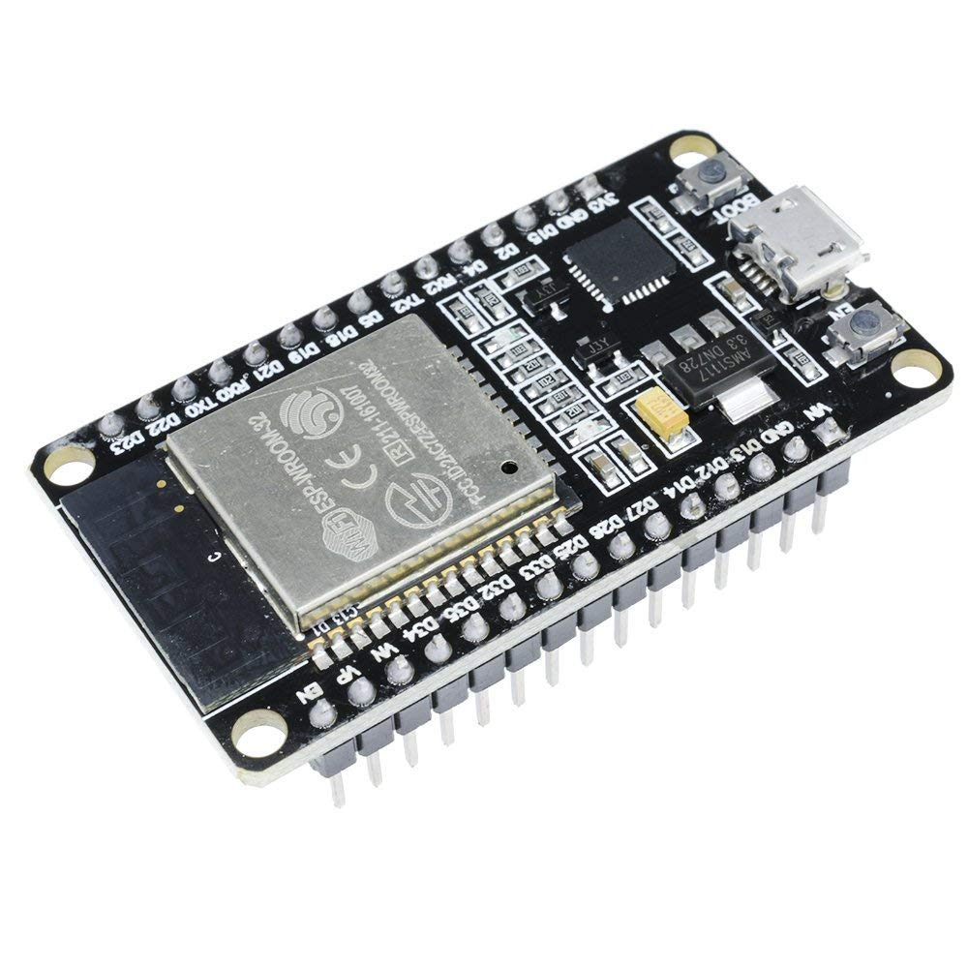
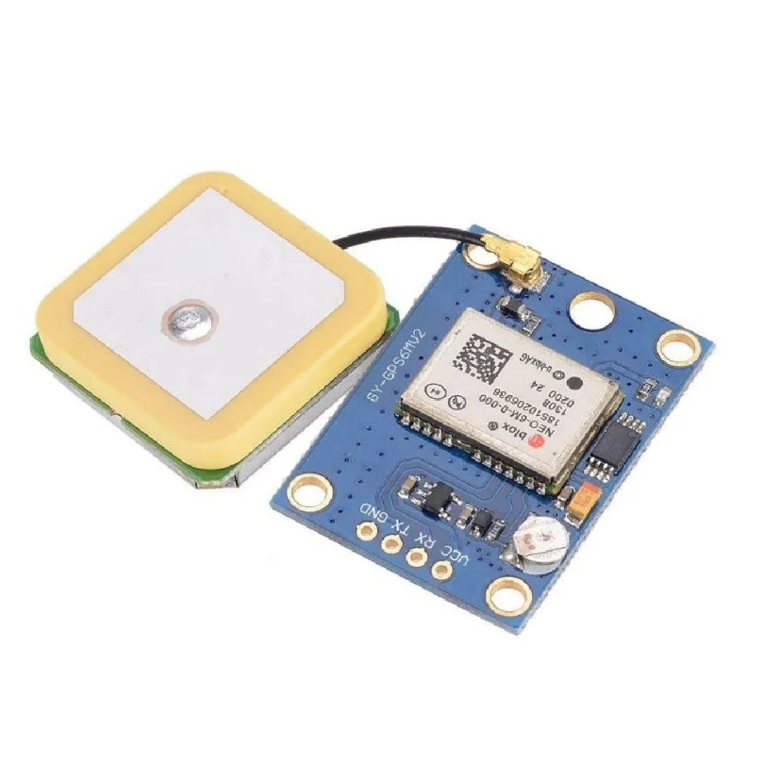
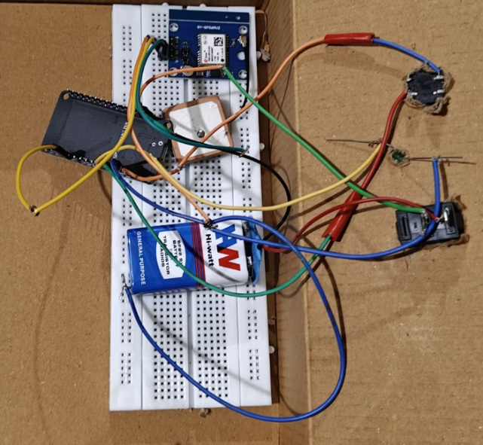
SUMMER INTRNSHIP
on
AIoT AND IT’S APPLICATIONS
Real-Time Emergency Alert for Passenger Medical Assistance in Trains
P. Kaveri , M. Hindu , P. Sai Prasanna , S. Dhanush
# Department of Computer science and Engineering,
Email:polepakakaveri402@gmail.com,hindureddy269@gmail.com,saiprasannapidugu27@gamil.com,dhanush.surasi@gamil.com
Abstract
Medical emergencies during train journeys often face delayed responses due to lack of real-time communication and location tracking. This project aims to solve the problem using an IoT and GPS-enabled alert system that identifies emergencies through sensor data or a panic button. The system then transmits real-time alerts with train location and passenger identity to railway staff and emergency responders. if functions offline and reliably, even in areas with poor mobile connectivity.
Problems Identified :
Lack of real-time health monitoring during train travel
Delayed response due to manual reporting
No GPS-linked passenger emergency system
Poor communication in remote rail areas Inaccurate passenger identification
False alarms and misclassification of emergencies.
Objectives :
Continuous real-time health monitoring using wearable sensors
Detect and classify medical emergencies accurately
Instant alert generation with passenger ID and GPS location
Ensure reliable communication even in no-signal zones
Protect data privacy with secure handling and dashboard access
Result
Notification
Objective Test Results
.
Conclusion
Successfully developed a Real-Time Emergency Alert System that detects and classifies medical emergencies in trains and sends instant alerts with passenger info and location. The system improves response time, operates offline, and uses a secure, real-time dashboard for monitoring. It enhances safety, saves lives, and provides better travel experience for passengers.
Push Button
Hardware Components
Esp32 GPS module
Acknowledgement
This work was supported by Professor T. Kishore Kumar Professor at T. Kishore Kumar, Professor at ECE Dept , NITW.
References
ESP32 Technical Reference Manual – Espressif Systems
Tiny GPS++ Library Documentation
Arduino Official Documentation – www.arduino.cc
NRF24L01 Datasheet – Nordic Semiconductor
Indian Railways Annual Safety Report, 2021
Kumar A. et al., “IoT-Based Real-Time Emergency Alert System for Elderly,” IJCSIT, 2020
https://randomnerdtutorials.com – ESP32 GPS Tutorials
https://www.w3schools.com – HTML/Python GUI references
.
Order online at https://www.postersession.com/order/

