Slide 1

National institute of technology Warangal
Real-Time Emergency Alert for Passenger Medical Assistance in Trains
Presentation by
M.Hindu(SRU 3rd yr)
S.Dhanush(SRU 3rd yr)
P.Kaveri(GCET 3rd yr)
P.Sai Prasanna(GLWEC 3rd yr)
Under the Gudience of
Prof.T.Kishore Kumar,Dept of ECE

Slide 2
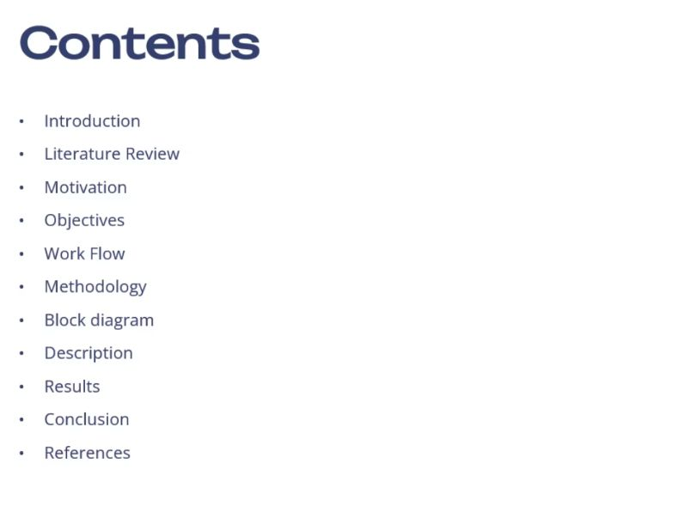

Slide 3

Real-Time Emergency Alert for Passenger Medical Assistance in Trains
Introduction
Many people in India travel by train every day, but if someone gets sick or has a medical emergency during the journey, help can take a long time to arrive. There are no doctors on most trains, and train staff may not know exactly where or how to get help quickly.
This project, called “Real-Time Emergency Alert System for Passenger Medical Assistance in Trains with Location,” is designed to solve this problem. It uses sensors or a panic button to detect if a passenger is having a health issue. It then sends an alert with the train’s real-time location to the nearby railway staff, doctors, or control room.
The system helps save time and gives passengers the medical help they need faster. It uses GPS, small electronic devices (IoT), and a web app to track and share emergency information quickly and clearly..

Slide 4
Problem Statement
During long train journeys, passengers may face sudden medical emergencies such as heart attacks, unconsciousness, or breathing issues. However, the absence of immediate medical attention, delayed communication with staff, and lack of real-time monitoring can result in severe consequences or even fatalities. Traditional systems rely heavily on manual reporting and lack smart health tracking. Therefore, there is a critical need for a real-time, automated system that can detect medical emergencies, alert medical personnel, and provide instant assistance to ensure passenger safety and save lives.

Slide 5





Core System Components
Health Monitoring Sensors
Microcontroller Unit
Wireless Communication Module
It processes data from sensors and manages system operations.
These sensors continuously track vital signs and detect anomalies.
Enables seamless data transfer to relevant parties.
GPS Module
Pinpoints the exact location of the emergency within the train.

Slide 6
Literature Survey
Paper Title
IoT-Based Health Monitoring System for Emergency Medical Alert in Trains
Paper Title
IoT-Based Health Monitoring System for Emergency Medical Alert in Trains
Authors
M. R. Khan, S. Dey
Authors
M. R. Khan, S. Dey
Publication/year
2021
Publication/year
2021
Research Area/ Subtopic
IoT & Smart Health Monitoring
Research Area/ Subtopic
IoT & Smart Health Monitoring
Dataset
Sensor data from heart rate and body temperature
Dataset
Sensor data from heart rate and body temperature
Problem Defined
How to detect and alert about medical emergencies in real time on trains?
Problem Defined
How to detect and alert about medical emergencies in real time on trains?

Slide 7
Literature Survey
Paper Title
Real-Time Health Monitoring and Alert System Using IoT and Cloud
Paper Title
Real-Time Health Monitoring and Alert System Using IoT and Cloud
Authors
R. Singh, P. Verma
Authors
R. Singh, P. Verma
Publication/year
2020
Publication/year
2020
Research Area/ Subtopic
IoT & Cloud Integration in Healthcare
Research Area/ Subtopic
IoT & Cloud Integration in Healthcare
Dataset
Cloud-based real-time vitals from wearable sensors
Dataset
Cloud-based real-time vitals from wearable sensors
Problem Defined
How to send instant emergency alerts using cloud-based monitoring?
Problem Defined
How to send instant emergency alerts using cloud-based monitoring?

Slide 8
Literature Survey
Paper Title
Smart Healthcare Monitoring System Using Raspberry Pi on Trains
Paper Title
Smart Healthcare Monitoring System Using Raspberry Pi on Trains
Authors
A. A. Pawar, V. Patil
Authors
A. A. Pawar, V. Patil
Publication/year
2019
Publication/year
2019
Research Area/ Subtopic
Embedded Health Systems on Trains
Research Area/ Subtopic
Embedded Health Systems on Trains
Dataset
Live sensor input via Raspberry Pi
Dataset
Live sensor input via Raspberry Pi
Problem Defined
Can Raspberry Pi serve as a low-cost health alerting solution on moving trains?
Problem Defined
Can Raspberry Pi serve as a low-cost health alerting solution on moving trains?

Slide 9
Literature Survey
Paper Title
Emergency Alert System for Elderly Patients Using Wearable Sensors and GSM Technology
Paper Title
Emergency Alert System for Elderly Patients Using Wearable Sensors and GSM Technology
Authors
S. Agarwal, K. S. Chatterjee
Authors
S. Agarwal, K. S. Chatterjee
Publication/year
2022
Publication/year
2022
Research Area/ Subtopic
Wearable Technology & GSM Communication
Research Area/ Subtopic
Wearable Technology & GSM Communication
Dataset
Heart rate and motion sensor data from wearables
Dataset
Heart rate and motion sensor data from wearables
Problem Defined
Can GSM-enabled wearables alert family or caregivers about elderly emergencies?
Problem Defined
Can GSM-enabled wearables alert family or caregivers about elderly emergencies?

Slide 10
Issues in the literature
Systems often can’t tell what kind of emergency is happening, just that something is wrong.
Many rely on good internet or mobile signals, which are weak or missing in remote train areas.
They don’t connect emergency alerts with the train’s exact location, making help slower.
Sometimes, sensors cause false alarms because of normal movements.
It’s hard to know which passenger needs help in shared coaches.

Slide 11
Motivation
Passengers on trains can have sudden health problems that need quick help.
Current systems don’t track health signs all the time or tell exactly what emergency it is.
Many systems rely on internet or mobile signals, which don’t always work well on trains.
It’s important to know the exact location of the train when an emergency happens.
A smart system using sensors and GPS can send fast alerts and help save lives.

Slide 12
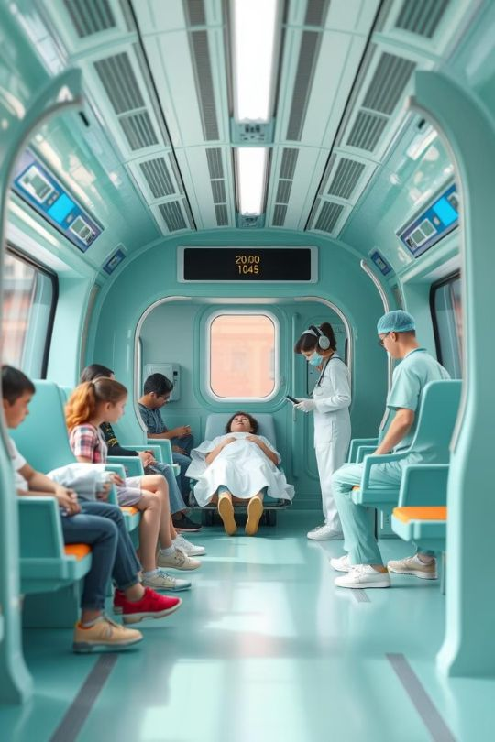





Objectives
Continuously monitor passengers’ vital signs using wearable sensors to detect any health abnormalities in real time.
Automatically classify the type and severity of medical emergencies for accurate alert generation.
Send immediate alerts to onboard medical staff and external emergency responders with relevant passenger and health data.
Integrate GPS location tracking to provide real-time train location along with the emergency alert for faster response.
Design a reliable communication system that works effectively even in low or no internet/mobile signal areas on train routes.

Slide 13








Work Flow
Emergency Button Activation
A passenger presses the emergency button when they need medical help.
Signal Sent to Processing Unit
The button sends a signal wirelessly to the onboard processing device.
Emergency Alert Triggered
The system immediately recognizes the alert and prepares to take action.
Passenger Identification
The system identifies the passenger or the coach from which the alert originated.
GPS Location Capture
The current GPS location of the train is recorded.
Alert Dispatch to Medical Staff and Emergency Services
An alert containing passenger details and location is sent to onboard medical teams and external responders.
Rapid Medical Response
Medical personnel use the alert and location info to quickly reach and assist the passenger.

Slide 14
Methodology
Emergency Button PressPassengers press an emergency button to signal a medical issue.
Alert ProcessingThe onboard system receives the signal, identifies the passenger location, and obtains the train’s GPS position.
Alert TransmissionAn automatic alert with passenger details and location is sent to medical staff and emergency responders.
Medical ResponseMedical teams use the alert information to provide quick assistance to the passenger.

Slide 15

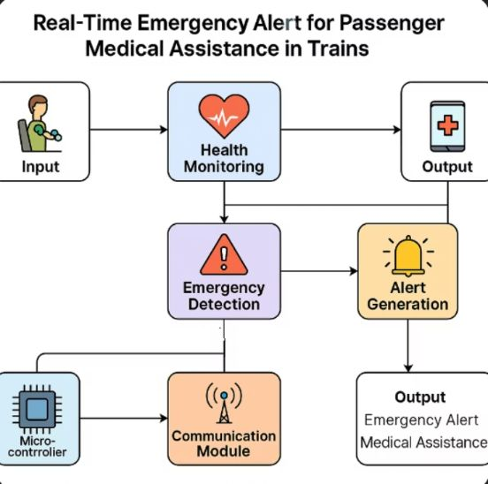
System Flow Diagram

Slide 16
Expected Output
The system instantly alerts medical staff when a passenger presses the emergency button or abnormal health data is detected, including the passenger’s ID and the train’s GPS location. It identifies the type of emergency and sends alerts reliably using multiple communication methods. False alarms are minimized through data validation, and a live dashboard helps responders monitor situations in real time. Passenger data is securely protected to ensure privacy.

Slide 17
Description
The system detects medical emergencies in real time by monitoring passenger inputs and health data, then immediately sends alerts with passenger ID and train location.
It classifies the emergency type to provide precise information and ensures reliable alert delivery using multiple communication channels, even in low-network areas.
A secure, real-time dashboard allows medical staff to monitor emergencies effectively while protecting passenger privacy through data encryption and access control.

Slide 18

Conclusion
The Real-Time Emergency Alert system significantly enhances passenger safety. It enables quick detection and response to medical emergencies onboard. Leveraging IoT and AI technologies, it reduces response time. This ensures timely medical support. Ultimately, it saves lives and improves the overall travel experience.

Slide 19
References
M. R. Khan and S. Dey, "IoT-Based Health Monitoring System for Emergency Medical Alert in Trains," International Journal of Advanced Research in Computer and Communication Engineering, vol. 10, no. 3, pp. 45–50, 2021.
S. Chatterjee and D. Bhattacharjee, "Emergency Medical Alert System Using Wearable Sensors and GSM Communication," International Journal of Engineering Research & Technology (IJERT), vol. 9, no. 6, pp. 212–216, 2020.
P. Rani and V. Kavitha, "Smart Health Monitoring System Using IoT for Railway Passengers," International Journal of Scientific & Technology Research, vol. 8, no. 11, pp. 3789–3792, 2019.
R. Jaiswal and A. Sharma, "Real-Time Train Tracking and Alert System Using GPS and GSM Technology," International Journal of Scientific Research in Engineering and Management (IJSREM), vol. 4, no. 2, pp. 102–107, 2020.
A. Patil and A. Deshmukh, "Design and Implementation of Emergency Response System in Smart Trains," in Proc. Int. Conf. on Electronics, Communication and Aerospace Technology (ICECA), pp. 154–158, 2022.

Slide 20
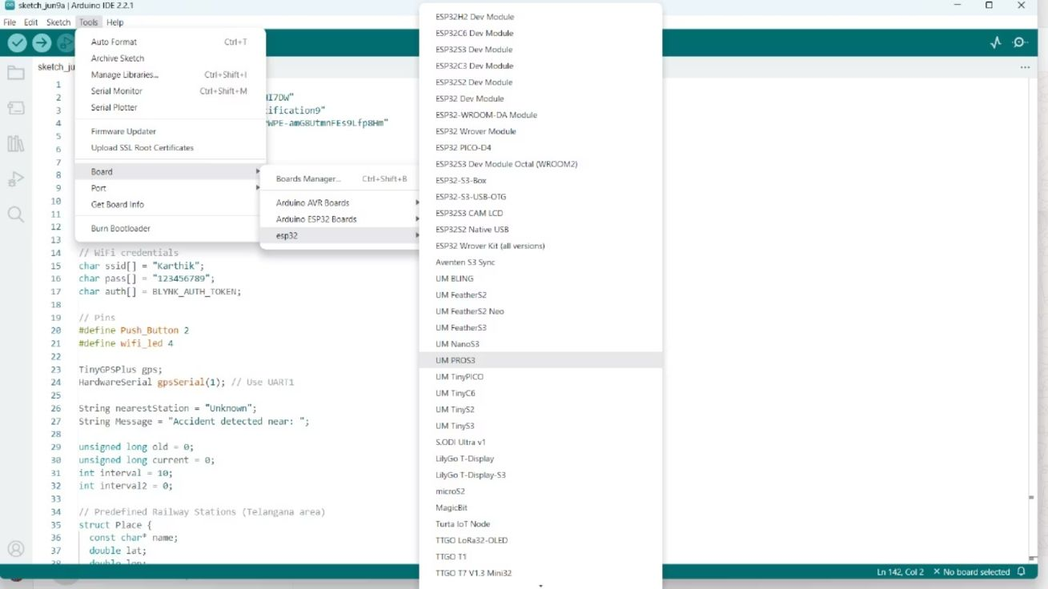
Code(main)

Slide 21
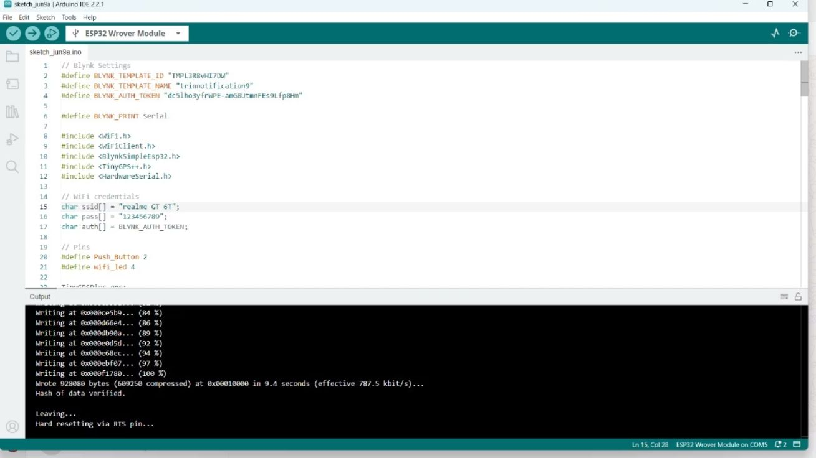
Code(Execution)

Slide 22
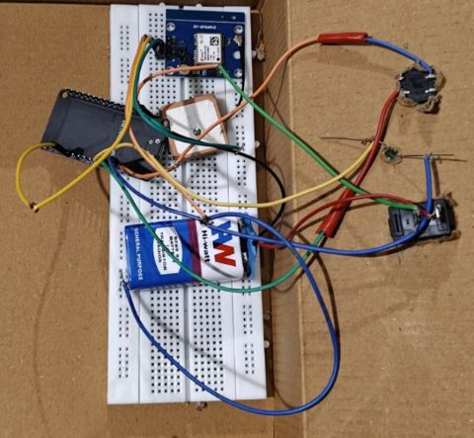
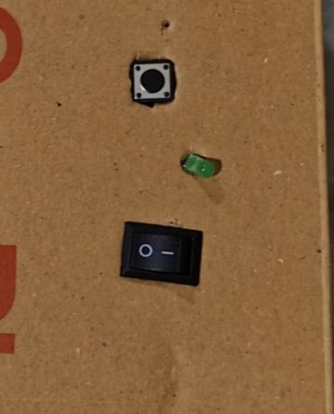
Connections

Slide 23

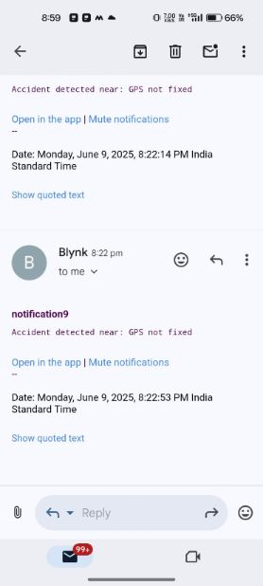
Result(Notification)

Slide 24
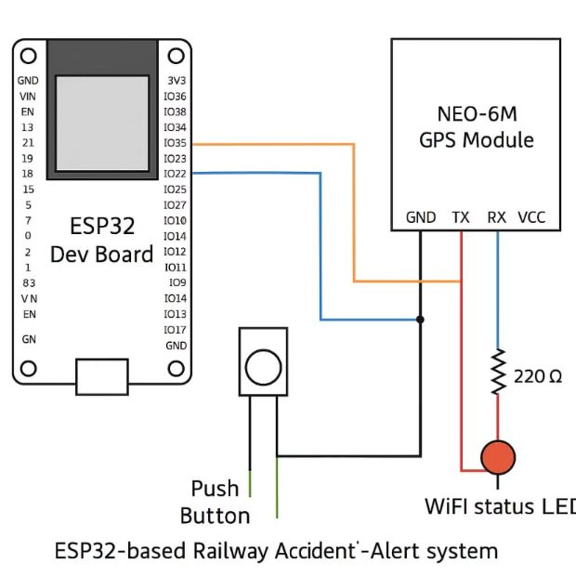
Hardware Result

Slide 25


