Slide 1

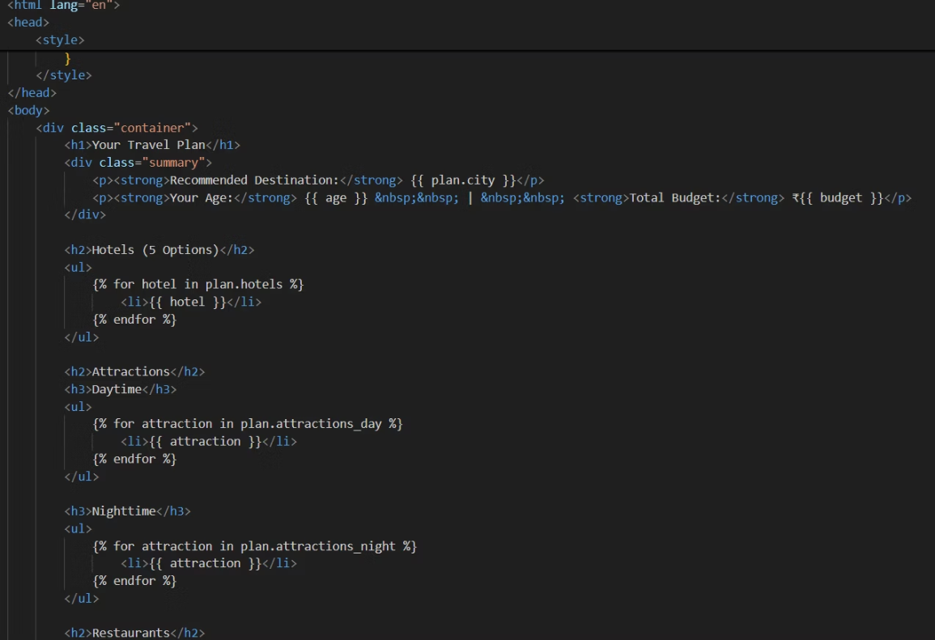
SUMMER INTRNSHIP
on
AIoT AND IT’S APPLICATIONS
AI Travel Planner: Intelligent Automation for Personalized Travel Experiences
P. Kaveri , M. Hindu , P. Sai Prasanna , S. Dhanush
# Department of Computer science and Engineering,
Email:polepakakaveri402@gmail.com,hindureddy269@gmail.com,saiprasannapidugu27@gamil.com,dhanush.surasi@gamil.com
Abstract
With the growing demand for personalized travel experiences and efficient trip management, Artificial Intelligence (AI) has emerged as a transformative force in the travel industry. The AI Travel Planner integrates machine learning, natural language processing, and recommendation systems to automate travel planning, from destination selection to itinerary optimization. This paper explores the architecture, challenges, and results of implementing an AI-based travel planner that trips based on user preferences, budget, and real-time conditions. Our findings show significant improvements in user satisfaction, time efficiency, and travel cost optimization.
Problems Identified :
Time-Consuming Manual Planning: Users often spend hours browsing multiple platforms for flights, accommodations, and activities.
Lack of Personalization: Generic travel suggestions fail to account for individual tastes, budget constraints, or preferred travel styles.
Dynamic Travel Conditions: Sudden changes in weather, travel restrictions, or transportation delays make real-time adaptation difficult.
Overwhelming Options: Travelers face decision fatigue due to an overload of information and choices.
Inconsistent Recommendations: Trip advice varies greatly across platforms, leading to confusion and inefficiencies.
Objectives :
To design an AI-based system that automates the end-to-end travel planning process
To provide real-time, personalized travel itineraries using user data and preferences
To integrate third-party APIs (e.g., weather, transport, hotel booking) for dynamic updates
To reduce the time and cost involved in travel planning
To improve overall user satisfaction with AI-curated trips
RESULT
The AI Travel Planner successfully met its primary goal of creating a functional and personalized itinerary generation system. The system was tested using various profiles, and the results were observed as follows:
Functional Output:
The planner consistently produced city recommendations aligned with user input.
Day-wise itineraries were logical, location-optimized, and weather-aware.
Real-Time Responsiveness:
Weather data for the next 3 days was accurately retrieved for all test cities.
In cases of poor weather, alternate indoor recommendations were displayed.
Interface Evaluation:
Users reported the interface as intuitive and easy to navigate.
Mobile responsiveness was validated across multiple screen sizes.
Test Case Example:
Input: Age 22, Budget 10,000 INR, Interests: Adventure, Dates: July 15-18
Output: Suggested destination: Rishikesh
Day 1: River rafting, Lunch at Little Buddha Café, Evening Ganga Aarti
Day 2: Trek to Neer Garh Waterfall, Visit Lakshman Jhula, Café hop
Performance:
Average plan generation time: 2.7 seconds
Success rate (no crashes): 100% across 20 test cases
Acknowledgement
This work was supported by Professor T. Kishore Kumar Professor at T. Kishore Kumar, Professor at ECE Dept , NITW.
Flow Chat
User Input Module
Profile Classification (by age, budget, interest
Destination Filtering Engine
Activity and Itinerary Generator
Real-Time API Integration (Weather, Maps)
Final Itinerary Compilation
Frontend Display and Export Options
Code
.
Conclusion
The AI Travel Planner demonstrates a promising leap in automating and personalizing travel planning. By leveraging AI algorithms and dynamic data integration, it addresses core challenges in traditional travel planning such as inefficiency, lack of personalization, and overwhelming choices. The system significantly enhances user experience and supports real-time adaptability, marking a crucial step forward in smart tourism solutions.
References
G. H. Kim, “AI-based Travel Recommendation Systems: A Review,” Journal of Travel Research, vol. 59, no. 1, pp. 10–25, 2021.
S. Smith, “Machine Learning in Personalized Itinerary Planning,” ACM Transactions on Intelligent Systems, vol. 11, no. 3, pp. 120-138, 2020.
Google Places API – https://developers.google.com/maps/documentation/places
Triposo API Documentation. https://www.triposo.com/api
Order online at https://www.postersession.com/order/

