Slide 1
Robust Federated Learning Models for
Intrusion Detection Systems
Sai Prasath S (17CS02002)
Dr. Padmalochan Bera

Slide 2
Overview:
Traditional IDS vs Federated Learning infrastructure
Baseline Performance of FL Models
Attacks and Defenses for FL Models

Slide 3
Overview:
Traditional IDS vs Federated Learning infrastructure
Baseline Performance of FL Models
Attacks and Defenses for FL Models

Slide 4
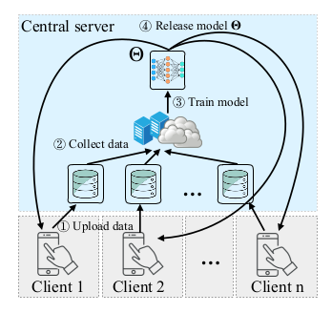
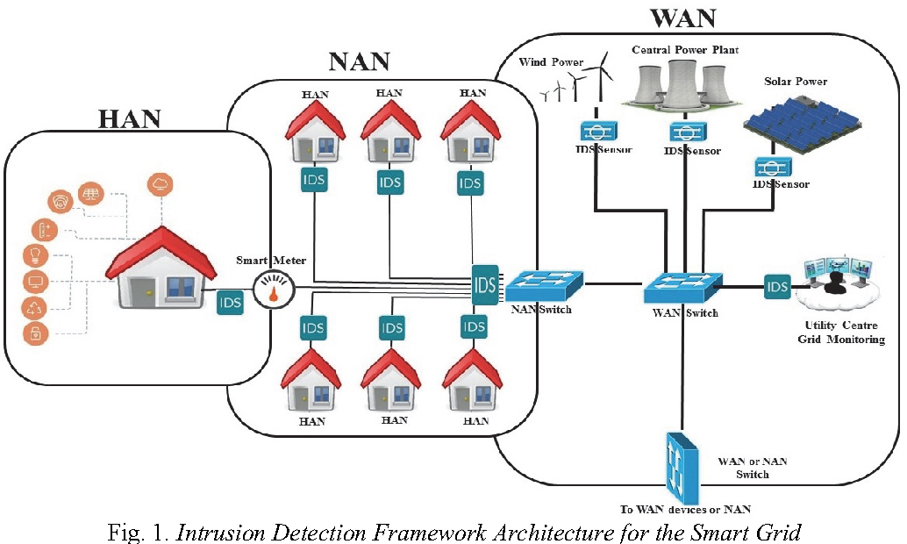
Traditional IDS Systems
Monitored and Controlled by a central server
All distributed units share their data with the central server
Data processed and analyzed at the central server

Slide 5
Drawbacks of Traditional IDS
Lack of Privacy and Security
Large storage and high computational power required
Single point of failure

Slide 6
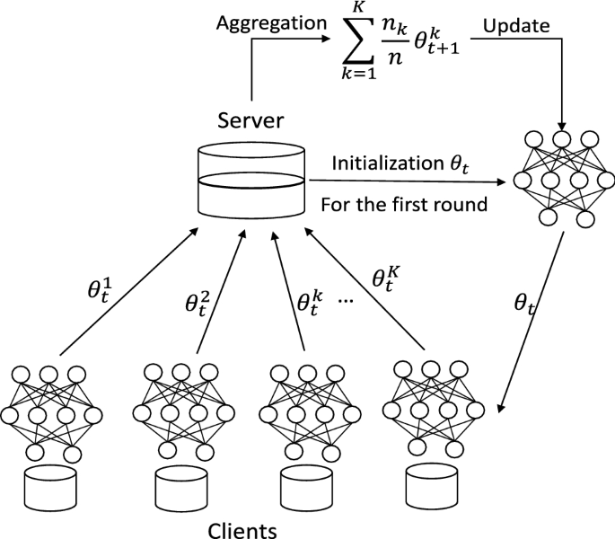
Federated Learning Models
Step 1: Server Sends Models(with random initial weights) to the users and they train the model with local data
Step 2: Users share the updated model with the server
Step 3: The Server aggregates the user models and creates a final mode
Step 4: The aggregated model is shared with the users.
Repeat Steps 1-4 till the model performance converges

Slide 7
How does FL solve this problem?
Lack of Privacy and Security
Don’t need to upload any private information to a central server
Models are shared instead of data
Large storage and high computational power required
Uses distributed training to minimize the requirements
Ex: Mobile phones can be used for training the models
Single point of failure
Due to the decentralized nature of the FL training process, different subsets of clients can be used for the update process.

Slide 8
Related Works and Our Contributions
Most research works on IDS focus on improving the accuracy and reducing the false positive rates of the models.
We focus on the privacy and security aspects of IDS models using FL.
There exist few research works on FL for IDS, but they don’t analyze the robustness of the models against various attacks and defenses.
We empirically analyze impact of various attacks on the FL model and evaluate the potential of various defenses.

Slide 9
Overview:
Traditional IDS vs Federated Learning infrastructure
Baseline Performance of FL Models
Attacks and Defenses for FL Models

Slide 10

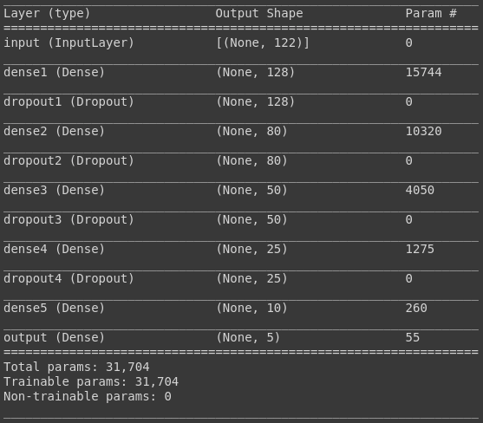
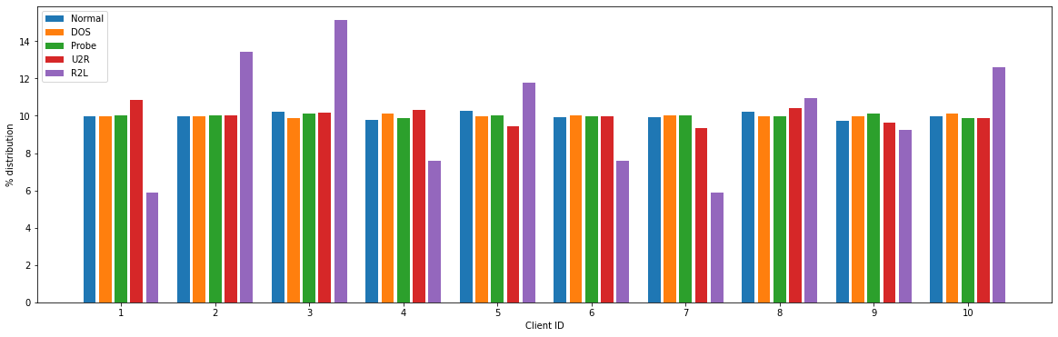
Analyzing FL on NSL KDD dataset
Neural Network Model
IID Data: The goals of the clients and the server align with each other

Slide 11
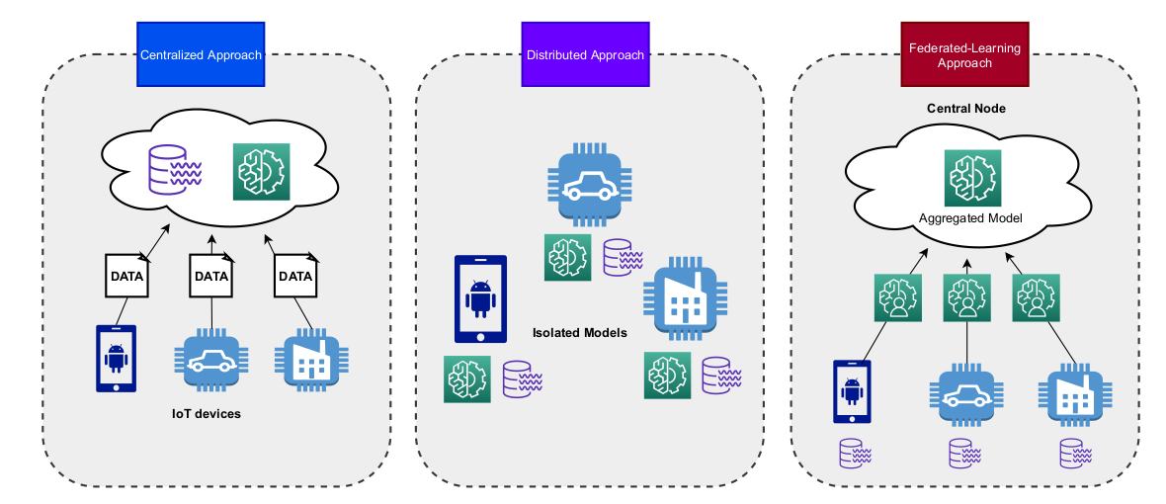
Values compared in the process
Centralized Server: Performance of traditional IDS system (Centralized training)
Local Client: Performance of a client that trained only on its local data
Federated Client: Performance of a client at the end of every local training
Federated Server: Performance of the aggregated model before the next updated round

Slide 12
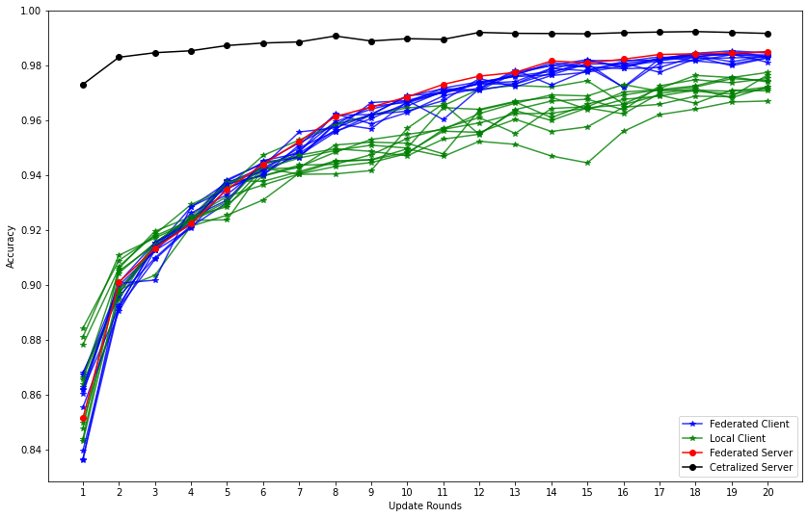
Results of FL: Overall Accuracy

Slide 13
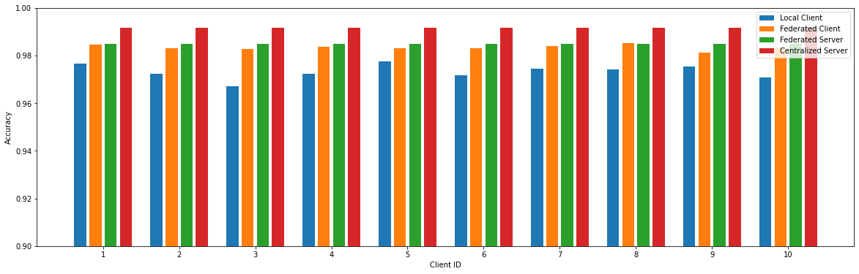
Results of FL: Final Accuracy
Central Server > Federated Server > Federated Client > Local Client

Slide 14
Overview:
Traditional IDS vs Federated Learning infrastructure
Baseline Performance of FL Models
Attacks and Defenses for FL Models

Slide 15
Attacks and Defenses for FL Models
Non IID Distribution
RL based Weight Estimation
Compromised Clients
RL based Weight Estimation
Privacy Invasion Attacks
Differential Privacy
Model Evasion Adversarial Attacks
Defensive Distillation and Adversarial Training

Slide 16
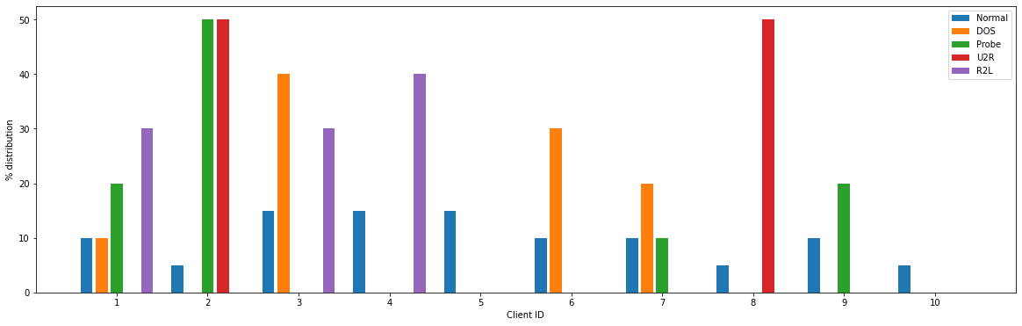
Attack 1: Non IID Distribution:
Because of the difference in distribution, clients and the server are trying to solve different problems.
Client 10: Normal
Client 6: Normal/DOS
Server: All classes

Slide 17
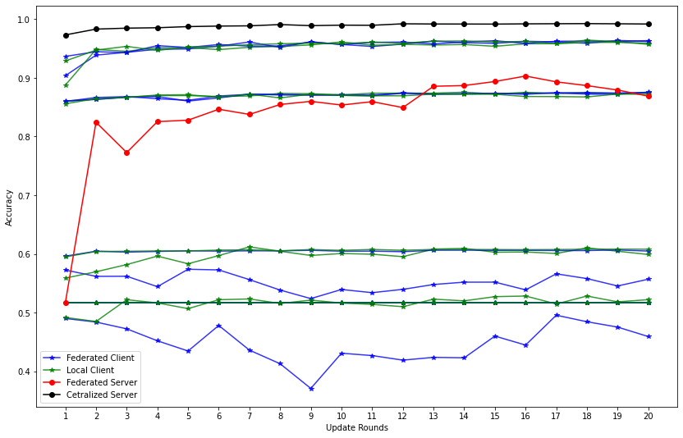
Results of Non IID:
Clients that have enough data perform well.
Clients that lack data perform worse.
Overall performance is affected(-12%) due to the difference in the data distribution between the clients as they solve different problems.
(Weight Divergence)

Slide 18
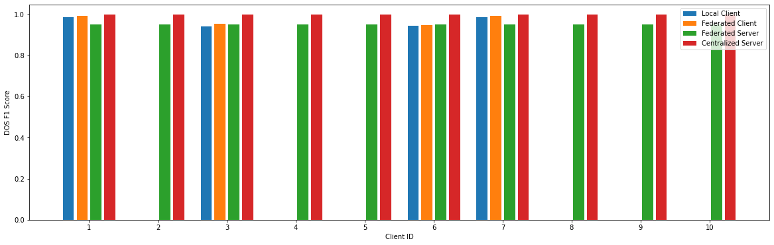
Advantages of knowledge sharing
Despite the lack of data, client models gain a lot of knowledge due to the federated learning process.
Client 2, 4, 5, 8, 9, and 10, haven’t encountered any DOS attacks, but still can detect them(day-0 setting) because of the federated learning process.

Slide 19
Adversarial attack types:
Dataset manipulation:
Label flipping: The target value of the data points are flipped so reduce the performance of the model. For example, all the attack data points are labelled as normal.
Model manipulation:
Instead of changing the dataset, the weights of the trained model can be directly manipulated.
During Aggregation: w1 + w2 + w3 + w4 + w5 + w6 + w7 + w8 - 2 * w9 - 2* w10
X1 | 0
X2 | 2
X3 | 3
X4 | 4
X1 | 0
X2 | 4
X3 | 4
X4 | 4

Slide 20
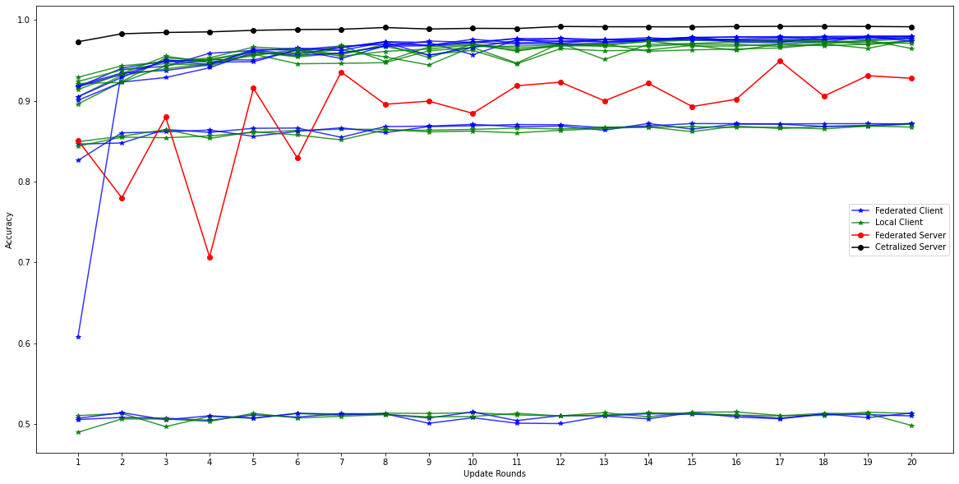
Dataset Manipulation: 20% compromised clients
Clients that are being attacked perform poorly.
Notable, few other client performance is also compromised due to the attack.
All other clients perform at high levels.
Overall model accuracy falls by 8-10%.

Slide 21
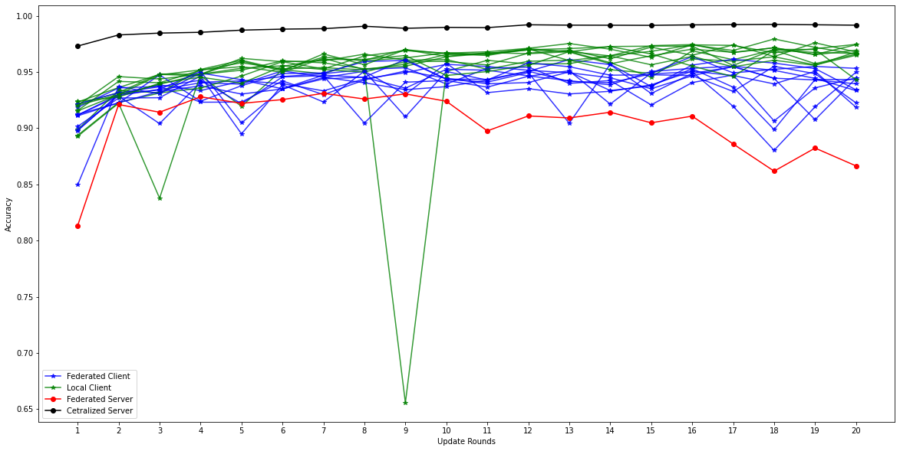
MITM: Weight Poisoning 20% Compromised Clients
Because the client accuracies are measured at the client side, the federated client accuracy remain high.
Notably, the local clients outperform federated clients due to the severe model degradation due to this attack.
Overall model performance reduces by 13-15%.

Slide 22
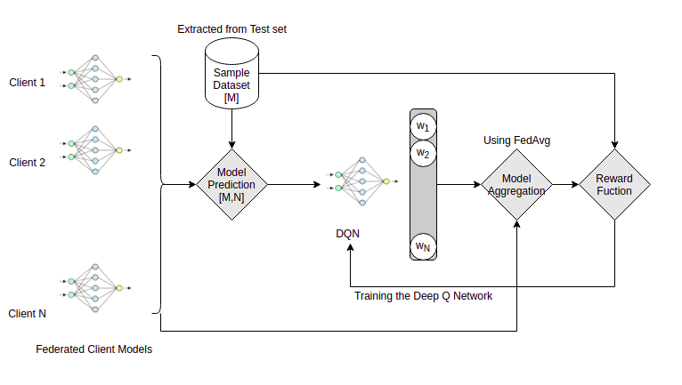
Defense 1: RL Based Weight Estimation
Server trusts the clients completely and aggregates them without any consideration.
Therefore, by looking at the client model performance, we select top-k clients for aggregation.

Slide 23
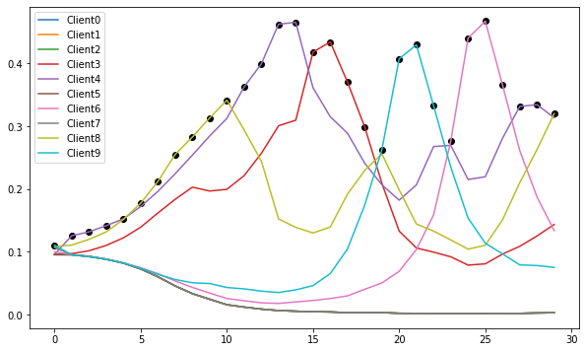
Change in model weights
By selecting high performing clients, we increase the average accuracy of the model by 5.8% from 90.23% to 96.03%.
Clients Selected:
3 ⇒ 4
4 ⇒ 10
6 ⇒ 4
8 ⇒ 7
9 ⇒ 5
Clients under attack:
{0, 1} ⇒ Data Poisoning
{2, 5} ⇒ Model Poisoning
{7} ⇒ Non IID data

Slide 24
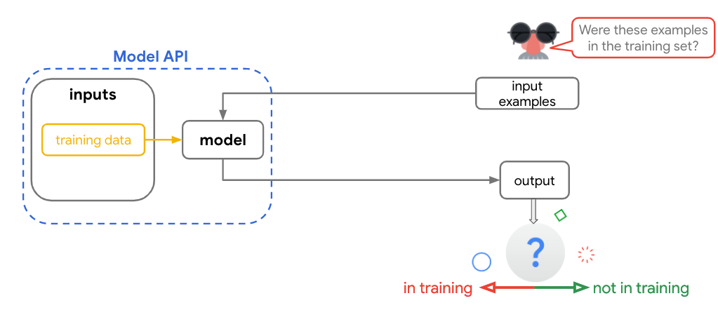
Attack 3: Privacy Invasion: Membership Inference
Local Client Modes overfit on their local training dataset, therefore their predictions for a member in the dataset is higher than a non-member.

Slide 25
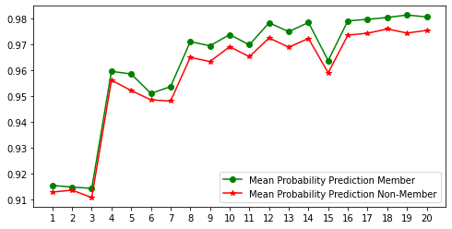
Performance of Membership Inference Attacks
78.34% of the training data of the local clients can be correctly identified by this attack.
As all the clients have a IID distribution, the overfitting allows the attacker to identify 28.34% more data points than the base case.

Slide 26
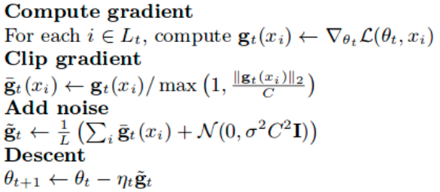
Defense 2: Differential Privacy(DP)
Forcing the model updates to forget any information regarding the training data points by modifying the gradients.
Avoids model over fitting, thereby reducing the impact of privacy invasion attacks like membership inference.

Slide 27
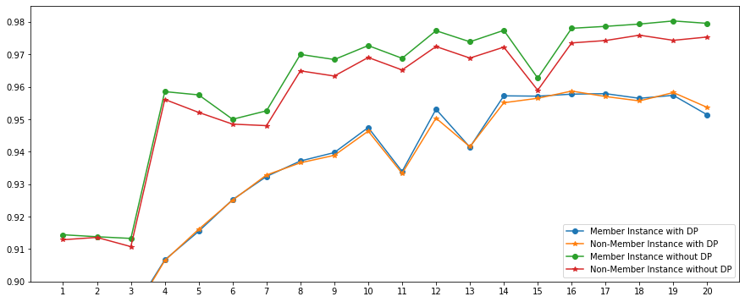
Performance of Differential Privacy
With DP, the difference between the average model prediction probability for the members and non-members is reduced significantly
⇒ Reduces the impact of membership inference attack accuracy from 78.34 to 55.53%(-22.81%)
⇒ Reduces the prediction confidence by 3-4%

Slide 28
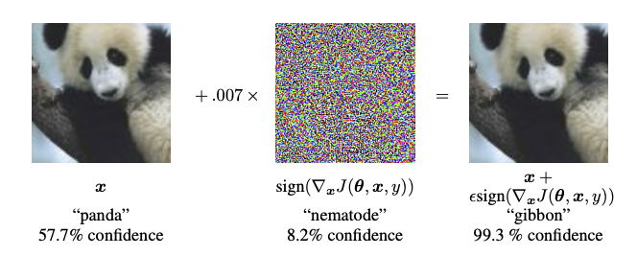
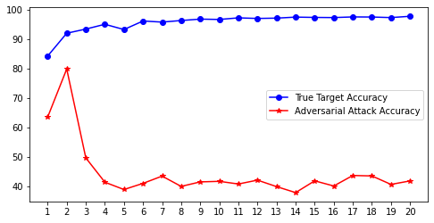
Attack 4: Model Evasion Adversarial Attacks (FGSM)
The average adversarial attack accuracy of the model = 44.58%
Only 44.58% of the generated adversarial samples are correctly classified.
Remaining 55.42% of the generated samples are misclassified by the model due to the added perturbation.

Slide 29
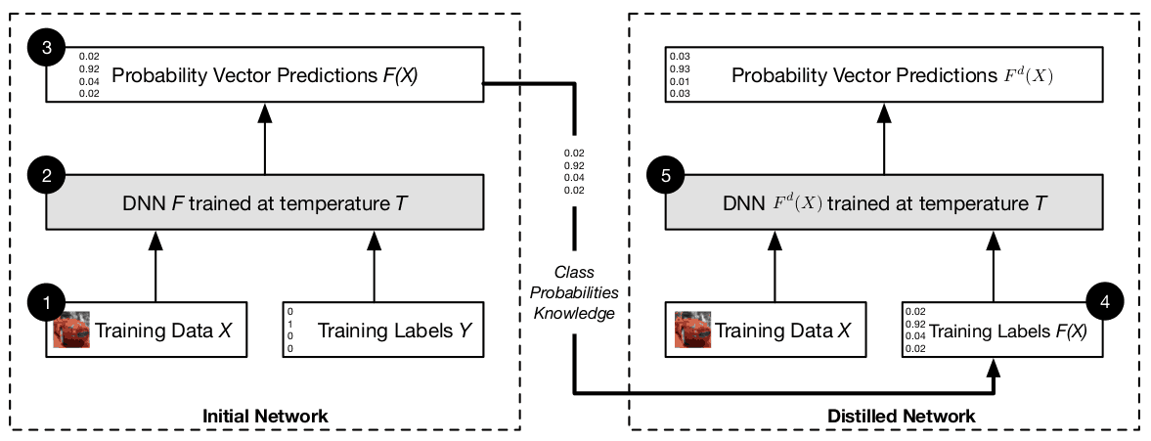
Defense 3: Defensive Distillation(DD) and Adversarial Training(AT)
Defensive Distillation:
Train the model using soft labels instead of hard labels to reduce the gradient at the boundaries.
Adversarial Training:
Generate adversarial samples by attacking the model
Label the adversarial samples with their actual class and add them to the training dataset
Retrain the model with both the true data and adversarial sample with correct labels

Slide 30
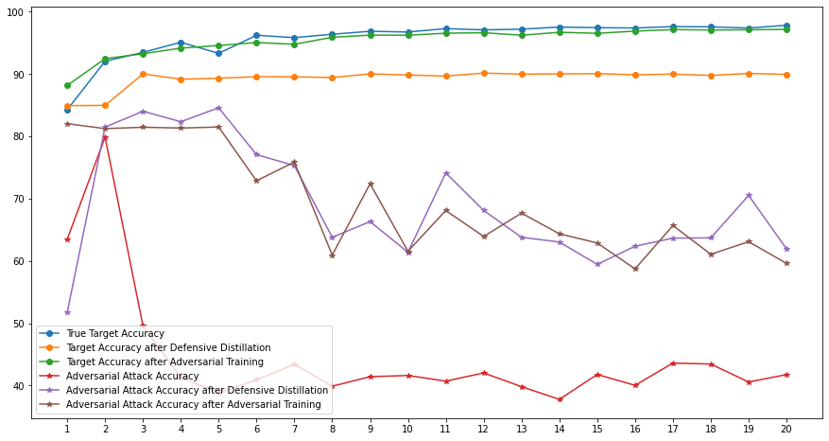
Performance of DD and AT:
Model Classification Accuracy:
True Model: 95.73%
With DD: 89.32% (-6.41%)
With AT: 95.44% (-0.29%)
Adversarial Accuracy:
True Model: 44.58%
With DD: 68.93% (+24.35%)
With AT: 69.03% (+24.45%)
Therefore, the defense techniques improves the accuracy against adversarial sample by around 24%.
However, the target accuracy of DD models reduces by 6% whereas the AT model almost remains the same.

Slide 31
In Conclusion (1),
On IID data, FL models achieve high performance without compromising client privacy and security.
On Non IID data, FL models performance degrades, but share valuable knowledge that can help other clients detect day-0 attacks.
Data and Model poisoning attacks significantly impact the performance of the FL model as the clients are blindly trusted.
Using an RL based weighting DQN, poorly performing client models can ignored and more importance can be given to the ones that perform well.

Slide 32
In Conclusion (2),
Privacy invasion attacks like membership inference, exploit the over fitting property of the FL models to attack them.
Differential Privacy, can be used to protect FL models against privacy attacks as they remove overfitting by clipping and adding noise to gradients before update.
Model evasion attacks(FGSM) can impact the deployment performance of the model by generating adversarial samples on the model boundaries.
Defensive Distillation and Adversarial Training, can protect models from evasion attacks by reducing the gradients across the boundaries but comes at the cost of model’s classification accuracy.

Slide 33


Slide 34
References(1)
[1] Dapeng Man, Fanyi Zeng, Wu Yang, Miao Yu, Jiguang Lv, and Yijing Wang. Intelligent intrusion detection based on federated learning for edge-assisted internet of things. Security and Communication Networks, 2021, 2021.
[2] Ruijie Zhao, Yue Yin, Yong Shi, and Zhi Xue. Intelligent intrusion detection based on federated learning aided long short-term memory. Physical Communication, 42:101157, 2020.
[3] Sawsan Abdul Rahman, Hanine Tout, Chamseddine Talhi, and Azzam Mourad. Internet of things intrusion detection: Centralized, on-device, or federated learning? IEEE Network, 34(6):310–317, 2020.
[4] Yue Zhao, Meng Li, Liangzhen Lai, Naveen Suda, Damon Civin, and Vikas Chandra. Federated learning with non-iid data. arXiv preprint arXiv:1806.00582, 2018.
[5]Valerian Rey, Pedro Miguel Sánchez Sánchez, Alberto Huertas Celdrán, Gérôme Bovet, and Martin Jaggi. Federated learning for malware detection in iot devices. arXiv preprint arXiv:2104.09994, 2021.
[6] Oualid Zari, Chuan Xu, and Giovanni Neglia. Efficient passive membership inference attack in federated learning. arXiv preprint arXiv:2111.00430, 2021.
[7] Milad Nasr, Reza Shokri, and Amir Houmansadr. Comprehensive privacy analysis of deep learning: Passive and active white-box inference attacks against centralized and federated learning. In 2019 IEEE symposium on security and privacy (SP), pages 739–753. IEEE, 2019.

Slide 35
References(2)
[8] Ian J Goodfellow, Jonathon Shlens, and Christian Szegedy. Explaining and harnessing adversarial examples. arXiv preprint arXiv:1412.6572, 2014.
[9] Sannara Ek, François Portet, Philippe Lalanda, and German Vega. Evaluation of federated learning aggregation algorithms: application to human activity recognition. In Adjunct Proceedings of the 2020 ACM International Joint Conference on Pervasive and Ubiquitous Computing and Proceedings of the 2020 ACM International Symposium on Wearable Computers, pages 638–643, 2020.
[10] Thore Graepel, Kristin Lauter, and Michael Naehrig. Ml confidential: Machine learning on encrypted data. In International Conference on Information Security and Cryptology, pages 1–21. Springer, 2012.
[11] Martin Abadi, Andy Chu, Ian Goodfellow, H Brendan McMahan, Ilya Mironov, Kunal Talwar, and Li Zhang. Deep learning with differential privacy. In Proceedings of the 2016 ACM SIGSAC conference on computer and communications security, pages 308–318, 2016.
[12] Nicolas Papernot, Patrick McDaniel, Xi Wu, Somesh Jha, and Ananthram Swami. Distillation as a defense to adversarial perturbations against deep neural networks. In 2016 IEEE symposium on security and privacy (SP), pages 582–597. IEEE, 2016.

