Slide 1
UNDERSTANDING MACHINE LEARNING BASED MALWARE DETECTORS
Saiprasath.G

Slide 2
What is Malware
Any software intentionally designed to cause damage to a computer, server or computer network.
Types
computer viruses
Worms
Trojan horses
Ransomware
Spyware
Adware
Scareware

Slide 3
What is Benignware
A regular resident file virus, which uses an algorithm to compress data and pack the infected file, so the infected file appear shorter than the original file.

Slide 4
Why we need machine learning for malware protection when there are antivirus softwares?
When we’ve access to examples of particular threats, such as malware used by a certain group of attackers targeting your network, building your own machine learning based detection technologies can allow you to catch new examples of these threats.
Since we know how they work ,we can tune them to our liking to reduce false positives or false negatives.
Commercial tools have been a closed book i.e. we don’t necessarily know how they work and we have limited ability to tune them.

Slide 5
Basic Ideas behind ML
Feature spaces
Decision boundaries
Training data
Underfitting
Overfitting

Slide 6
Foundation approaches
Logistic Regression
KNN
Decision Trees
Random Forest

Slide 7

Methodology
Here data collected consists of two categories. Malware and Benignware.
The feature format is array of numbers. This is important, which helps machine learning system make accurate predictions.
The extracted features are trained to recognise malware.
Test the approach includes some data not included in our training. They are used to see how well our detection system works.

Slide 8
Gathering Data
The ability to detect depends on the quality and quantity of data collected. They determine the accuracy.
The collected must mirror the malware we want to detect.

Slide 9
Feature Extraction
This helps the ML detector to whether the file is good or bad.
Some of the features are
Was digital signature present
Presence of malformed headers
Presence of encrypted data
Whether the data was seen many times in workstation

Slide 10
How to select features
Choose ones that represent your best guess as to what might help a machine learning system distinguish bad files from good files.
Malware often contain encrypted data, whereas benignware rarely contain.
If vice versa the data will be ignored.
The ratio of samples must be more than number of features.
The types of feature must be more.

Slide 11
Training
Here the algorithm is chosen for training.
The feature along with the labels are passed for training, which tells the category of the feature.

Slide 12
Testing
The trained system is now used to predict the data that wasn’t trained or seen
This how well it the chosen algorithm perfom.

Slide 13
Geometric Ideas
Feature Space = samples are placed here
Decision Boundary = Seperating line

Slide 14
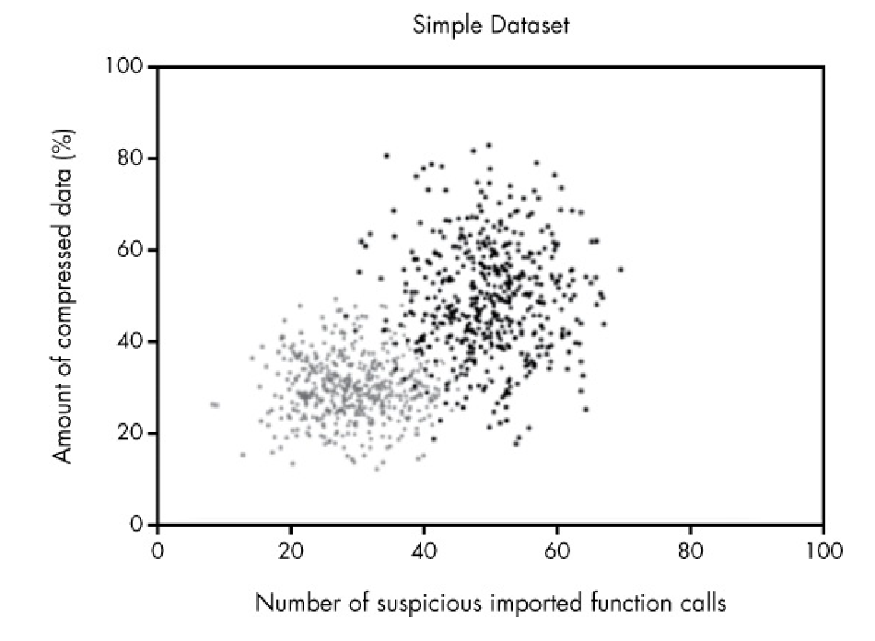
Feature Space
Black dots represent Malware
Gray dots represent Benignware

Slide 15
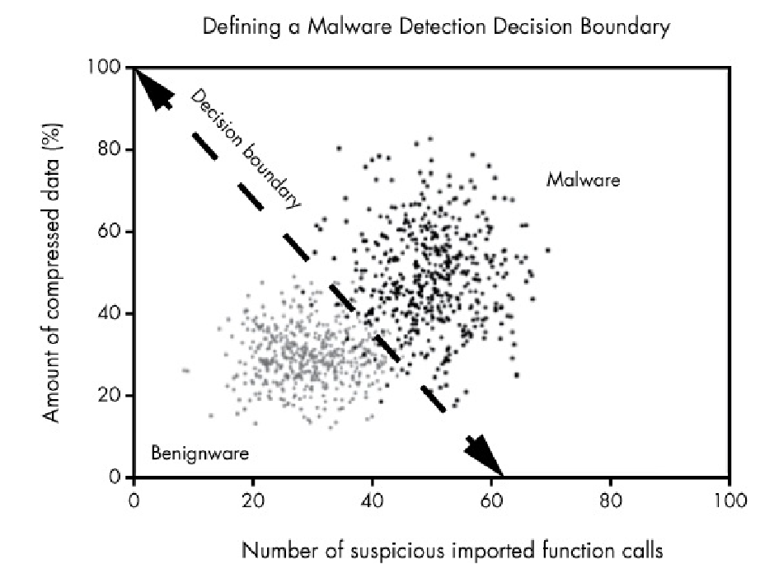
Decision Boundary
Drawn Manually

Slide 16
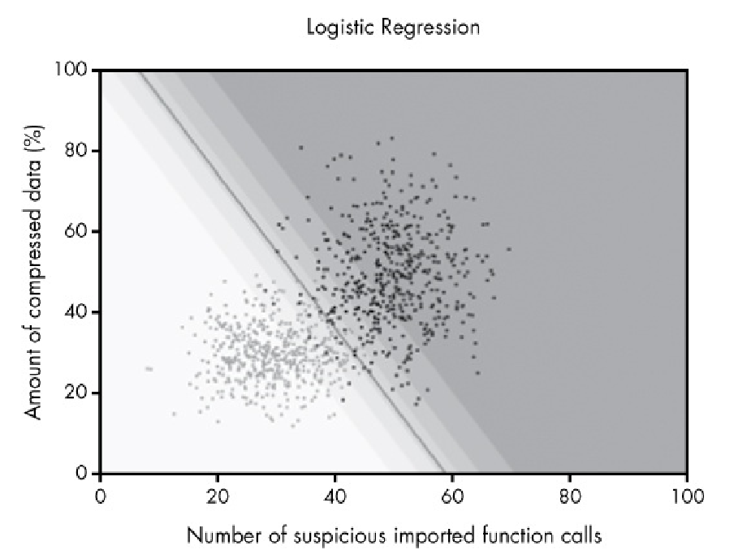
Decision Boundary

Slide 17
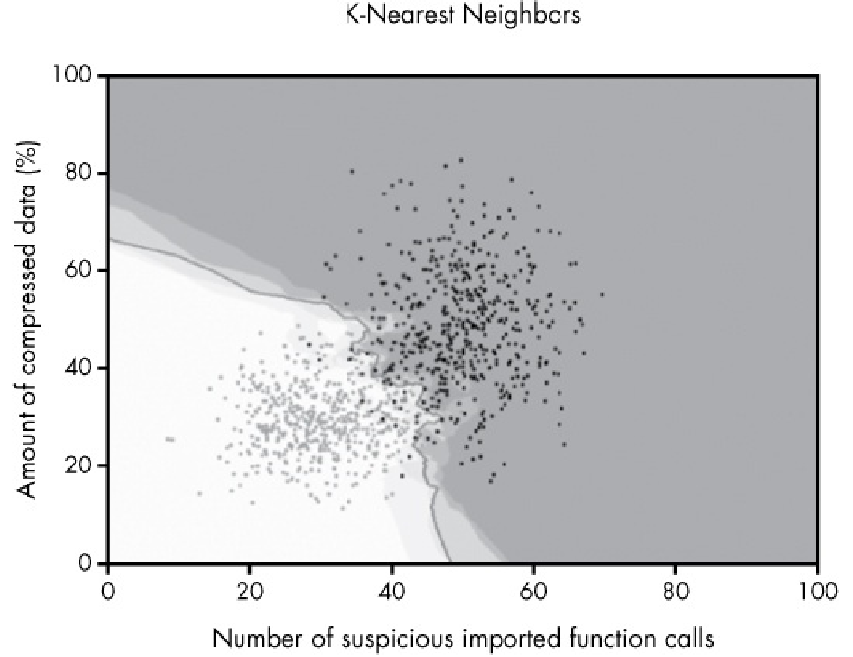

Slide 18
Overfitting and Underfitting
Good detection models in machine learning must capture the general trend.
Underfit fails to capture the general trend of the data.
Overfit fails to capture the general trend, but obsesses over the exception in the data.

Slide 19
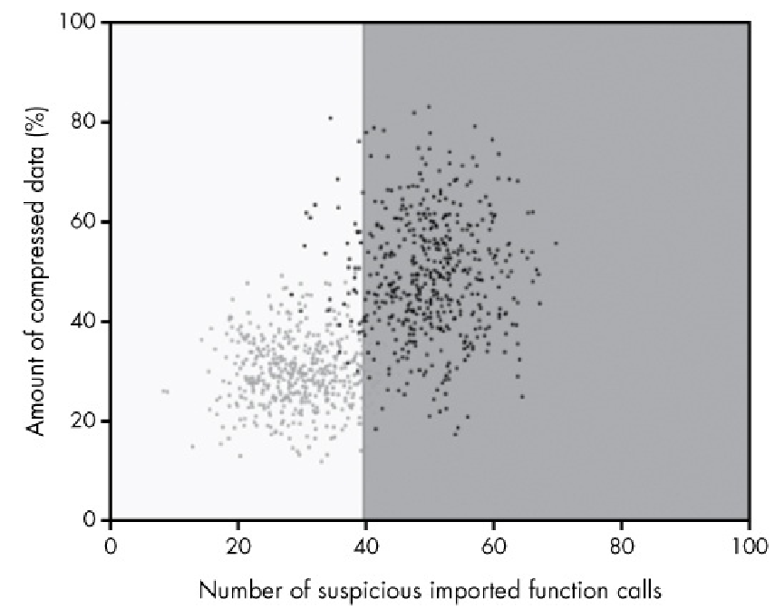
Underfit

Slide 20
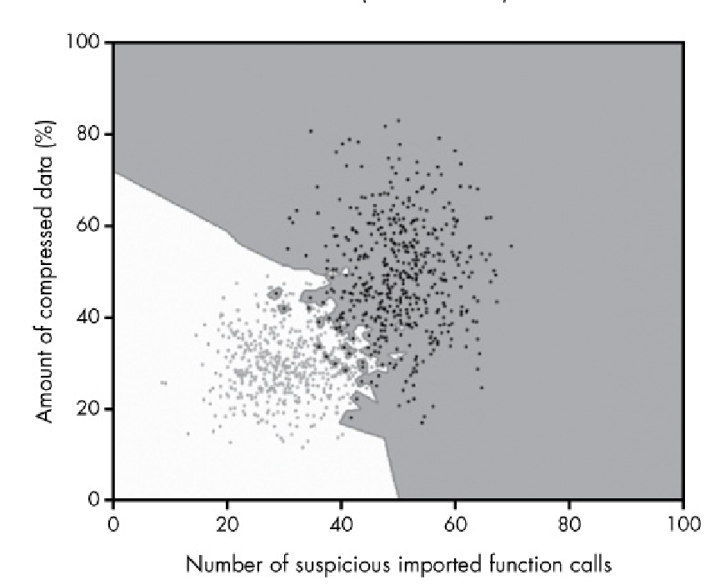
Overfit

Slide 21
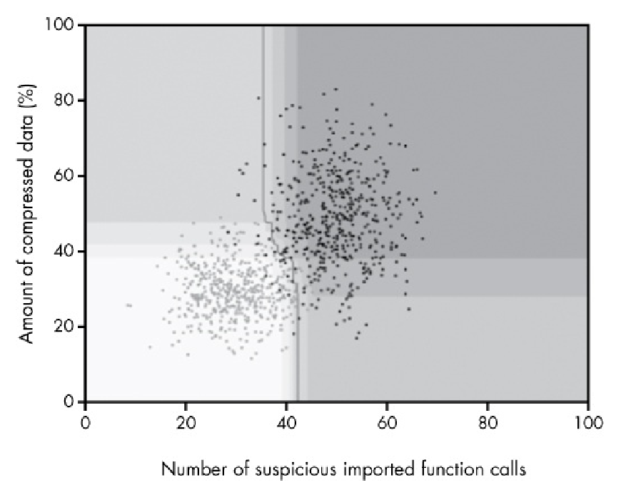
Well Fit

Slide 22
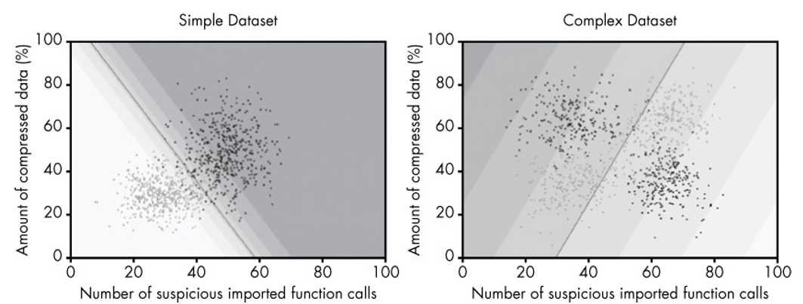
Logistic Regression
Geometrically separates your training malware from your training benignware.
Features should’ve strong indicators on their own, else it fails

Slide 23
KNN
Category is decided based on the neighbouring points. In other words, similarity in the feature decides the category of data.
Extract the binary features and find the k samples that are closest to it in the feature space.
Divide the number of malware samples that are close to the sample by k to get the percentage of nearest neighbors that are malicious.
If enough of the samples are malicious, define the sample as malicious.

Slide 24
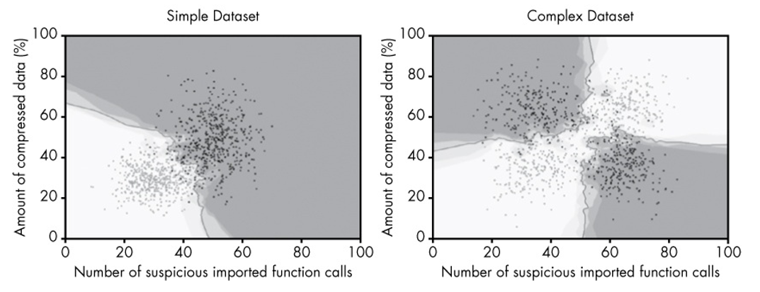
It works based on the distance function or euclidean distance
If the number of data points are increased then the prediction could be made more accurate

Slide 25
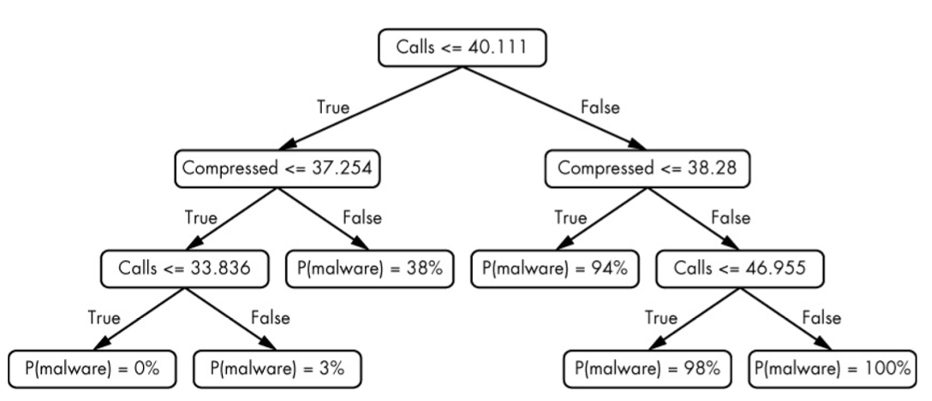
Desicion Trees
Selecting root node is the most important part in Desicion tress
Desicion tress tend to overfit and underfit. So it’s a must to limit the questions.

Slide 26
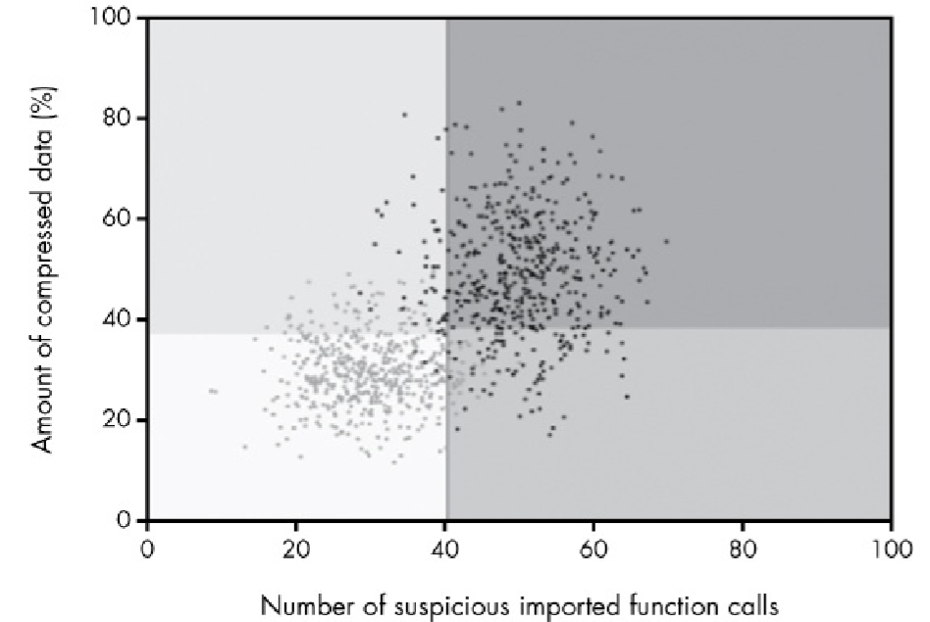

Slide 27
How to choose root node
The best root node is the one for which we get a “yes” answer for most if not all samples of one type, and a “no” answer for most if not all samples of the other type.

Slide 28
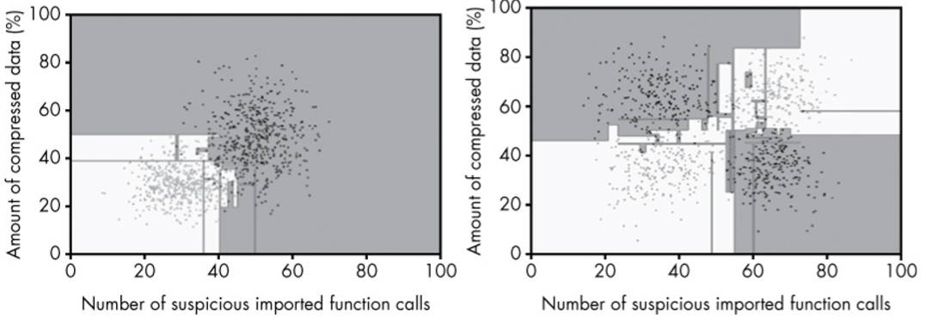
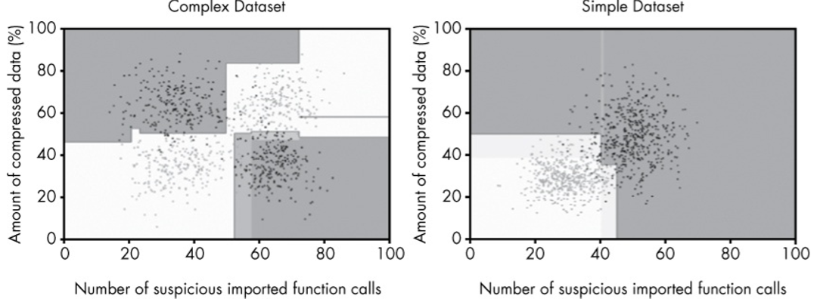
Without limiting the questions
Limiting the questions

Slide 29
Random Forest
Many Decision Trees are used to make decisions.
The category is decided by the votes of desicion trees given.
Build a sample and build desicion tree for each sample. They take only a handful of features and disregard the others. Then desicion is the averaged decisions of the decision trees.

