Slide 1
⚡ AI Intelligence &
Demand Forecasting Dashboard
Comprehensive EDA & Data Quality Assessment Platform
ISB Capstone Project
📊 7 Pages
🎯 82K+ Records
⚡ Real-time

Slide 2
🎯 Dashboard Overview
✨ Key Features
Modern, gradient-based UI with purple-blue theme
Interactive visualizations using Plotly
Real-time data quality assessment
Comprehensive statistical analysis tools
Advanced demand forecasting with ML & statistical models
Professional report generation (PDF, Excel, CSV)
Responsive design for all screen sizes
📊
📈
7
23
Dashboard
Pages
Data
Columns
🔢
⚡
82K+
100%
Records
Analyzed
Interactive
🔧 Built With
Streamlit • Plotly • Pandas • NumPy Statsmodels • Scikit-learn • FPDF

Slide 3
📑 Seven Comprehensive Pages
🏠
📊
Overview
Data Quality
Quick snapshot: metrics, trends,
segment distribution
Quality score, missing values,
data type analysis
🧹
📈
Data Cleaning
Statistical Analysis
Recommendations, duplicates,
standardization needs
Descriptive stats, correlations,
distributions
🔍
🎯
Detailed Exploration
Demand Forecasting
Column browser, search,
data preview
SKU predictions, ML models,
confidence intervals
📄
Export Reports
PDF, Excel, CSV exports
with full analysis

Slide 4
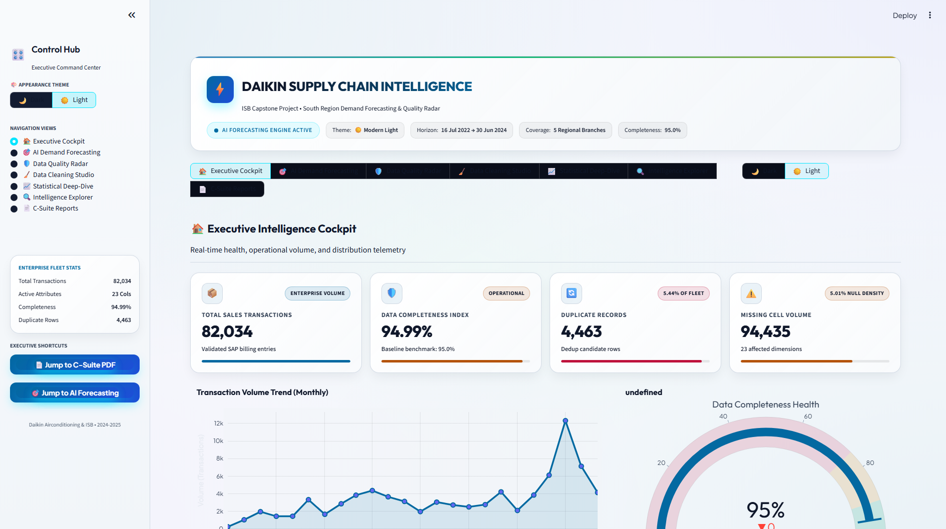
Dashboard Home 🏠 Overview Page
📊 Key Metrics Cards
• Total records: 82,034
• Data completeness percentage
• Duplicate records count
• Missing values analysis
📈 Visualizations
• Time series: Records over billing dates
• Gauge: Data completeness indicator
• Pie chart: Segment distribution
• Box plots: Tonnage analysis by segment

Slide 5
📊🧹 Data Quality & Cleaning
📊 Data Quality Assessment
• Overall Quality Score (0-100)
• Automated status indicators:
✅ Excellent: >95% complete
⚠️ Good: 75-95% complete
🔴 Poor: <75% complete
• Missing values bar charts
• Column-by-column analysis
• Data type distribution
• Issues counter and alerts
🧹 Data Cleaning Studio
• Actionable Recommendations:
○ Duplicate removal strategies
○ Missing value handling
○ Column standardization
○ Date format validation
○ Categorical normalization
• Visual Analysis:
○ Unique vs duplicate pie chart
○ Column standardization panel
○ Top 5 values preview
○ Before/after metrics

Slide 6
Deep Insights 📈 Statistical Analysis
📊 Descriptive Statistics Table
• Count, Mean, Std Dev, Min/Max
• Quartiles (25%, 50%, 75%)
• All numeric columns
🔥 Correlation Heatmap
• Color-coded relationships (-1 to +1)
• Interactive hover for exact values
• Identify strong correlations
📉 Distribution Analysis
• Interactive column selector
• Customizable histogram bins
• Box plot for outlier detection
• Statistical summary cards
μ
📊
Mean
σ
Average
Values
Standard
Deviation
⚖️
🔗
Med
R²
Median
Values
Correlation
Strength
💡 Use Cases
• Pattern identification & anomaly detection • Feature engineering for ML models • Research and exploratory analysis • Understanding data distributions

Slide 7
⭐ New Feature 🎯 Demand Forecasting
⭐ NEW
🤖 Available Models
📈 Statistical Models:
• ARIMA - Auto Regressive Integrated MA
• SARIMA - Seasonal ARIMA
• Exponential Smoothing
🧠 Machine Learning Models:
• Random Forest Regressor
• Gradient Boosting Regressor
• Automatic feature engineering
• Lag features & rolling averages
🎯 Business Use Cases
📦 Inventory Planning
Optimize stock levels based on predicted demand patterns
🏭 Production Capacity
Schedule manufacturing runs according to forecasts
💰 Budget Allocation
Allocate resources by predicted SKU performance
📈 Sales Strategy
Plan promotions during high demand periods
🚚 Supply Chain
Improve logistics and reduce stockouts/overstock
✨ Key Features
• SKU-wise demand prediction (4-52 weeks)
• Interactive forecast charts with confidence intervals
• Performance metrics: MAE, RMSE, MAPE, Accuracy
• Historical pattern analysis
• CSV export for further analysis

Slide 8
Professional Output 📄 Export & Reporting
📕
📗
PDF Reports
Excel Export
Executive summary, quality
assessment, recommendations
Full dataset + summary sheet
for further analysis
📘
📄
CSV Export
Text Summary
Raw data compatible with
all analysis tools
Plain text reports for quick
reference and email
📋 PDF Report Contents
Executive Summary • Data Quality Assessment • Missing Values Analysis • Data Type Distribution
Cleaning Recommendations • Standardization Strategies • Monitoring Guidelines • Next Steps
✅ Professional formatting • Automated generation • Ready for stakeholders

Slide 9
Real-time Analysis ⚡ Interactive Features
📊 Chart Interactions
🖱️ Hover: View exact values
🔍 Zoom: Click and drag to zoom in
↔️ Pan: Shift + drag to move
💾 Download: Save charts as PNG
🔄 Reset: Double-click to reset view
🎨 Interactive legends: Toggle series
📈 Supported Visualizations
📉 Line Charts
Time series trends and patterns
📊 Bar Charts
Categorical comparisons
🥧 Pie Charts
Proportions and distributions
📊 Histograms
Value distributions
📦 Box Plots
Outliers and quartiles
🔥 Heatmaps
Correlation matrices
🎯 Gauge Charts
Single metric visualization
🔵 Scatter Plots
Relationship analysis
🔍 Data Filtering & Search
• Multi-select column explorer
• Search within specific columns
• Time range analysis
• Individual column deep-dive
• Value counts and distributions
• First 100 rows preview

Slide 10
Under the Hood 🔧 Technical Architecture
🐍
⚡
📊
🐼
Python
Streamlit
Plotly
Pandas
Core
Language
Web
Framework
Interactive
Charts
Data
Analysis
📚 Core Libraries
🌐 Streamlit - Web framework
📊 Plotly - Interactive visualizations
🐼 Pandas - Data manipulation
🔢 NumPy - Numerical computing
📈 Statsmodels - Time series models
🤖 Scikit-learn - Machine learning
📄 FPDF - PDF generation
📗 OpenPyXL - Excel handling
⚡ Performance & Optimization
• Cached data loading for speed
• Efficient pandas operations
• Lazy loading of visualizations
• Handles 82K+ records smoothly
• Responsive UI with smooth animations
• Graceful handling of missing data
• Optimized memory usage
• Fast duplicate detection algorithms

Slide 11
Who Benefits? 💡 Use Cases & Benefits
👨‍💼 Data Analysts
👨‍💻 Data Engineers
• Quick EDA before modeling
• Pattern identification
• Outlier detection
• Distribution analysis
• Pipeline monitoring
• Data validation
• Quality tracking
• Cleaning recommendations
👨‍💼 Managers
👨‍🔬 Data Scientists
• Executive summaries
• Quality reports
• Progress tracking
• Stakeholder presentations
• Feature understanding
• Correlation discovery
• Statistical insights
• Demand forecasting

Slide 12
Quick Setup 🚀 Getting Started
📦 Installation Steps
1️⃣ Prerequisites
Python 3.8+ and pip installed
2️⃣ Install Dependencies
pip install -r requirements.txt
3️⃣ Prepare Data
Place Filtered.xlsx in project folder
4️⃣ Run Dashboard
streamlit run dashboard.py
5️⃣ Open Browser
Navigate to http://localhost:8501
✨ Best Practices
🏠 Start with Overview page
📊 Check Data Quality for issues
🧹 Review Cleaning recommendations
📈 Dive into Statistical Analysis
🔍 Use Detailed Exploration for specifics
🎯 Try Demand Forecasting for SKUs
📄 Export Reports for documentation
⚡ Use search for quick record lookup
📌 Monitor trends over time
🔄 Run weekly for quality tracking

Slide 13
Thank You! 🎉
AI Intelligence & Demand Forecasting Dashboard
ISB Capstone Project
7 Pages • 82K+ Records • Real-time Analysis • ML Forecasting
Interactive Visualizations • Professional Reports

