Slide 1
EXATHON INDIA 2026 · HEALTHCARE ANALYTICS
CareWeave
Front desk · check-in
One platform
Role portals
One patient record from front desk to doctor, with live analytics on Exasol.
Laboratory · results
Safety gates
Exasol analytics
Pharmacy · prescriptions
Blocked
Amoxicillin: penicillin allergy
PROJECT
Unified clinical records and an in-memory analytics engine
Doctor · encounters
Team Aetherius
Illustrative concept, synthetic data
Dhivya Dharshini CS · Suriya Sudhakar · Sai Prashanth T
ExaThon India 2026 · Powered by Exasol Personal · 25 October 2026

Slide 2
Three desks, three copies of the truth
WHERE IT GOES WRONG
WHAT CAREWEAVE DOES ABOUT IT
Reception and lab · paper
Crumpled slips are retyped by hand. A misplaced decimal becomes a wrong value.
Three portals share one record
Doctor's room · blind prescribing
No real-time allergy check. A penicillin allergy can sit in another record.
Safety gates stop the unsafe order
Management · slow reports
Basic operational reports take days to assemble across separate systems.
Exasol turns the activity into answers
Every one of these starts with data that never met.
Problem framing from the team. No study is cited. All patient data in this deck is synthetic.

Slide 3
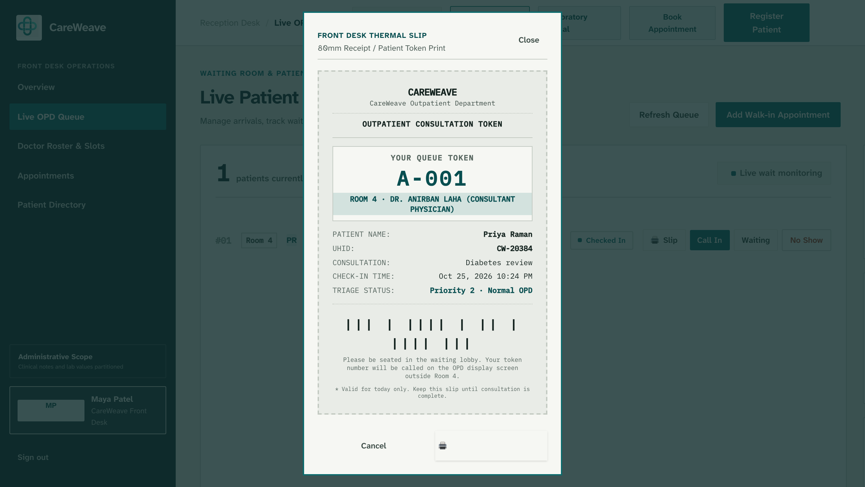
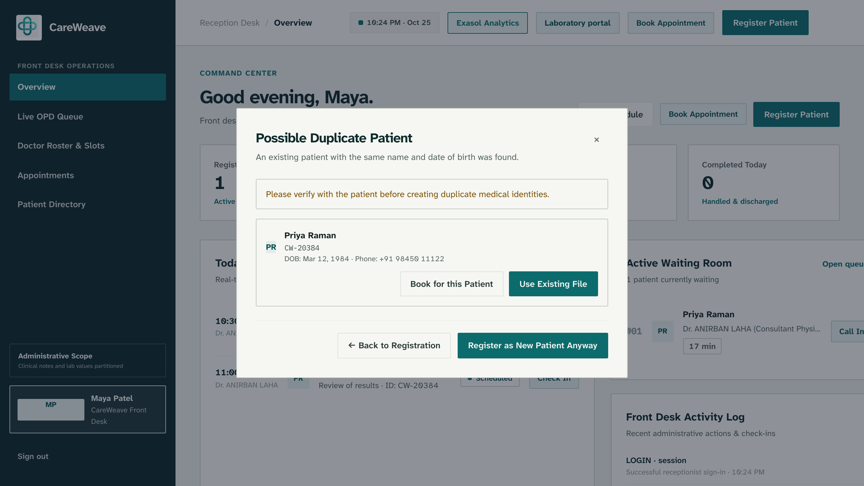
One case, four roles, one record
1
2
3
4
Receptionist
Lab technician
Pathologist
Doctor
Checks Priya in, warns on duplicates, prints an 80 mm slip.
Enters or scans results. Cannot verify their own.
A second person verifies and releases to the doctor.
Reads one timeline. Prescribes with safety guards.
A second registration is caught before it creates a second record.
The existing ID is shown. A person decides what happens next.
Prototype screenshot: queue slip (80 mm)
Prototype screenshot: duplicate warning
One patient, one chart, four people who can each do only their part.

Slide 4
How data flows from desk to dashboard
Role portals
Express API
MongoDB Atlas
SQL MERGE sync
Exasol Personal
Analytics hub
Front desk, lab and doctor, each with its own routes.
Role checks on the server for every request. Audit log.
Transactional records: visits, orders, prescriptions, notes.
Idempotent. Counts the rows back from Exasol before saying it worked.
In-memory columnar tables. Window and percentile SQL.
Visits, waits, lab turnaround, prescribing demand, SQL Inspector.
Gemma 4 report scan saves drafts only · maker-checker release · allergy and duplicate-therapy guards
Manual: the sync runs from a button. Not built: scheduled sync, FHIR or ABDM integration, stock levels.
Built and shown in the demo
Needs a human click
If Exasol is offline, the page says so

Slide 5
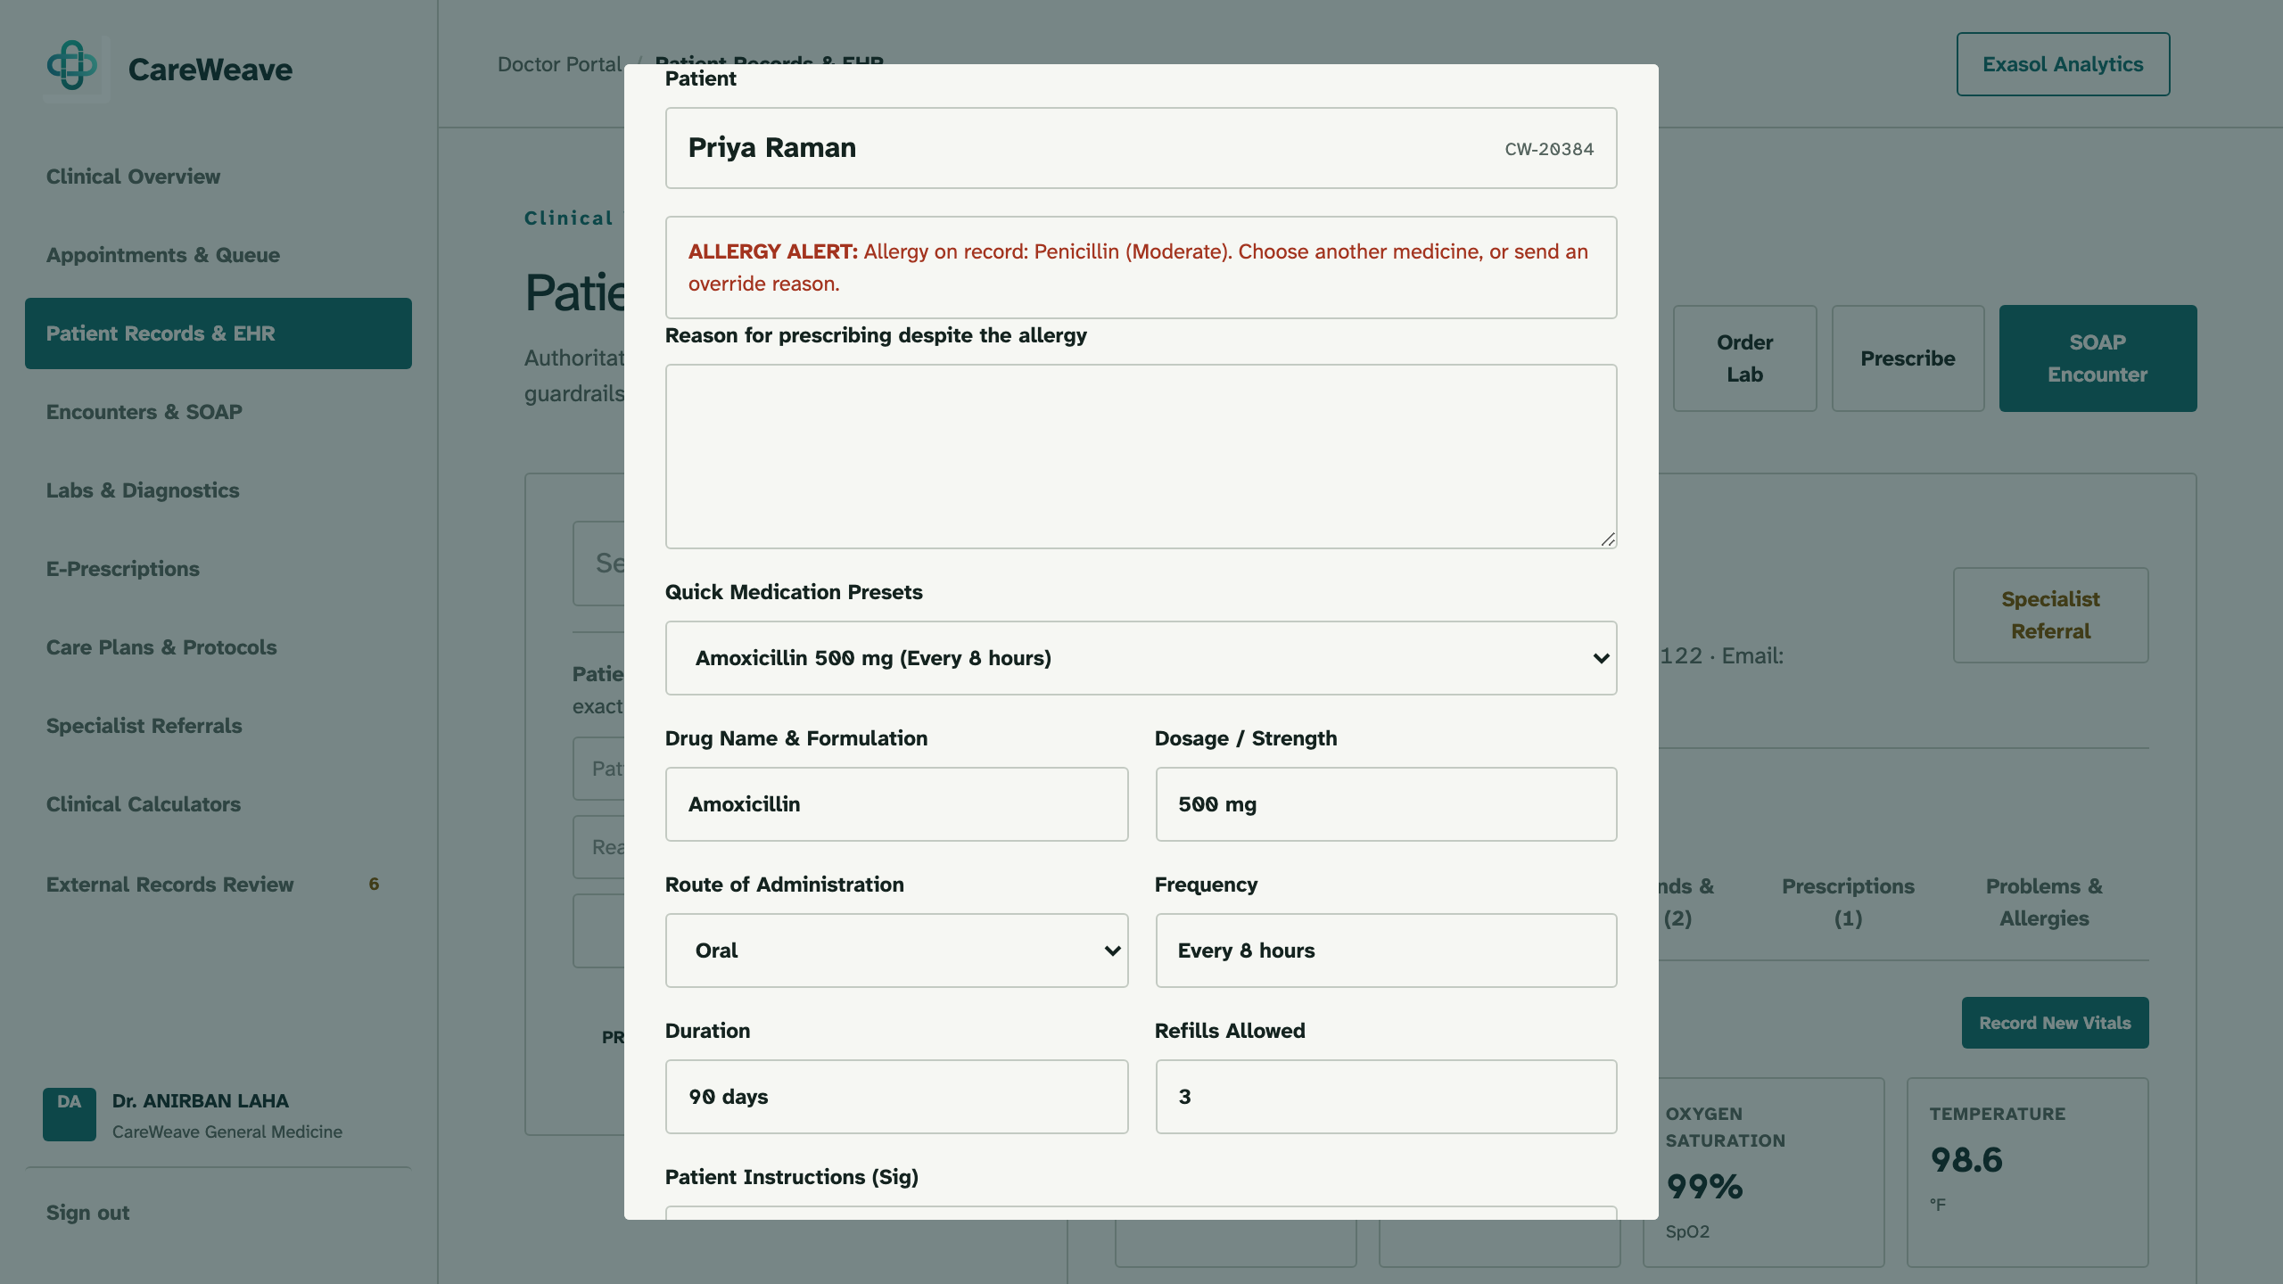
The system says no before the harm
1
Allergy guard
IN PROTOTYPE
Same-family drugs are blocked. Amoxicillin is stopped for a documented penicillin allergy.
2
Duplicate-therapy guard
IN PROTOTYPE
The same molecule under another brand name is caught before it is prescribed twice.
3
Maker-checker
IN PROTOTYPE
Whoever enters a lab result cannot verify it. A second person releases it.
Prototype screenshot: Amoxicillin blocked for a penicillin allergy (synthetic patient)
An override needs a written reason; every block is audit-logged.
Synthetic Demo Patient. Clinical-review support, not a diagnostic system.

Slide 6
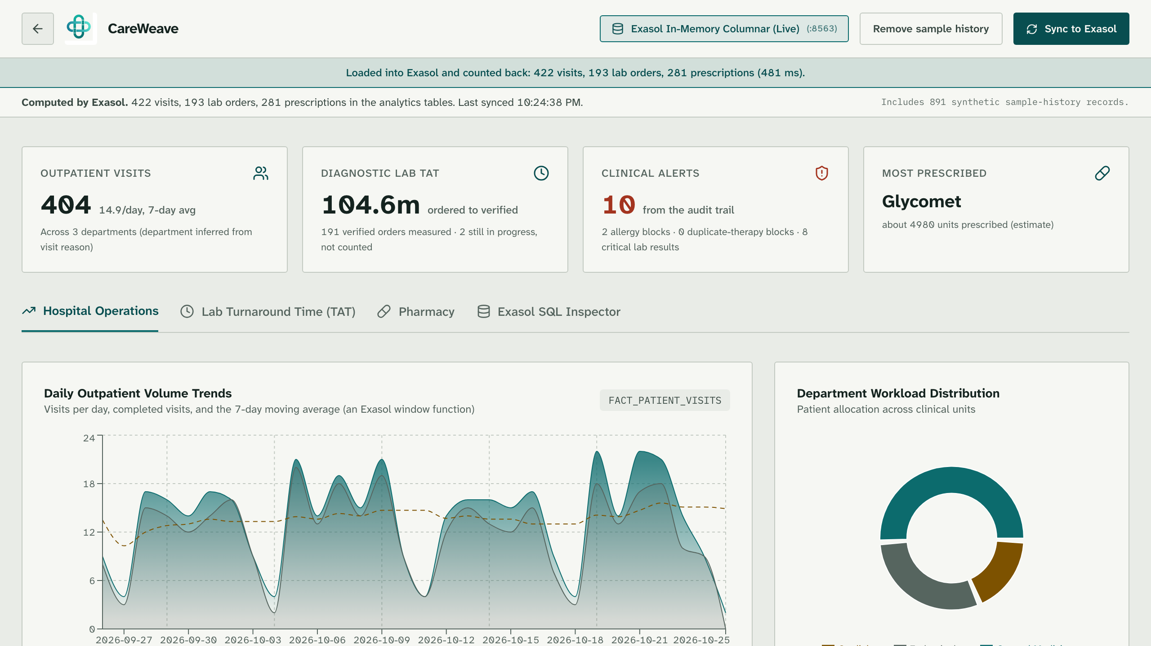
Everything we just did is now data
WHAT TO NOTICE
Live badge
Exasol In-Memory Columnar, connected on port 8563.
Counted back
The banner reports rows read back from Exasol: 422 visits, 193 lab orders, 281 prescriptions.
Window function
Visits per day with a 7-day moving average, computed in SQL.
Waiting time
Average wait by department.
Includes 891 synthetic sample-history records, labelled as such in the app.
Prototype screenshot, synthetic data. Figures shown are from this run, not hospital results.

Slide 7
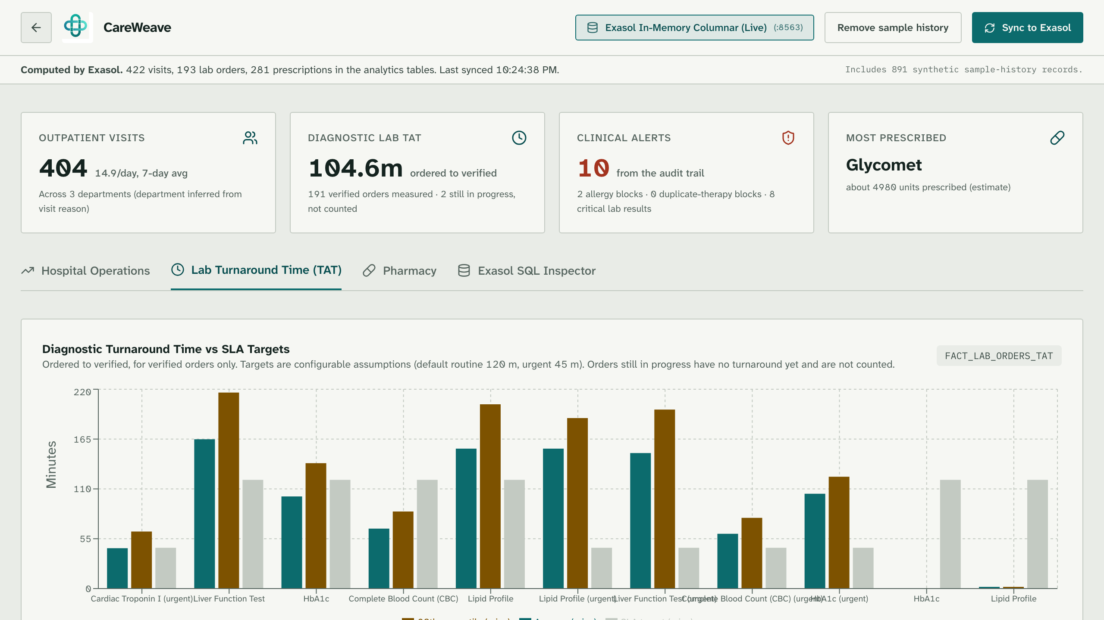
Lab turnaround, measured not assumed
HOW TO READ IT
Verified orders only
Ordered to verified. Orders still in progress are not counted.
Average and p90
The 90th percentile sits beside the average, against the SLA target.
Where the time goes
Order to collected versus collected to verified.
SLA targets are configurable assumptions, not hospital standards.
Prototype screenshot, synthetic data.

Slide 8
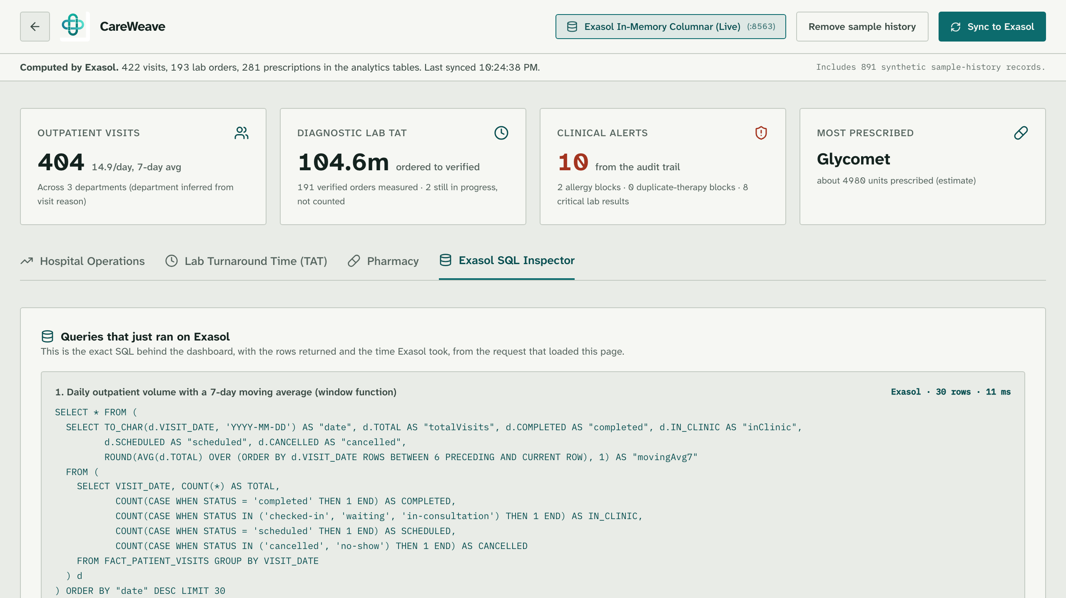
Nothing is mocked: see the SQL
WHY IT BUILDS TRUST
Every query shown
The exact SQL behind each chart, with rows returned and milliseconds taken.
Real Exasol features
Window functions for the moving average, PERCENTILE_CONT for the p90.
Estimates are labelled
Prescribing demand is an estimate. Stock is not recorded, so no stock-out is claimed.
If Exasol is offline, the page says so instead of passing off other numbers.
Prototype screenshot, synthetic data.

Slide 9
What is checked, and what is not
1
Safety rules
IN REPO
2
Exasol parity
IN REPO
Allergy, duplicate-therapy and maker-checker rules have test scripts.
Each Exasol SQL metric is compared with the same metric computed in code.
3
Idempotent sync
IN REPO
4
Scale demo
IN REPO
A repeat sync adds no duplicate rows. Counts are read back.
A script runs the analytics queries on larger synthetic data.
5
Clinician review
PLANNED
6
Real hospital data
NOT USED
No clinician has reviewed the workflow yet.
Not used. No speed or outcome claims are made.
Test scripts are in the repository. No performance results are claimed.

Slide 10
What comes next
Planned or future. None of these are built yet.
4 FUTURE
FHIR R4 and ABDM integration
3 FUTURE
Clinician feedback and validation
2 PROPOSED
Stock and dispensing data for a real stock forecast
1 PLANNED
Scheduled sync instead of a button
CareWeave makes unsafe orders harder to place and operational questions faster to answer. Clinicians stay in charge.
github.com/saiprashanth2410/Care-weave · Synthetic data only · Clinical-review support, not a diagnostic system

