Slide 1
COMPLIANCE
INTELLIGENCE
PLATFORM
An NLP-Based Approach to Contract Compliance and State Policy Analysis
Project Presentation
Presented by: 23MID0005-Varanasi Sreeja 23MID0046-G.Varsha 23MIC0086-Sai Pravali

Slide 2
Problem Statement
Proposed Solution
To develop a Compliance Intelligence Platform that combines Natural Language Processing (NLP) and rule-based reasoning to analyze company profiles, contract clauses, internal policies and state regulatory requirements.
The platform aims to support faster, more structured and evidence-based compliance review.
Problem Statement
Organizations must ensure that their contracts comply with internal company policies and applicable state regulations. Manually reviewing large volumes of documents is time-consuming and can make it difficult to identify conflicting obligations and relevant requirements consistently.
02

Slide 3
Project Objectives
1
Automated Document Processing: Extract and organize text from uploaded contract documents.
2
Requirement Extraction: Identify obligations, conditions, quantities and other relevant information from contract clauses.
3
State Policy Evaluation: Assess company profiles against state policy requirements.
4
Internal Policy Compliance: Compare contract clauses with internal organizational policies to identify potential conflicts.
5
State Regulation Analysis: Compare contract clauses with relevant state regulatory requirements.
6
Evidence-Based Reporting: Present compliance results with supporting clauses and explanations.
03

Slide 4
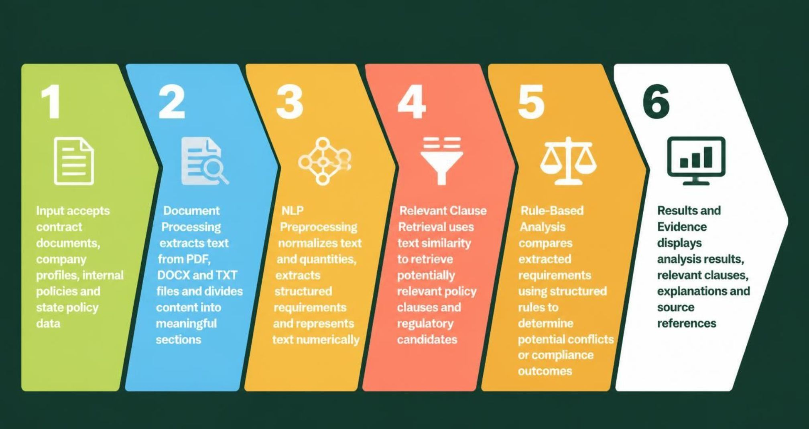
Three Analysis Modules
System Architecture and Pipeline
Module 1: State Fit Advisor
Module 2: Contract vs Internal Policies
Module 3: Contract vs State Regulations
Proposed System Pipeline
The system uses NLP techniques to process and retrieve relevant information, while structured rules support the final comparison and conflict analysis.
04

Slide 5






Module 1 — State Fit Advisor
Purpose
Working
To evaluate a company's profile against state policy requirements and identify requirements that the company satisfies, fails to satisfy or needs to investigate further.
Load the canonical state policy requirements.
Collect company profile information, such as sector, location and other relevant attributes.
Apply structured rules to evaluate the profile against each requirement.
Assign an appropriate status to each requirement.
Present the evaluation results for review.
Output Statuses
Implementation
 | PASS: | The available profile information satisfies the requirement.
 | FAIL: | The available information does not satisfy the requirement.
 | UNKNOWN: | There is insufficient information to determine the outcome.
 | POTENTIAL: | The requirement may apply or needs further examination.
 | APPLIES / NOT_APPLICABLE: | Indicates whether a requirement applies to the profile.
 | INFO: | Provides informational context.
93 canonical state policy requirements.
Structured rules maintained in profile_rules.json.
Three sample company profiles: AgriVision, Nirmaan and SteelForge.
Supports state policy evaluation for Tamil Nadu and Karnataka.
Outcome: A structured assessment that helps identify relevant requirements and potential compliance gaps.
05

Slide 6
Example
Module 2 — Contract vs Internal Policies
Contract Clause: Termination is permitted with 30 days' notice.
Internal Policy: A minimum notice period of 60 days is required.
Analysis: The contract permits a shorter notice period than the internal policy requires.
Result: Potential conflict, supported by the relevant contract clause and policy requirement.
Purpose
To identify potential conflicts between clauses in an uploaded contract and an organization's internal policies.
Working
Possible Outputs
Extract and segment contract text into clauses.
Identify relevant internal policies using clause retrieval.
Extract structured information, including obligations, time periods, quantities and conditions.
Normalize comparable values and requirements.
Apply rule-based conflict detection.
Generate a result with supporting evidence.
CONFLICT
NO_CONFLICT
PARTIAL_CONFLICT
UNCERTAIN
Outcome: Helps reviewers identify contractual obligations that may not align with internal policies.
06

Slide 7
Module 3 — Contract vs State Regulations
Purpose
Key Features
To compare contract clauses with relevant state regulatory requirements and identify potential compliance concerns.
Uses a structured set of state regulatory candidates.
Supports requirement retrieval and conflict analysis.
Provides available source references to help reviewers trace the evidence.
Flags legal status and applicability for further verification.
Working
Extract requirements from the uploaded contract.
Identify potentially relevant state regulation candidates.
Retrieve corresponding regulatory requirements and available source references.
Compare contract requirements with regulatory candidates using structured rules.
Present the result with evidence and review indicators.
Outcome: Supports preliminary identification of possible regulatory conflicts and helps direct attention to clauses requiring legal review.
The module assists compliance review; it does not independently establish the legal validity or applicability of a regulation.
07

Slide 8
Dataset Preparation and Application
Dataset Preparation
Application
Used CUAD contract data as a source for contract clause analysis.
Mapped contract categories to the internal policy corpus.
Created a candidate-clause dataset containing 6,723 mapped rows.
Prepared a 64-pair evaluation sample covering 16 contract categories.
Organized state policy requirements into a canonical structured dataset.
The platform provides a Streamlit-based interface through which users can interact with the compliance analysis system and review its results.
08

Slide 9
Conclusion
The Compliance Intelligence Platform combines Natural Language Processing and rule-based reasoning to support contract and policy compliance analysis.
The project implements three modules that address company-state policy fit, contract comparison with internal policies and contract comparison with state regulatory requirements.
Through document processing, requirement extraction, relevant clause retrieval and structured conflict analysis, the system provides a systematic approach to identifying potential compliance issues and presenting supporting evidence.
Future Scope
Expand the coverage of states and regulatory requirements.
Improve semantic retrieval and requirement extraction.
Extend multilingual document processing.
Refine evaluation using additional labelled real-world examples.
Enhance reporting and integration with organizational compliance workflows.
09

Slide 10
Thank You
10

