Slide 1
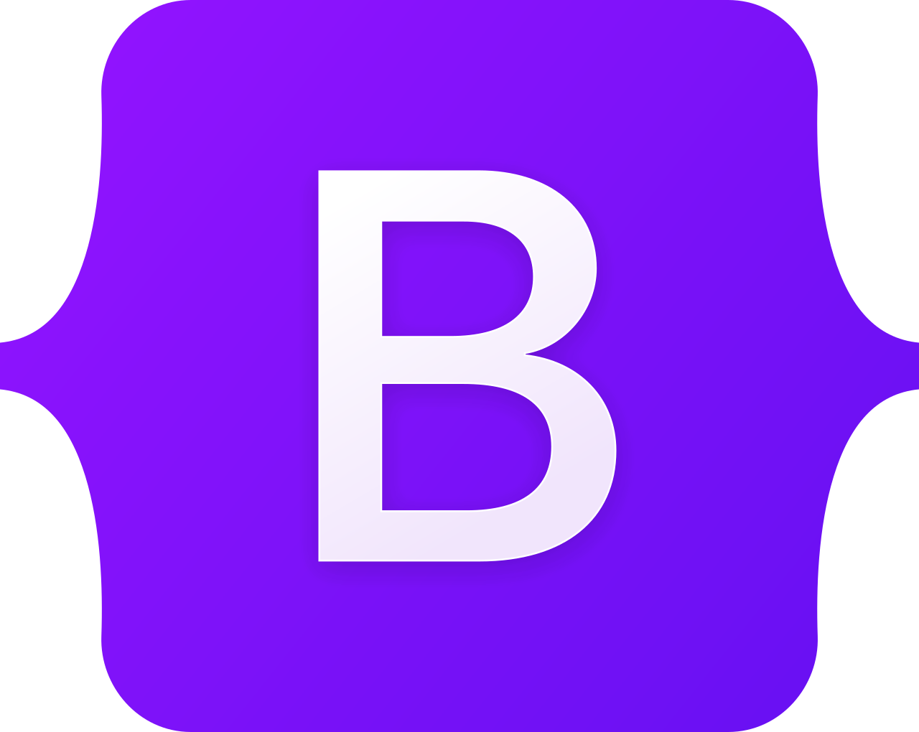










Web
(Front-end)
Google Login
Back-end
Password resets and alerts JSON web tokens (JWT)
Continuous deployment

Slide 2


Web
(Front-end)
SQLite Database
Password resets and alerts JSON web tokens (JWT)
Grammar check in reports
Continuous deployment

