Slide 1

AI_Assignment-2
IDA* and BnB applied to Frozen Lake environment
Simulated Annealing and Hill Climbing applied on TSP problem
CS22B029-SANJAY VARSHITH
CS22B006-SAI PREETHIKA

Slide 2

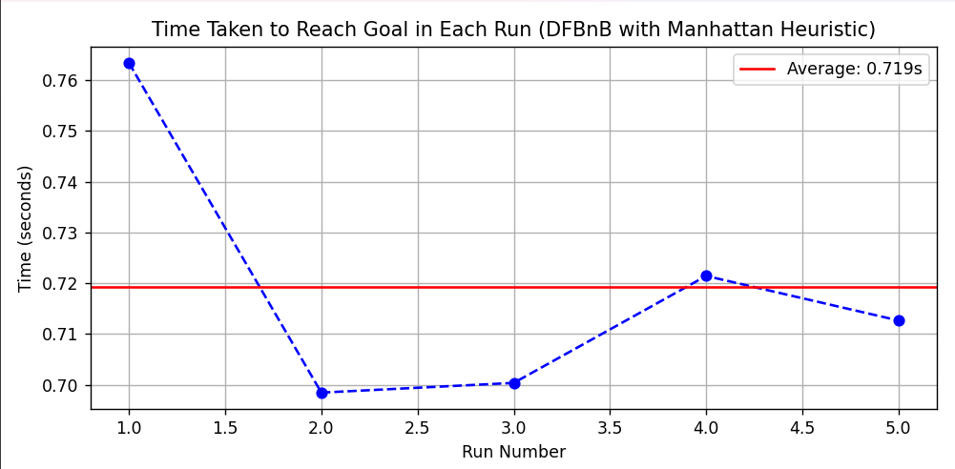
Branch and Bound
in frozen lake environment
Heuristic used : Manhattan
h(n)=∣x1​−x∣+∣y1​−y​∣
Results :
h(n): heuristic cost (estimated distance) from current node to goal
(x1,y1) : coordinates of the current node
(x ,y) : coordinates of the goal node
 | RUN 1 | RUN 2 | RUN 3 | RUN 4 | RUN 5
TIME(IN SECS) | 0.763 | 0.693 | 0.700 | 0.721 | 0.713
Chosen due to consistency and admissibility
Average time : 0.719 secs
Click the gif to play
Showing all the explored paths and then showing the optimal path traversed

Slide 3

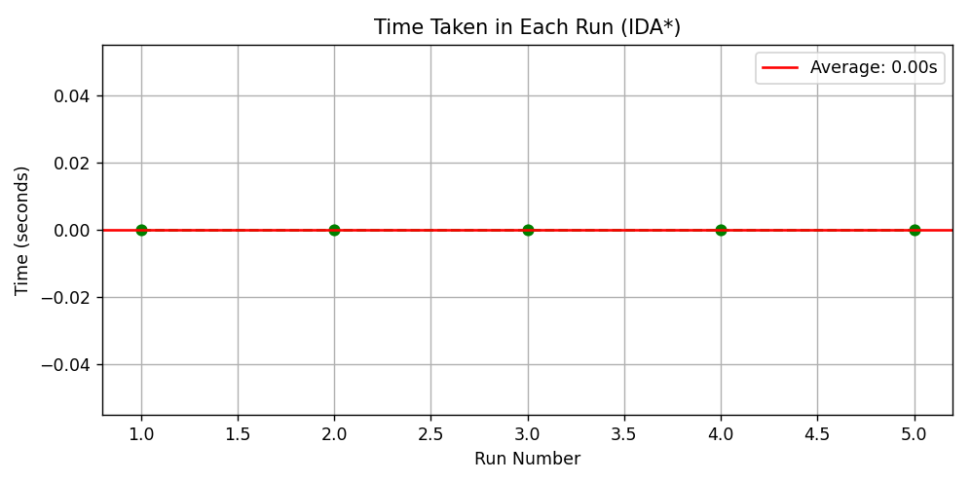
IDA*
in frozen lake environment
Heuristic used : Manhattan
Results :
h(n)=∣x1​−x∣+∣y1​−y​∣
h(n): heuristic cost (estimated distance) from current node to goal
(x1,y1) : coordinates of the current node
(x ,y) : coordinates of the goal node
 | RUN 1 | RUN 2 | RUN 3 | RUN 4 | RUN 5
TIME(IN SECS) | 0.000 | 0.000 | 0.000 | 0.000 | 0.000
Chosen due to consistency and admissibility
Average time : 0.000 secs
Click the gif to play
Showing all the explored paths and then showing the optimal path traversed

Slide 4
Observations and Explanations :
Speed: IDA* uses a depth-first search with heuristic boounds , making it quicker in deterministic (non-slippery) environments compared to Branch and
Bound , which explores more nodes before pruning .
Optimal and Memory-Efficient Search: IDA* guarantees an optimal path like Branch and Bound , but does so more efficiently by using the Manhattan heuristic to guide the search explore fewer noed reducing both computation and memory usage through iterative depening.
Better in Deterministic Environments: IDA* performs better when the environment (like FrozenLake with is_slippery=False) is predictable, while Branch and Bound is more
robust in uncertain conditions .

Slide 5
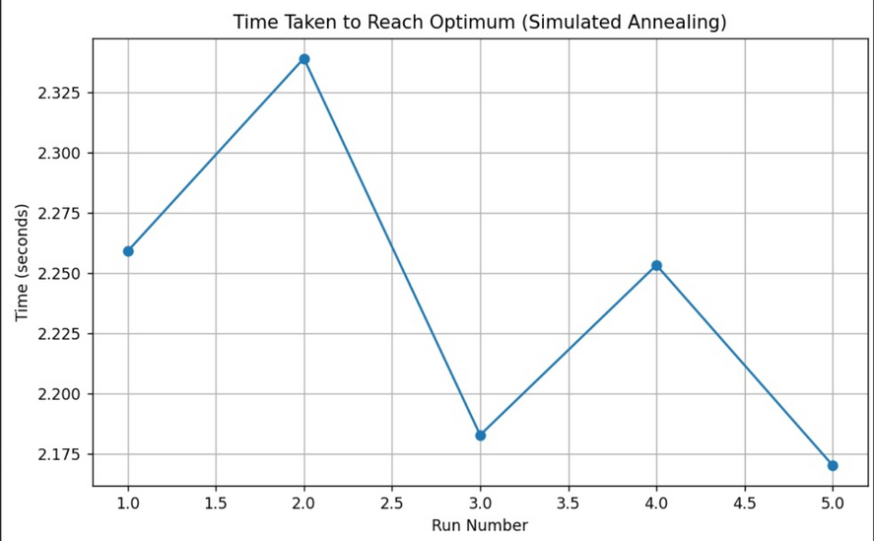
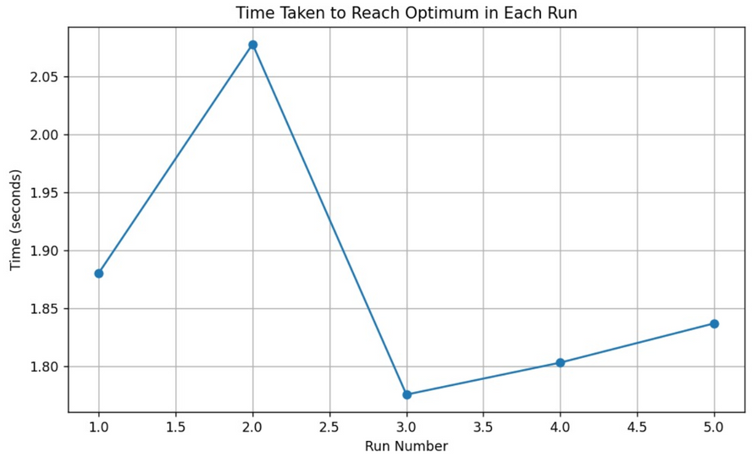
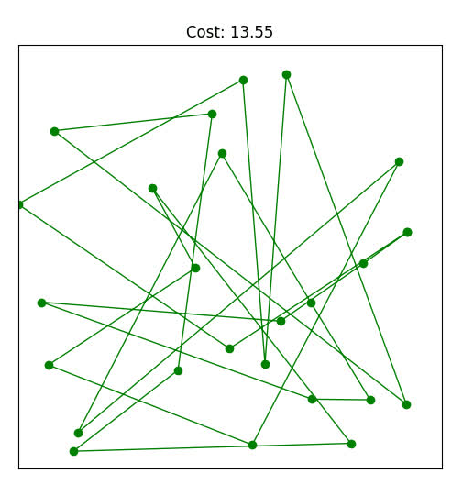
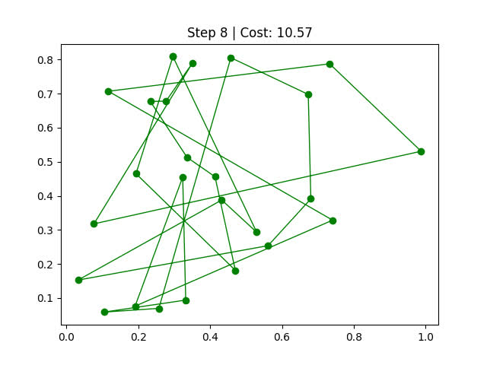
&
Simulated Annealing
Hill Climbing
Results :
Average Time-2.24 secs
Results :
Average Time-1.87 secs
Click on the gifs to play

Slide 6
Observations and Explanations :
Heuristic used : The negative of the Euclidean distance between consecutive nodes.
Exploration vs Exploitation: Simulated Annealing explores more broadly due to
probabilistic jumps, while Hill Climbing exploits immediate gains and risk
getting stuck in local optima.
Convergence Pattern: SA converges gradually with fluctuations due to its cooling schedule,
whereas HC converges quickly but may plateau early without randomness.
Final Solution Quality: SA often achieves better final solutions by escaping local minima,
while HC may settle for suboptimal peaks.
Performance Variability: SA shows variable outcomes based on parameters, while HC
is deterministic and consistent but less adaptive.

