Slide 1


ASSIGNMENT - 3
GAME PLAYING
Implemented Algorithms:
MINIMAX
ALPHA-BETA PRUNING
ENVIROMENT USED :
Chess(for both the algorithms)
SUBMITTED BY:
CS22B029 - SANJAY VARSHITH
CS22B006 - SAI PREETHIKA

Slide 2
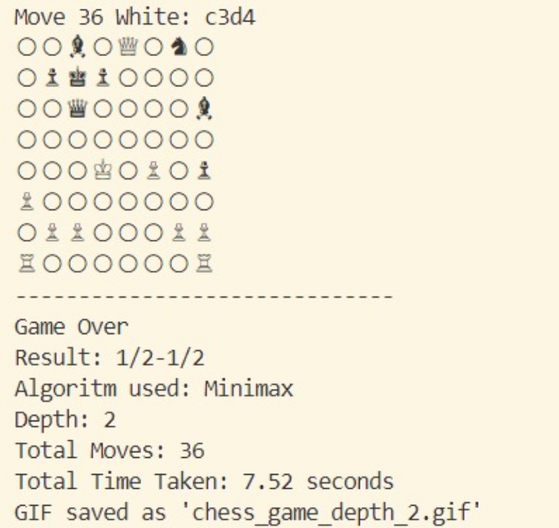
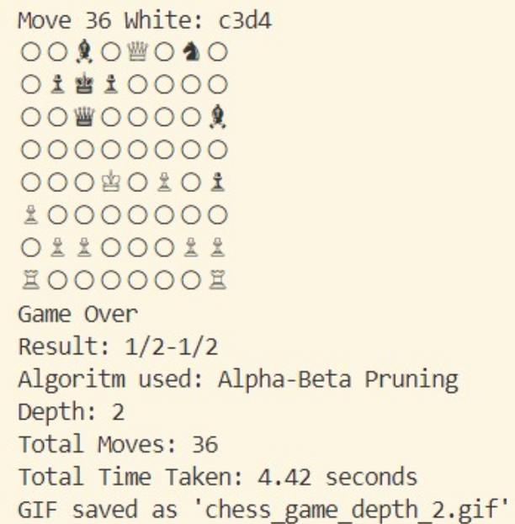
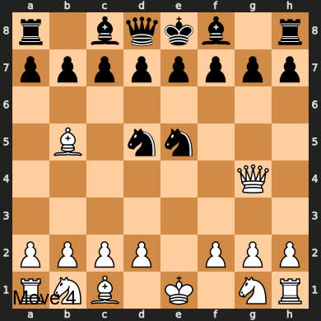
OUTPUTS
At Depth = 2
MINIMAX
ALPHA-BETA PRUNING

Slide 3
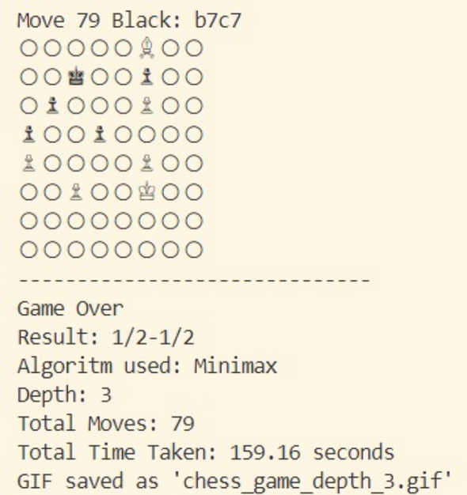
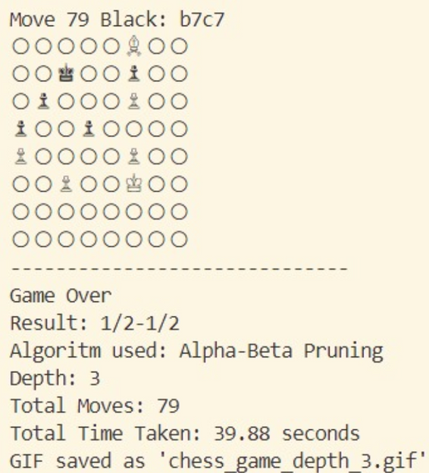
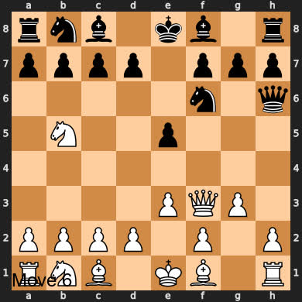
OUTPUTS
At Depth = 3
MINIMAX
ALPHA-BETA PRUNING

Slide 4
Evaluation Function:
Material and Positional Evaluation (Eval(node)): Assigns predefined values to pieces and adds positional bonuses based on their placement using piece-square tables.
Strategic Bonuses (S(node)): Includes bonuses for having a bishop pair, rooks on open files, and greater mobility (more legal moves).
Game Outcome (O(node)): Returns high positive/negative scores for checkmate, 0 for stalemate, and evaluates board favorability for white or black based on the above factors.
Eval(node) = M(node)+S(node)+O(node)
RESULTS:
ALGORITHM USED | RESULT | DEPTH | MOVES | TIME TAKEN
MINIMAX
ALPHA-BETA
36
2
7.52 secs
1/2-1/2 (Draw)
3
1/2-1/2 (Draw)
79
159.16 secs
36
2
4.42 secs
1/2-1/2 (Draw)
3
1/2-1/2 (Draw)
76
39.88 secs

Slide 5
OBERVATIONS AND REASONING
Draw Outcome (1/2–1/2):
→ The evaluation uses material + positional heuristics but doesn't aggressively push for checkmate. So, if no clear advantage is found, the game tends toward equilibrium (draw)
Move Count
→ Without pruning, Minimax explores all branches, including many suboptimal or equivalent lines, leading to non-optimal move choices that prolong the game.
→ In contrast, Alpha-Beta prunes irrelevant paths, focusing on stronger continuations, yielding the same result in fewer, more efficient moves.
Time Efficiency
→ Alpha-Beta pruning drastically reduces computation time(observed that at depth 3 , is 4 times faster than Minimax).
→ This is because Alpha-Beta skips evaluating branches that won't affect the final decision.
Increase in Time and optimality with increase in Depth
→ As depth increases, the algorithm evaluates future consequences of moves more accurately, enabling better decision-making; this leads to increased optimality since the agent avoids short-term gains that result in long-term losses.
→ This comes at the cost of increased computation time due to the exponential growth of the game tree.

