Slide 1

Project Title -
Seasonal Agriculture Performance Analysis
Student Name:Enjam Sai Priya
College Name-Vijaya Engineering College
AICTE STU ID : STU67d9286dcb69c1742284909

Slide 2

PROBLEM STATEMENT
(Agricultural activities are influenced by seasonal variations in environmental conditions, farming practices, resource availability and market conditions. As a result, agricultural performance may differ from one season to another. However, raw agricultural data does not clearly explain how agricultural performance changes across seasons or what patterns can be observed in different seasonal conditions. The problem is to analyze the given agricultural dataset and investigate seasonal differences in agricultural performance by identifying meaningful patterns, trends, relationships and variations within the available data.

Slide 3
Project Description
Seasonal Agriculture Performance Analysis is a Data Analytics project that examines agricultural activities across Kharif, Rabi and Zaid seasons.
The project uses agricultural data containing information about crops, geographical regions, environmental conditions, irrigation methods, fertilizer usage, water consumption, production, yield, revenue, cost and profit.
The analysis begins with data understanding and cleaning, followed by exploratory data analysis and visualization. Seasonal comparisons are performed to understand differences in agricultural performance.
The project also analyzes environmental conditions, irrigation, fertilizer usage, water efficiency, crop performance, regional performance and profitability.
Statistical techniques such as one-way ANOVA and correlation analysis are used to determine significant differences and relationships within the dataset.
The final objective is to generate evidence-based insights and recommendations that can support better seasonal agricultural planning.

Slide 4

WHO ARE THE END USERS?
Farmers
Can understand seasonal yield, resource usage and profitability patterns.
Agricultural Planners
Can use seasonal insights for better agricultural planning and resource allocation.
Agricultural Researchers
Can study relationships between environmental conditions, farming practices and agricultural outcomes.
Government & Agricultural Departments
Can use data-driven insights to support seasonal agricultural policies and planning.
Agricultural Businesses
Can understand production, cost and profitability patterns across seasons and regions.

Slide 5

Technology Used
Programming Language
Python
Libraries
Pandas
NumPy
Matplotlib
Seaborn
SciPy
Platform
Google Colab / Jupyter Notebook
Techniques
Data Cleaning
Exploratory Data Analysis
Data Visualization
Correlation Analysis
Statistical Analysis

Slide 6
RESULTS
Seasonal Performance
Kharif recorded the highest average yield at approximately 5.64 Tonnes/Ha.
Rabi recorded an average yield of approximately 5.08 Tonnes/Ha.
Zaid recorded the lowest average yield at approximately 4.67 Tonnes/Ha.
Seasonal comparisons were performed using bar charts and boxplots.
Yield variation was also examined to identify unusual observations.

Slide 7
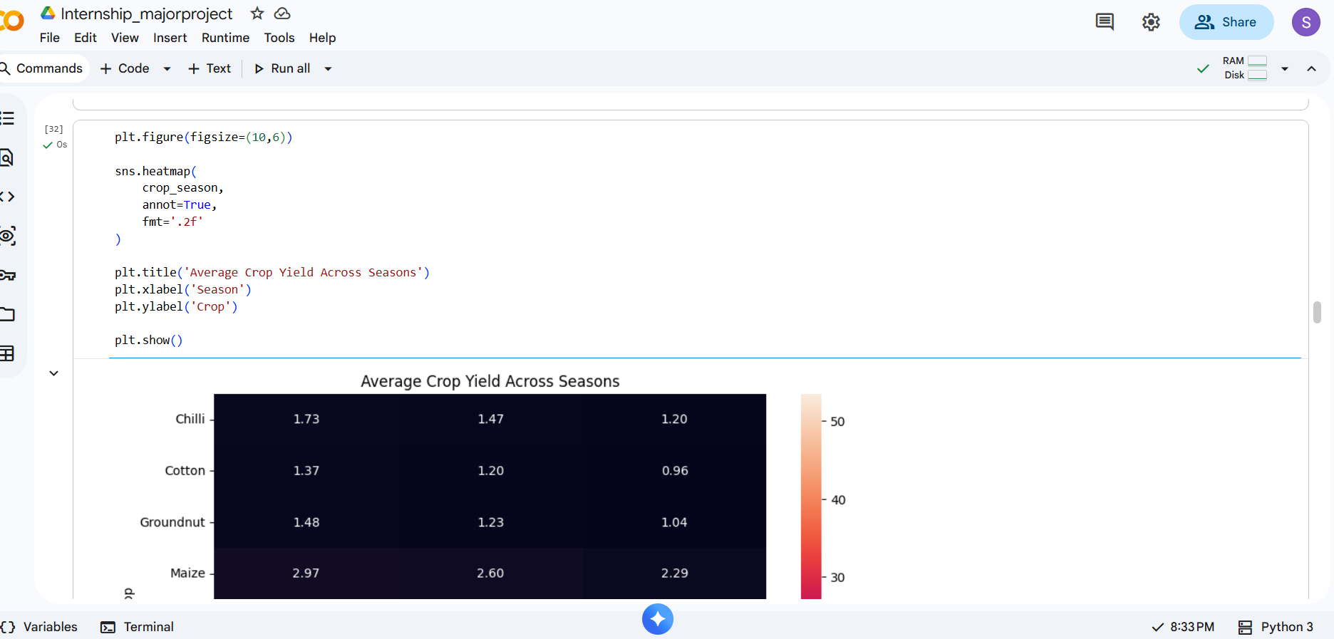
RESULTS

Slide 8
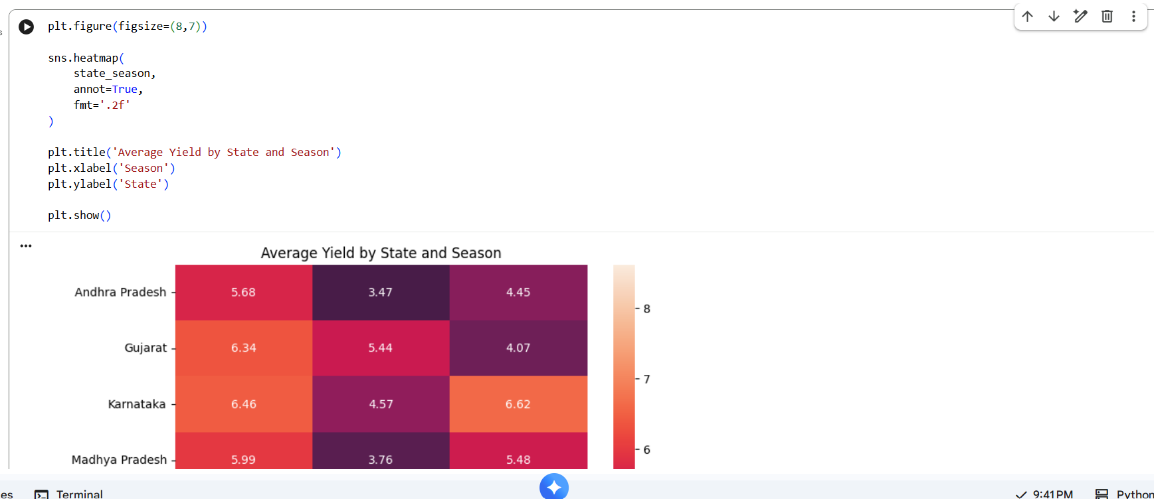
RESULTS

Slide 9
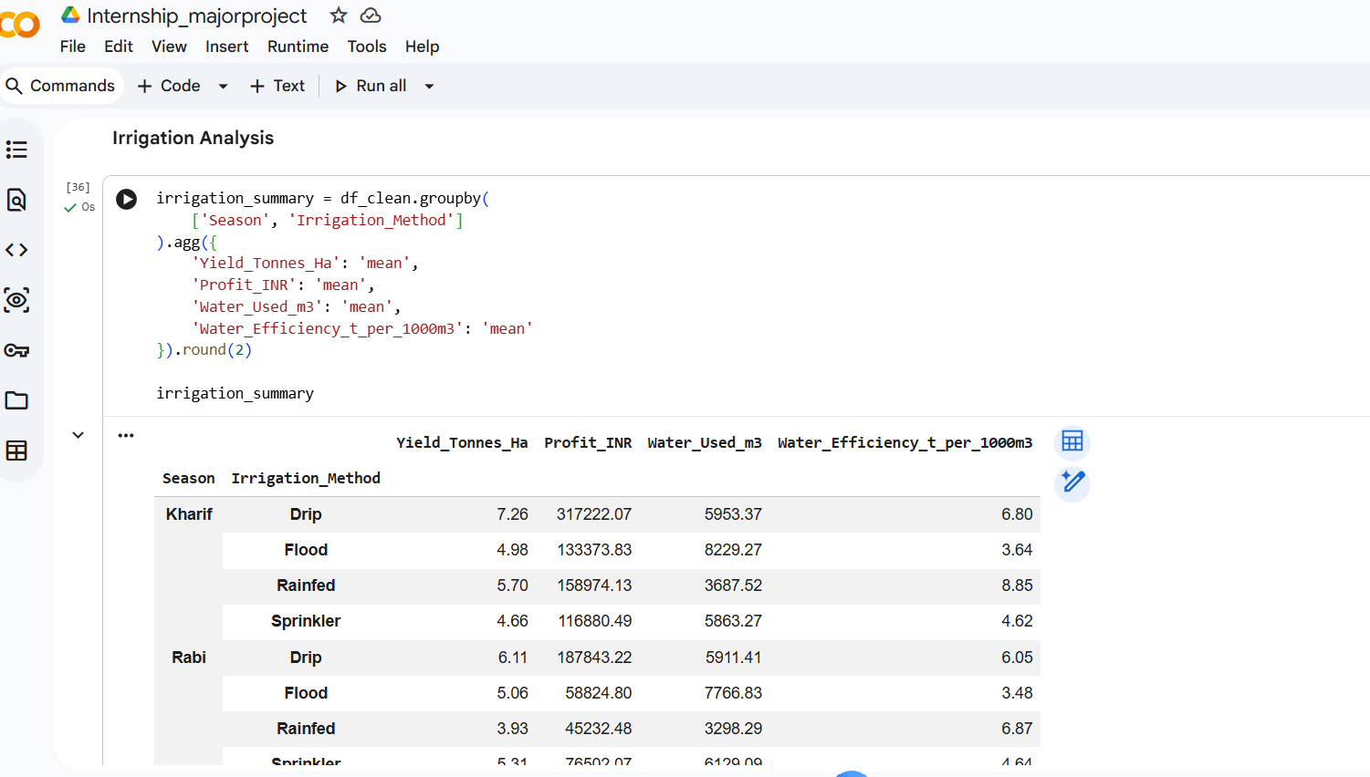
RESULTS

Slide 10
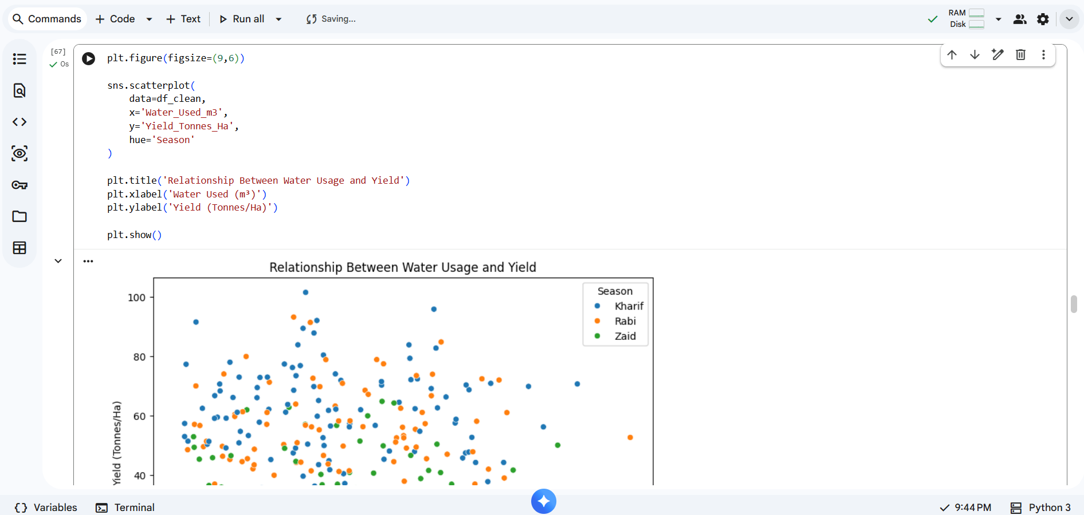
RESULTS

Slide 11
Future scope
Develop machine learning models to predict crop yield.
Develop models to predict agricultural profit.
Perform time-series analysis using multi-year agricultural data.
Build crop recommendation systems.
Develop region-specific agricultural recommendations.
Analyze the impact of environmental factors using advanced statistical models.
Develop dashboards for real-time agricultural performance monitoring.
Optimize irrigation, fertilizer and other resource usage using data-driven methods.

Slide 12
GitHub Link
https://github.com/saipriya-4/Seasonal_Agriculture_Performance_Analysis_for_internship_vois.git

Slide 13
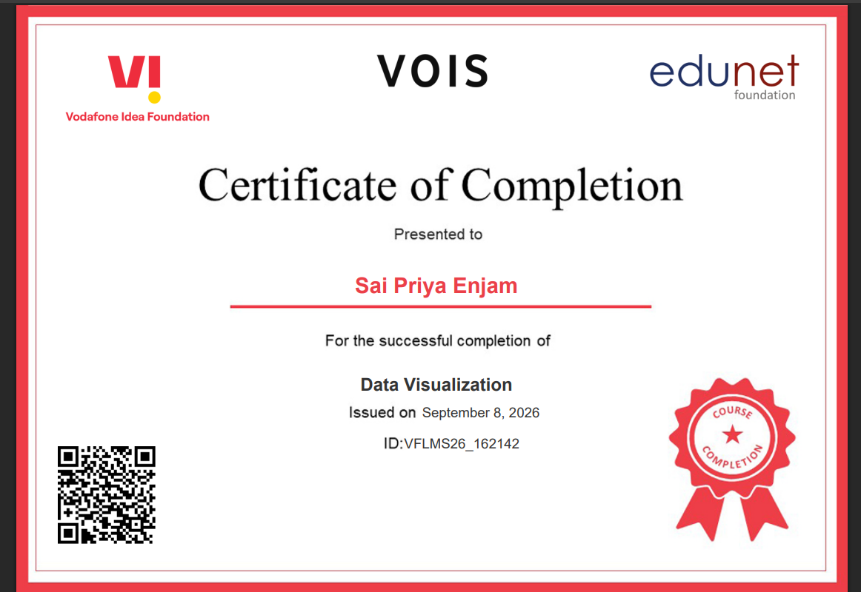

VOIS Course completion certificate -
Course name- Data Visualization

Slide 14
Thank you
Seasonal Agriculture Performance Analysis
.
.

