Slide 1
A MACHINE LEARNING MODEL TO ANALYZE AND FORECAST BANKRUPTCY
Group 15
Surya Kiran Adari
Parithosh Girish
Kavya Gundla
Anirudh Muppidi
Saipriya Nallamala

Slide 2
Participants and Roles
S.No | Name | E-mail | Role
1. | Surya Kiran Adari | SuryaKiranAdari@my.unt.edu | Designing & Researching
2. | Parithosh Girish | ParithoshGirish@my.unt.edu | Researching & Editing
3. | Kavya Gundla | KavyaGundla@my.unt.edu | Coding & Presentation
4. | Anirudh Muppidi | Anirudhmuppidi@my.unt.edu | Literature survey & Coding
5. | Sai Priya Nallamala | SaipriyaNallamala@my.unt.edu | Coding/testing & presentation

Slide 3
Contents
Introduction
Abstract
Dataset description
Design
Workflow
Modelling
Results
Conclusion
References

Slide 4
Introduction
Abstract :
The term Bankruptcy is defined as a legal proceeding in which any person or organization is incapable of repaying the loans. Bankruptcy is one of the key problems for both associations and banks. Throughout the world, academic literature and professional researchers have discussed the chance of business debts. Foretelling at the starting stage of bankruptcy may help the banks reduce their financial losses and help them to choose correct opinions. The aim of bankruptcy prediction is to evaluate a company's financial status and its potential prospects for sustained operation in the market over the long term. This field encompasses a broad range of topics in finance and econometrics, incorporating both expert insights into the phenomenon and data on successful and unsuccessful companies.
This model helps us to predict whether any person or association will go bankrupt or not. Bankruptcy is one of the crucial topics that needs to be addressed in order to reduce risk of money for both organizations and banks.

Slide 5
Problem Statement :
If the organization unable to know it’s financial status, then there will be more risk for organizations that they may go bankrupt in future.
Solution :
Our project can assist banks in making more informed decisions when granting loans to companies by analyzing bankruptcy models. This information is crucial as without it, a bank cannot properly evaluate a company's financial status and growth potential, leading to potential incorrect loan sanctions.

Slide 6
Dataset Description
We utilized the Polish bankruptcy data from the University of California Irvine (UCI) Machine Learning Repository, which is a comprehensive collection of datasets accessible for research and learning purposes for the Machine Learning/Data Science community.
First year: The information includes financial rates for the first year of the forecasting period and a class label that, after five years, indicates whether or not a company will file for bankruptcy.
Second year : Financial rates from the second year of the forecasting period are included in the data, and a matching class label indicates whether bankruptcy will occur after four years.
Third year: The information includes financial rates for the third year of the forecasting period and a class label that designates whether bankruptcy will occur after three years.
Fourth year: The information includes financial rates for the fourth year of the projection period and a class label that designates whether bankruptcy will occur after two years.
Fifth year: The information includes financial rates for the fifth year of the forecasting period and a class label that designates whether bankruptcy will occur after one year.
Data set Link : https://archive.ics.uci.edu/ml/datasets/Polish+companies+bankruptcy+data

Slide 7
Data | Total Instances | Bankrupt Instances | Non-Bankrupt Instances
1st Year | 7027 | 271 | 6756
2nd Year | 10173 | 400 | 9773
3rd Year | 10503 | 495 | 10008
4th Year | 9792 | 515 | 9227
5th Year | 5910 | 410 | 5500

Slide 8
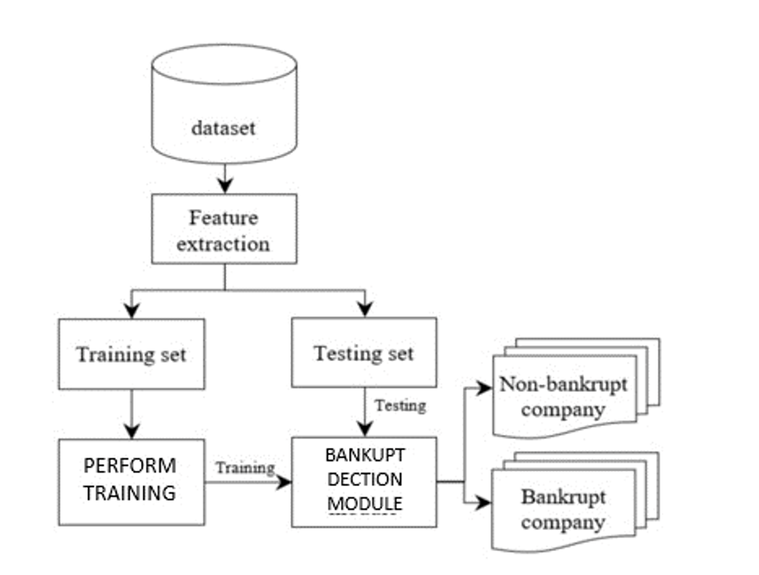
Design

Slide 9
Workflow
Importing libraries
Importing and organizing the data
Convert the columns types for the features to float
Convert the class label types to int
Data Analysis and Preprocessing
1.Missing Data Analysis
2.Generate Sparsity Matrix for the missing data
3.Generate Heat Map for the missing data
4.Data Imputation
a.Mean Imputation
b.K-NN
c.EM

Slide 10
5.Dealing with imbalanced data
a.Oversampling with SMOTE
Data Modeling
a.K-Fold Cross validation
Models
a.Gaussian Naive Bayes classifier
b.Logistic Regression classifier
c.Decision Tree classifier
d.Random Forest classifier
e.Extreme Gradient Boosting classifier
Results and Evaluation

Slide 11
Data Modelling
1.Gaussian Naïve Bayes Classifier-Naive Bayes classifier is one of the supervised learning algorithms which is based on applying Bayes’ theorem with the “naive” assumption of independence between every pair of features.
2.Logistic Regression Classifier-In this model, the probabilities describing the possible outcomes of a single trial are modeled using a logistic function.
3. Decision Trees Classifier-For our classification task, we create a model that predicts the value of a target variable (y = will a firm go bankrupt?) by learning simple decision rules inferred from the data features (𝑥1, 𝑥2…. 𝑥64- all the financial distress variables of a firm)
4.Random Forest Classifier-A random forest is a meta estimator that fits a number of decision tree classifiers on various subsamples of the dataset and use averaging to improve the predictive accuracy and control over-fitting.
5. Extreme Gradient Boosting Classifier- It builds the model in a stage-wise fashion like other boosting methods do, and it generalizes them by allowing optimization of an arbitrary differentiable loss function.

Slide 12
Results
Our findings are structured in the following way: Initially, we present the accuracy scores of five models that we have tested. We display accuracy in a graph that plots each of the three imputation(Mean, KNN, EM) techniques against the five models(Naive Bayes’ , Random Forest, Decision Tree, Logistic Regression, XGBoost) used.
As noted in the results section, the Gradient Boost Classifier with Mean Imputation method is the most effective model that we have tested.
The Extreme Gradient Boosting model emerged as the most accurate model for all imputation techniques, with Random Forest coming in second place. Third place is Decision Tree. Our analysis in the results section showed that Logistic Regression performed slightly better than the Gaussian Naïve Bayes model, which ranked fourth. Finally, Gaussian Naïve Bayes model had the worst performance among all models,which ranked fifth.

Slide 13
 | Mean | K-NN | EM
Gaussian Naïve Bayes | 0.514834 | 0.516469 | 0.515161
Logistic Regression | 0.715885 | 0.717098 | 0.706942
Decision Tree | 0.929784 | 0.904210 | 0.923568
Random Forest | 0.953388 | 0.937045 | 0.945997
ExtremeGradient Boosting | 0.989260 | 0.985345 | 0.989093

Slide 14
Conclusion
This section provides a summary of the work done in the project so far. The project involved building five classification models, namely Gaussian Naïve Bayes, Logistic Regression, Decision Trees, Random Forests, and Extreme Gradient Boosting classifiers. The training data was balanced by oversampling the minority class labels using Synthetic Minority Oversampling technique. Missing values in the data were handled by using three imputation techniques: Mean, k-Nearest Neighbors (k-NN) and, Expectation-Maximization (EM). The main challenge faced in the project was dealing with missing or sparse data, which is a common issue in bankruptcy prediction because companies don't operate on the same timelines. The features used for bankruptcy prediction are not straightforward and require thorough study and validation. The findings of the project have been documented, and the best bankruptcy prediction model has been suggested.

Slide 15
References
Rachit Toshniwal. (2020, July 21). (Code) KNN Imputer for imputing missing values | Machine Learning [Video]. YouTube. https://www.youtube.com/watch?v=HXV8DYRNAT4
DataMites. (2020, February 10). Handling Imbalanced Datasets SMOTE Technique [Video]. YouTube. https://www.youtube.com/watch?v=dkXB8HH_4-k
Medium. (n.d.). Medium. https://towardsdatascience.com/all-machine-learning-models-explained-in-6-minutes-%209fe30ff6776a?gi=c4dbee0b2d92

Slide 16
Thank you

