Slide 1
GIT
A version control system (VCS) allows you to track the history of a collection of files. It supports creating different versions of this collection. Each version captures a snapshot of the files at a certain point in time and the VCS allows you to switch between these versions. These versions are stored in a specific place, typically called a repository
Git is currently the most popular implementation of a distributed version control system
DISTRIBUTED VS. CENTRALIZED
The main difference between the two classes is that Centralized VCSs keep the history of changes on a central server from which everyone requests the latest version of the work and pushes the latest changes to. This means that everyone sharing the server also shares everyone’s work. Sourceforge.net uses this type of versioning in their projects.
On the other hand, on a Distributed VCS, everyone has a local copy of the entire work’s history. This means that it is not necessary to be online to change revisions or add changes to the work. “Distributed” comes from the fact that there isn’t a central entity in charge of the work’s history, so that anyone can sync with any other team member. This helps avoid failure due to a crash of the central versioning server

Slide 2
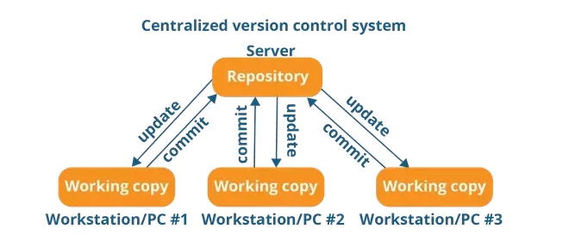
Centralized VCS
Centralized version control system (CVCS) uses a central server to store all files and enables team collaboration. It works on a single repository to which users can directly access a central server
Every programmer can extract or update their workstations with the data present in the repository or can make changes to the data or commit in the repository. Every operation is performed directly on the repository
It is not locally available; meaning you always need to be connected to a network to perform any action.
Since everything is centralized, in any case of the central server getting crashed or corrupted will result in losing the entire data of the project

Slide 3
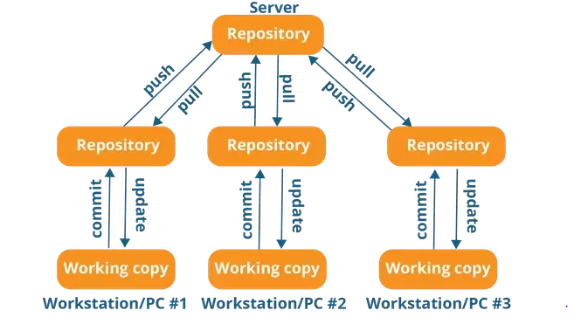
Distributed VCS
In Distributed VCS, every contributor has a local copy or “clone” of the main repository i.e. everyone maintains a local repository of their own which contains all the files and metadata present in the main repository
They can update their local repositories with new data from the central server by an operation called “pull” and affect changes to the main repository by an operation called “push” from their local repository

Slide 4
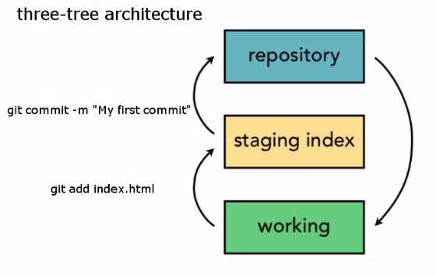
GIT ARCHITECTURE

Slide 5
GIT Installation
Ubuntu, Debian and derived systems
sudo apt-get install git
RedHat, CentOS and Fedora
sudo yum install git
GIT Configuration
git config --global user.name "Firstname Lastname“
git config --global user.email "your.email@example.org"
Creating Repository thru CLI
[root@localhost ~]# mkdir devops
[root@localhost ~]# cd devops
[root@localhost devops]# git init
Initialized empty Git repository in /root/devops/.git/
[root@localhost devops]#
git init is used to start using git on a project that's not under git.

Slide 6
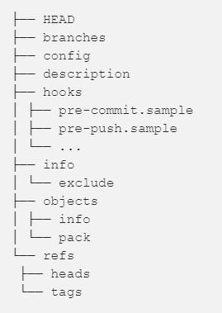
your local repository consists of three "trees" maintained by git. the first one is your Working Directory which holds the actual files. the second one is the Index which acts as a staging area and finally the HEAD which points to the last commit you've made

Slide 7
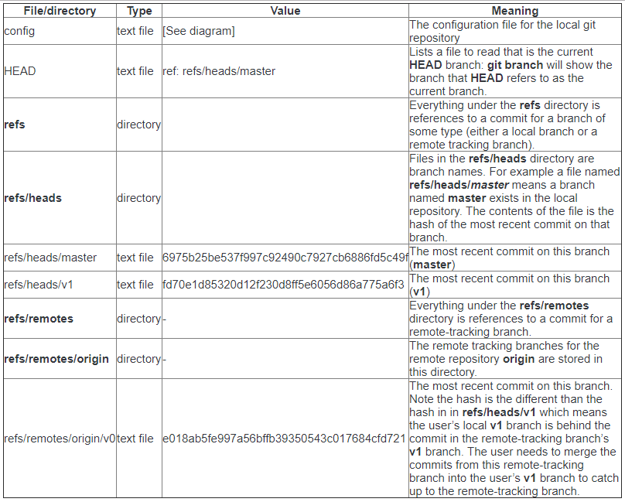

Slide 8

Bare git repository
A bare repository created with git init --bare is for… sharing. If you are collaborating with a team of developers, and need a place to share changes to a repo, then you will want to create a bare repository in centralized place where all users can push their changes (often the easy choice is github.com). Because git is a distributed version control system, no one will directly edit files in the shared centralized repository. Instead developers will clone the shared bare repo, make changes locally in their working copies of the repo, then push back to the shared bare repo to make their changes available to other users.
I use a working directory created with git init or git clone when I want to add, edit and delete files in myproject locally on my dev machine.
When I am ready, I share my local changes with a git push to a bare repository myproject.git (usually on a remote server like github.com) so other developers can access my local changes.

Slide 9
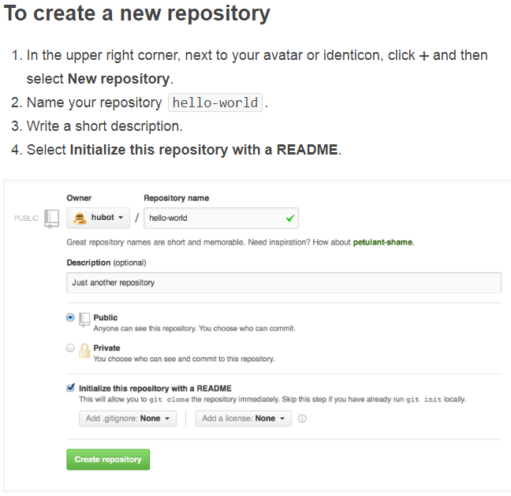
in GIT HUB

Slide 10
Create GIT HUB Repository thru CLI
curl -u 'USER' https://api.github.com/user/repos -d '{"name":"REPO"}'
USER : user name of github
REPO : repository name
Ignore the files which don’t want to push to GITHUB
.gitignore
Create .gitignore file in the local repository
Open the .gitignore file add the files which don’t want to push to GIT HUB
Save the file and and exit
Push the repository to GIT HUB (git push origin master)

Slide 11
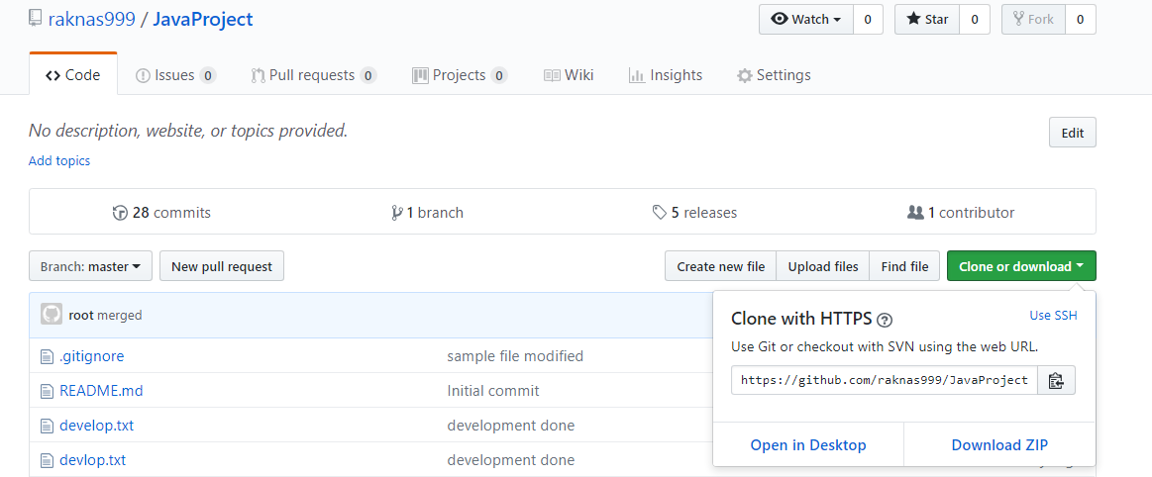
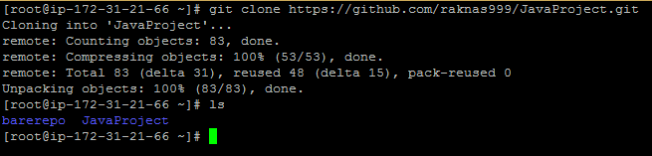
GIT Clone using HTTPS

Slide 12
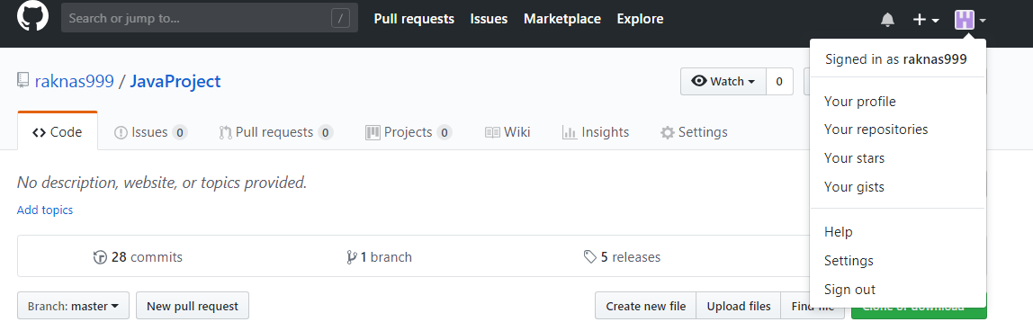
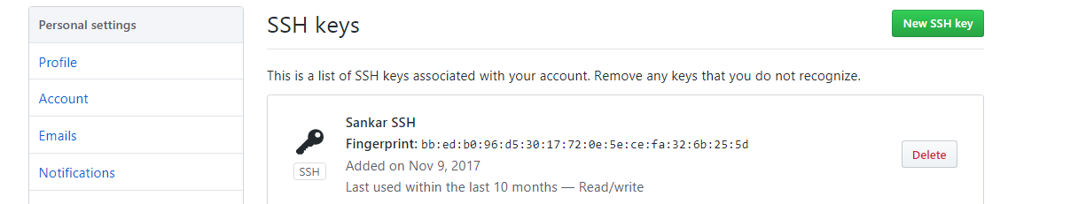
GIT Clone using SSH
Create Private key and Public key using SSH-KEYGEN command on the development machine for the user
Log in to GIT HUB , go to user settings then select SSH an GPG keys option
Click on New SSH Key and add the public key

Slide 13
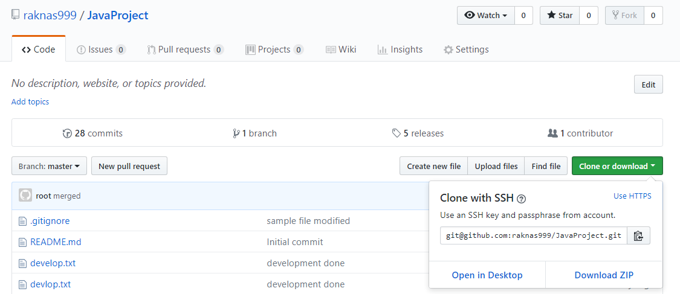
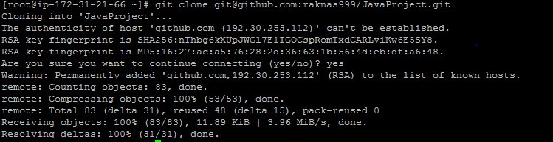

Slide 14
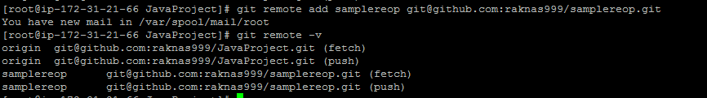

Remote Path :
Git remote –v : to view pull and push path
Adding Remote Path :
Git remote add <name> path
Renaming Remote Name :

Slide 15


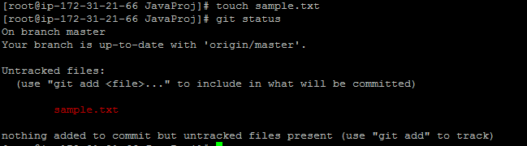
Change Remote Path :
Git remote set-url <remote name> path
Delete Remote Path :
git remote rm <remote name>
Add or Modify data :

Slide 16
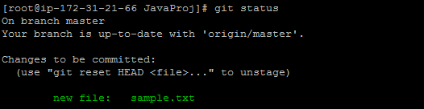
untracked: the file is not tracked by the Git repository. This means that the file never staged nor committed
Git add :
Git add file-name (to add particular file)
Git add . (to add all the files)
Git commit :
Git commit –m “message”
Or
Git commit –am “message” (in a single shot add and commit will be done)
After every commit new unique SHA value generated

Slide 17

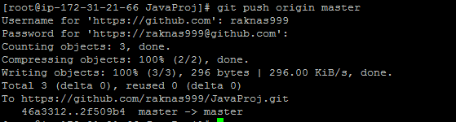
untracked: the file is not tracked by the Git repository. This means that the file never staged nor committed
Git Push with HTTPS : Push the changes to remote repository (git hub)
If the repository is cloned using HTTPS then it will ask user name and password at the time of pushing the change to remote repo

Slide 18
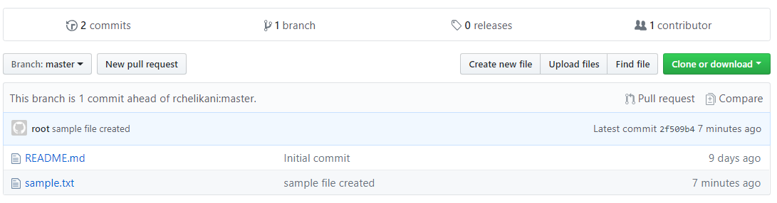
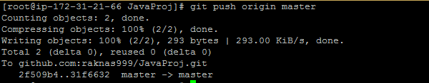
Git Push with SSH : Push the changes to remote repository (git hub)
If the repository is cloned using SSH, it will push the changes to remote repo with out asking user name and password
Git Pull : git pull runs git fetch with the given parameters and calls git merge to merge the retrieved branch heads into the current branch

Slide 19
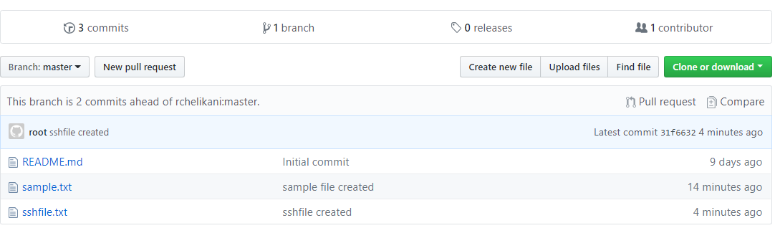
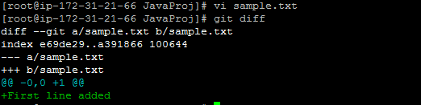
Git Diff : Compare the changes (between branches, commits, local and remote)

Slide 20
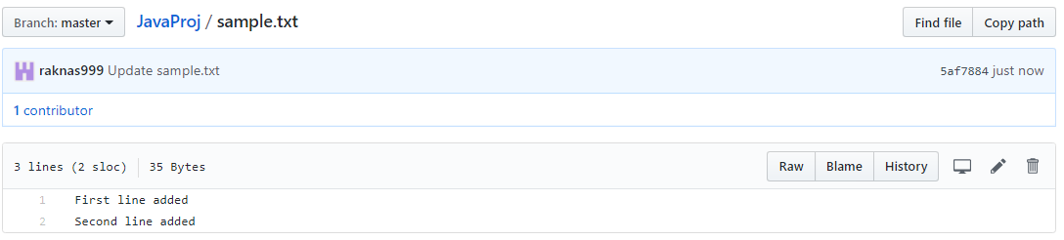
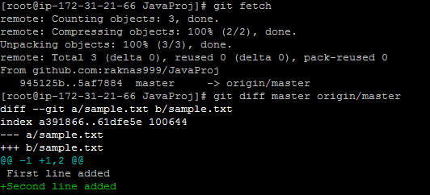

Slide 21
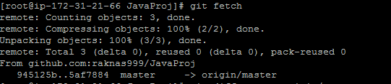


Git Fetch : Fetch branches and/or tags (collectively, "refs") from one or more other repositories, along with the objects necessary to complete their histories but not merged with local repository
Git Merge : Merge the changes to local repository

Slide 22
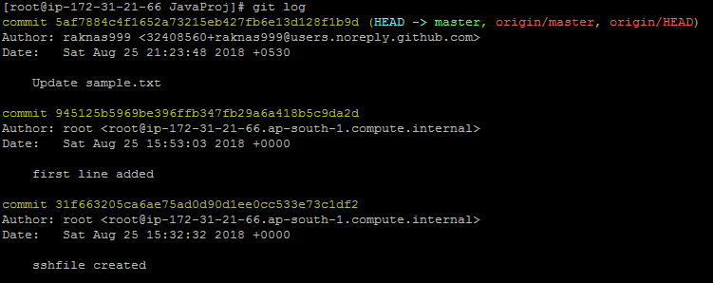
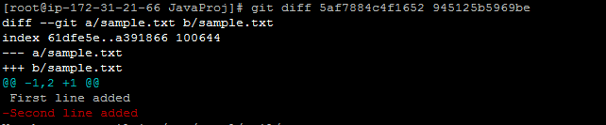
Git Log : To check the log information
Comparing difference between commits

Slide 23

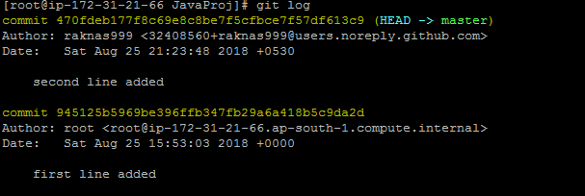
Git commit --amend : To modify the commit message
git commit --amend -m “message"
Git Branch :
Git supports branching which means that you can work on different versions of your collection of files. A branch allows the user to switch between these versions so that he can work on different changes independently from each other.

Slide 24



Create Branch :
git branch (branch name)
Verify Branch :
Switch to Branch :
git checkout branch
Modify and verify the changes in branch
Verify the changes in Master branch

Slide 25

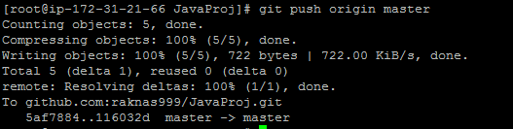
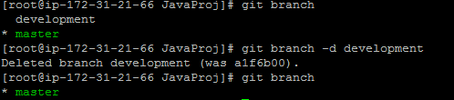
Merging Branch :
git merge branch
Delete Branch :
Git branch –d <Branch Name>
Git brand –D <Branch Name> (To delete forcefully)

Slide 26
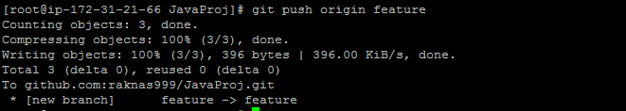
Create Pull Request:
1. Update the local repository (git pull)
2. Create Branch and switch (git checkout –b branch (it will create and switch))
3. Push Branch to Remote (git push origin <branch name>)

Slide 27
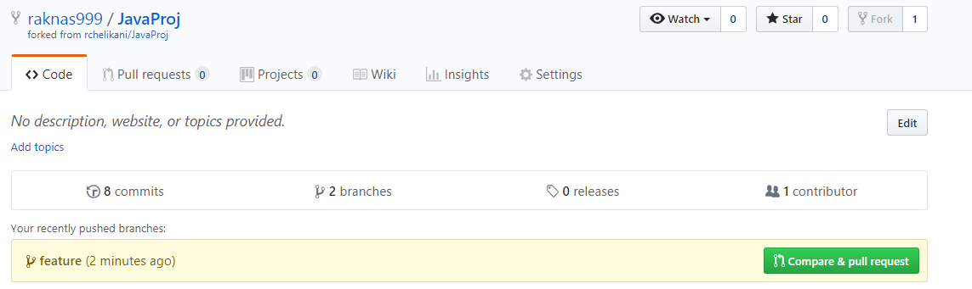
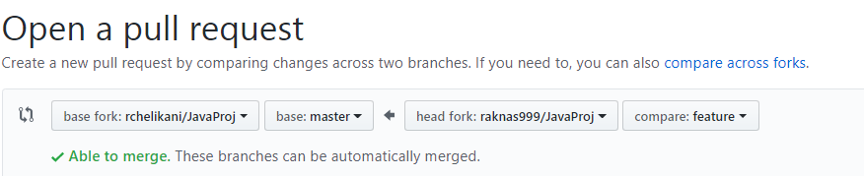
4. Verify in git hub, compare and pull request button will appear
5. Compare the changes by clicking the button

Slide 28
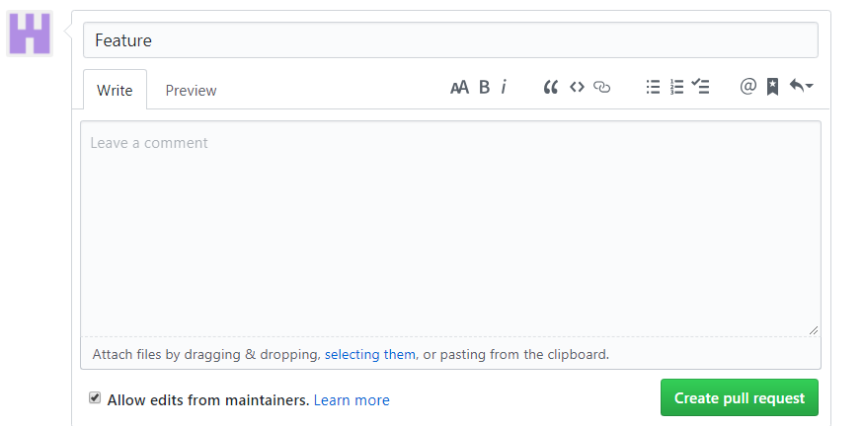
6. Create pull request

Slide 29
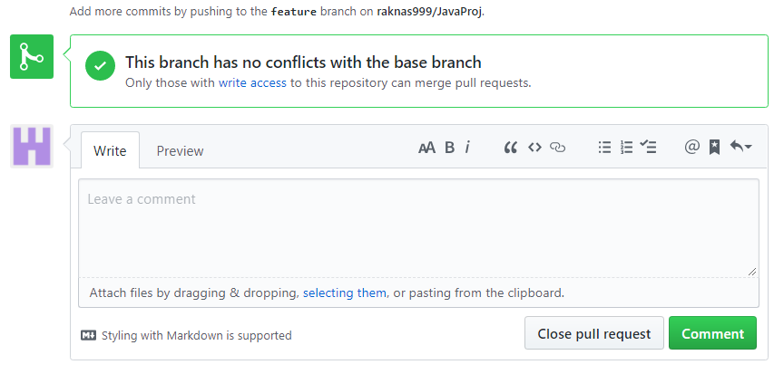
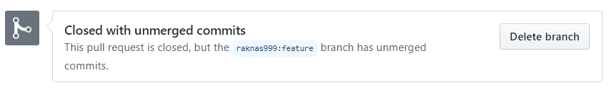
7. Close pull request
8. Delete Branch

Slide 30
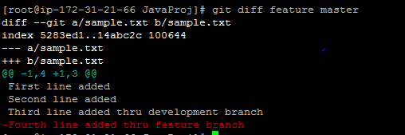

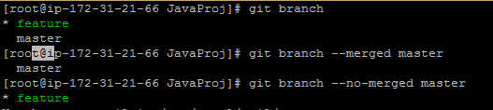
Compare two branches:
Branches merged with Master
git branch --merged master
Branches not merged with Master
git branch –no-merged master

Slide 31

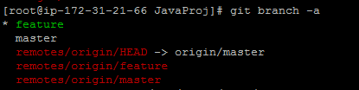

Remote Branches list :
git branch -r
All Branches list(local and remote) :
git branch -a
Rename Local Branch :
git branch -m (old name) (newname)
git branch -M (old name) (newname) -→ To rename forecfully

Slide 32
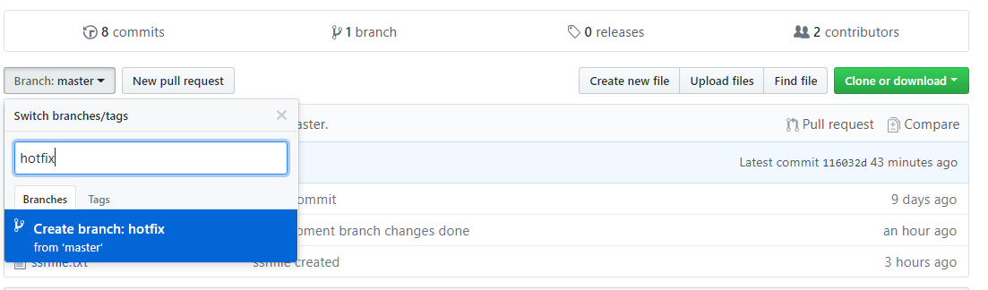
Rename Remote Branch :
1. Create Branch on GIT HUB
2. Update Local repository (git pull)
3. Rename the branch (git branch –m <old name> <new name>)
4. Delete the branch one Remote (git push origin :branch name )
5. Push the branch to remote (git push orign <branch name> )
Delete Branch Locally :
Git branch –d branch name
Git branch –D branch nae (forceful delete)

Slide 33


Delete all the local Branches :
git branch --merged | grep -v \* | xargs git branch -D
Delete Remote Branch
git push origin :<branch name>
git fetch origin –prune : this removes all obsolete local remote-tracking branches for any remote branches that no longer exist on the remote

Slide 34

Tagging or Versioning
it has the ability to tag specific points in history as being important. Typically people use this functionality to mark release points (v1.0, and so on)
Tagging Types :
Git supports two types of tags: lightweight and annotated.
1. Lightweight Tags
git tag <tag name> (create tag on latest commit)
Tags List :
Create tag for particular commit :
git tag <tag name> <commit id>

Slide 35
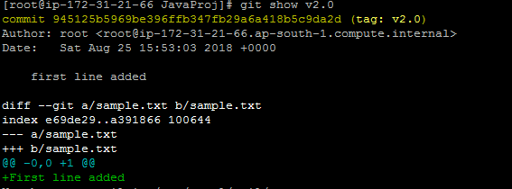
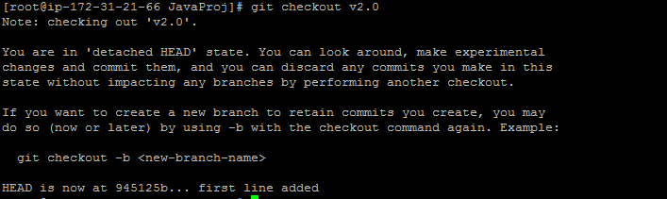
To view the tag :
git show <tag version>
Modify particular version :
git checkout <version>

Slide 36


Create branch for the version
Now the new branch will contain the particular version code
Push the tags to remote from local
git push origin <tag name>
Push all the tags to remote from local
git push origin --tags

Slide 37
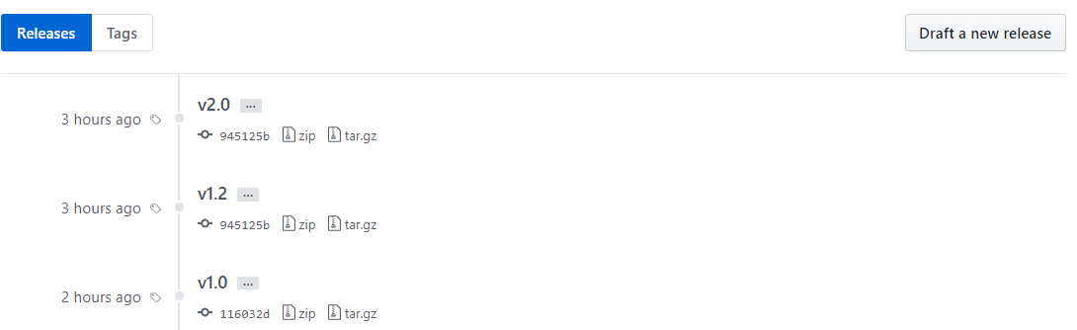
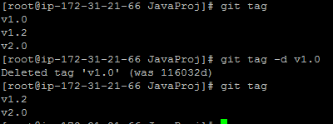
Delete local tag :
git tag -d (tag name)

Slide 38



Delete all the local tags :
git tag -d $(git tag -l)
To view remote tags :
git ls-remote --tags
Delete remote tag :
git push origin :<tag name>

Slide 39

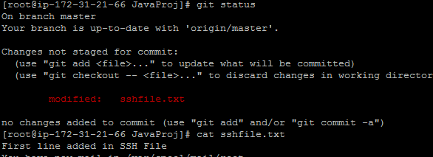
Delete all the remote tag :
git ls-remote --tags --refs origin | cut -f2 | xargs git push origin --delete
2. Annotated Tags :
git tag -a v1.4 -m “message"
Undo the changes before add :
git checkout <file>

Slide 40

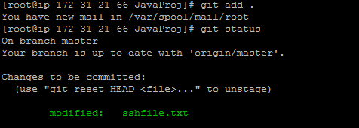
Undo the changes after add :
Do the changes
Add the file (git add .)
Git reset file

Slide 41
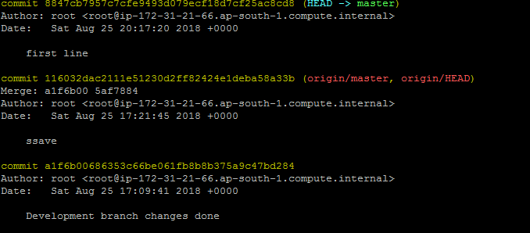
Undo the changes after commit :
Types of reset
1. git reset soft
2. git reset mixed (default)
3. git reset hard
git reset soft
Take the commit id which we want to keep
Apply the command (git reset --soft paste the id)

Slide 42
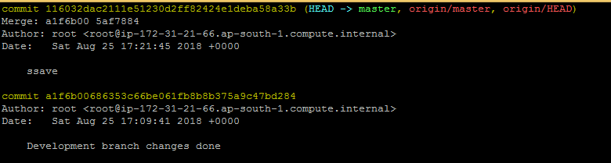
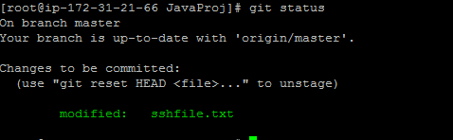
Changes will come back to staging (after add)

Slide 43
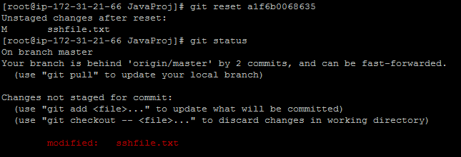
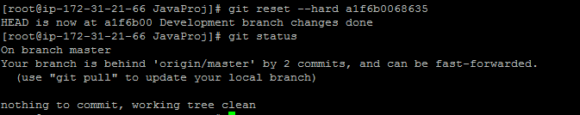
git reset mixed (default)
Changes will come back to staging (before add)
git reset hard

Slide 44
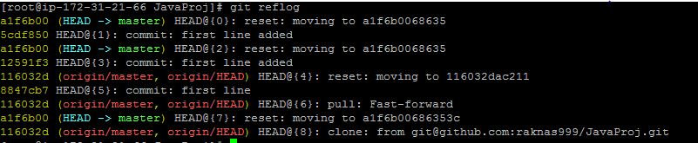


Bring back deleted data:
git reflog --> will show all the commits history even after reset
git checkout <commid id> --> checkout the deleted commit id

Slide 45


Revert commit :
git revert <commit id>
It won’t delete the commit id instead creates new commit on top of existing one

Slide 46


cherry-pick
choose a commit from one branch and apply it onto another
Make sure you are on the branch you want to apply the commit to.
git checkout <branch>
Execute the following:
git cherry-pick <commit-hash>
Take the commit id of the branch
Switch the branch which you want to copy the commit and apply cherry-pick

Slide 47


Commit will be copied into the destination branch
Stashing :
Often, when you’ve been working on part of your project, things are in a messy state and you want to switch branches for a bit to work on something else and don’t want to commit half done work
Git stash -→ to save the changes in buffer
Git stash list -→ to check the stashed list
Git stash apply -→ To jump into latest one
Git stash apply stashid → to go to the particular stash block
Git stash apply pop → to go to the particular block and remove the entry from stash list

Slide 48
Stash process:
create branch(child1) on master do some changes to file, then add the file then stash
create branch(child2) on master do some changes to file, then add the file then stash
create branch(child3) on master do some changes to file, then add the file then stash
git stash list (it will show you from 0 to 2)
git stash apply stash@{1} --> it will go to second one
now undo the changes or commit (git checkout file or git commit)
git stash apply stash@{2} --> it will go to third one
now undo the changes or commit (git checkout file or git commit)
GIT Rebase :
Rebasing is the process of moving or combining a sequence of commits to a new base commit.
Example :
Commit A: we add a.txt file in the ‘master’ branch
Commit B: we add b.txt file in the ‘master’ branch
At this stage, we create the branch ‘feature’ which means it will have a.txt and b.txt
Commit C: we add c.txt file in the ‘master’ branch
We go to the ‘feature’ branch
Commit E: we modify a.txt in ‘feature’ branch
Commit F: we modify b.txt in ‘feature’ branch

Slide 49
git init
touch a.txt
git add -A
git commit -m "Commit A: added a.txt"
touch b.txt
git add -A
git commit -m "Commit B: added b.txt"
git branch feature
touch c.txt
git add -A
git commit -m "Commit C: added c.txt"
git status
git checkout feature
echo aaa > a.txt
git add -A
git commit -m "Commit E: modified a.txt"
echo bbb > b.txt
git add -A
git commit -m "Commit F: modified b.txt"

Slide 50



git checkout master
git checkout feature
Merge the feature branch to master

Slide 51



Check the commit history after merge
After merge log of feature branch

Slide 52


In the Commit G(new), all the changes from ‘feature’ branch have been brought into the master branch. But the ‘feature’ branch itself has remained untouched due to the merge process. Notice the hash of each commit. After the merge, E (376a209) and F (cc097be) commit has the same hash on the ‘feature’ and ‘master’ branch.
Merging with Rebasing
After done the changes on both master and feature branches
git checkout master
git checkout feature

Slide 53



git rebase master
merge ‘feature’ into ‘master
Git checkout master
git merge feature
Verify the log of master branch
Verify the log of feature branch

Slide 54


Notice that after the rebase and merge both branches are the same. Also, the hashes for E and F have changed in both branches. Basically, in the rebase scenario, this is what happened:
That’s why there is no new commit. The E and F commits have been recalculated and latched to the end of the ‘master’ branch.
Re arranging commit using rebase

Slide 55

git rebase -i HEAD~3 : will open latest three commits

Slide 56

Now change the order and save the file

Slide 57

Check th log , now we can see the changed order

Slide 58


GIT Conflict
No sync between remote repository and local repository conflicts will happen
GIT
GIT HUB

Slide 59


Try update the remote with local , will face conflict due to non sync
Resolving Conflicts : open the file and modify accordingly

Slide 60


GIT FORK
github makes a separate copy for you, independent of the original repository

Slide 61

Open the project which you want to be fork and click on fork

Slide 62

GIT Merge Conflict Resolution
Launch Merge Tool : git mergetool
Changing Merge Tool : Git config –global merge.tool <tool name>

Slide 63
You can incorporate the changes by manually editing the MERGED split, or use Vim shortcuts pull from one of the LOCAL, BASE ad REMOTE versions.
:diffg RE # get from REMOTE
:diffg BA # get from BASE
:diffg LO # get from LOCAL
save the changes then quit with :wqa to close all the splits. Remember to commit the merge.
$ git commit -am 'merged from several branches'

Slide 64



Slide 65


Slide 66



Slide 67


Slide 68


Slide 69


Slide 70


Slide 71




Slide 72



Slide 73




Slide 74



Slide 75







Slide 76


Slide 77





Slide 78


Slide 79


Slide 80



Slide 81


Slide 82


Slide 83

https://enterprise.github.com/releases

Slide 84


