Slide 1

TIC-TAC-TOE
Team
-Meghana Reddy Beemireddy
-Sai Priya Kanuganti.

Slide 2

AIMS
-Goal is to build an agent to play against the user in Tic-Tac-Toe
The game is to be played between two people.

Slide 3
The goal for each agent is to win the game by forming a horizontal, vertical, or diagonal line of all X OR all O in a grid in which each agent plays one after the other.
The second goal is to ensure that your adversary is unable to create an X OR O pattern since this is a zero-sum game.
Objective of the Agents

Slide 4
We're creating four AI agents who will play the game as guests.
The user can choose which two agents will compete in a Tic-Tac-Toe tournament.
The logic of the game is Agent 1 wins against Agent 2 or Agent 2 wins against Agent 1or Tie between Agent 1 and Agent 2.
Statement of Project objectives

Slide 5
Minimax algorithm using traditional approach.
Minimax algorithm using alpha-beta pruning approach.
Expectimax algorithm.
Q-learning - Reinforcement Learning Algorithm.
Algorithms used

Slide 6

Code will be written with the help of Python language
APPROACH

Slide 7
Deliverables:
Documentation report(README.md)
Link of GitHub Repository
Power Point presentation(PPT)
YouTube video
Program file(.py files)

Slide 8

Evaluation Methodology
The success of the project is determined by the successful implementation of four AI algorithms.
Agents should be conditioned so that the game’s performance is as accurate as if it were played by two human brains.
While making the next move, none of the agents can freeze or struggle.

Slide 9
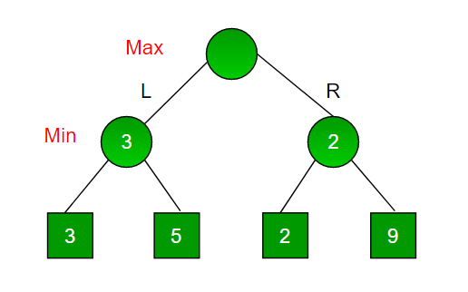
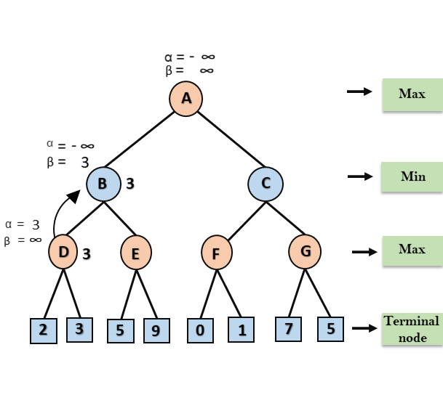
Minimax-graph
Minimax - Alpha-Beta graph

Slide 10
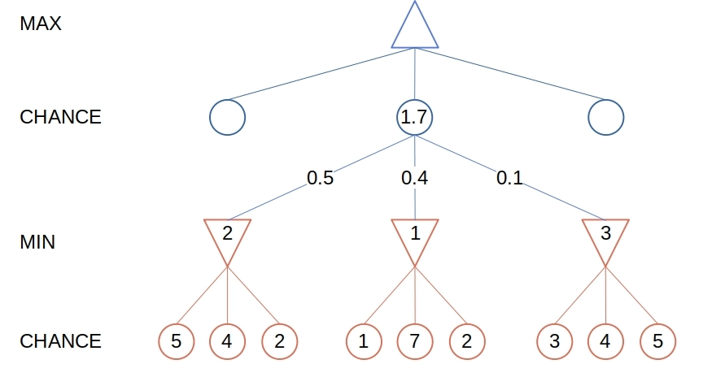
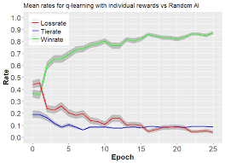
Expectimax - graph
Q-Learning - graph

Slide 11

Thank You!

