Slide 1


WWT Unravel 2025
Team : Gods
Roshnee Gouda
Sairaj G. Adhav
Problem Statement and Solution:
Fast, scalable lookup-based recommender with KMeans fallback delivering 8–10× speed gains while matching or exceeding traditional ML accuracy.

Slide 2


Understanding Problem Statement
Current Problem
Business Context
Checkout experience lacks personalized last-minute recommendations
Missed opportunity to upsell complementary items (e.g., drinks, sides, flavours)
Current suggestions are static and repetitive, reducing engagement
Leadership seeks to:
Increase basket size and average order value (AOV)
Improve retention and customer satisfaction
Keep recommendations fresh, scalable, and platform-consistent
Wings R Us: US quick service restaurant (QSR) specializing in wings, sides, and beverages
Strong presence via mobile app, website, and in-store kiosks
Customers range from first-time visitors to loyal repeat buyers
Digital platform already supports menu browsing, order placement, loyalty rewards, and past order history

Slide 3


Project Objectives
Business Objectives
Deliver personalized recommendations to boost (Average Order Value) AOV and retention
Ensure fresh, relevant, non-repetitive suggestions for diverse customers
Maintain consistent experience across app, web, and kiosks
Enable fast, low-risk pilot before large-scale rollout
Technical Objectives
Integrate customer, order history, and store metadata into a unified dataset
Build a hybrid recommendation engine combining rule-based matching, vector similarity, embeddings, and clustering
Optimize for Recall@3 using offline validation and pilot testing
Design for real-time inference and modular scalability

Slide 4
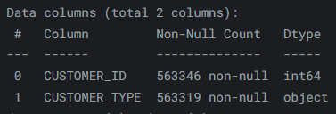
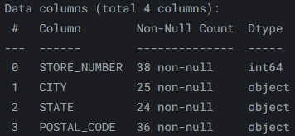
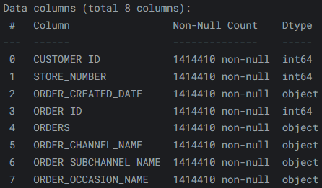
Data Overview
Provided Datasets
order_data – 1.4M rows, 9 columns, includes order metadata and JSON item details
customer_data – 550k rows, 2 columns, customer ID and customer type
store_data – 38 rows, 5 columns, store location details
test_data_question – 1k rows, 10 columns, cart triplets for prediction evaluation
customer_data
order_data
store_data

Slide 5
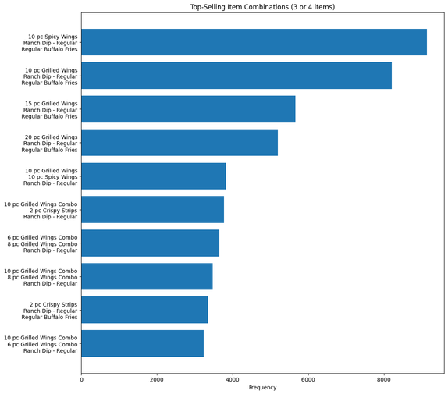
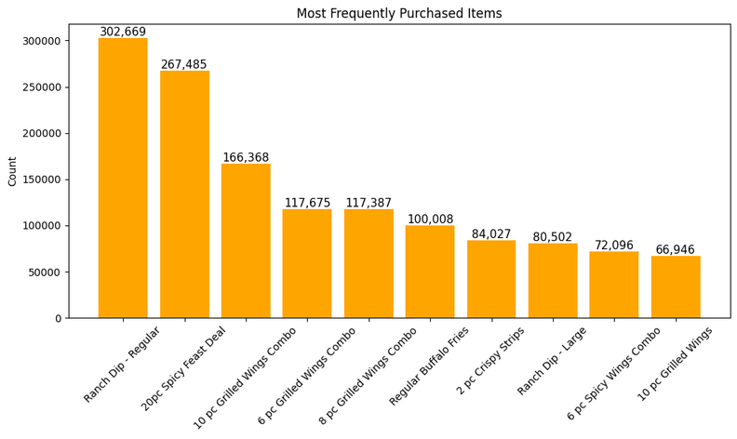
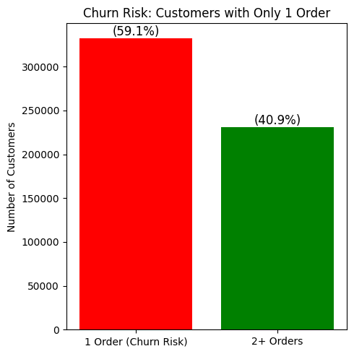
EDA Highlights
10 pc Spicy Wings
Ranch Dip Regular
Regular Buffalo Fries
Most popular item combination
Most frequently purchased
Ranch Dip - Regular
Nearly 59% for customers account for churn risk

Slide 6
Recommendation System Design
Orders Dataset
Orders Preprocessing
Feature Preprocessing
Unified Feature Dataset
Order Level
Customer Level
Store Level
Creating Lookups (Past 1.5M)
Supervised Lookup Based RecSys
Hybrid Recommendation System
(Supervised + Unsupervised)
Combination Filtering
Encoding Items
Recommendation
FastText Vectorization
Unsupervised KMeans Clustering

Slide 7
Model Training and Evaluation
Creating Lookups (Past 1.5M)
Supervised Lookup Based RecSys
Hybrid Recommendation System
(Supervised + Unsupervised)
Combination Filtering
Encoding Items
Recommendation
FastText Vectorization
Unsupervised KMeans Clustering
Model Training Flow
Evaluation
Combination Filtering: Select valid order baskets with 3+ unique items.
Item Encoding: Convert product names to numbers.
Supervised Path:
Create lookup dictionaries from 1.5M past orders.
Train a recommendation module for known patterns.
Unsupervised Path:
Use FastText for item embeddings.
Apply KMeans clustering for similar item grouping.
Hybrid System: Combine supervised predictions with unsupervised recommendations.
Output: Generate the Top 3 recommendations optimized for Recall@3.
Supervised Path Evaluation => 0.8642
(86 .42% tests were accurate)
Unsupervised Path Evaluation => 0.5245
(52.45% tests were accurate)
Hybrid Path Evaluation => 0.8645
(86.45% tests were accurate)

Slide 8




Pilot Rollout Plan
Phase 1 – Limited Deployment
Launch in 5–10 selected stores across different regions
Target both app and kiosk orders to test multi-channel consistency
Phase 2 – Performance Monitoring
Track Recall@3 on live data
Measure uplift in average order value (AOV) and basket size
Monitor click-through rate (CTR) on recommendations
Phase 4 – Full Rollout
Gradually expand to all stores and digital platforms
Automate retraining pipeline for continuous improvement
Phase 3 – Iteration & Optimization
Refine hybrid model weights based on real-world performance
Adjust clustering for freshness and diversity
Fix cold-start cases for new items and first-time customers

Slide 9
Unique Selling Point & Business
Differentiator
Business Impact
Proprietary lookup-based recommendation engine delivering 8–10× faster performance than conventional ML approaches
Maintains equal accuracy while drastically reducing training and inference time
Enables rapid deployment, effortless scaling, and low-maintenance operations
Hybridized with KMeans clustering to enhance diversity, freshness, and contextual relevance
Clustering doubles as a smart fallback for cold-start and low-frequency item scenarios
Guarantees non-repetitive recommendations, improving user engagement over time
Purpose-built for multi-platform consistency across app, web, and kiosks
+8–12% projected increase in Average Order Value (AOV)
Higher add-on rates for complementary items (drinks, sides, sauces)
Improved click-through rate from relevant, fresh recommendations
Increased loyalty program participation via personalization
Optimized menu placement and inventory through data insights
Better demand forecasting for popular combos
Reduced churn with targeted offers to at-risk customers
Stronger relationships with loyal customers
Competitive edge in QSR market through AI-powered personalization
Consistent experience across app, web, and kiosks

Slide 10




Future Scope
Model Enhancements
Fine-tune hybrid model weights for better balance between supervised and unsupervised predictions
Expand embedding features with more contextual signals (seasonality, promotions)
Testing & Validation
Conduct A/B testing with control group to measure actual business uplift
Monitor model performance in different regions and ordering channels
Long-Term Roadmap
Add personalization at item customization level (flavors, portion sizes)
Explore reinforcement learning for continuous optimization
Operational Integration
Integrate with live ordering systems for real-time recommendations
Automate retraining pipeline for weekly or monthly model updates

Slide 11
Thank You!
Links
GitHub Repo Link : https://github.com/saipy10/Gods_Codebase
Kaggle Notebook Link: https://www.kaggle.com/code/sai10py/gods-codebase
Video Explanation:

