Slide 1
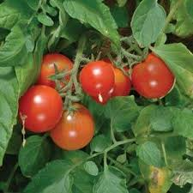
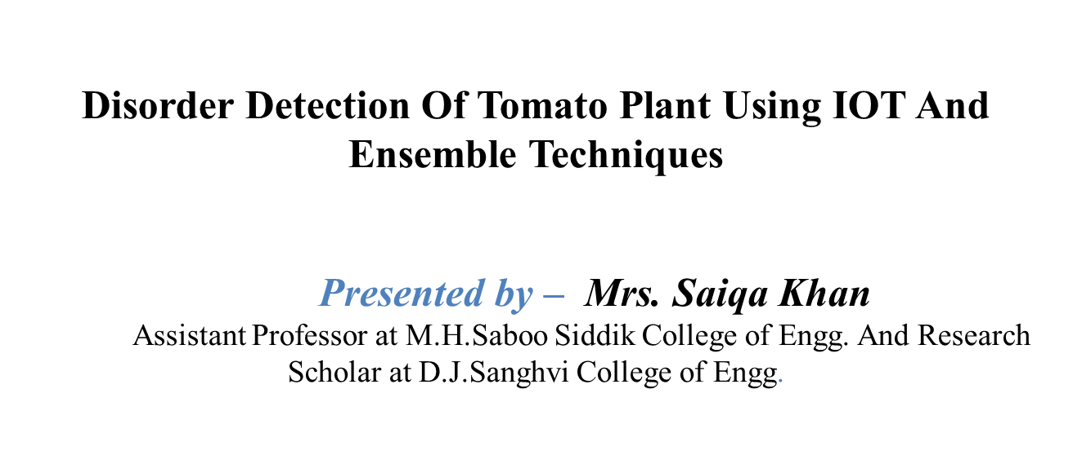

Slide 2
Contents
Introduction
Types of biotic disorder
Abiotic disorder
Nutritional deficiency disorder
Application
Challenges
Literature Survey
Conclusions
References

Slide 3
1. Introduction
Motivation:
In India, uncertain climatic conditions are on rise which has caused agriculture industry to be in dilemma regarding an overuse of pesticides.
Solanum lycopersicum commonly known as a tomato plant. The plant belongs to the nightshade family, Solanaceae. An article in Indian Express Newspaper quotes one of the framer’s opinion that “tomato crops requires less labour with high returns, luring farmers to opt for it”.
Plant Disoder is defined as “an abnormal growth and/or dysfunction of a plant. They are the result of some disturbance in the normal life process of the plant”.
Types of disorders
1. Biotic
2. Abiotic
3. Nutritional deficiency

Slide 4
Types of biotic disorder for Solanum lycopersicum
Biotic Disorder:
Biotic plant problems are caused by living organisms, such as fungi, bacteria, viruses, nematodes, insects, mites, and animals. Following are some common tomato plant biotic disorders.
1. Early Blight
This disease is caused by the fungi Alternaria tomatophila and A. solani and is first observed on the plants as small, brown lesions mostly on the older foliage.
2.Late Blight
Late blight is a potentially devastating disease of tomato and potato, infecting leaves, stems, and fruits of tomato plants.
3. Septoria leaf spot
Septoria leaf spot is caused by a fungus, Septoria lycopersici.
4. Bacterial leaf spot
Symptoms begin as small, yellow-green lesions on young leaves which usually appear deformed and twisted.
5. Bacterial wilt
Bacterial wilt is caused by the pathogen bacterium Ralstonia Solanacearum and is quite common in the moist sandy soils of the humid coastal south.
Notes:
THIS SLIDE SHOWSHOW DIFFERENT TYPES OF BRAIN INJURIES ARE CLASSIFIED
THE TYPE OF INJURY WE WILL FOCUS ON TODAY IS TRAUMATIC BRAIN INJURY

Slide 5
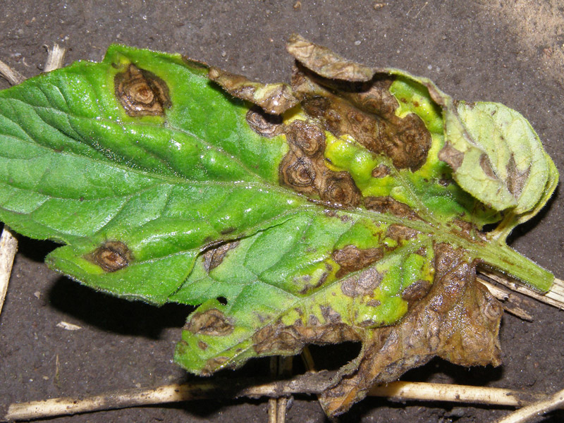
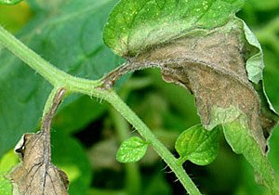
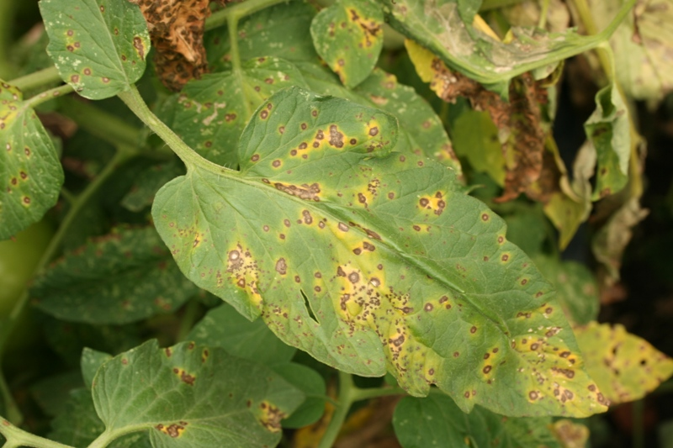
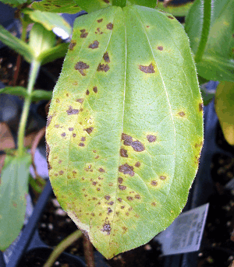
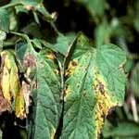
Common biotic disorders Contd…
(a) | (b) | (c)
(d) | Fig Disorders caused due to biotic factors (a) Early blight (b) Late blight (c) Septoria leaf spot (d) Bacterial leaf spot (e) Bacterial wilt | (e)

Slide 6
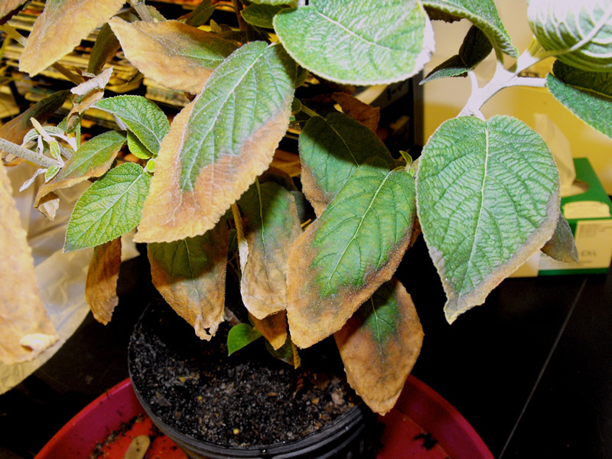
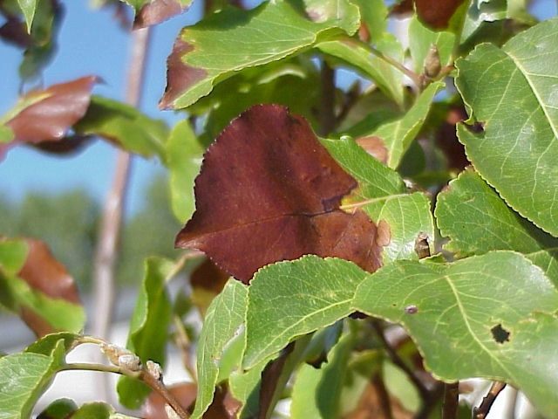
1. Introduction contd…
Abiotic Disorder:
Unfavorable soil properties
Fertility imbalances, Moisture extremes, temperature extremes, Chemical toxicity
Physical injuries, and other problems are examples of abiotic disorders that can reduce plant health and even kill plants
Plants may grow more slowly or not at all, young leaves may not fully expand, or foliage may not appear as colorful relative to healthy foliage.

Slide 7
1. Introduction contd…
Nutritional Deficiency Disorder
Nitrogen (N): Due to N deficiency, older leaves gradually change from green to paler green. As the deficiency progresses these older leaves become uniformly yellow (chlorotic). Under extreme deficiency, leaves approach a yellowish white color.
Phosphorus (P): Leaves to have a blue/green tint.
Potassium (K): Lack of potassium tends to make older leaves ‘scorch’, eventually turning brownish and rolling up inwards and downwards.
Magnesium (Mg): Due to magnesium deficiency, there happens a discoloring of the leaves between the veins.
Calcium (Ca): A sign of leaves curling inward and lacking in color shows a deficiency of calcium.
Other nutrients – Other nutrients required in small quantity are Zinc, Copper, Manganese, Iron, Sulphur and Boron.

Slide 8
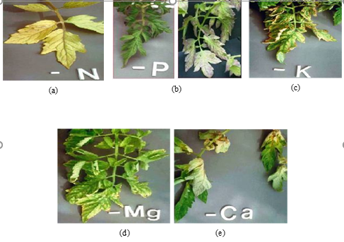
Fig. Nutritional deficiency on plant leaves (a) Nitrogen (b) Phosphorus (c) Potassium (d) Magnesium and (e) Calcium

Slide 9
2. Literature Survey
2.1 Methods in disorder detection
Traditional Methods
Serological assay-based methods
Nucleic acid-based methods
Volatile compound-based methods
Innovative Methods
Remote Sensing(RS)
Image Processing based Methods

Slide 10
2. Literature Survey Contd…
2.2 Feature extraction related literature Survey
Feature Extraction:
It is a transformation of input data into a set of features. Features are distinctive properties of input patterns that help in differentiating between the categories of input patterns.
Following are some of the feature extraction techniques used in the past:
Gray level Co-occurrence Matrix(GLCM)
Color Feature
Gabor Wavelets
Convolution Neural Network(CNN)
Deep Learning

Slide 11
3. Methods for Feature Extraction
The proposed system considers features:
1. Sensor’s data
2. Leaf image
It aims at mapping the semantic relationship between the image and the sensor’s data (Humidity, Temperature, Moisture).
Features are divided into two categories;
Sensor’s Based Feature Extraction
Deep Learning Based Feature Extraction.

Slide 12
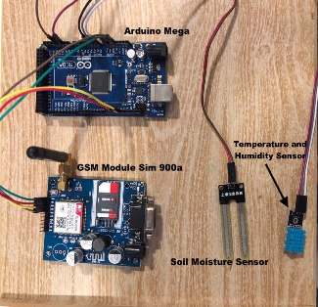
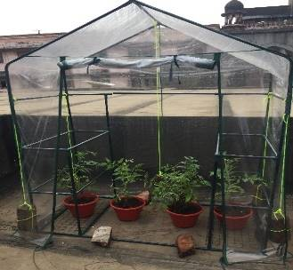
4. Proposed System
Fig .Proposed System

Slide 13
Following are the steps to be follow
Pre-processing
In this step, the images are prepared through Image Enhancement, Noise Removing, and Resizing.
Feature Extraction
The proposed system will be extracting features from the sensor’s data and from the leaf image.
Ensemble Classification
The proposed system will be using multiple deep neural nets and sensor data. This will help create a voting system or called an ensemble technique to predict considering multiple outputs from multiple models. Ensemble techniques take multiple classifiers as input and predict based on multiple models.

Slide 14
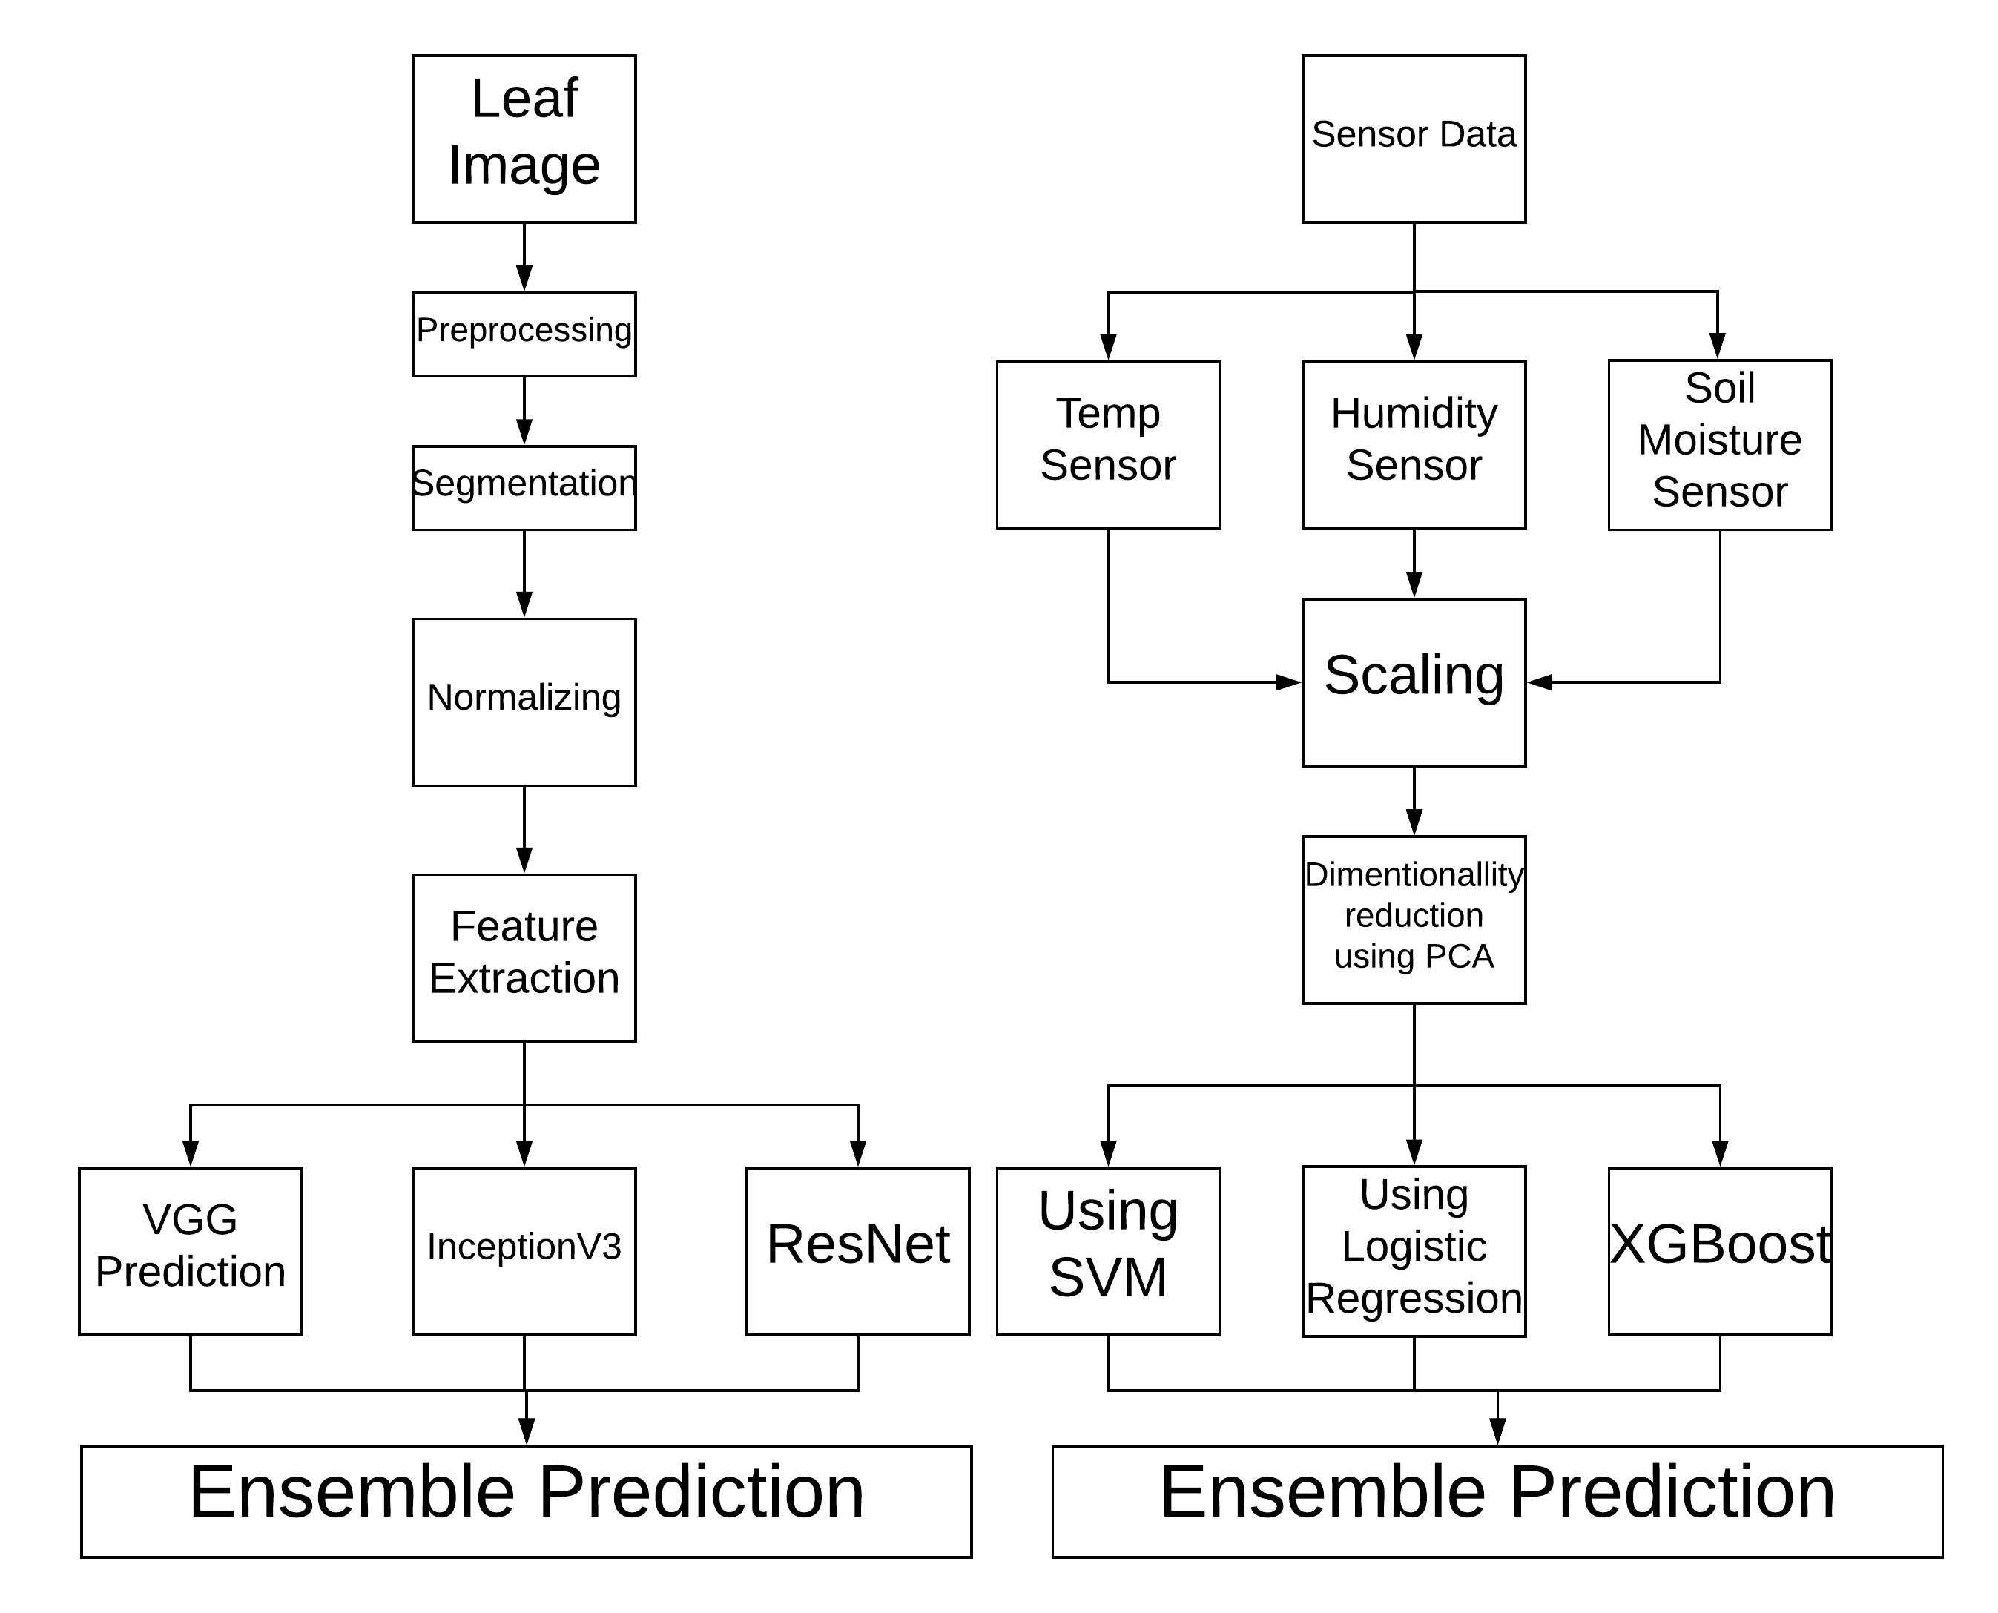
Fig Proposed System

Slide 15
3. Conclusions
All the past work in disorder detection process directed towards the use of leaf images or sensor-based data.
This paper has given significance to a process where leaf images are combined with sensory input to aid in reliable and efficient detection process.

Slide 17
References
M.M Peet, G Welles (2005). Green House Tomato Production. CAB International 2005. Tomatoes (ed. E. Heuvelink).
M. S. Kumar, T. R. Chandra, D. P. Kumar and M. S. Manikandan, "Monitoring moisture of soil using low cost homemade Soil moisture sensor and Arduino UNO," 2016 3rd International Conference on Advanced Computing and Communication Systems (ICACCS), Coimbatore, 2016, pp. 1-4. doi: 10.1109/ICACCS.2016.7586312 URL: http://ieeexplore.ieee.org/stamp/stamp.jsp?tp=&arnumber=7586312&isnumber=7586284
Tomatoes, Advisory Committee on Vegetable Crops. Vegetable Crops Production Guide. Services Coordinating Committee. [online] Available at https://www.faa.gov.nl.ca/agrifoods/plants/pdf/tomatoes.pdf.s
Gaurav Kumar, Pradeep Kumar Bhatia (2014). A Detailed Review of Feature Extraction in Image Processing Systems. IEEE Explore. 2014 fourth international conference on advance computing and communication technology
Gang Wu, S., Sheng Bao, F., & You Xu, E. (n.d.). A Leaf Recognition Algorithm for Plant Classification Using Probabilistic Neural Network - IEEE Conference Publication. Retrieved from https://ieeexplore.ieee.org/abstract/document/4458016/

Slide 18
References
Shambhuraj Porob, et al. “Figure 2f from: Irimia R, Gottschling M (2016) Taxonomic Revision of Rochefortia Sw. (Ehretiaceae, Boraginales). Biodiversity Data Journal 4: e7720. Https://Doi.org/10.3897/BDJ.4.e7720.”
“How Deep Learning Extracts and Learns Leaf Features for Plant Classification.” NeuroImage, Academic Press, 18 May 2017, www.sciencedirect.com/science/article/pii/S003132031730198X.
Hussein, Mohammed A., and Amel H. Abbas. “Comparison of Features Extraction Algorithms Used in the Diagnosis of Plant Diseases.” Ibn AL- Haitham Journal For Pure and Applied Science, www.jihcoed.com/ihj/index.php/j/article/view/1785.
Mirchandani, Sanjay, et al. “Figure 2f from: Irimia R, Gottschling M (2016) Taxonomic Revision of Rochefortia Sw. (Ehretiaceae, Boraginales). Biodiversity Data Journal 4: e7720. Https://Doi.org/10.3897/BDJ.4.e7720.”
Amara, Jihen, et al. “Figure 2f from: Irimia R, Gottschling M (2016) Taxonomic Revision of Rochefortia Sw. (Ehretiaceae, Boraginales). Biodiversity Data Journal 4: e7720. Https://Doi.org/10.3897/BDJ.4.e7720.” A Deep Learning-Based Approach for Banana Leaf Diseases Classification, 2017, doi:10.3897/bdj.4.e7720.figure2f.
Kamilaris, Andreas, and Francesc X. Prenafeta-Boldú. “Deep Learning in Agriculture: A Survey.” Computers and Electronics in Agriculture, vol. 147, 2018, pp. 70–90., doi:10.1016/j.compag.2018.02.016.
Fuentes, Alvaro, et al. “A Robust Deep-Learning-Based Detector for Real-Time Tomato Plant Diseases and Pests Recognition.” Sensors, vol. 17,no.9,Apr.2017,p.2022.,doi:10.3390/s17092022.
LeBoeuf / OMAFRA, Janice, et al. “Bacterial Diseases Of Tomato: Bacterial Spot, Bacterial Speck, Bacterial Canker.” Soil Erosion Causes andEffects,www.omafra.gov.on.ca/english/crops/facts/05-069.htm.
Ferdoush, S. and Li, X. (2014). Wireless Sensor Network System Design Using Raspberry Pi and Arduino for Environmental Monitoring Applications. Procedia Computer Science, 34, pp.103-110.

Slide 19
Thank you !!!

