Slide 1

PROMPT BASED TUNE GENERATION USING COHERE
TEAM INT ELLIGENCE

Slide 2

WHY TO GENERATE MUSIC
People who have no sense of rhythm can’t enjoy music.
You have to record an audio file and share it with a website.
Most restaurants, office buildings, and even shopping malls play music continuously. Technically, all of that music needs to be licensed. Licensing music costs money.

Slide 3
WHAT IS IT?
This Prompt Based Tune Generation Tool generates music tune using Cohere Generate API endpoint based on the genre and musical notes given by the user. This tool can generate different types of music.

Slide 4
HOW IS IT DONE?
To provide an insight into the working flow
A virtual piano (piano notes) with corresponding frequencies is created.
This function will implement a wave function on musical notes and generates music.
In the runtime, when a person selects genre and type in his requirements, this model will create musical note.

Slide 5
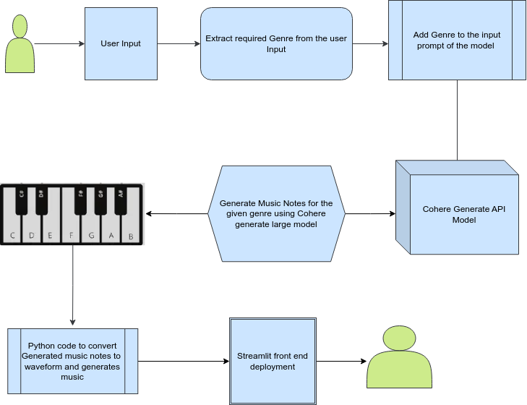
HOW IT WORKS

Slide 6
USABILITY CHALLENGES
The challenge is it requires high amount of computational power to locally generate, or internet bandwidth necessary to generate in the cloud and retrieve your creation.
The most glaring usability challenge for a text-based prompt interface is that it’s hard to describe sound with words.

Slide 7
FUTURE APPLICATIONS
Major assistance to music artists
Creativity Potential
Major role in AI advancement
This tool can generate millions of different music.

Slide 8
THANK YOU

