Slide 1
ETL: Extract, Transform, Load
The Data Bootcamp

Slide 2
ETL
Data integration is an important part of working with data.
Extract: read the data, often from multiple sources
Transform: clean and structure the data in desired form
Load: write the data into a database for storage

Slide 3
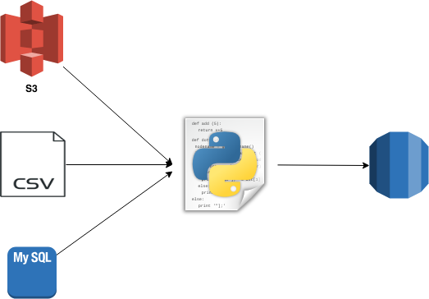
Extract
Data may come from disparate sources, such as:
CSV files
JSON files
HTML tables
SQL databases
Spreadsheets
Extract

Slide 4
Transform
Transform the data to suit business needs.
This may include:
Data Cleaning
Summarization
Selection
Joining
Filtering
Aggregating
Note: We will use Python and Pandas for transformation, but this could be done with SQL or a specialized ETL tool.
Transform

Slide 5
Load
Load the data into a final database that can be used for future analysis or business use.
Can be a relational or non-relational database
Can be local or in the cloud
Can be a data lake or data warehouse
Load

Slide 6
Questions / Discussion
Notes:
It’s important to keep in mind why you joined this class. Let’s talk about your goals.

