Slide 1

SO YOU WANT TO TAKE A FLIGHT? 2013-2018 AIRLINE PERFORMANCE TEN US BUSIEST AIRPORTS
Georgia Tech Data Science and Analytics Bootcamp
Team:
Saira Bhurjri
Hakan Demirojlu
Bruce Hart
Sean McCray
Meryem Ozcelik
Adrienne Thomas
October 13, 2018

Slide 2

Introduction
Purpose of the Project
Identify Data Sources and Data Collection
Strategy and Metrics, and Data Cleaning
Data Visualization/Analysis
Limitations and More Stuff if We Had More Time
Q&A
Notes:
How presentation will benefit audience: Adult learners are more interested in a subject if they know how or why it is important to them.
Presenter’s level of expertise in the subject: Briefly state your credentials in this area, or explain why participants should listen to you.

Slide 3
PURPOSE OF THE PROJECT
Notes:
Lesson descriptions should be brief.

Slide 4
IDENTIFYING DATA SOURCES AND DATA COLLECTION
US Department of Transportation, Bureau of Transportation Statistics
“Reporting Carrier On-Time Performance” data table
Notes:
Example objectives
At the end of this lesson, you will be able to:
Save files to the team Web server.
Move files to different locations on the team Web server.
Share files on the team Web server.

Slide 5
STRATEGY AND METRICS, AND DATA CLEANING
Years: 2013-2018
US Airports (highest passenger volume): ATL, LAX, CHI, DFW, DEN, JFK
US Airlines:
began with 17 (American [AA], Delta [FL], United [UA], Southwest [WN], Spirit [NK], Airtran [FL], Alaska [AS], Endeavor [9E], Envoy [MQ], ExpressJet [EV], Frontier [F9], Hawaiian [HA], JetBlue [B6], Mesa [YV], Skywest [OO], USAirways [US], and Virgin America [VX])
Reduced to 10 busiest airlines (passenger volume)
Data cleaning: merged various versions of BTS tables into one table for analysis (eliminated airlines and airports that didn’t include the target airlines and airports)

Slide 6
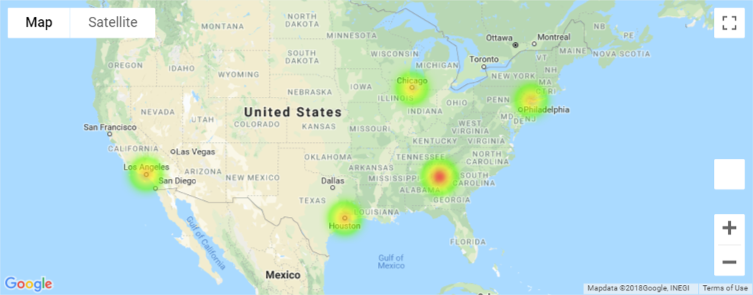
DATA VISUALIZATION/ANALYSIS (graph titles based on what is being produced – these titles are in no particular order but only to show the types and number of graphs)

Slide 7
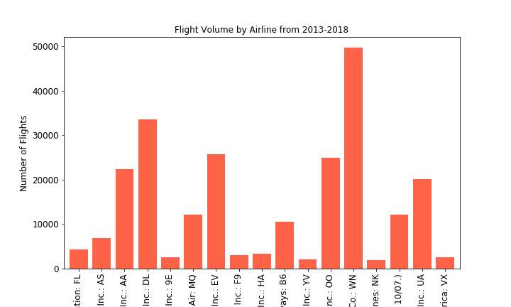
DATA VISUALIZATION/ANALYSIS (graph titles based on what is being produced – these titles are in no particular order but only to show the types and number of graphs)

Slide 8
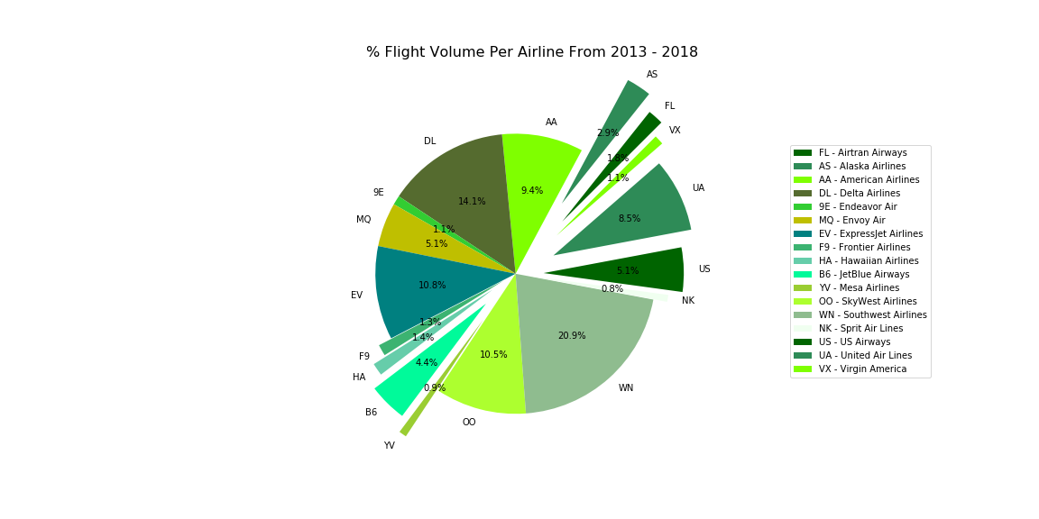
% cancellations of all airlines and all flights (pie chart)

Slide 9
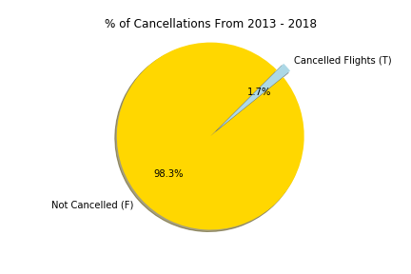
GRAPH - # flights for each airline (bar), % volume of each airline (pie chart)

Slide 10
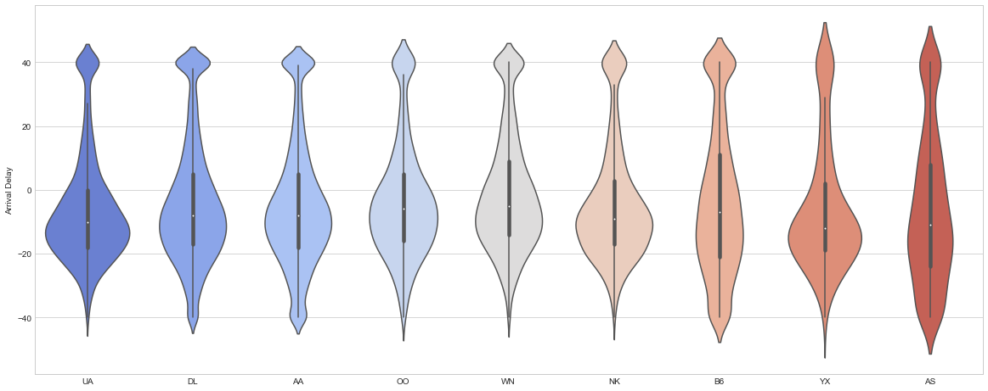
GRAPH – flight delays by airline (separated by departure and arrival delay) (bar), % of all flights delayed per carrier (pie)

Slide 11
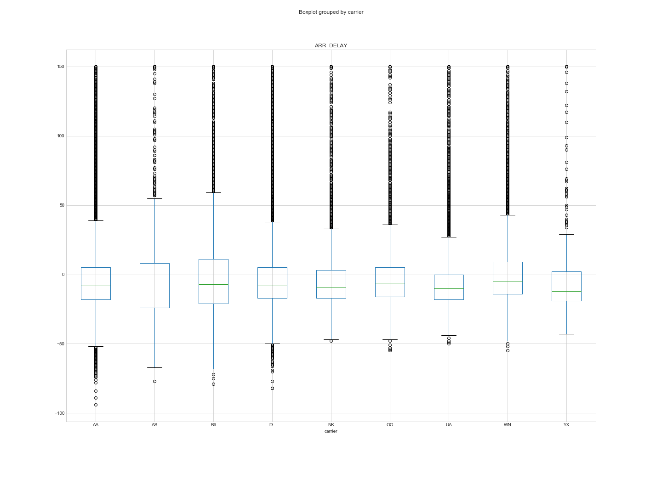
GRAPH – flight delays by airline (separated by departure and arrival delay) (bar), % of all flights delayed per carrier (pie)

Slide 12
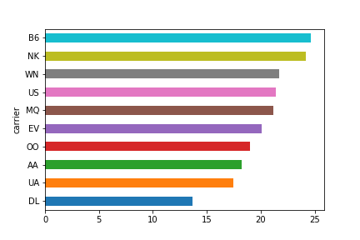
GRAPH – flight delays by airline (separated by departure and arrival delay) (bar), % of all flights delayed per carrier (pie)

Slide 13
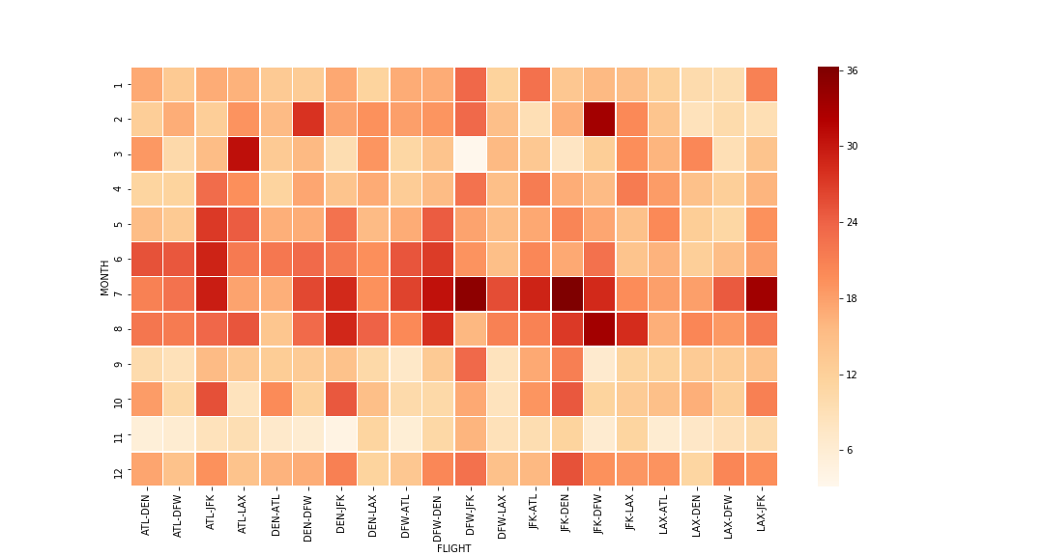
GRAPH - % of delay by carrier by calendar month (heat map), % of delay by carrier by season

Slide 14
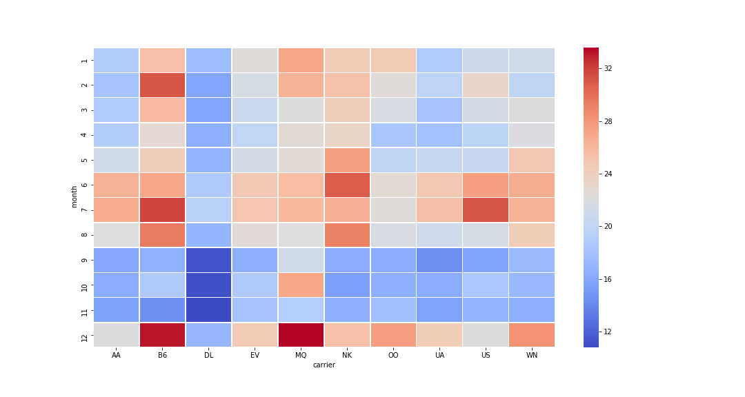
GRAPH – delay type (bar)

Slide 15
LIMITATIONS AND MORE STUFF IF WE HAD MORE TIME
Limitations
Additional questions that we wanted to consider if we had more time
Origin and destination analysis

Slide 16
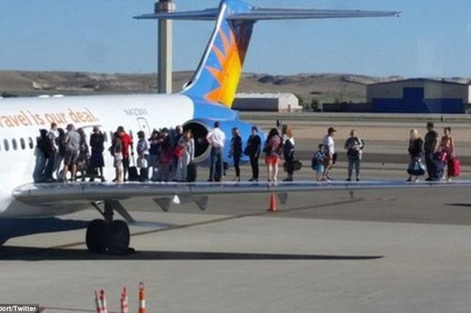
Q & A
This Photo by Unknown Author is licensed under CC BY-SA

