Slide 1
Analysis of Google Playstore Apps

Slide 2
Data Description
1048573 rows and 21 variables
App Name
Category
Subcategory
Rating
Rating Count
Average Installs
Minimum Installs
Maximum Installs
Free
Price
Currency
Size
Minimum Android
Released
Last Updated
Content Rating
Ad Supported
In app purchases
Editor’s Choice
Size_In_MB
Installs

Slide 3
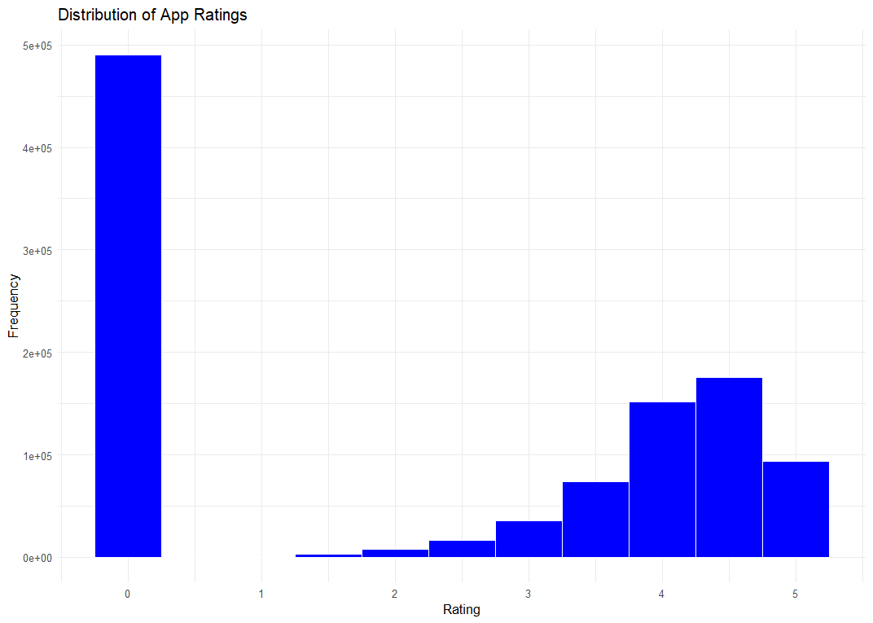
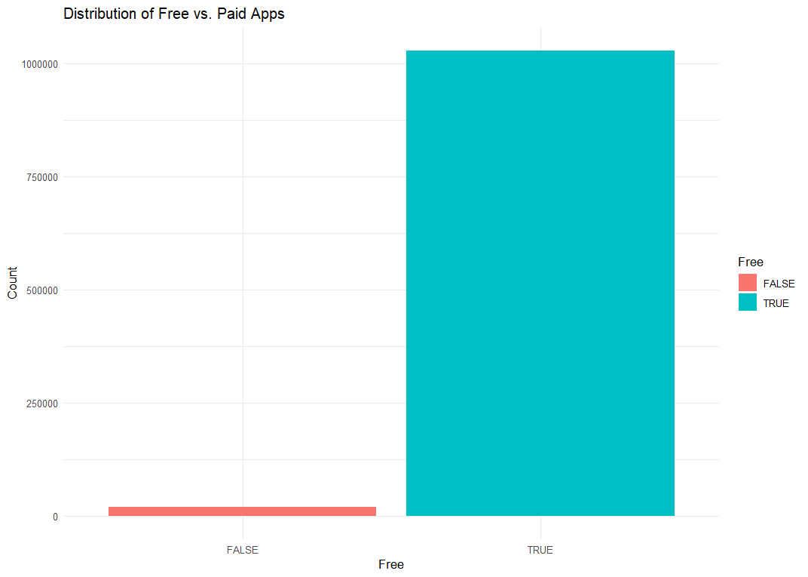
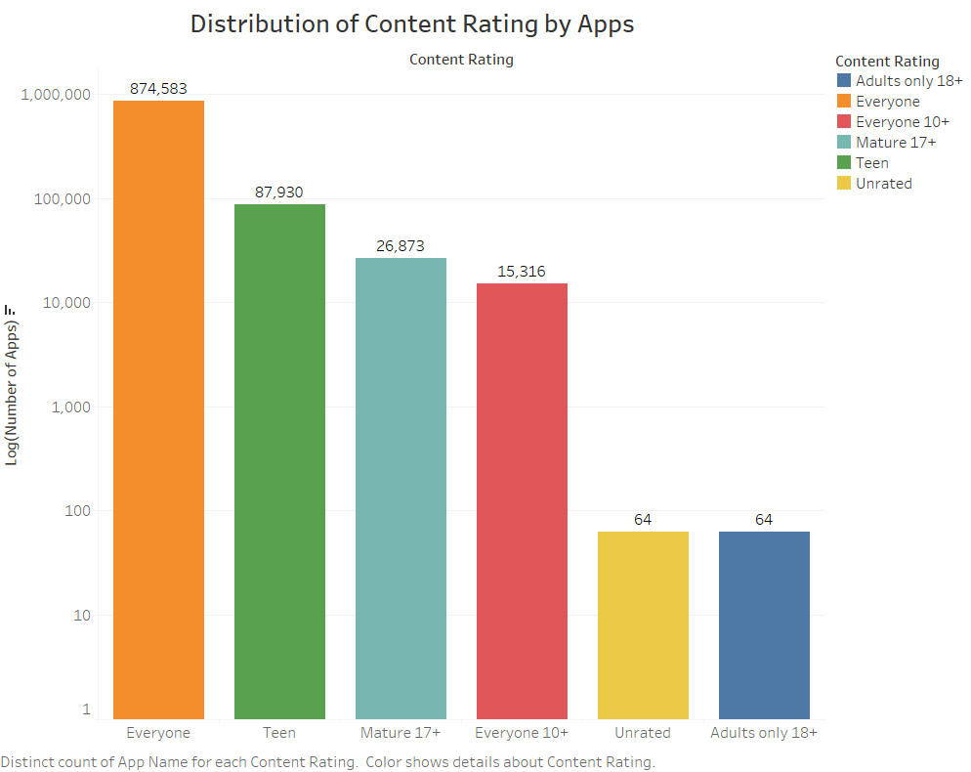

Slide 4
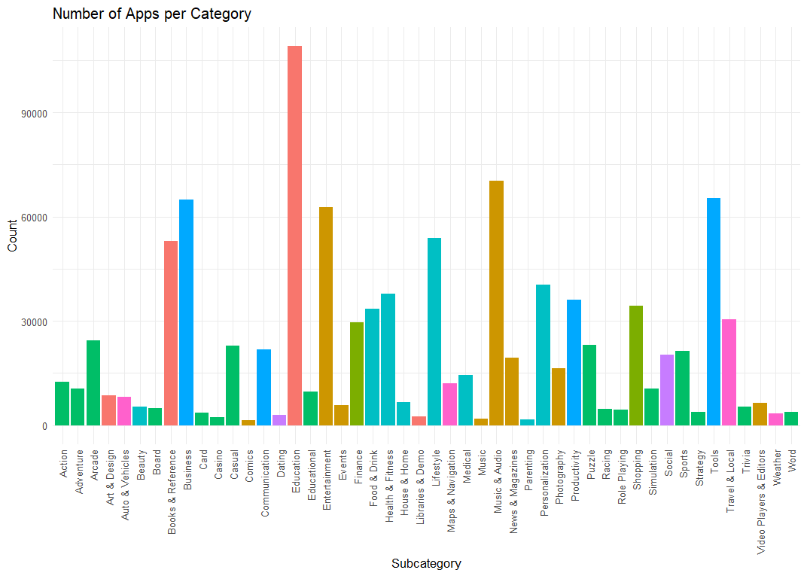

Slide 5
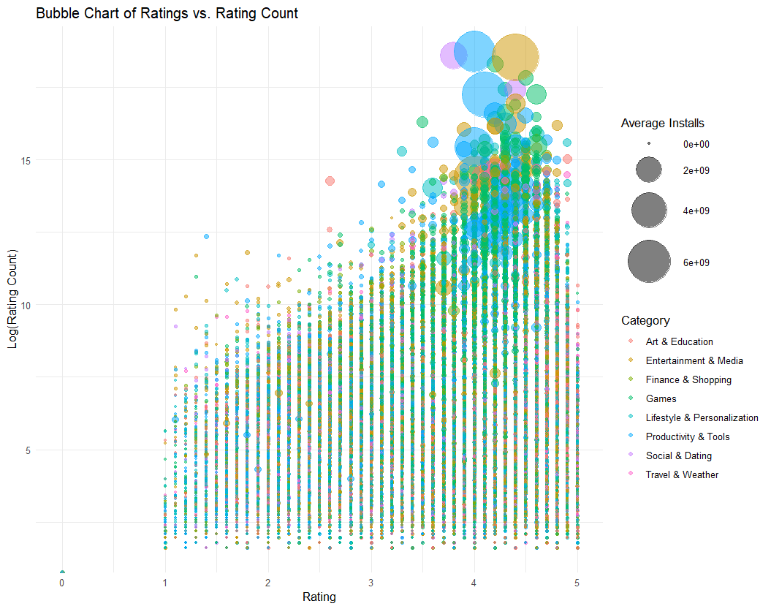

Slide 6
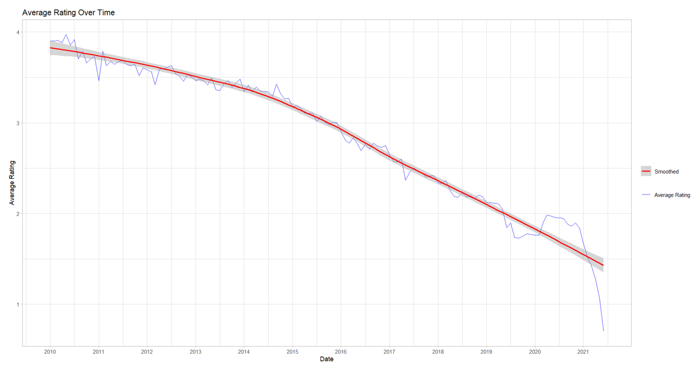

Slide 7
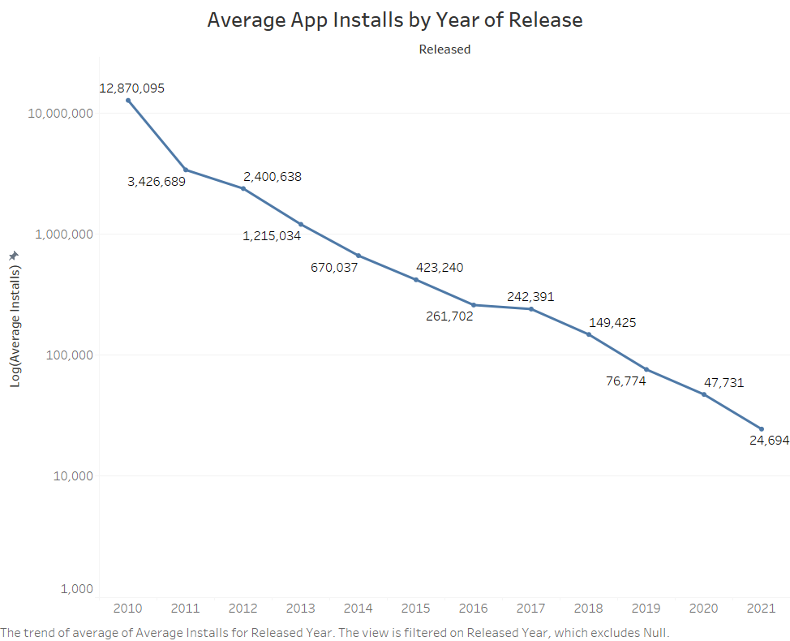
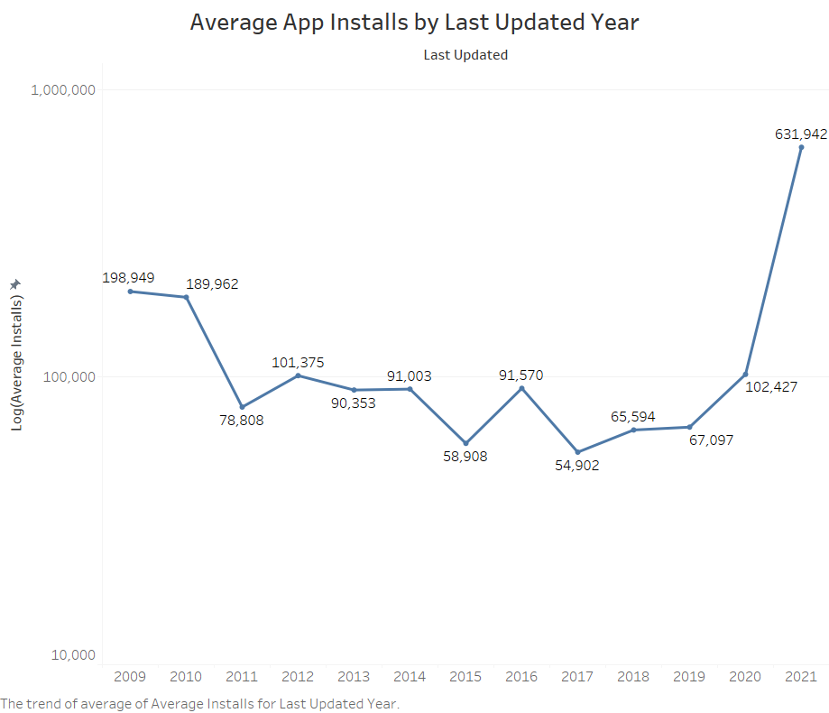

Slide 8
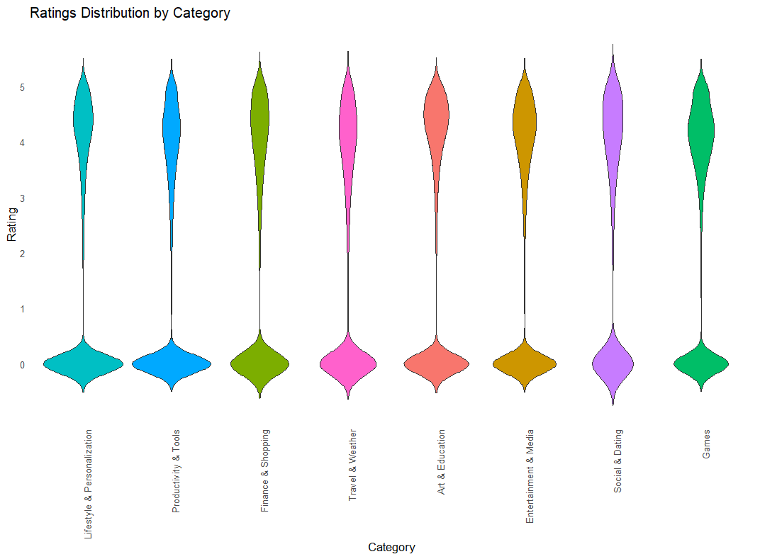

Slide 9
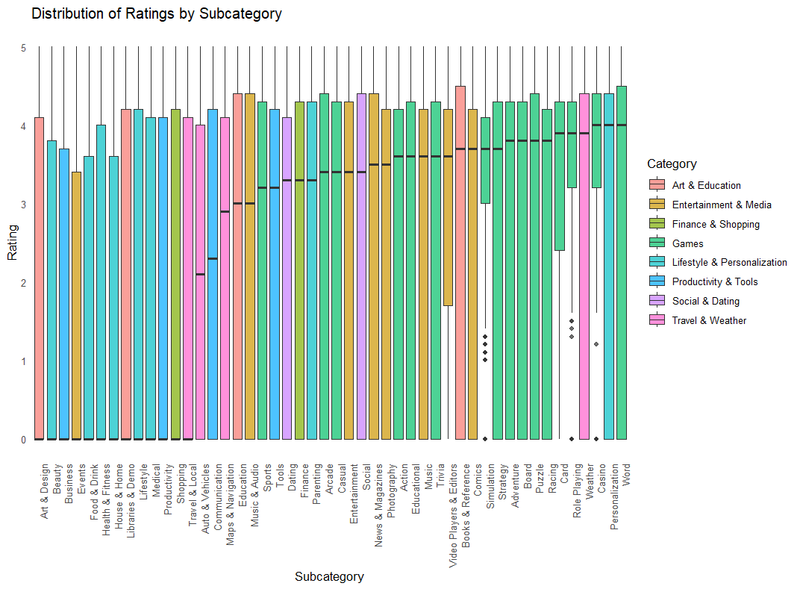

Slide 10
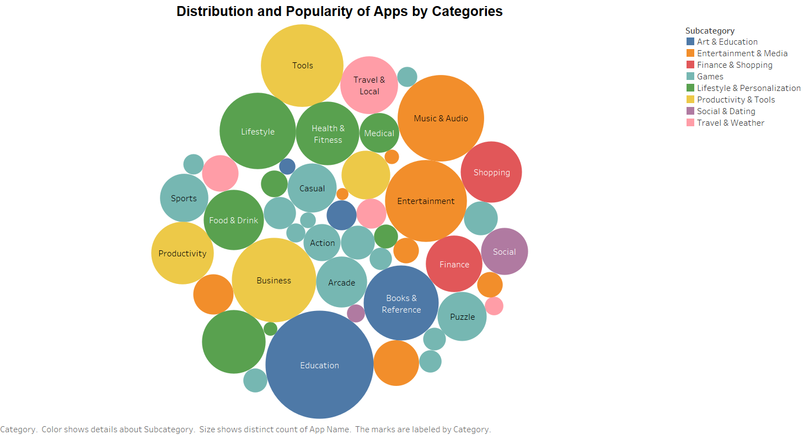

Slide 11
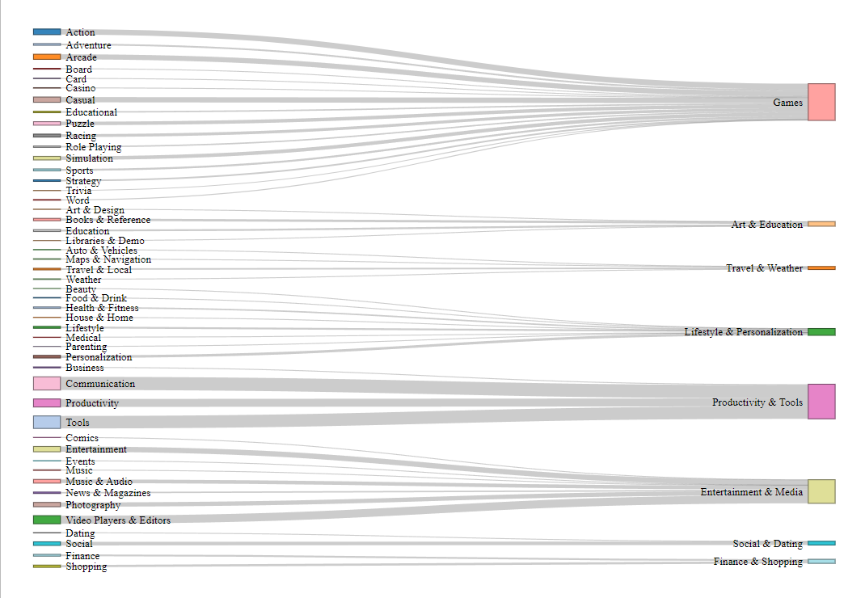
Average Installs by Category & Subcategory

Slide 12
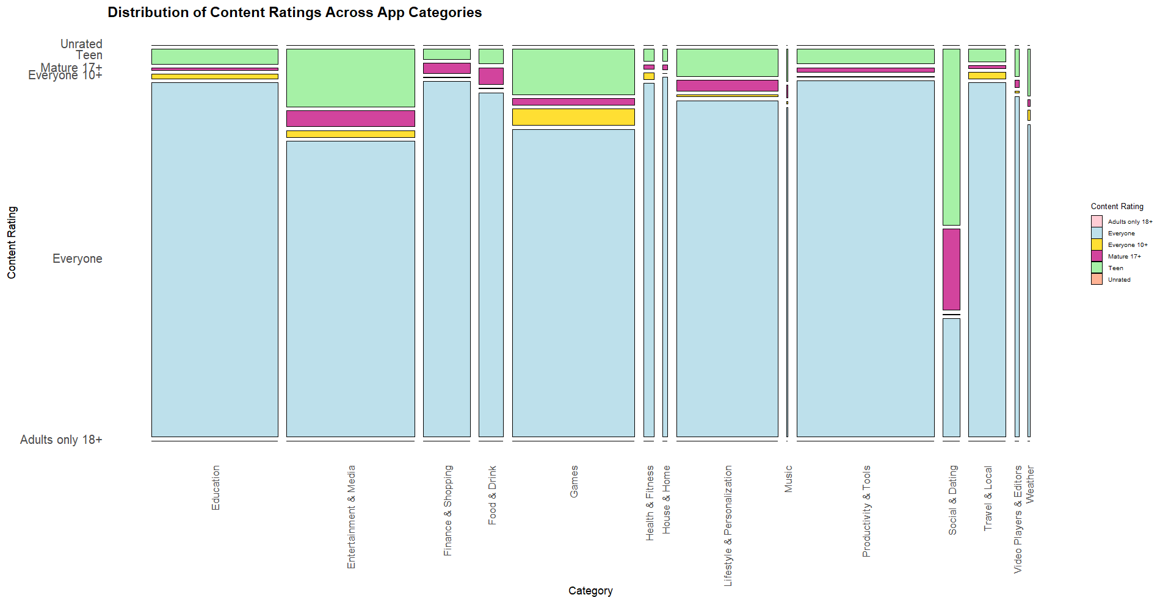

Slide 13
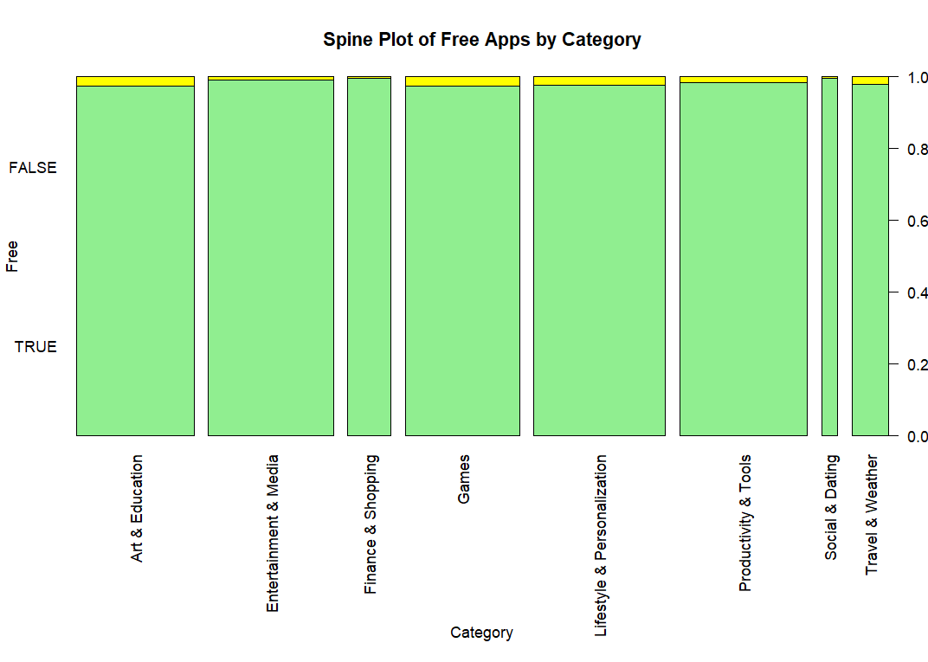

Slide 14
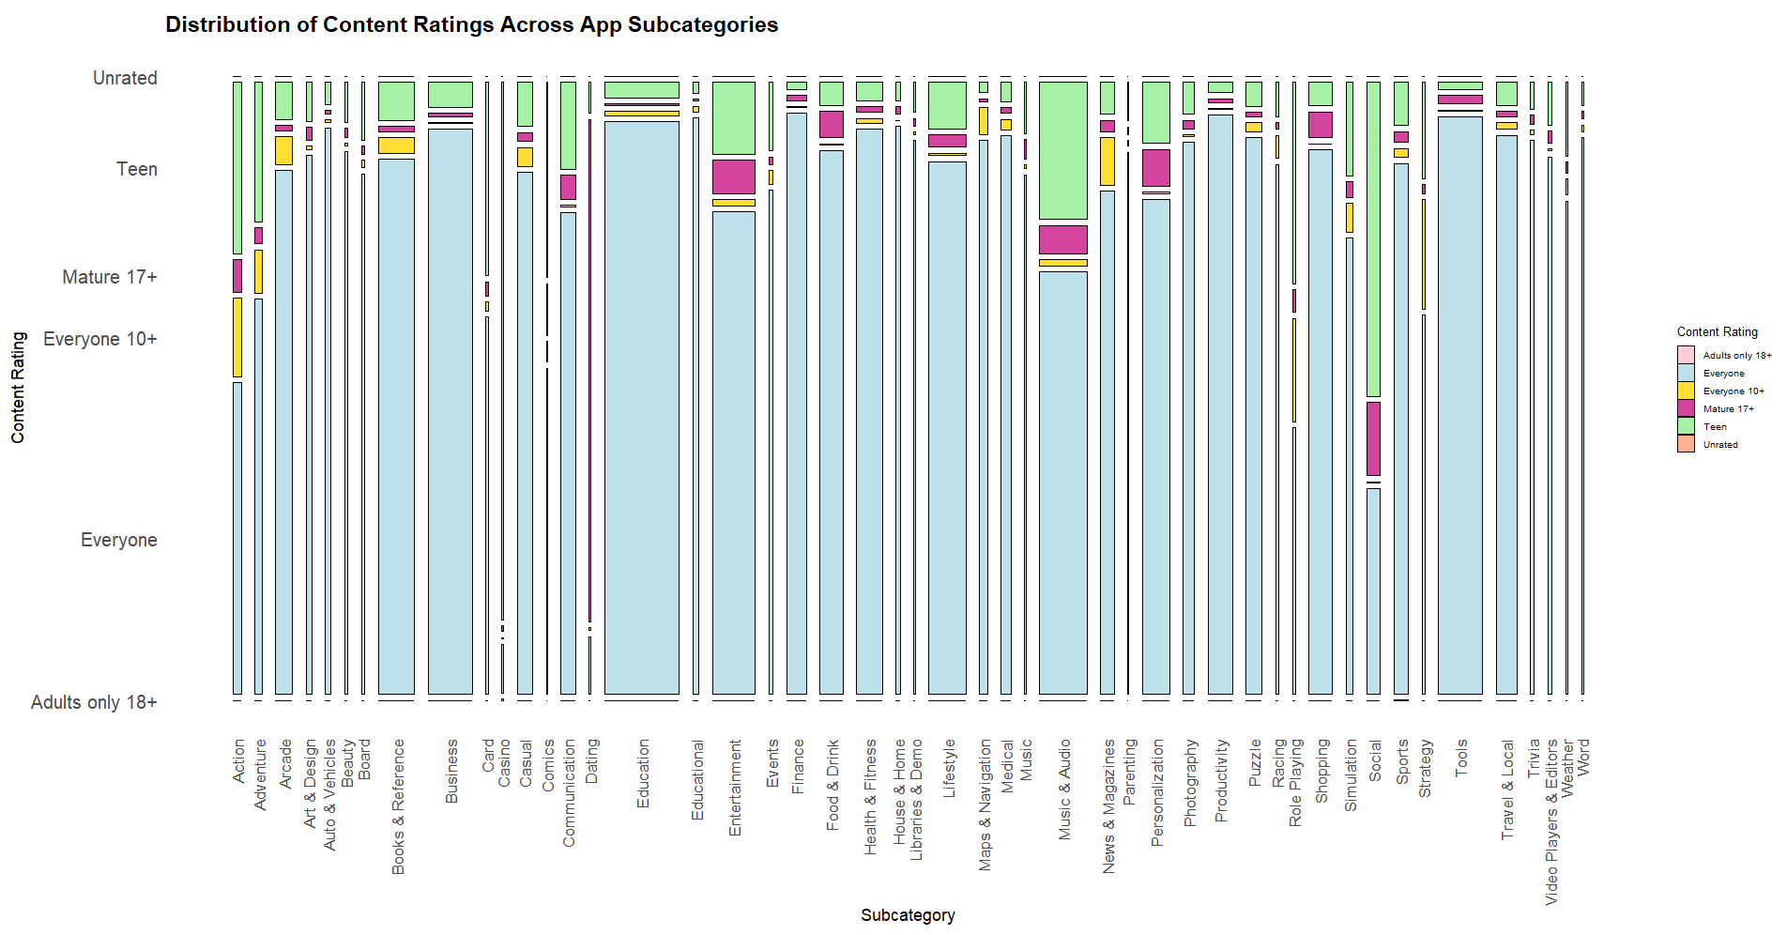

Slide 15
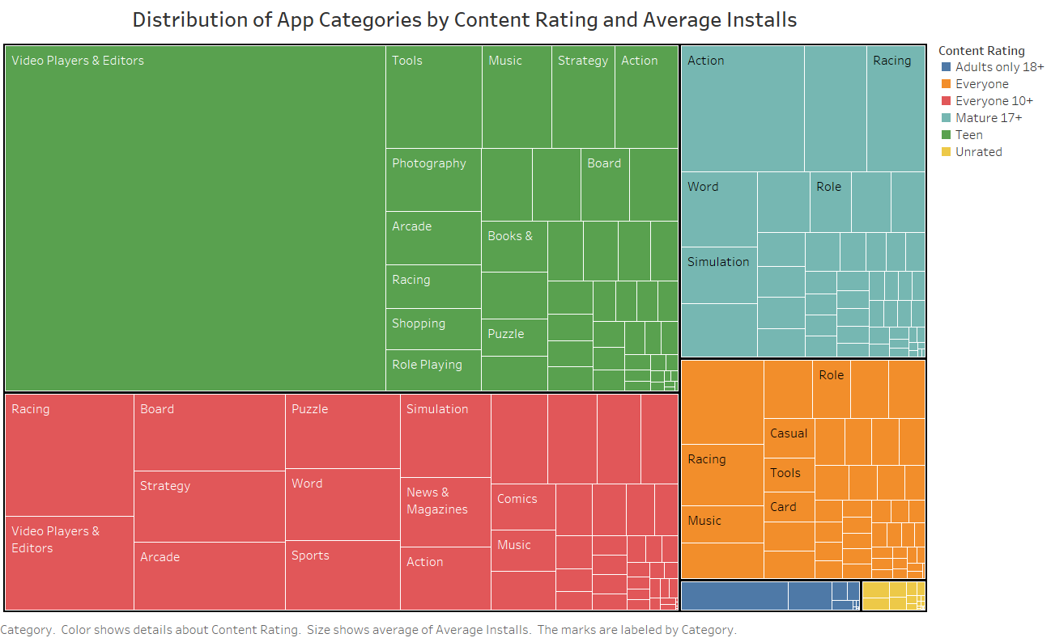

Slide 16
THANK YOU!!

