Slide 1
Classification
Decision Tree Induction
  Best Split
Measures of Node Impurity

Slide 2
Process
f(X)
Training data: X
Class labels Y
A classifier, a mapping, a hypothesis
f(U)
Test data: U
Predicted class labels

Slide 3
Relational Representation of Gene Expression Data
n features (order of 1000)
gene₁ gene₂ gene₃ gene₄ … gene_{n}
class
x₁₁ x₁₂ x₁₃ x₁₄ … x_{1n}
x₂₁ x₂₂ x₂₃ x₂₄ … x_{2n}
x₃₁ x₃₂ x₃₃ x₃₄ … x_{3n}
………………………………….
x_{m1} x_{m2} x_{m3} x_{m4} … x_{mn}
P
N
P
N
m samples

Slide 4
Algorithm for Decision Tree Induction
Basic algorithm (a greedy algorithm)
  Tree is constructed in a top-down recursive divide-and-conquer manner
  At start, all the training examples are at the root
  Attributes are categorical (if continuous-valued, they are discretized in advance)
  Examples are partitioned recursively based on selected attributes
  Test attributes are selected on the basis of a heuristic or statistical measure (e.g., information gain)
Conditions for stopping partitioning
  All samples for a given node belong to the same class
  There are no remaining attributes for further partitioning – majority voting is employed for classifying the leaf
  There are no samples left

Slide 5
Decision Tree Induction: Training Dataset

Slide 6
Output: A Decision Tree for “buys_computer”
age?
<=30
overcast
>40
31..40
student?
yes
credit rating?
no
yes
excellent
fair
no
yes
no
yes

Slide 7
Decision Tree Classification
A decision tree is created in two phases:
  Tree Building Phase
    Repeatedly partition the training data until all the examples in each partition belong to one class or the partition is sufficiently small
  Tree Pruning Phase
    Remove dependency on statistical noise or variation that may be particular only to the training set

Slide 8
Tree Building Phase
General tree-growth algorithm (binary tree)
Partition(Data S)
If (all points in S are of the same class) then return;
for each attribute A do
evaluate splits on attribute A;
Use best split to partition S into S1 and S2;
Partition(S1);
Partition(S2);

Slide 9
Tree Building Phase (cont.)
The form of the split depends on the type of the attribute
Splits for numeric attributes are of the form A ≤ v, where v is a real number
Splits for categorical attributes are of the form A ∈ S’, where S’ is a subset of all possible values of A

Slide 10
Tree Induction
Greedy strategy.
  Split the records based on an attribute test that optimizes certain criterion.
Issues
  Determine how to split the records
    How to specify the attribute test condition?
    How to determine the best split?
  Determine when to stop splitting

Slide 11
How to determine the Best Split
Before Splitting: 10 records of class 0,
10 records of class 1
Which test condition is the best?

Slide 12
How to determine the Best Split
Greedy approach:
  Nodes with homogeneous class distribution are preferred
Need a measure of node impurity:
Non-homogeneous,
High degree of impurity
Uniform
Homogeneous,
Low degree of impurity
Skewed

Slide 13
Measures of Node Impurity
Measures of Node Impurity
Gini Index
Entropy
Misclassification error

Slide 14
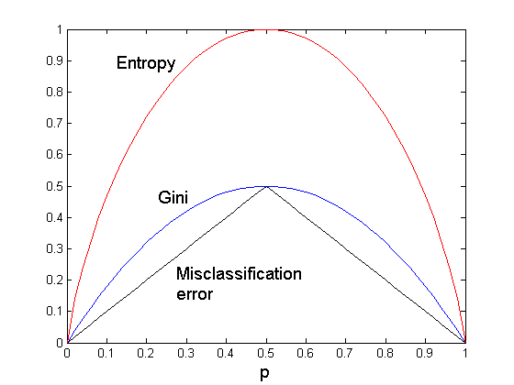
Comparison among Splitting Criteria
For a 2-class problem:

Slide 15
How to Find the Best Split
Before Splitting:
M0
A?
B?
Yes
No
Yes
No
Node N1
Node N2
Node N3
Node N4
M1
M2
M3
M4
M12
M34
Gain = M0 – M12 vs M0 – M34

Slide 16
Splitting Criteria based on INFO
Entropy at a given node t:
    (NOTE: p( j | t) is the relative frequency of class j at node t).
  Measures homogeneity of a node.
    Maximum (log n_{c}) when records are equally distributed among all classes implying least information
    Minimum (0.0) when all records belong to one class, implying most information

Slide 17
Examples for computing Entropy
P(C1) = 0/6 = 0 P(C2) = 6/6 = 1
Entropy = – 0 log 0 – 1 log 1 = – 0 – 0 = 0
P(C1) = 1/6 P(C2) = 5/6
Entropy = – (1/6) log₂ (1/6) – (5/6) log₂ (1/6) = 0.65
P(C1) = 2/6 P(C2) = 4/6
Entropy = – (2/6) log₂ (2/6) – (4/6) log₂ (4/6) = 0.92

Slide 18
Measure of Impurity: GINI
Gini Index for a given node t :
    (NOTE: p( j | t) is the relative frequency of class j at node t).
  Maximum (1 - 1/n_{c}) when records are equally distributed among all classes, implying least interesting information
  Minimum (0.0) when all records belong to one class, implying most interesting information

Slide 19
Examples for computing GINI
P(C1) = 0/6 = 0 P(C2) = 6/6 = 1
Gini = 1 – P(C1)² – P(C2)² = 1 – 0 – 1 = 0
P(C1) = 1/6 P(C2) = 5/6
Gini = 1 – (1/6)² – (5/6)² = 0.278
P(C1) = 2/6 P(C2) = 4/6
Gini = 1 – (2/6)² – (4/6)² = 0.444

Slide 20
Splitting Criteria based on Classification Error
Classification error at a node t :
Measures misclassification error made by a node.
    Maximum (1 - 1/n_{c}) when records are equally distributed among all classes, implying least interesting information
    Minimum (0.0) when all records belong to one class, implying most interesting information

Slide 21
Examples for Computing Error
P(C1) = 0/6 = 0 P(C2) = 6/6 = 1
Error = 1 – max (0, 1) = 1 – 1 = 0
P(C1) = 1/6 P(C2) = 5/6
Error = 1 – max (1/6, 5/6) = 1 – 5/6 = 1/6
P(C1) = 2/6 P(C2) = 4/6
Error = 1 – max (2/6, 4/6) = 1 – 4/6 = 1/3

Slide 22
Splitting Based on GINI
Used in CART, SLIQ, SPRINT.
When a node p is split into k partitions (children), the quality of split is computed as,
where, n_{i} = number of records at child i,
n = number of records at node p.
Weighted Average of Gini Index

Slide 23
Binary Attributes: Computing GINI Index
Splits into two partitions
Effect of Weighing partitions:
  Larger and Purer Partitions are sought for.
B?
Yes
No
Node N1
Node N2
Gini(N1)
= 1 – (5/7)² – (2/7)²
= 0.41
Gini(N2)
= 1 – (1/5)² – (4/5)²
= 0.32
Gini(Children)
= 7/12 * 0.41 +
5/12 * 0.32
= 0.37

Slide 24
Categorical Attributes: Computing Gini Index
For each distinct value, gather counts for each class in the dataset
Use the count matrix to make decisions
Multi-way split
Two-way split
(find best partition of values)

Slide 25
Continuous Attributes: Computing Gini Index
Use Binary Decisions based on one value
Several Choices for the splitting value
  Number of possible splitting values
  = Number of distinct values
Each splitting value has a count matrix associated with it
  Class counts in each of the partitions, A < v and A ≥ v
Simple method to choose best v
  For each v, scan the database to gather count matrix and compute its Gini index
  Computationally Inefficient! Repetition of work.

Slide 26
Continuous Attributes: Computing Gini Index..
For efficient computation: for each attribute,
  Sort the attribute on values
  Linearly scan these values, each time updating the count matrix and computing gini index
  Choose the split position that has the least gini index
Sorted Values
Split Positions

Slide 27
Splitting Based on INFO...
Information Gain:
    Parent Node, p is split into k partitions;
    n_{i} is number of records in partition i
  Measures Reduction in Entropy achieved because of the split. Choose the split that achieves most reduction (maximizes GAIN)
  Used in ID3 and C4.5
  Disadvantage: Tends to prefer splits that result in large number of partitions, each being small but pure.

Slide 28
Splitting Based on INFO...
Gain Ratio:
    Parent Node, p is split into k partitions
    n_{i} is the number of records in partition i
  Adjusts Information Gain by the entropy of the partitioning (SplitINFO). Higher entropy partitioning (large number of small partitions) is penalized!
  Used in C4.5
  Designed to overcome the disadvantage of Information Gain

Slide 29
Attribute Selection: Information Gain
Class P: buys_computer = “yes”
Class N: buys_computer = “no”
means “age <=30” has 5 out of 14 samples, with 2 yes’es and 3 no’s. Hence
Similarly,

Slide 30
Tree Induction
Greedy strategy.
  Split the records based on an attribute test that optimizes certain criterion.
Issues
  Determine how to split the records
    How to specify the attribute test condition?
    How to determine the best split?
  Determine when to stop splitting

Slide 31
Stopping Criteria for Tree Induction
Stop expanding a node when all the records belong to the same class
Stop expanding a node when all the records have similar attribute values
Early termination (to be discussed later)

Slide 32
Decision Tree Based Classification
Advantages:
  Inexpensive to construct. It does not require any domain knowledge.
  Extremely fast at classifying unknown records
  convertible to simple and easy to understand classification rules
  Easy to interpret for small-sized trees
  Accuracy is comparable to other classification techniques for many simple data sets

Slide 33
Example: C4.5
Simple depth-first construction.
Uses Information Gain
Sorts Continuous Attributes at each node.
Needs entire data to fit in memory.
Unsuitable for Large Datasets.
  Needs out-of-core sorting.

Slide 34
Practical Issues of Classification
Underfitting and Overfitting
Missing Values
Costs of Classification

Slide 35
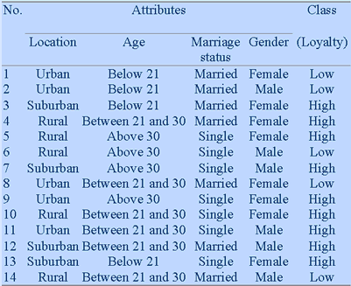
Another Example

Slide 36
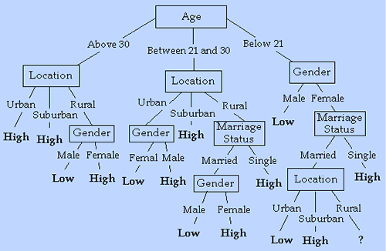
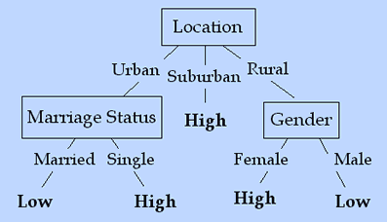
Another Example

Slide 37
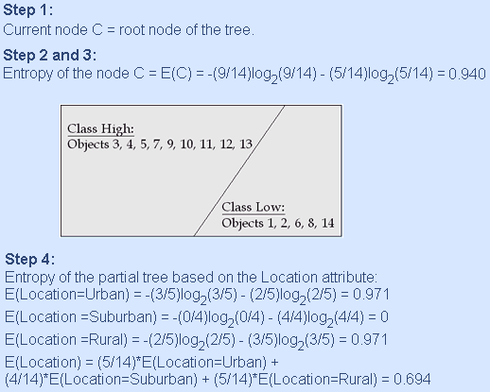
Decision Tree Generation Algorithm: ID3

Slide 38
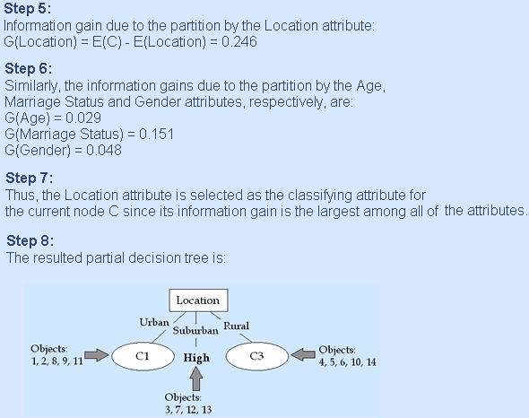
Decision Tree Generation Algorithm: ID3

Slide 39
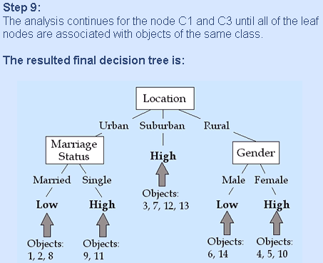
Decision Tree Generation Algorithm: ID3

