Slide 1
Classification
Decision Tree Example
Characteristics/Issues Decision Tree
Model Overfitting

Slide 2
Decision Tree Induction: Training Dataset

Slide 3
Output: A Decision Tree for “buys_computer”
age?
<=30
overcast
>40
31..40
student?
yes
credit rating?
no
yes
excellent
fair
no
yes
no
yes

Slide 4
Gain
Gain of an attribute split: compare the impurity of the parent node with the average impurity of the child nodes
Maximizing the gain ⇔ Minimizing the weighted average impurity measure of children nodes
If I() = Entropy(), then Δ_{info} is called information gain

Slide 5
Attribute Selection: Information Gain
Class P: buys_computer = “yes”
Class N: buys_computer = “no”
means “age <=30” has 5 out of 14 samples, with 2 yes’es and 3 no’s. Hence
Similarly,

Slide 6
What is the entropy of this collection of training examples with respect to the positive class?
(b) What are the information gains of a1 and a2 relative to these training examples?

Slide 7
Splitting Based on INFO...
Information Gain:
    Parent Node, p is split into k partitions;
    n_{i} is number of records in partition i
  Measures Reduction in Entropy achieved because of the split. Choose the split that achieves most reduction (maximizes GAIN)
  Used in ID3 and C4.5
  Disadvantage: Tends to prefer splits that result in large number of partitions, each being small but pure.

Slide 8
Splitting Based on INFO...
Gain Ratio:
    Parent Node, p is split into k partitions
    n_{i} is the number of records in partition i
  Adjusts Information Gain by the entropy of the partitioning (SplitINFO). Higher entropy partitioning (large number of small partitions) is penalized!
  Used in C4.5
  Designed to overcome the disadvantage of Information Gain

Slide 9
Tree Induction
Greedy strategy.
  Split the records based on an attribute test that optimizes certain criterion.
Issues
  Determine how to split the records
    How to specify the attribute test condition?
    How to determine the best split?
  Determine when to stop splitting

Slide 10
Stopping Criteria for Tree Induction
Stop expanding a node when all the records belong to the same class
Stop expanding a node when all the records have similar attribute values
Early termination (to be discussed later)

Slide 11
Decision Tree Based Classification
Advantages:
  Inexpensive to construct. It does not require any domain knowledge.
  Extremely fast at classifying unknown records
  convertible to simple and easy to understand classification rules
  Easy to interpret for small-sized trees
  Accuracy is comparable to other classification techniques for many simple data sets

Slide 12
Example: C4.5
Simple depth-first construction.
Uses Information Gain
Sorts Continuous Attributes at each node.
Needs entire data to fit in memory.
Unsuitable for Large Datasets.
  Needs out-of-core sorting.

Slide 13
Practical Issues of Classification
Underfitting and Overfitting
Missing Values
Costs of Classification

Slide 14
Characteristics of Decision Tree Induction
Non Parametric approach
Finding an optimal decision tree is an NP-Complete Problem.
Uses Computationally inexpensive techniques
Robust of handle the presence of Noise
Presence of Redundant Attributes (No Effect)
Presence of Irrelevant Attributes(Overfitting)
Data Fragmentation
Subtree Replication
Decision Boundary
Oblique Decision Tree
Constructive Induction

Slide 15
Other Issues
Data Fragmentation
Search Strategy
Expressiveness
Tree Replication

Slide 16
Data Fragmentation
Number of instances gets smaller as you traverse down the tree
Number of instances at the leaf nodes could be too small to make any statistically significant decision
You can introduce a lower bound on the number of records per leaf node in the stopping criterion.

Slide 17
Tree Replication
Same subtree appears in multiple branches

Slide 18
Search Strategy
Finding an optimal decision tree is NP-hard
The algorithm presented so far uses a greedy, top-down, recursive partitioning strategy to induce a reasonable solution
Other strategies?
  Bottom-up
  Bi-directional

Slide 19
Expressiveness
A classifier defines a function that discriminates between two (or more) classes.
The expressiveness of a classifier is the class of functions that it can model, and the kind of data that it can separate
  When we have discrete (or binary) values, we are interested in the class of boolean functions that can be modeled
  If the data-points are real vectors we talk about the decision boundary that the classifier can model

Slide 20
Expressiveness
Decision tree provides expressive representation for learning discrete-valued function
  But they do not generalize well to certain types of Boolean functions
    Example: parity function:
      Class = 1 if there is an even number of Boolean attributes with truth value = True
      Class = 0 if there is an odd number of Boolean attributes with truth value = True
    For accurate modeling, must have a complete tree
Not expressive enough for modeling continuous variables
  Particularly when test condition involves only a single attribute at-a-time

Slide 21
Decision Boundary
Border line between two neighboring regions of different classes is known as decision boundary
Decision boundary is parallel to axes because test condition involves a single attribute at-a-time

Slide 22
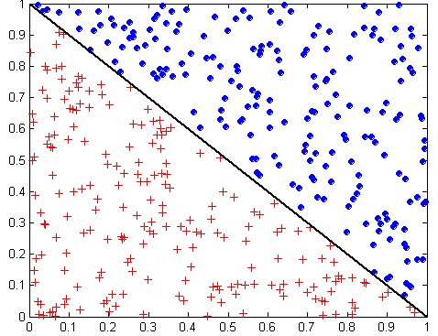
Oblique Decision Trees
x + y < 1
Class = +
Class =
Test condition may involve multiple attributes
More expressive representation
Finding optimal test condition is computationally expensive

Slide 23
Overfitting the Data
A classification model commits two kinds of errors:
  Training Error (TE) (resubstitution error , apparent error)
  Generalization Errors (GE)
A good classification model must have low TE as well as low GE
A model that fits the training data too well can have high GE than a model with high TE
This problem is known as model overfitting

Slide 24
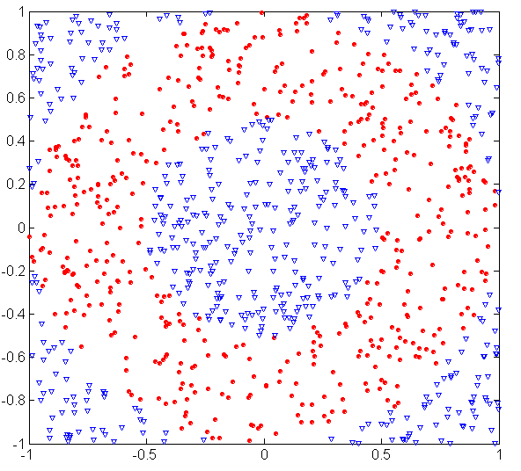
Underfitting and Overfitting (Example)
500 circular and 500 triangular data points.
Circular points:
0.5 ≤ sqrt(x₁²+x₂²) ≤ 1
Triangular points:
sqrt(x₁²+x₂²) > 0.5 or
sqrt(x₁²+x₂²) < 1

Slide 25
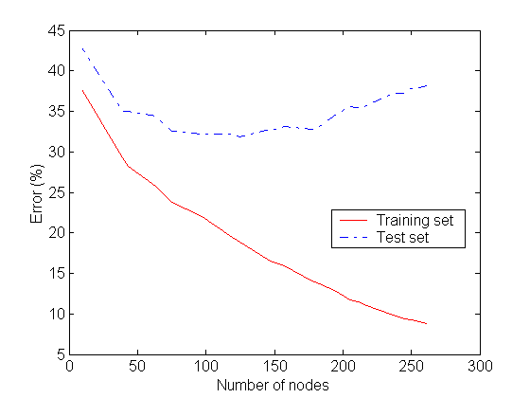
Underfitting and Overfitting
Underfitting
Overfitting
Underfitting: when model is too simple, both training and test errors are large
Overfitting: when model is too complex it models the details of the training set and fails on the test set
Notes:
Underfitting: when model is too simple, both training and test errors are large. TE & GE are large when the size of the tree is very small.
It occurs because the model is yet to learn the true structure of the data and as a result it performs poorly on both training and test sets

Slide 26
Overfitting the Data
When a decision tree is built, many of the branches may reflect anomalies in the training data due to noise or outliers.
We may grow the tree just deeply enough to perfectly classify the training data set.
This problem is known as overfitting the data.

Slide 27
Overfitting the Data
TE of a model can be reduced by increasing the model complexity
Leaf nodes of the tree can be expanded until it perfectly fits the training data
TE for such a complex tree = 0
GE can be large because the tree may accidently fit noise points in the training set
Overfitting & underfitting are two pathologies that are related to model complexity

Slide 29
Occam’s Razor
Given two models of similar generalization errors, one should prefer the simpler model over the more complex model
For complex models, there is a greater chance that it was fitted accidentally by errors in data
Therefore, one should include model complexity when evaluating a model

Slide 30
Definition
A decision tree T is said to overfit the training data if there exists some other tree T’ which is a simplification of T, such that T has smaller error than T’ over the training set but T’ has a smaller error than T over the entire distribution of the instances.

Slide 31
Problems of Overfitting
Overfitting can lead to many difficulties:
Overfitted models are incorrect.
Require more space and more computational resources
Require collection of unnecessary features
They are more difficult to comprehend

Slide 32
Overfitting
Overfitting can be due to:
Presence of Noise
Lack of representative samples

Slide 33
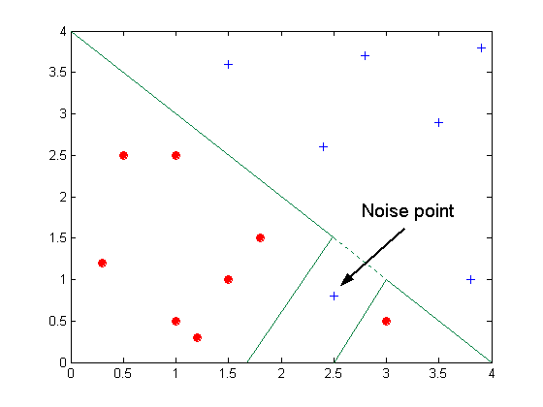
Overfitting due to Noise
Decision boundary is distorted by noise point

Slide 34
Overfitting: Example
Presence of Noise: Training Set
Name | Body Temperature | Gives Birth | 4-legged | Hibernates | Class Label (mammal)
Porcupine | Warm Blooded | Y | Y | Y | Y
Cat | Warm Blooded | Y | Y | N | Y
Bat | Warm Blooded | Y | N | Y | N*
Whale | Warm Blooded | Y | N | N | N*
Salamander | Cold Blooded | N | Y | Y | N
Komodo Dragon | Cold Blooded | N | Y | N | N
Python | Cold Blooded | N | N | Y | N
Salmon | Cold Blooded | N | N | N | N
Eagle | Warm Blooded | N | N | N | N
Guppy | Cold Blooded | Y | N | N | N
*mislabeled records

Slide 35
Overfitting: Example
Presence of Noise:Test Set
Name | Body Temperature | Gives Birth | 4-legged | Hibernates | Class Label (mammal)
Human | Warm Blooded | Y | N | N | Y
Pigeon | Warm Blooded | N | N | N | N
Elephant | Warm Blooded | Y | Y | N | Y
Leopard Shark | Cold Blooded | Y | N | N | N
Turtle | Cold Blooded | N | Y | N | N
Penguin | Cold Blooded | N | N | N | N
Eel | Cold Blooded | N | N | N | N
Dolphin | Warm Blooded | Y | N | N | Y
Spiny Anteater | Warm Blooded | N | Y | Y | Y
Gila Monster | Cold Blooded | N | Y | Y | N
Table taken from text book (Tan, Steinbach, Kumar)

Slide 36
Overfitting: Example
Presence of Noise: Models
Body Temp
Body Temp
Warm blooded
Cold blooded
Warm blooded
Cold blooded
Gives Birth
Non-mammals
Gives Birth
Non-mammals
Yes
No
Yes
No
4-legged
Non-mammals
Mammals
Non-mammals
Yes
No
Model M2
TE = 20%, GE=10%
Mammals
Non-mammals
Model M1
TE = 0%, GE=30% Find out why?
Figure taken from text book (Tan, Steinbach, Kumar)

Slide 37
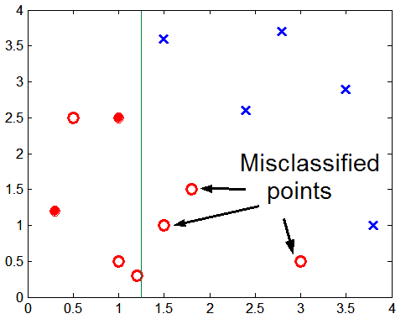
Overfitting due to Insufficient Examples
Lack of data points in the lower half of the diagram makes it difficult to predict correctly the class labels of that region
- Insufficient number of training records in the region causes the decision tree to predict the test examples using other training records that are irrelevant to the classification task
Figure taken from text book (Tan, Steinbach, Kumar)

Slide 38
Overfitting: Example
Lack of representative samples: Training Set
Name | Body Temperature | Gives Birth | 4-legged | Hibernates | Class Label (mammal)
Salamander | Cold Blooded | N | Y | Y | N
Eagle | Warm Blooded | N | N | N | N
Guppy | Cold Blooded | Y | N | N | N
Poorwill | Warm blooded | N | N | Y | N
Platypus | Warm blooded | N | Y | Y | Y
Table taken from text book (Tan, Steinbach, Kumar)

Slide 39
Overfitting: Example
Lack of representative samples: Training Set
Body Temp
Warm blooded
Cold blooded
Hibernates
Non-mammals
Model M3
TE = 0%, GE=30% Find out why?
Yes
No
4-legged
Non-mammals
Yes
No
Mammals
Non-mammals
Figure taken from text book (Tan, Steinbach, Kumar)

