Slide 1
Classification
Model Overfitting
K-NN Classifier

Slide 3
How to Address Overfitting
Pre-Pruning (Early Stopping Rule)
  Stop the algorithm before it becomes a fully-grown tree
  Typical stopping conditions for a node:
    Stop if all instances belong to the same class
    Stop if all the attribute values are the same
  More restrictive conditions:
    Stop if number of instances is less than some user-specified threshold
    Stop if class distribution of instances are independent of the available features (e.g., using χ ² test)
    Stop if expanding the current node does not improve impurity
    measures (e.g., Gini or information gain).

Slide 4
How to Address Overfitting…
Post-pruning
  Grow decision tree to its entirety
  Trim the nodes of the decision tree in a bottom-up fashion
  If generalization error improves after trimming, replace sub-tree by a leaf node.
  Class label of leaf node is determined from majority class of instances in the sub-tree
  Can use MDL for post-pruning

Slide 5
Example of Post-Pruning
Training Error (Before splitting) = 10/30
Pessimistic error = (10 + 0.5)/30 = 10.5/30
Training Error (After splitting) = 9/30
Pessimistic error (After splitting)
= (9 + 4 × 0.5)/30 = 11/30
PRUNE!
Class = Yes | 20
Class = No | 10
Error = 10/30
Class = Yes | 8
Class = No | 4
Class = Yes | 3
Class = No | 4
Class = Yes | 4
Class = No | 1
Class = Yes | 5
Class = No | 1

Slide 6
Post-pruning
  Post-pruning approach- removes branches of a fully grown tree.
Subtree replacement replaces a subtree with a single leaf node
Alt
Alt
Yes
Yes
Price
Yes
$
$$$
$$
Yes
Yes
No

Slide 7
Post-pruning
Subtree raising moves a subtree to a higher level in the decision tree, subsuming its parent
Alt
Alt
Yes
Yes
Res
Price
No
Yes
$
$$$
Price
No
$$
4/4
Yes
Yes
No
$
$$$
$$
Yes
Yes
No

Slide 8
Post-pruning: Techniques
Cost Complexity pruning Algorithm: pruning operation is performed if it does not increase the estimated error rate.
  Of course, error on the training data is not the useful estimator (would result in almost no pruning)
Minimum Description Length Algorithm: states that the best tree is the one that can be encoded using the fewest number of bits.
  The challenge for the pruning phase is to find the subtree that can be encoded with the least number of bits.

Slide 9
Methods of Estimation
Holdout
  Reserve 2/3 for training and 1/3 for testing
Random subsampling
  Repeated holdout
Cross validation
  Partition data into k disjoint subsets
  k-fold: train on k-1 partitions, test on the remaining one
  Leave-one-out: k=n
Stratified sampling
  oversampling vs undersampling
Bootstrap
  Sampling with replacement

Slide 10
Different Learning Methods
Eager Learning
  Explicit description of target function on the whole training set
Instance-based Learning
  Learning=storing all training instances
  Classification=assigning target function to a new instance
  Referred to as “Lazy” learning

Slide 11
Different Learning Methods
Eager Learning
Any random movement
=>It’s a mouse
I saw a mouse!

Slide 12
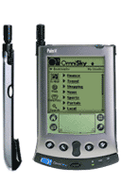


Instance-based Learning
Its very similar to a
Desktop!!

Slide 13
Instance-Based Classifiers
Store the training records
Use training records to
predict the class label of
unseen cases

Slide 14
Instance Based Classifiers
Examples:
  Rote-learner
    Memorizes entire training data and performs classification only if attributes of record match one of the training examples exactly
  Nearest neighbor
    Uses k “closest” points (nearest neighbors) for performing classification

Slide 15
Nearest Neighbor Classifiers
Basic idea:
  If it walks like a duck, quacks like a duck, then it’s probably a duck
Compute Distance
Test Record
Training Records
Choose k of the “nearest” records

Slide 16
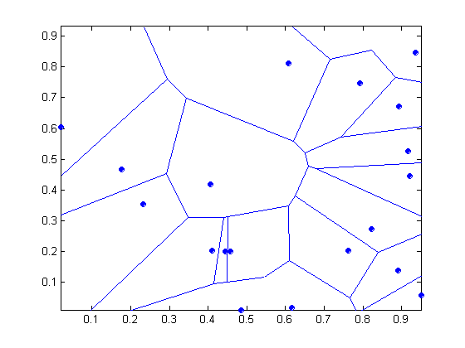
1 nearest-neighbor
Voronoi Diagram : Decision surface formed by the training examples

Slide 17
Nearest-Neighbor Classifiers
Requires three things
  The set of stored records
  Distance Metric to compute distance between records
  The value of k, the number of nearest neighbors to retrieve
  To classify an unknown record:
  Compute distance to other training records
  Identify k nearest neighbors
  Use class labels of nearest neighbors to determine the class label of unknown record (e.g., by taking majority vote)

Slide 18
Definition of Nearest Neighbor
K-nearest neighbors of a record x are data points that have the k smallest distance to x

Slide 19
Nearest Neighbor Classification…
Choosing the value of k:
  If k is too small, sensitive to noise points
  If k is too large, neighborhood may include points from other classes

Slide 21
Nearest Neighbor Classification
Compute distance between two points:
  Euclidean distance
Determine the class from nearest neighbor list
  take the majority vote of class labels among the k-nearest neighbors
  Weigh the vote according to distance
    weight factor, w = 1/d²

Slide 22
Distance-Weighted Nearest Neighbor Algorithm
Assign weights to the neighbors based on their ‘distance’ from the query point
  Weight ‘may’ be inverse square of the distances
All training points may influence a particular instance

Slide 23
Nearest Neighbor Classification…
Scaling issues
  Attributes may have to be scaled to prevent distance measures from being dominated by one of the attributes
  Example:
    height of a person may vary from 1.5m to 1.8m
    weight of a person may vary from 90lb to 300lb
    income of a person may vary from $10K to $1M

Slide 24
Nearest Neighbor Classification…
Problem with Euclidean measure:
  High dimensional data
    curse of dimensionality
  Can produce counter-intuitive results
1 1 1 1 1 1 1 1 1 1 1 0
1 0 0 0 0 0 0 0 0 0 0 0
vs
0 1 1 1 1 1 1 1 1 1 1 1
0 0 0 0 0 0 0 0 0 0 0 1
d = 1.4142
d = 1.4142
    Solution: Normalize the vectors to unit length

Slide 25
Nearest neighbor Classification…
k-NN classifiers are lazy learners
  It does not build models explicitly
  Unlike eager learners such as decision tree induction and rule-based systems
Classifying unknown records are relatively expensive
  Naïve algorithm: O(n)
  Need for structures to retrieve nearest neighbors fast.
    The Nearest Neighbor Search problem.

