Slide 1
Classification
Rule Based Classifier
  Rule Ordering Schemes
  Building Classification Rules
  Direct Method : Sequential Covering algorithm
  Direct Method : RIPPER Algorithm
  Rule Evaluation
  Indirect Method : Decision Tree
Naïve Bayes Classifier

Slide 2
Ordered Rule Set
Rules are rank ordered according to their priority
  An ordered rule set is known as a decision list
When a test record is presented to the classifier
  It is assigned to the class label of the highest ranked rule it has triggered
  If none of the rules fired, it is assigned to the default class
R1: (Give Birth = no) ∧ (Can Fly = yes) → Birds
R2: (Give Birth = no) ∧ (Live in Water = yes) → Fishes
R3: (Give Birth = yes) ∧ (Blood Type = warm) → Mammals
R4: (Give Birth = no) ∧ (Can Fly = no) → Reptiles
R5: (Live in Water = sometimes) → Amphibians

Slide 3
Rule Ordering Schemes
Rule-based ordering
  Individual rules are ranked based on their quality
Class-based ordering
  Rules that belong to the same class appear together

Slide 4
Building Classification Rules
Direct Method:
    Extract rules directly from data
    e.g.: RIPPER, CN2, Holte’s 1R
Indirect Method:
    Extract rules from other classification models (e.g.
    decision trees, neural networks, etc).
    e.g: C4.5rules

Slide 5
Direct Method: Sequential Covering
Start from an empty rule
Grow a rule using the Learn-One-Rule function
Remove training records covered by the rule
Repeat Step (2) and (3) until stopping criterion is met

Slide 7
Example of Sequential Covering

Slide 8
Example of Sequential Covering…

Slide 13
When to Stop Building a Rule
When the rule is perfect, i.e. accuracy = 1
When increase in accuracy gets below a given threshold
When the training set cannot be split any further

Slide 14
Aspects of Sequential Covering
Rule Growing
Instance Elimination
Rule Evaluation
Stopping Criterion
Rule Pruning

Slide 15
Rule Growing
Two common strategies

Slide 17
Rule Evaluation

Slide 18
Instance Elimination
Why do we need to eliminate instances?
  Otherwise, the next rule is identical to previous rule
Why do we remove positive instances?
  Ensure that the next rule is different
Why do we remove negative instances?
  Prevent underestimating accuracy of rule
  Compare rules R2 and R3 in the diagram

Slide 19
Stopping Criterion and Rule Pruning
Stopping criterion
  Compute the gain
  If gain is not significant, discard the new rule
Rule Pruning
  Similar to post-pruning of decision trees
  Reduced Error Pruning:
    Remove one of the conjuncts in the rule
    Compare error rate on validation set before and after pruning
    If error improves, prune the conjunct

Slide 20
Direct Method: RIPPER
For 2-class problem, choose one of the classes as positive class, and the other as negative class
  Majority class will be default class (Positive)
  Learn rules for minority class (Negative)
For multi-class problem
  Order the classes according to increasing class prevalence (fraction of instances that belong to a particular class)
  Learn the rule set for smallest class first, treat the rest as negative class
  Repeat with next smallest class as positive class

Slide 21
Direct Method: RIPPER
Growing a rule:
  Start from empty rule
  Add conjuncts as long as they improve FOIL’s information gain
  Stop when rule no longer covers negative examples
  Prune the rule immediately using incremental reduced error pruning
  Measure for pruning: v = (p-n)/(p+n)
    p: number of positive examples covered by the rule in
    the validation set
    n: number of negative examples covered by the rule in
    the validation set
  Pruning method: delete any final sequence of conditions that maximizes v

Slide 22
Rule Growing (Examples)
CN2 Algorithm:
  Start from an empty conjunct: {}
  Add conjuncts that minimizes the entropy measure: {A}, {A,B}, …
  Determine the rule consequent by taking majority class of instances covered by the rule
RIPPER Algorithm:
  Start from an empty rule: {} => class
  Add conjuncts that maximizes FOIL’s information gain measure:
    R0: {} => class (initial rule)
    R1: {A} => class (rule after adding conjunct)
    Gain(R0, R1) = t [ log (p1/(p1+n1)) – log (p0/(p0 + n0)) ]
    where t: number of positive instances covered by both R0 and R1
    p0: number of positive instances covered by R0
    n0: number of negative instances covered by R0
    p1: number of positive instances covered by R1
    n1: number of negative instances covered by R1

Slide 23
Direct Method: RIPPER
Building a Rule Set:
  Use sequential covering algorithm
    Finds the best rule that covers the current set of positive examples
    Eliminate both positive and negative examples covered by the rule
  Each time a rule is added to the rule set, compute the new description length
    stop adding new rules when the new description length is d bits longer than the smallest description length obtained so far

Slide 24
Direct Method: RIPPER
Optimize the rule set:
  For each rule r in the rule set R
    Consider 2 alternative rules:
      Replacement rule (r*): grow new rule from scratch
      Revised rule(r’): add conjuncts to extend the rule r
    Compare the rule set for r against the rule set for r*
    and r’
    Choose rule set that minimizes MDL principle
  Repeat rule generation and rule optimization for the remaining positive examples

Slide 25
Summary of Direct Method
Grow a single rule
Remove Instances from rule
Prune the rule (if necessary)
Add rule to Current Rule Set
Repeat

Slide 26
Indirect Method: C4.5rules
Extract rules from an unpruned decision tree
For each rule, r: RHS → c, consider pruning the rule
Use class ordering
    – Each subset is a collection of rules with the same rule consequent (class)
  – Classes described by simpler sets of rules tend to appear first

Slide 28
Indirect Method: C4.5rules
Extract rules from an unpruned decision tree
For each rule, r: A → y,
  consider an alternative rule r’: A’ → y where A’ is obtained by removing one of the conjuncts in A
  Compare the pessimistic error rate for r against all r’s
  Prune if one of the r’s has lower pessimistic error rate
  Repeat until we can no longer improve generalization error

Slide 29
Indirect Method: C4.5rules
Instead of ordering the rules, order subsets of rules (class ordering)
  Each subset is a collection of rules with the same rule consequent (class)
  Compute description length of each subset
    Description length = L(error) + g L(model)
    g is a parameter that takes into account the presence of redundant attributes in a rule set
    (default value = 0.5)

Slide 30
Example

Slide 31
C4.5 versus C4.5 rules versus RIPPER
C4.5rules:
(Give Birth=No, Can Fly=Yes) → Birds
(Give Birth=No, Live in Water=Yes) → Fishes
(Give Birth=Yes) → Mammals
(Give Birth=No, Can Fly=No, Live in Water=No) → Reptiles
( ) → Amphibians
RIPPER:
(Live in Water=Yes) → Fishes
(Have Legs=No) → Reptiles
(Give Birth=No, Can Fly=No, Live In Water=No)
→ Reptiles
(Can Fly=Yes,Give Birth=No) → Birds
() → Mammals

Slide 32
C4.5 versus C4.5rules versus RIPPER
C4.5 and C4.5rules:
RIPPER:

Slide 33
Advantages of Rule-Based Classifiers
As highly expressive as decision trees
Easy to interpret
Easy to generate
Can classify new instances rapidly
Performance comparable to decision trees

Slide 34
Classification
Bayesian Classifier
Naive Bayes Classifier

Slide 35
Bayesian Classification
What are Bayesian Classifiers?
Statistical Classifiers
Predict class membership probabilities
Based on Bayes Theorem
Naïve Bayesian Classifier
Computationally Simple
Comparable performance with DT and NN classifiers

Slide 36
Bayesian Classification
Probabilistic learning: Calculate explicit probabilities for hypothesis, among the most practical approaches to certain types of learning problems
Incremental: Each training example can incrementally increase/decrease the probability that a hypothesis is correct. Prior knowledge can be combined with observed data.

Slide 37
Bayes Theorem
Let X be a data sample whose class label is unknown
Let H be some hypothesis that X belongs to a class C
For classification determine P(H|X)
P(H|X) is the probability that H holds given the observed data sample X
P(H|X) is posterior probability of H conditioned on X

Slide 38
Bayes Theorem
Example: Sample space: All Fruits described by their color and shape
X is “round” and “red”
H= hypothesis that X is an Apple
P(H|X) is our confidence that X is an apple given that X is “round” and “red”
P(H) is Prior Probability of H, i.e. the probability that any given data sample is an apple regardless of how it looks
P(H|X) is based on more information
Note that P(H) is independent of X

Slide 39
Bayes Theorem
Example: Sample space: All Fruits
P(X|H) ?
It is the probability that X is round and red given that we know that it is true that X is an apple
Here P(X) is prior probability =
P(data sample from our set of fruits is red and round)

Slide 40
Estimating Probabilities
P(X), P(H), and P(X|H) may be estimated from given data
Bayes Theorem
Use of Bayes Theorem in Naïve Bayesian Classifier!!

Slide 41
Bayesian Classifiers
Consider each attribute and class label as random variables
Given a record with attributes (A₁, A₂,…,A_{n})
  Goal is to predict class C
  Specifically, we want to find the value of C that maximizes P(C| A₁, A₂,…,A_{n} )
Can we estimate P(C| A₁, A₂,…,A_{n} ) directly from data?

Slide 42
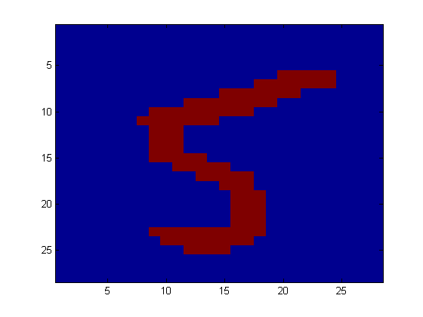
Application
Digit Recognition
X₁,…,X_{n} ∈ {0,1} (Black vs. White pixels)
Y ∈ {5,6} (predict whether a digit is a 5 or a 6)
Classifier
5

Slide 43

The Bayes Classifier
In class, we saw that a good strategy is to predict:
  (for example: what is the probability that the image represents a 5 given its pixels?)
So … How do we compute that?

Slide 44
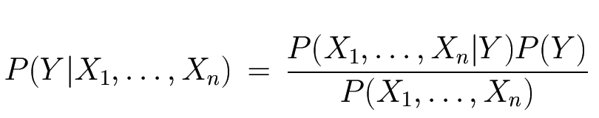
The Bayes Classifier
Use Bayes Rule!
Why did this help? Well, we think that we might be able to specify how features are “generated” by the class label
Likelihood
Prior
Normalization Constant

Slide 45
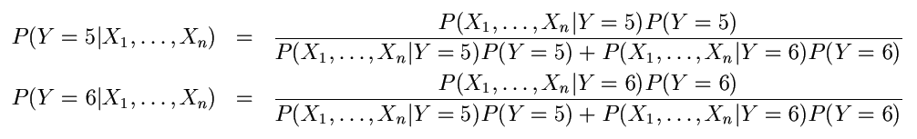
The Bayes Classifier
Let’s expand this for our digit recognition task:
To classify, we’ll simply compute these two probabilities and predict based on which one is greater

