Slide 1
CS F415: Data Mining
Yashvardhan Sharma

Slide 2
Today’s Outline
Introduction
  What is Data Mining
  Origins of Data Mining
  Challenges of Data Mining
  Data Mining Tasks
  Applications

Slide 3
Motivation
Problem
IS’s and DB’s make it possible to convert data into information, but make it difficult to convert information into knowledge.
This cannot be done manually any more.

Slide 4
Motivation
Old tools:
Data Source:
  Transactional Database:
  Relational or Object-Relational Data Organisation
Information Delivery (Exploitation) Tools:
  Batch Reporting Tools
  EIS (Executive Information Systems)
  Traditional DSS (Decision Support Systems)
  Desktop Reporting Tools (Spreadsheet Add-ins,…)

Slide 5
Motivation
New tools:
Data Source:
  Data warehouses or operational data stores.
    Other models: multidimensional
    Other organisations: datamarts
Exploitation tools:
  OLAP (On-Line Analytical Processing) Tools.
  Data Mining
  Simulation

Slide 6
Motivation
Needs and Tools:
Operational decisions → operational queries:
Requirement Examples:
  “Are there available seats for flight IB-2323?”.
» TOOL: SQL.
  “List the products which currently have a special offer”.
    » TOOL: SQL/Reporting tools.

Slide 7
Motivation
Needs and Tools:
Tactical decisions → aggregated queries:
  Requirement Example:
  “Top ten sellers in the sales department during the last year”.
    » TOOL: SQL, OLAP tools, data warehouses
  “Total sales of seaside supermarkets in the second quarter of 2005 vs. total sales of interior supermarkets”.
    » TOOL: DSS, OLAP tools, data warehouses

Slide 8
Motivation
Needs and Tools:
Planning → descriptive or predictive models:
Requirement Examples:
  “Products which are sold together frequently in seaside supermarkets”.
» TOOL: Descriptive Data Mining
  “Sales expected for next quarter for all products in category “multimedia”.
    » TOOL: Predictive Data Mining
  “Expected penetration rates of offer 1 after offer 2 in interior supermarkets”.
» TOOL: Predictive Data Mining + Simulation

Slide 9
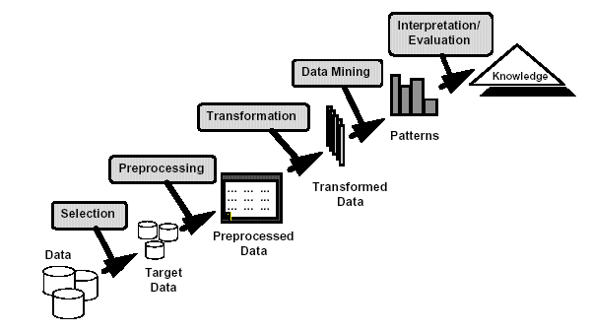
What is Data Mining?
Many Definitions
  Non-trivial extraction of implicit, previously unknown and potentially useful information from data
  Exploration & analysis, by automatic or
  semi-automatic means, of
  large quantities of data
  in order to discover
  meaningful patterns

Slide 10
What is NOT Data Mining?
Originally a “statistician” term
Overusing of data to draw invalid inferences
Bonferroni's theorem warns us that if there are too many possible conclusions to draw, some will be true for purely statistical reasons, with no physical validity.
Famous example: David Rhine, a “parapsychologist" at Duke in the 1950's tested students for Extra Sensory Perception(ESP) by asking them to guess 10 cards - red or black. He found about 1/1000 of them guessed all 10, and instead of realizing that is what you'd expect from random guessing, declared them to have ESP. When he retested them, he found they did no better than average.
His conclusion: telling people they have ESP causes them to lose it!

Slide 11
What is (not) Data Mining?
What is not Data Mining?
  Look up phone number in phone directory
  Query a Web search engine for information about “Amazon”
  What is Data Mining?
  Group together similar documents returned by search engine according to their context (e.g. Amazon rainforest, Amazon.com,)
  customers who buy diapers are more likely to buy beer

Slide 12
Origins of Data Mining
Draws ideas from machine learning/AI, pattern recognition, statistics, and database systems, parallel computing and Distributed Computing
Traditional Techniques
may be unsuitable due to
  Enormity of data
  High dimensionality
  of data
  Heterogeneous,
  distributed nature
  of data
Statistics/
AI
Machine Learning/
Pattern
Recognition
Data Mining
Database systems

Slide 13
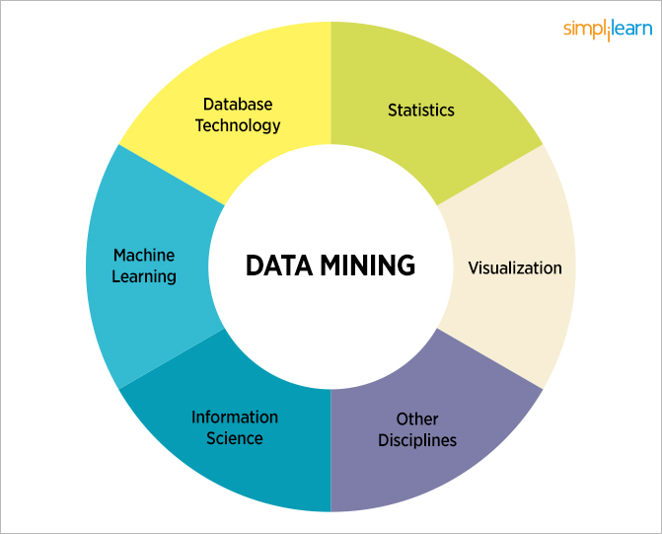

Slide 14
Challenges of Data Mining
Scalability
Dimensionality
Complex and Heterogeneous Data
Data Quality
Data Ownership and Distribution
Privacy Preservation
Streaming Data

Slide 15
Data Mining
Learning
Predictive
Descriptive
Classification
Prediction
Summarization
Clustering
Time Series Analysis
Sequence Discovery
Regression
Association Rules

Slide 16
Data Mining Tasks
Prediction Methods
  Use some variables to predict unknown or future values of other variables.
Description Methods
  Find human-interpretable patterns that describe the data.

Slide 17
Classification: Definition
Given a collection of records (training set )
  Each record contains a set of attributes, one of the attributes is the class.
Find a model for class attribute as a function of the values of other attributes.
Goal: previously unseen records should be assigned a class as accurately as possible.
  A test set is used to determine the accuracy of the model. Usually, the given data set is divided into training and test sets, with training set used to build the model and test set used to validate it.

Slide 18
Classification Example
categorical
categorical
continuous
class
Test
Set
Learn
Classifier
Training
Set
Model

Slide 19
Classification: Application 1
Direct Marketing
  Goal: Reduce cost of mailing by targeting a set of consumers likely to buy a new cell-phone product.
  Approach:
    Use the data for a similar product introduced before.
    We know which customers decided to buy and which decided otherwise. This {buy, don’t buy} decision forms the class attribute.
    Collect various demographic, lifestyle, and company-interaction related information about all such customers.
      Type of business, where they stay, how much they earn, etc.
    Use this information as input attributes to learn a classifier model.

Slide 20
Classification: Application 2
Fraud Detection
  Goal: Predict fraudulent cases in credit card transactions.
  Approach:
    Use credit card transactions and the information on its account-holder as attributes.
      When does a customer buy, what does he buy, how often he pays on time, etc.
    Label past transactions as fraud or fair transactions. This forms the class attribute.
    Learn a model for the class of the transactions.
    Use this model to detect fraud by observing credit card transactions on an account.

Slide 21
Classification: Application 3
Customer Attrition/Churn:
  Goal: To predict whether a customer is likely to be lost to a competitor.
  Approach:
    Use detailed record of transactions with each of the past and present customers, to find attributes.
      How often the customer calls, where he calls, what time-of-the day he calls most, his financial status, marital status, etc.
    Label the customers as loyal or disloyal.
    Find a model for loyalty.

Slide 22
Classification: Application 4
Sky Survey Cataloging
  Goal: To predict class (star or galaxy) of sky objects, especially visually faint ones, based on the telescopic survey images (from Palomar Observatory).
      3000 images with 23,040 x 23,040 pixels per image.
  Approach:
    Segment the image.
    Measure image attributes (features) - 40 of them per object.
    Model the class based on these features.
    Success Story: Could find 16 new high red-shift quasars, some of the farthest objects that are difficult to find!

Slide 23
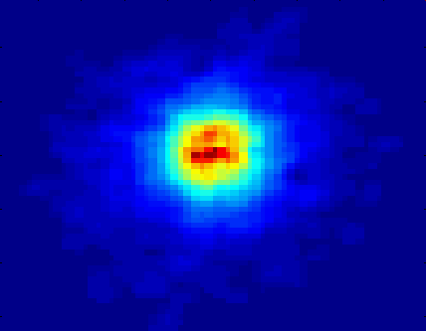
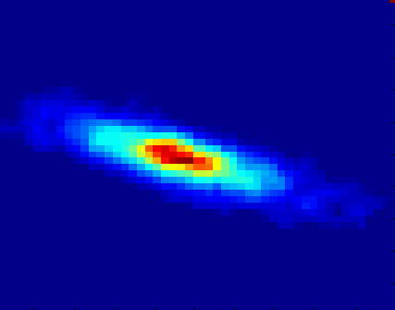
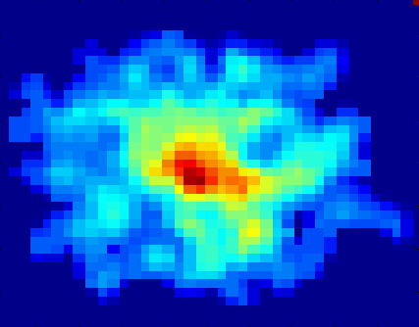
Classifying Galaxies
Early
Class:
Stages of Formation
Attributes:
Image features,
Characteristics of light waves received, etc.
Intermediate
Late
Data Size:
72 million stars, 20 million galaxies
Object Catalog: 9 GB
Image Database: 150 GB
Courtesy: http://aps.umn.edu

Slide 24
Clustering Definition
Given a set of data points, each having a set of attributes, and a similarity measure among them, find clusters such that
  Data points in one cluster are more similar to one another.
  Data points in separate clusters are less similar to one another.
Similarity Measures:
  Euclidean Distance if attributes are continuous.
  Other Problem-specific Measures.

Slide 25
Illustrating Clustering
Euclidean Distance Based Clustering in 3-D space.
Intracluster distances
are minimized
Intercluster distances
are maximized

Slide 26
Clustering: Application
Document Clustering:
  Goal: To find groups of documents that are similar to each other based on the important terms appearing in them.
  Approach: To identify frequently occurring terms in each document. Form a similarity measure based on the frequencies of different terms. Use it to cluster.
  Gain: Information Retrieval can utilize the clusters to relate a new document or search term to clustered documents.

Slide 27
Illustrating Document Clustering
Clustering Points: 3204 Articles of Los Angeles Times.
Similarity Measure: How many words are common in these documents (after some word filtering).

Slide 28
Association Rule Discovery: Definition
Given a set of records each of which contain some number of items from a given collection;
  Produce dependency rules which will predict occurrence of an item based on occurrences of other items.
Rules Discovered:
{Milk} --> {Coke}
{Diaper, Milk} --> {Beer}

Slide 29
Association Rule Discovery: Application 1
Marketing and Sales Promotion:
  Let the rule discovered be
  {Bagels, … } --> {Potato Chips}
  Potato Chips as consequent => Can be used to determine what should be done to boost its sales.
  Bagels in the antecedent => Can be used to see which products would be affected if the store discontinues selling bagels.
  Bagels in antecedent and Potato chips in consequent => Can be used to see what products should be sold with Bagels to promote sale of Potato chips!

Slide 30
Association Rule Discovery: Application 2
Supermarket shelf management.
  Goal: To identify items that are bought together by sufficiently many customers.
  Approach: Process the point-of-sale data collected with barcode scanners to find dependencies among items.
  A classic rule --
    If a customer buys diaper and milk, then he is very likely to buy beer.
    So, don’t be surprised if you find six-packs stacked next to diapers!

Slide 31
Association Rule Discovery: Application 3
Inventory Management:
  Goal: A consumer appliance repair company wants to anticipate the nature of repairs on its consumer products and keep the service vehicles equipped with right parts to reduce on number of visits to consumer households.
  Approach: Process the data on tools and parts required in previous repairs at different consumer locations and discover the co-occurrence patterns.

Slide 32
Sequential Pattern Discovery
Given is a set of objects, with each object associated with its own timeline of events, find rules that predict strong sequential dependencies among different events.
(A B) (C) (D E)

Slide 33
Sequential Pattern Discovery: Examples
In telecommunications alarm logs,
  (Inverter_Problem Excessive_Line_Current)
  (Rectifier_Alarm) --> (Fire_Alarm)
In point-of-sale transaction sequences,
  Computer Bookstore:
  (Intro_To_Visual_C) (C++_Primer) --> (Perl_for_dummies,Tcl_Tk)
  Athletic Apparel Store:
  (Shoes) (Racket, Racketball) --> (Sports_Jacket)

Slide 34
Regression
Predict a value of a given continuous valued variable based on the values of other variables, assuming a linear or nonlinear model of dependency.
Greatly studied in statistics, neural network fields.
Examples:
  Predicting sales amounts of new product based on advetising expenditure.
  Predicting wind velocities as a function of temperature, humidity, air pressure, etc.
  Time series prediction of stock market indices.

Slide 35
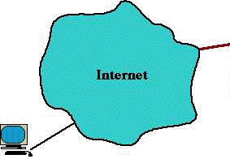
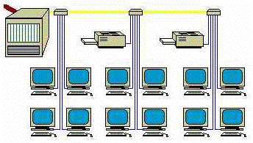
Deviation/Anomaly Detection
Detect significant deviations from normal behavior
Applications:
  Credit Card Fraud Detection
  Network Intrusion
  Detection
Typical network traffic at University level may reach over 100 million connections per day

