Slide 1
Clustering

Slide 2
What is Cluster Analysis?
Finding groups of objects such that the objects in a group will be similar (or related) to one another and different from (or unrelated to) the objects in other groups
Inter-cluster distances are maximized
Intra-cluster distances are minimized

Slide 3
What is Cluster Analysis?
Cluster: a collection of data objects
  Similar to one another within the same cluster
  Dissimilar to the objects in other clusters
Cluster analysis
  Grouping a set of data objects into clusters
Clustering is unsupervised classification: no predefined classes
Clustering is used:
  As a stand-alone tool to get insight into data distribution
    Visualization of clusters may unveil important information
  As a preprocessing step for other algorithms
    Efficient indexing or compression often relies on clustering

Slide 4
Clustering
Clustering of data is a method by which large sets of data is grouped into clusters of smaller sets of similar data
Objects in one cluster have high similarity to each other and are dissimilar to objects in other clusters
Group objects that share common characteristics

Slide 5
Some Applications of Clustering
Pattern Recognition
Image Processing
  cluster images based on their visual content
Bio-informatics
WWW and IR
  document classification
  cluster Weblog data to discover groups of similar access patterns

Slide 6
Clustering Applications
Segment customer database based on similar buying patterns.
Group houses in a town into neighborhoods based on similar features.
Identify new plant species
Identify similar Web usage patterns

Slide 7
Clustering Applications
Marketing: Help marketers discover distinct groups in their customer bases, and then use this knowledge to develop targeted marketing programs
Land use: Identification of areas of similar land use in an earth observation database
Insurance: Identifying groups of motor insurance policy holders with a high average claim cost
City-planning: Identifying groups of houses according to their house type, value, and geographical location
Earth-quake studies: Observed earth quake epicenters should be clustered along continent faults

Slide 8
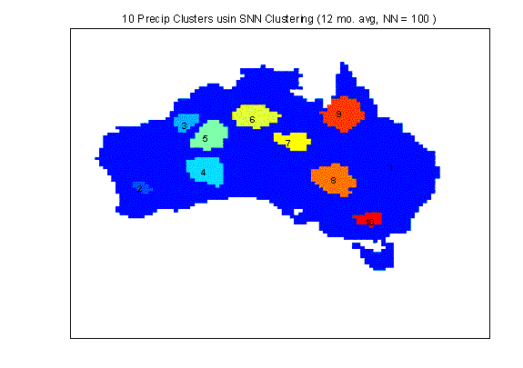
Applications of Cluster Analysis
Understanding
  Group related documents for browsing, group genes and proteins that have similar functionality, or group stocks with similar price fluctuations
Summarization
  Reduce the size of large data sets
Clustering precipitation in Australia

Slide 9
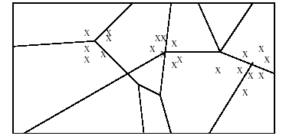
Applications of Cluster Analysis
Many years ago, during a cholera outbreak in London, a physician plotted the location of cases on a map, getting a plot that looked like Fig. below. Properly visualized, the data indicated that cases clustered around certain intersections, where there were polluted wells, not only exposing the cause of cholera, but indicating what to do about the problem. Alas, not all data mining is this easy, often because the clusters are in so many dimensions that visualization is very hard.

Slide 10
Applications of Cluster Analysis
Skycat clustered 2x10⁹ sky objects into stars, galaxies, quasars, etc. Each object was a point in a space of 7 dimensions, with each dimension representing radiation in one band of the spectrum. The Sloan Sky Survey is a more ambitious attempt to catalog and cluster the entire visible universe.
Documents may be thought of as points in a high-dimensional space, where each dimension corresponds to one possible word. The position of a document in a dimension is the number of times the word occurs in the document (or just 1 if it occurs, 0 if not). Clusters of documents in this space often correspond to groups of documents on the same topic.

Slide 11
What is not Cluster Analysis?
Supervised classification
  Have class label information
Simple segmentation
  Dividing students into different registration groups alphabetically, by last name
Graph partitioning
  Some mutual relevance and synergy, but areas are not identical

Slide 12
Notion of a Cluster can be Ambiguous
How many clusters?
Six Clusters
Two Clusters
Four Clusters

Slide 13
Clustering vs. Classification
No prior knowledge
  Number of clusters
  Meaning/interpretation of clusters
Unsupervised learning

Slide 14
Types of Clustering
A clustering is a set of clusters
Important distinction between hierarchical and partitional sets of clusters
Partitional Clustering
  A division data objects into non-overlapping subsets (clusters) such that each data object is in exactly one subset
Hierarchical clustering
  A set of nested clusters organized as a hierarchical tree

Slide 15
Clustering Approaches
Clustering
Hierarchical
Partitional
Density-based
Grid-based

Slide 16
Partitional Clustering
Original Points
A Partitional Clustering

Slide 17
Hierarchical Clustering
Traditional Hierarchical Clustering
Traditional Dendrogram
Non-traditional Hierarchical Clustering
Non-traditional Dendrogram

Slide 18
Hierarchical Methods
Creates a hierarchical decomposition of a given set of data objects
Agglomerative
  Initially each item in its own cluster
  Clusters are merged iteratively
  Bottom up
Divisive
  Initially all items in one cluster
  Large clusters are divided successively
  Top down

Slide 19
Hierarchical Clustering
Step 0
Step 1
Step 2
Step 3
Step 4
agglomerative
(AGNES)
a
a b
b
a b c d e
c
c d e
d
d e
e
divisive
(DIANA)
Step 4
Step 3
Step 2
Step 1
Step 0

Slide 20
Hierarchical Clustering
Produces a set of nested clusters organized as a hierarchical tree
Can be visualized as a “dendrogram”
  A tree like diagram that records the sequences of merges or splits

Slide 21
Density-based Methods
Most partitioning-based methods cluster objects based on distances between them
Can find only spherical-shaped clusters
Density-based clustering
  Continue growing a given cluster as long as the density in the ‘neighborhood’ exceeds some threshold.

Slide 22
Other Distinctions Between Sets of Clusters
Exclusive versus non-exclusive
  In non-exclusive clusterings, points may belong to multiple clusters.
  Can represent multiple classes or ‘border’ points
Fuzzy versus non-fuzzy
  In fuzzy clustering, a point belongs to every cluster with some weight between 0 and 1
  Weights must sum to 1
  Probabilistic clustering has similar characteristics
Partial versus complete
  In some cases, we only want to cluster some of the data
Heterogeneous versus homogeneous
  Cluster of widely different sizes, shapes, and densities

Slide 23
Partitioning Algorithms:
Basic Concept
Partitioning method: Construct a partition of a database D of n objects into a set of k clusters
Given a k, find a partition of k clusters that optimizes the chosen partitioning criterion
  Global optimal: exhaustively enumerate all partitions
  Heuristic methods: k-means and k-medoids algorithms
    k-means (MacQueen’67): Each cluster is represented by the center of the cluster (mean value of objects in the cluster)
    k-medoids or PAM (Partition around medoids) (Kaufman & Rousseeuw’87): Each cluster is represented by one of the objects in the cluster

Slide 24
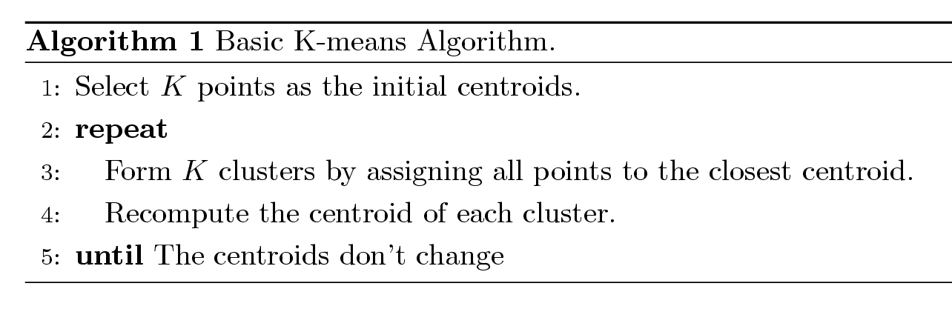
K-means Clustering
Partitional clustering approach
Each cluster is associated with a centroid (center point)
Each point is assigned to the cluster with the closest centroid
Number of clusters, K, must be specified
The basic algorithm is very simple

Slide 25
K-means Example
For simplicity, 1-dimension objects and k=2.
  Numerical difference is used as the distance
Objects: 1, 2, 5, 6,7
K-means:
  Randomly select 5 and 6 as centroids;
  => Two clusters {1,2,5} and {6,7}; meanC1=8/3, meanC2=6.5
  => {1,2}, {5,6,7}; meanC1=1.5, meanC2=6
  => no change.
  Aggregate dissimilarity
    (sum of squares of distance each point of each cluster from its cluster center--(intra-cluster distance)
  = 0.5²+ 0.5²+ 1²+ 0²+1² = 2.5
|1-1.5|²

Slide 26
K-Means Example
Given: {2,4,10,12,3,20,30,11,25}, k=2
Randomly assign means: m₁=3,m₂=4
K₁={2,3}, K₂={4,10,12,20,30,11,25}, m₁=2.5,m₂=16
K₁={2,3,4},K₂={10,12,20,30,11,25}, m₁=3,m₂=18
K₁={2,3,4,10},K₂={12,20,30,11,25}, m₁=4.75,m₂=19.6
K₁={2,3,4,10,11,12},K₂={20,30,25}, m₁=7,m₂=25
Stop as the clusters with these means are the same.

Slide 27
K Means Example
(K=2)
Pick seeds
Reassign clusters
Compute centroids
Reasssign clusters
x
x
x
Compute centroids
x
x
x
Reassign clusters
Converged!
[From Mooney]

Slide 28
K-means Clustering – Details
Initial centroids are often chosen randomly.
  Clusters produced vary from one run to another.
The centroid is (typically) the mean of the points in the cluster.
‘Closeness’ is measured by Euclidean distance, cosine similarity, correlation, etc.
K-means will converge for common similarity measures mentioned above.
Most of the convergence happens in the first few iterations.
  Often the stopping condition is changed to ‘Until relatively few points change clusters’
Complexity is O( n * K * I * d )
  n = number of points, K = number of clusters,
  I = number of iterations, d = number of attributes

Slide 29
Evaluating K-means Clusters
Most common measure is Sum of Squared Error (SSE)
  For each point, the error is the distance to the nearest cluster
  To get SSE, we square these errors and sum them.
  x is a data point in cluster C_{i} and m_{i} is the representative point for cluster C_{i}
    can show that m_{i} corresponds to the center (mean) of the cluster
  Given two clusters, we can choose the one with the smallest error
  One easy way to reduce SSE is to increase K, the number of clusters
    A good clustering with smaller K can have a lower SSE than a poor clustering with higher K

Slide 30
Two different K-means Clusterings
Original Points
Optimal Clustering
Sub-optimal Clustering

Slide 31
Importance of Choosing Initial Centroids

Slide 32
Importance of Choosing Initial Centroids

Slide 33
Importance of Choosing Initial Centroids …

Slide 34
Importance of Choosing Initial Centroids …

Slide 35
Good Initial Centroids
Source of figure: Introduction to Data Mining by Tan et. al.

Slide 36
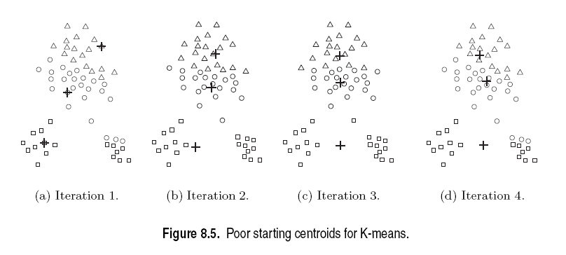
Poor Initial Centroids
Source of figure: Introduction to Data Mining by Tan et. al.

Slide 37
Pros & Cons of K-means
Relatively efficient: O(tknd)
n: # objects, k: # clusters, t: # iterations; n:# attributes k, t << n.
Applicable only when mean is defined
What about categorical data?
Need to specify the number of clusters
Unable to handle noisy data and outliers

Slide 38
Limitations of K-means
K-means has problems when clusters are of differing
  Sizes
  Densities
  Non-globular shapes
Empty clusters
K-means has problems when the data contains outliers.

Slide 39
Types of Clusters
Well-separated clusters
Center-based clusters
Contiguous clusters
Density-based clusters
Property or Conceptual
Described by an Objective Function

Slide 40
Types of Clusters: Well-Separated
Well-Separated Clusters:
  A cluster is a set of points such that any point in a cluster is closer (or more similar) to every other point in the cluster than to any point not in the cluster.
3 well-separated clusters

Slide 41
Types of Clusters: Center-Based
Center-based
  A cluster is a set of objects such that an object in a cluster is closer (more similar) to the “center” of a cluster, than to the center of any other cluster
  The center of a cluster is often a centroid, the average of all the points in the cluster, or a medoid, the most “representative” point of a cluster
4 center-based clusters

Slide 42
Types of Clusters: Contiguity-Based
Contiguous Cluster (Nearest neighbor or Transitive)
  A cluster is a set of points such that a point in a cluster is closer (or more similar) to one or more other points in the cluster than to any point not in the cluster.
8 contiguous clusters

Slide 43
Types of Clusters: Density-Based
Density-based
  A cluster is a dense region of points, which is separated by low-density regions, from other regions of high density.
  Used when the clusters are irregular or intertwined, and when noise and outliers are present.
6 density-based clusters

Slide 44
Types of Clusters: Conceptual Clusters
Shared Property or Conceptual Clusters
  Finds clusters that share some common property or represent a particular concept.
  .
2 Overlapping Circles

Slide 45
What Is Good Clustering?
A good clustering method will produce high quality clusters with
  high intra-class similarity
  low inter-class similarity
The quality of a clustering result depends on both the similarity measure used by the method and its implementation.
The quality of a clustering method is also measured by its ability to discover some or all of the hidden patterns.

Slide 46
Requirements of Clustering in Data Mining
Scalability
Ability to deal with different types of attributes
Discovery of clusters with arbitrary shape
Minimal requirements for domain knowledge to determine input parameters
Able to deal with noise and outliers
Insensitive to order of input records
High dimensionality
Incorporation of user-specified constraints
Interpretability and usability

Slide 47
Outliers
Outliers are objects that do not belong to any cluster or form clusters of very small cardinality
In some applications we are interested in discovering outliers, not clusters (outlier analysis)
cluster
outliers

Slide 48
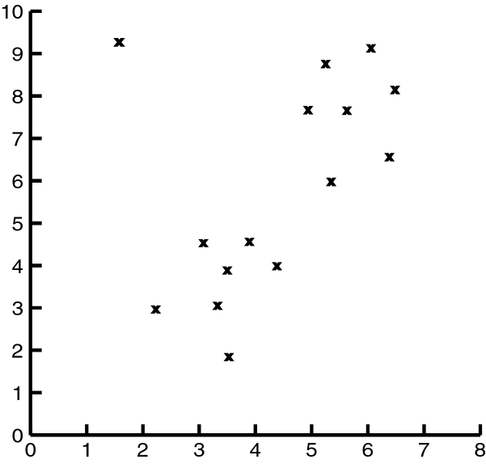
Impact of Outliers on Clustering
Source of figure: Data Mining by Dunham, M H

Slide 49
Problems with Outliers
Many clustering algorithms take as input the number of clusters
Some clustering algorithms find and eliminate outliers
Statistical techniques to detect outliers
Discordancy Test
Not very realistic for real life data

Slide 50
Clustering Problem
Given a database D={t₁,t₂,…,t_{n}} of tuples and an integer value k, the Clustering Problem is to define a mapping f:Dg{1,..,k} where each t_{i} is assigned to one cluster K_{j}, 1<=j<=k.
A Cluster, K_{j}, contains precisely those tuples mapped to it.
Unlike classification problem, clusters are not known a priori.

Slide 51
Clustering Algorithms
K-means and its variants
Hierarchical clustering
Density-based clustering

Slide 52
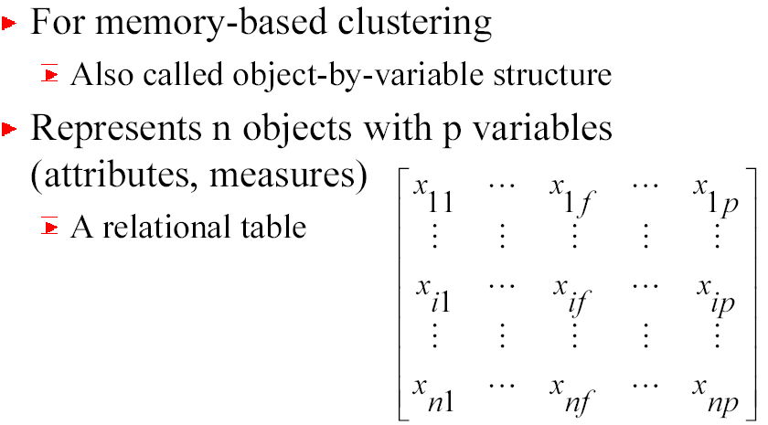
Types of Data in Cluster Analysis
Data matrix

Slide 53
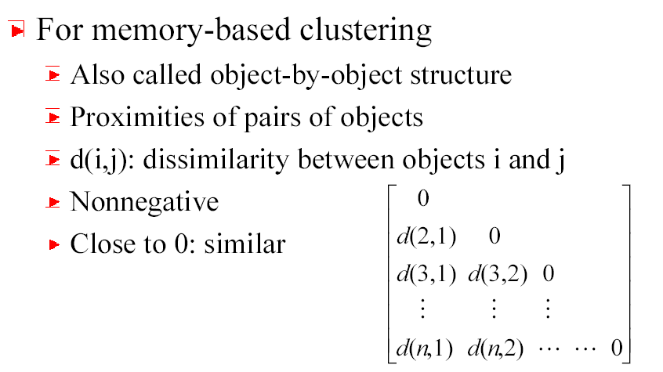
Types of Data in Cluster Analysis
Dissimilarity Matrix

Slide 54
Dissimilarity Matrix
Many clustering algorithms operate on dissimilarity matrix
If data matrix is given, it needs to be transformed into a dissimilarity matrix first
How can we assess dissimilarity d(i,j)?

Slide 55
Types of Data
Interval-scaled variables
Binary variables
Nominal, ordinal, and ratio variables
Variables of mixed types

Slide 56
Interval-scaled Variables
Continuous measurements of a roughly linear scale
Weight, height, latitude and longitude coordinates, temperature, etc.
Effect of measurement units in attributes
    Smaller unit Larger variable range Larger effect to the clustering structure
Standardization + background knowledge
Clustering BB player may require giving more weightage to height

Slide 57
Standardizing Variables
Standardize data
  Calculate the mean absolute deviation:
  where
  Calculate the standardized measurement (z-score)
Using mean absolute deviation is more robust than using standard deviation as z-scores of outliers do not become too small and so they remain detectable

Slide 58
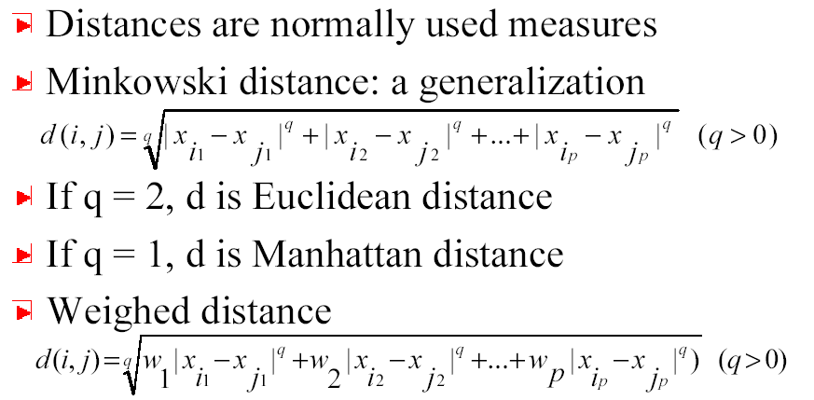
Similarity & dissimilarity between Objects

Slide 59
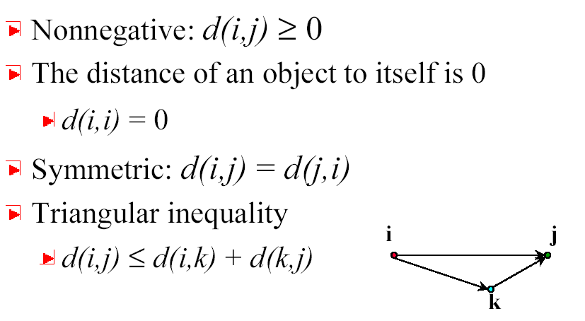
Properties of Minkowski Distance

Slide 60
Binary Variables
A contingency table for binary data
Simple matching coefficient (invariant, if the binary variable is symmetric):
Jaccard coefficient (noninvariant if the binary variable is asymmetric):
Object j
Object i

Slide 61
Dissimilarity between Binary Variables
Example
  gender is a symmetric attribute
  the remaining attributes are asymmetric binary
  let the values Y and P be set to 1, and the value N be set to 0

Slide 62
Nominal Variables
A generalization of the binary variable in that it can take more than 2 states, e.g., red, yellow, blue, green
Method 1: Simple matching
  m: # of matches, p: total # of variables
Method 2: use a large number of binary variables
  creating a new binary variable for each of the M nominal states

Slide 63
Ordinal Variables
An ordinal variable can be discrete or continuous
order is important, e.g., rank
Can be treated like interval-scaled
  replacing x_{if} by their rank
  map the range of each variable onto [0, 1] by replacing i-th object in the f-th variable by
  compute the dissimilarity using methods for interval-scaled variables

Slide 64
Ratio-Scaled Variables
Ratio-scaled variable: a positive measurement on a nonlinear scale, approximately at exponential scale, such as Ae^{Bt} or Ae^{-Bt}
Methods:
  treat them like interval-scaled variables — not a good choice! (why?)
  apply logarithmic transformation
y_{if} = log(x_{if})
  treat them as continuous ordinal data treat their rank as interval-scaled.

Slide 65
Variables of Mixed Types
A database may contain all the six types of variables
  symmetric binary, asymmetric binary, nominal, ordinal, interval and ratio.
One may use a weighted formula to combine their effects.
  f is binary or nominal:
    d_{ij}^{(f)} = 0 if x_{if} = x_{jf} , or d_{ij}^{(f)} = 1 o.w.
  f is interval-based: use the normalized distance
  f is ordinal or ratio-scaled
    compute ranks r_{if} and
    and treat z_{if} as interval-scaled

Slide 66
Similarity Measures
If i = (x_{i1}, x_{i2}, …, x_{ip},) and j = (x_{j1}, x_{j2}, …, x_{jp}) are two p-dimensional data objects, then
Euclidean distance
Manhattan distance
Minkowski distance

