Slide 1
Clustering

Slide 2
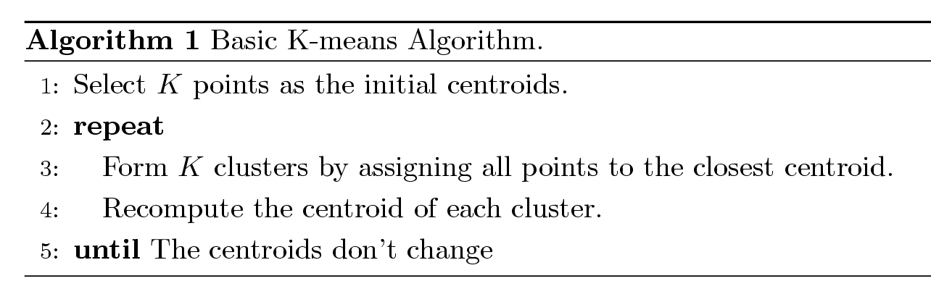
K-means Clustering
Partitional clustering approach
Each cluster is associated with a centroid (center point)
Each point is assigned to the cluster with the closest centroid
Number of clusters, K, must be specified
The basic algorithm is very simple

Slide 3
K-means Example
For simplicity, 1-dimension objects and k=2.
  Numerical difference is used as the distance
Objects: 1, 2, 5, 6,7
K-means:
  Randomly select 5 and 6 as centroids;
  => Two clusters {1,2,5} and {6,7}; meanC1=8/3, meanC2=6.5
  => {1,2}, {5,6,7}; meanC1=1.5, meanC2=6
  => no change.
  Aggregate dissimilarity
    (sum of squares of distance each point of each cluster from its cluster center--(intra-cluster distance)
  = 0.5²+ 0.5²+ 1²+ 0²+1² = 2.5
|1-1.5|²

Slide 4
K-Means Example
Given: {2,4,10,12,3,20,30,11,25}, k=2
Randomly assign means: m₁=3,m₂=4
K₁={2,3}, K₂={4,10,12,20,30,11,25}, m₁=2.5,m₂=16
K₁={2,3,4},K₂={10,12,20,30,11,25}, m₁=3,m₂=18
K₁={2,3,4,10},K₂={12,20,30,11,25}, m₁=4.75,m₂=19.6
K₁={2,3,4,10,11,12},K₂={20,30,25}, m₁=7,m₂=25
Stop as the clusters with these means are the same.

Slide 5
K Means Example
(K=2)
Pick seeds
Reassign clusters
Compute centroids
Reasssign clusters
x
x
x
Compute centroids
x
x
x
Reassign clusters
Converged!
[From Mooney]

Slide 6
K-means Clustering – Details
Initial centroids are often chosen randomly.
  Clusters produced vary from one run to another.
The centroid is (typically) the mean of the points in the cluster.
‘Closeness’ is measured by Euclidean distance, cosine similarity, correlation, etc.
K-means will converge for common similarity measures mentioned above.
Most of the convergence happens in the first few iterations.
  Often the stopping condition is changed to ‘Until relatively few points change clusters’
Complexity is O( n * K * I * d )
  n = number of points, K = number of clusters,
  I = number of iterations, d = number of attributes

Slide 7
Evaluating K-means Clusters
Most common measure is Sum of Squared Error (SSE)
  For each point, the error is the distance to the nearest cluster
  To get SSE, we square these errors and sum them.
  x is a data point in cluster C_{i} and m_{i} is the representative point for cluster C_{i}
    can show that m_{i} corresponds to the center (mean) of the cluster
  Given two clusters, we can choose the one with the smallest error
  One easy way to reduce SSE is to increase K, the number of clusters
    A good clustering with smaller K can have a lower SSE than a poor clustering with higher K

Slide 8
Two different K-means Clusterings
Original Points
Optimal Clustering
Sub-optimal Clustering

Slide 9
Importance of Choosing Initial Centroids

Slide 10
Importance of Choosing Initial Centroids

Slide 11
Importance of Choosing Initial Centroids …

Slide 12
Importance of Choosing Initial Centroids …

Slide 13
Good Initial Centroids
Source of figure: Introduction to Data Mining by Tan et. al.

Slide 14
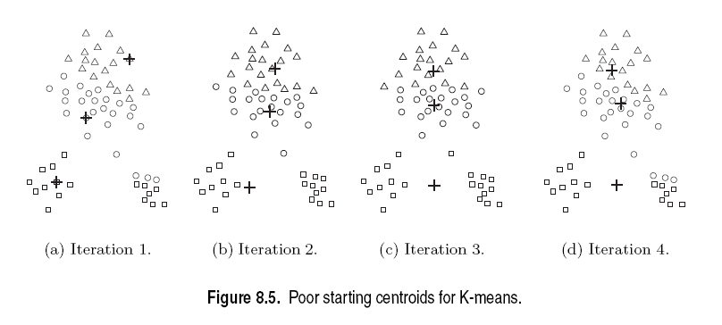
Poor Initial Centroids
Source of figure: Introduction to Data Mining by Tan et. al.

Slide 15
Pros & Cons of K-means
Relatively efficient: O(tknd)
n: # objects, k: # clusters, t: # iterations; n:# attributes k, t << n.
Applicable only when mean is defined
What about categorical data?
Need to specify the number of clusters
Unable to handle noisy data and outliers

Slide 16
Limitations of K-means
K-means has problems when clusters are of differing
  Sizes
  Densities
  Non-globular shapes
Empty clusters
K-means has problems when the data contains outliers.

Slide 17
Choosing Initial Centroids
Random Initialization
  Perform multiple runs with randomly chosen initial seeds
  Choose the set of clusters with minimum SSE
  Not necessarily a good solution
Sampling
  Sample and do hierarchical clustering
  K clusters are found
  Centroids of these clusters are used as initial seeds
  Works well only if
    Sample is relatively small (few 100_{s} to few 1000_{s})
    K<<sample size

Slide 18
Choosing Initial Centroids
Source of figure: Introduction to Data Mining by Tan et. al.

Slide 19
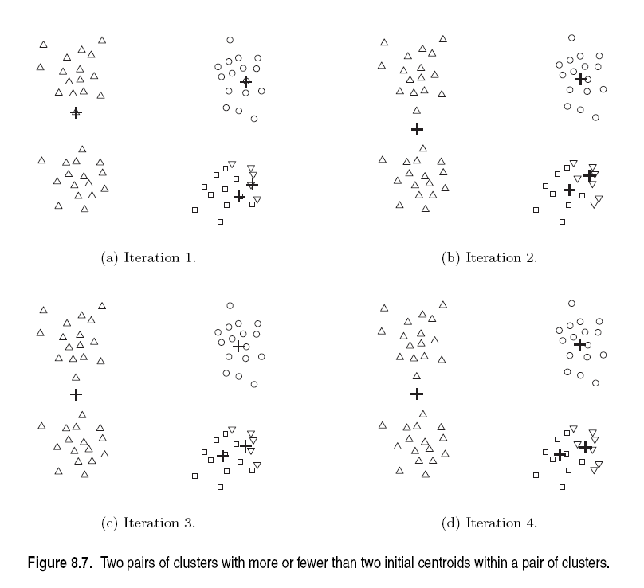
Choosing Initial Centroids
Source of figure: Introduction to Data Mining by Tan et. al.

Slide 20
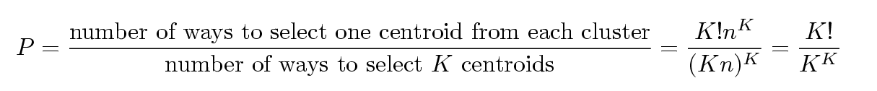
Problems with Selecting Initial Points
If there are K ‘real’ clusters then the chance of selecting one centroid from each cluster is small.
  Chance is relatively small when K is large
  If clusters are the same size, n, then
  For example, if K = 10, then probability = 10!/10¹⁰ = 0.00036
  Sometimes the initial centroids will read just themselves in ‘right’ way, and sometimes they don’t
  Consider an example of five pairs of clusters

Slide 21
10 Clusters Example
Starting with two initial centroids in one cluster of each pair of clusters

Slide 22
10 Clusters Example
Starting with two initial centroids in one cluster of each pair of clusters

Slide 23
10 Clusters Example
Starting with some pairs of clusters having three initial centroids, while other have only one.

Slide 24
10 Clusters Example
Starting with some pairs of clusters having three initial centroids, while other have only one.

Slide 25
Solutions to Initial Centroids Problem
Multiple runs
  Helps, but probability is not on your side
Sample and use hierarchical clustering to determine initial centroids
Select more than k initial centroids and then select among these initial centroids
  Select most widely separated
Postprocessing
Bisecting K-means
  Not as susceptible to initialization issues

Slide 26
Handling Empty Clusters
Basic K-means algorithm can yield empty clusters
Several strategies
  Choose the point that is farthest away from any current centroid
  Choose a point from the cluster with the highest SSE
  If there are several empty clusters, the above can be repeated several times.

Slide 27
Pre-processing and Post-processing
Pre-processing
  Normalize the data
  Eliminate outliers
Post-processing
  Eliminate small clusters that may represent outliers
  Split ‘loose’ clusters, i.e., clusters with relatively high SSE
  Merge clusters that are ‘close’ and that have relatively low SSE
  Can use these steps during the clustering process

Slide 28
Updating Centers Incrementally
In the basic K-means algorithm, centroids are updated after all points are assigned to a centroid
An alternative is to update the centroids after each assignment (incremental approach)
  Each assignment updates zero or two centroids
  More expensive
  Introduces an order dependency
  Never get an empty cluster
  Can use “weights” to change the impact

Slide 29
Variations on K-means
Recompute the centroid after every (or few) changes (rather than after all the points are re-assigned)
  Improves convergence speed
Starting centroids (seeds) change which local minima we converge to, as well as the rate of convergence
  Use heuristics to pick good seeds
    Can use another cheap clustering over random sample
  Run K-means M times and pick the best clustering that results
    Bisecting K-means takes this idea further…
Lowest aggregate
Dissimilarity
(intra-cluster
distance)

Slide 30
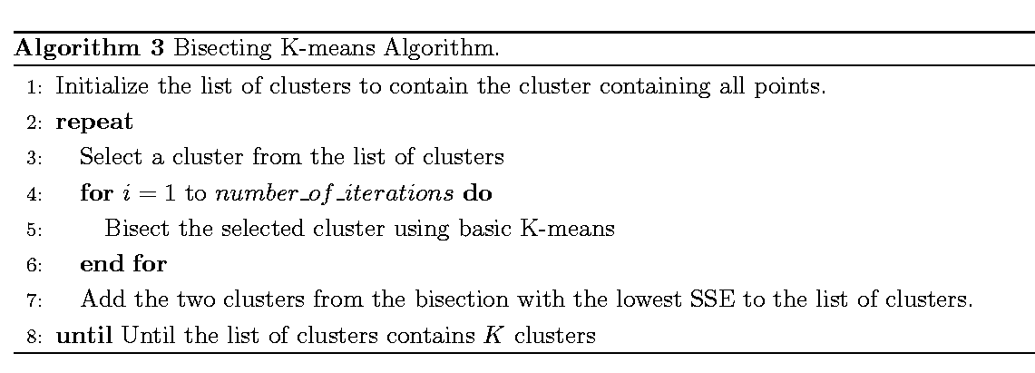
Bisecting K-means
Bisecting K-means algorithm
  Variant of K-means that can produce a partitional or a hierarchical clustering

Slide 32
Bisecting K-means
Can pick the largest
Cluster or the cluster
With lowest average
similarity
For I=1 to k-1 do{
  Pick a leaf cluster C to split
  For J=1 to ITER do{
    Use K-means to split C into two sub-clusters, C₁ and C₂
    Choose the best of the above splits and make it permanent}
  }
Divisive hierarchical clustering method
uses K-means

Slide 33
Limitations of K-means
K-means has problems when clusters are of differing
  Sizes
  Densities
  Non-globular shapes
K-means has problems when the data contains outliers.

Slide 34
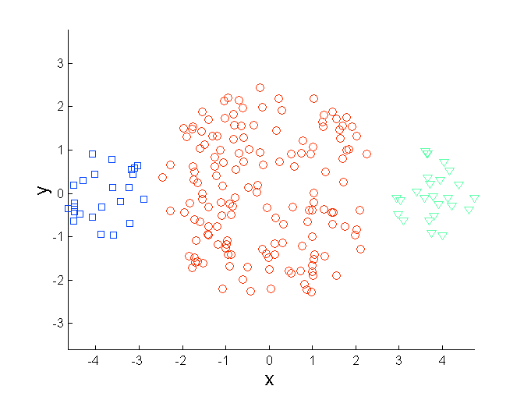
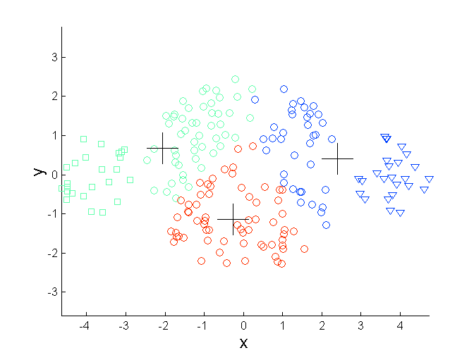
Limitations of K-means: Differing Sizes
Original Points
K-means (3 Clusters)

Slide 35
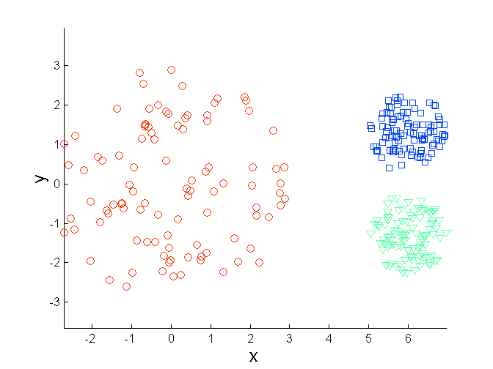
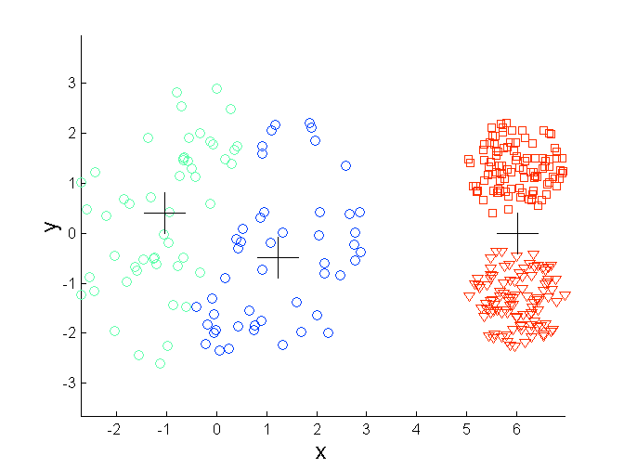
Limitations of K-means: Differing Density
Original Points
K-means (3 Clusters)

Slide 36
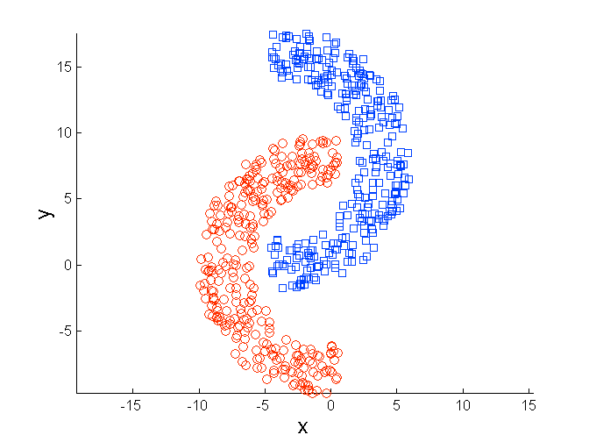
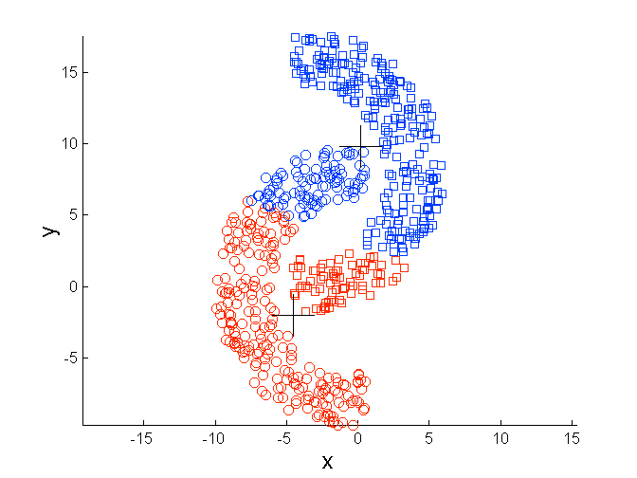
Limitations of K-means: Non-globular Shapes
Original Points
K-means (2 Clusters)

Slide 37
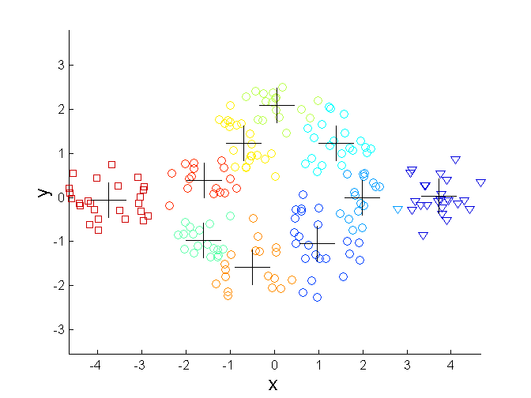
Overcoming K-means Limitations
Original Points K-means Clusters
One solution is to use many clusters.
  Find parts of clusters, but need to put together.

Slide 38
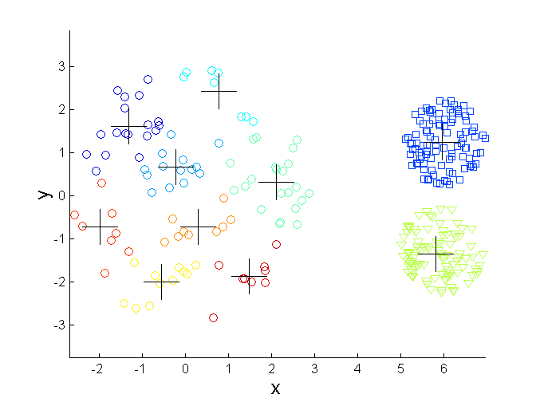
Overcoming K-means Limitations
Original Points K-means Clusters

Slide 39
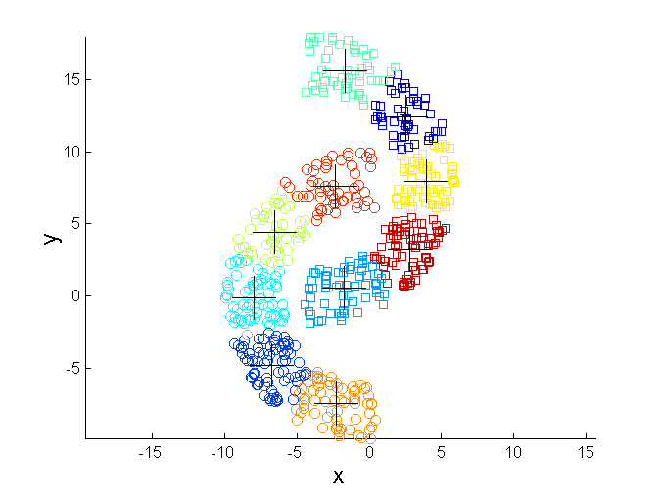
Overcoming K-means Limitations
Original Points K-means Clusters

Slide 40
Types of Clusters
Well-separated clusters
Center-based clusters
Contiguous clusters
Density-based clusters
Property or Conceptual
Described by an Objective Function

Slide 41
Types of Clusters: Well-Separated
Well-Separated Clusters:
  A cluster is a set of points such that any point in a cluster is closer (or more similar) to every other point in the cluster than to any point not in the cluster.
3 well-separated clusters

Slide 42
Types of Clusters: Center-Based
Center-based
  A cluster is a set of objects such that an object in a cluster is closer (more similar) to the “center” of a cluster, than to the center of any other cluster
  The center of a cluster is often a centroid, the average of all the points in the cluster, or a medoid, the most “representative” point of a cluster
4 center-based clusters

Slide 43
Types of Clusters: Contiguity-Based
Contiguous Cluster (Nearest neighbor or Transitive)
  A cluster is a set of points such that a point in a cluster is closer (or more similar) to one or more other points in the cluster than to any point not in the cluster.
8 contiguous clusters

Slide 44
Types of Clusters: Density-Based
Density-based
  A cluster is a dense region of points, which is separated by low-density regions, from other regions of high density.
  Used when the clusters are irregular or intertwined, and when noise and outliers are present.
6 density-based clusters

Slide 45
Types of Clusters: Conceptual Clusters
Shared Property or Conceptual Clusters
  Finds clusters that share some common property or represent a particular concept.
  .
2 Overlapping Circles

Slide 46
What Is Good Clustering?
A good clustering method will produce high quality clusters with
  high intra-class similarity
  low inter-class similarity
The quality of a clustering result depends on both the similarity measure used by the method and its implementation.
The quality of a clustering method is also measured by its ability to discover some or all of the hidden patterns.

Slide 47
Requirements of Clustering in Data Mining
Scalability
Ability to deal with different types of attributes
Discovery of clusters with arbitrary shape
Minimal requirements for domain knowledge to determine input parameters
Able to deal with noise and outliers
Insensitive to order of input records
High dimensionality
Incorporation of user-specified constraints
Interpretability and usability

Slide 48
Outliers
Outliers are objects that do not belong to any cluster or form clusters of very small cardinality
In some applications we are interested in discovering outliers, not clusters (outlier analysis)
cluster
outliers

Slide 49
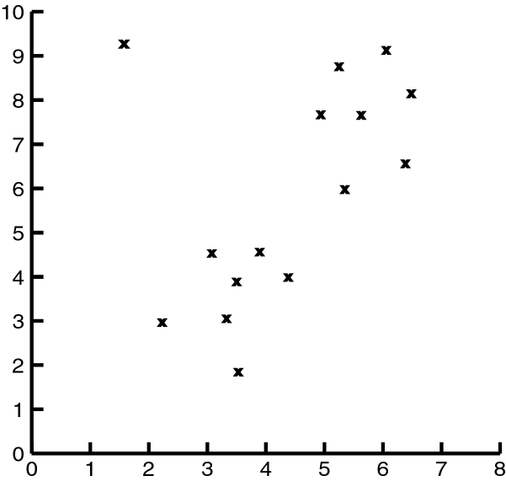
Impact of Outliers on Clustering
Source of figure: Data Mining by Dunham, M H

Slide 50
Problems with Outliers
Many clustering algorithms take as input the number of clusters
Some clustering algorithms find and eliminate outliers
Statistical techniques to detect outliers
Discordancy Test
Not very realistic for real life data

Slide 51
Clustering Problem
Given a database D={t₁,t₂,…,t_{n}} of tuples and an integer value k, the Clustering Problem is to define a mapping f:Dg{1,..,k} where each t_{i} is assigned to one cluster K_{j}, 1<=j<=k.
A Cluster, K_{j}, contains precisely those tuples mapped to it.
Unlike classification problem, clusters are not known a priori.

Slide 52
Clustering Algorithms
K-means and its variants
Hierarchical clustering
Density-based clustering

Slide 53
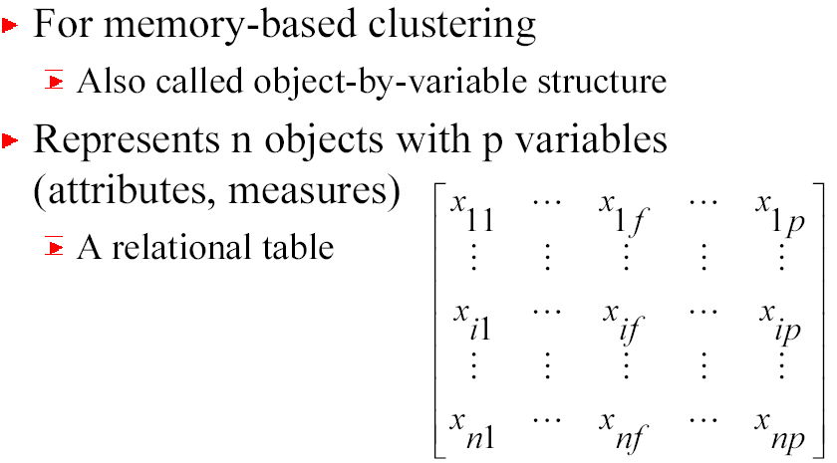
Types of Data in Cluster Analysis
Data matrix

Slide 54
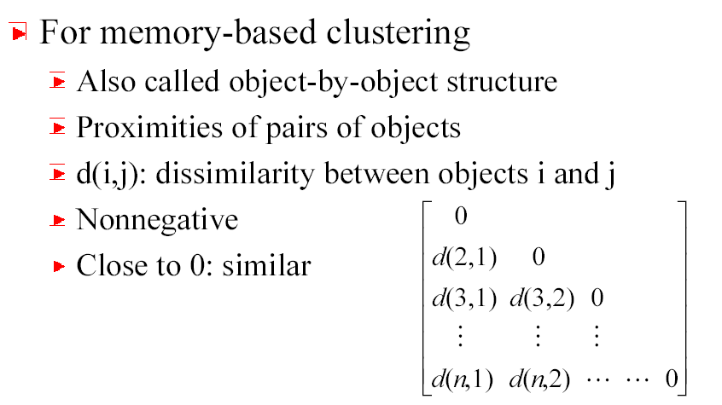
Types of Data in Cluster Analysis
Dissimilarity Matrix

Slide 55
Dissimilarity Matrix
Many clustering algorithms operate on dissimilarity matrix
If data matrix is given, it needs to be transformed into a dissimilarity matrix first
How can we assess dissimilarity d(i,j)?

Slide 56
Types of Data
Interval-scaled variables
Binary variables
Nominal, ordinal, and ratio variables
Variables of mixed types

Slide 57
Interval-scaled Variables
Continuous measurements of a roughly linear scale
Weight, height, latitude and longitude coordinates, temperature, etc.
Effect of measurement units in attributes
    Smaller unit Larger variable range Larger effect to the clustering structure
Standardization + background knowledge
Clustering BB player may require giving more weightage to height

Slide 58
Standardizing Variables
Standardize data
  Calculate the mean absolute deviation:
  where
  Calculate the standardized measurement (z-score)
Using mean absolute deviation is more robust than using standard deviation as z-scores of outliers do not become too small and so they remain detectable

Slide 59
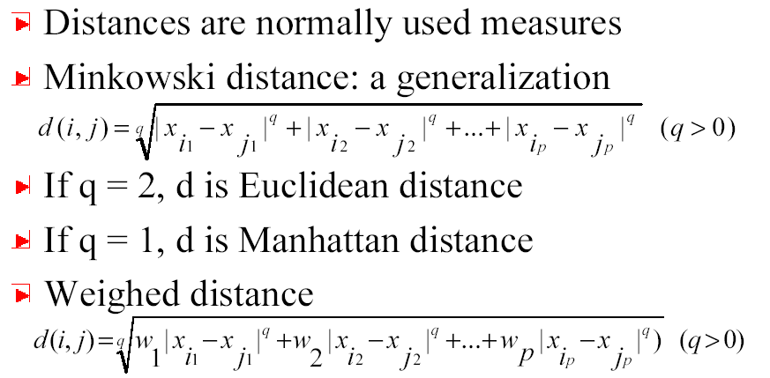
Similarity & dissimilarity between Objects

Slide 60
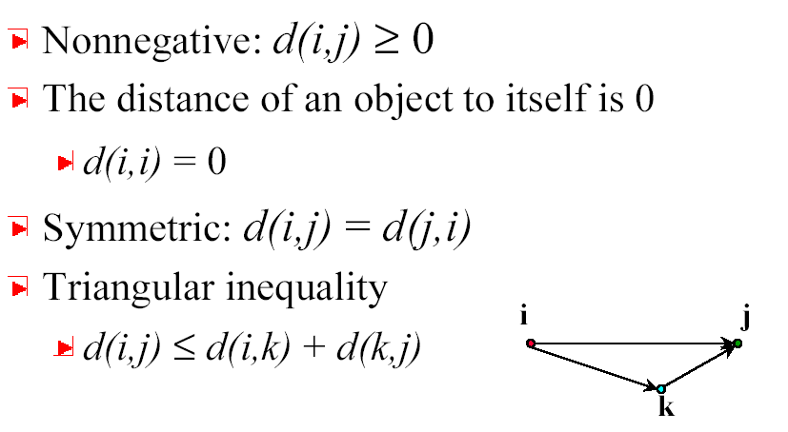
Properties of Minkowski Distance

Slide 61
Binary Variables
A contingency table for binary data
Simple matching coefficient (invariant, if the binary variable is symmetric):
Jaccard coefficient (noninvariant if the binary variable is asymmetric):
Object j
Object i

Slide 62
Dissimilarity between Binary Variables
Example
  gender is a symmetric attribute
  the remaining attributes are asymmetric binary
  let the values Y and P be set to 1, and the value N be set to 0

Slide 63
Nominal Variables
A generalization of the binary variable in that it can take more than 2 states, e.g., red, yellow, blue, green
Method 1: Simple matching
  m: # of matches, p: total # of variables
Method 2: use a large number of binary variables
  creating a new binary variable for each of the M nominal states

Slide 64
Ordinal Variables
An ordinal variable can be discrete or continuous
order is important, e.g., rank
Can be treated like interval-scaled
  replacing x_{if} by their rank
  map the range of each variable onto [0, 1] by replacing i-th object in the f-th variable by
  compute the dissimilarity using methods for interval-scaled variables

Slide 65
Ratio-Scaled Variables
Ratio-scaled variable: a positive measurement on a nonlinear scale, approximately at exponential scale, such as Ae^{Bt} or Ae^{-Bt}
Methods:
  treat them like interval-scaled variables — not a good choice! (why?)
  apply logarithmic transformation
y_{if} = log(x_{if})
  treat them as continuous ordinal data treat their rank as interval-scaled.

Slide 66
Variables of Mixed Types
A database may contain all the six types of variables
  symmetric binary, asymmetric binary, nominal, ordinal, interval and ratio.
One may use a weighted formula to combine their effects.
  f is binary or nominal:
    d_{ij}^{(f)} = 0 if x_{if} = x_{jf} , or d_{ij}^{(f)} = 1 o.w.
  f is interval-based: use the normalized distance
  f is ordinal or ratio-scaled
    compute ranks r_{if} and
    and treat z_{if} as interval-scaled

Slide 67
Similarity Measures
If i = (x_{i1}, x_{i2}, …, x_{ip},) and j = (x_{j1}, x_{j2}, …, x_{jp}) are two p-dimensional data objects, then
Euclidean distance
Manhattan distance
Minkowski distance

