Slide 1
CS F415: Data Mining
Yashvardhan Sharma

Slide 2
Today’s Outline
Introduction
  Data Mining Tasks
  Applications
  Comparisons

Slide 3
Data Mining
Learning
Predictive
Descriptive
Classification
Prediction
Summarization
Clustering
Time Series Analysis
Sequence Discovery
Regression
Association Rules

Slide 4
Data Mining Tasks
Prediction Methods
  Use some variables to predict unknown or future values of other variables.
Description Methods
  Find human-interpretable patterns that describe the data.

Slide 5
Classification: Definition
Given a collection of records (training set )
  Each record contains a set of attributes, one of the attributes is the class.
Find a model for class attribute as a function of the values of other attributes.
Goal: previously unseen records should be assigned a class as accurately as possible.
  A test set is used to determine the accuracy of the model. Usually, the given data set is divided into training and test sets, with training set used to build the model and test set used to validate it.

Slide 6
Classification Example
categorical
categorical
continuous
class
Test
Set
Learn
Classifier
Training
Set
Model

Slide 7
Classification: Application 1
Direct Marketing
  Goal: Reduce cost of mailing by targeting a set of consumers likely to buy a new cell-phone product.
  Approach:
    Use the data for a similar product introduced before.
    We know which customers decided to buy and which decided otherwise. This {buy, don’t buy} decision forms the class attribute.
    Collect various demographic, lifestyle, and company-interaction related information about all such customers.
      Type of business, where they stay, how much they earn, etc.
    Use this information as input attributes to learn a classifier model.

Slide 8
Classification: Application 2
Fraud Detection
  Goal: Predict fraudulent cases in credit card transactions.
  Approach:
    Use credit card transactions and the information on its account-holder as attributes.
      When does a customer buy, what does he buy, how often he pays on time, etc.
    Label past transactions as fraud or fair transactions. This forms the class attribute.
    Learn a model for the class of the transactions.
    Use this model to detect fraud by observing credit card transactions on an account.

Slide 9
Classification: Application 3
Customer Attrition/Churn:
  Goal: To predict whether a customer is likely to be lost to a competitor.
  Approach:
    Use detailed record of transactions with each of the past and present customers, to find attributes.
      How often the customer calls, where he calls, what time-of-the day he calls most, his financial status, marital status, etc.
    Label the customers as loyal or disloyal.
    Find a model for loyalty.

Slide 10
Classification: Application 4
Sky Survey Cataloging
  Goal: To predict class (star or galaxy) of sky objects, especially visually faint ones, based on the telescopic survey images (from Palomar Observatory).
      3000 images with 23,040 x 23,040 pixels per image.
  Approach:
    Segment the image.
    Measure image attributes (features) - 40 of them per object.
    Model the class based on these features.
    Success Story: Could find 16 new high red-shift quasars, some of the farthest objects that are difficult to find!

Slide 11
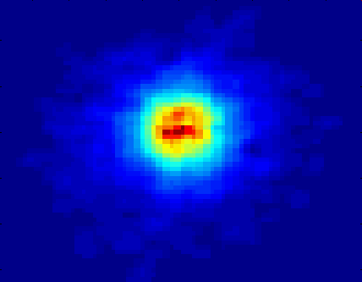
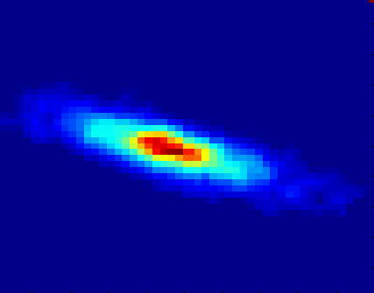
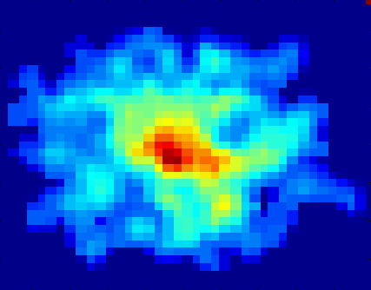
Classifying Galaxies
Early
Class:
Stages of Formation
Attributes:
Image features,
Characteristics of light waves received, etc.
Intermediate
Late
Data Size:
72 million stars, 20 million galaxies
Object Catalog: 9 GB
Image Database: 150 GB
Courtesy: http://aps.umn.edu

Slide 12
Clustering Definition
Given a set of data points, each having a set of attributes, and a similarity measure among them, find clusters such that
  Data points in one cluster are more similar to one another.
  Data points in separate clusters are less similar to one another.
Similarity Measures:
  Euclidean Distance if attributes are continuous.
  Other Problem-specific Measures.

Slide 13
Illustrating Clustering
Euclidean Distance Based Clustering in 3-D space.
Intracluster distances
are minimized
Intercluster distances
are maximized

Slide 14
Clustering: Application
Document Clustering:
  Goal: To find groups of documents that are similar to each other based on the important terms appearing in them.
  Approach: To identify frequently occurring terms in each document. Form a similarity measure based on the frequencies of different terms. Use it to cluster.
  Gain: Information Retrieval can utilize the clusters to relate a new document or search term to clustered documents.

Slide 15
Illustrating Document Clustering
Clustering Points: 3204 Articles of Los Angeles Times.
Similarity Measure: How many words are common in these documents (after some word filtering).

Slide 16
Association Rule Discovery: Definition
Given a set of records each of which contain some number of items from a given collection;
  Produce dependency rules which will predict occurrence of an item based on occurrences of other items.
Rules Discovered:
{Milk} --> {Coke}
{Diaper, Milk} --> {Beer}

Slide 17
Association Rule Discovery: Application 1
Marketing and Sales Promotion:
  Let the rule discovered be
  {Bagels, … } --> {Potato Chips}
  Potato Chips as consequent => Can be used to determine what should be done to boost its sales.
  Bagels in the antecedent => Can be used to see which products would be affected if the store discontinues selling bagels.
  Bagels in antecedent and Potato chips in consequent => Can be used to see what products should be sold with Bagels to promote sale of Potato chips!

Slide 18
Association Rule Discovery: Application 2
Supermarket shelf management.
  Goal: To identify items that are bought together by sufficiently many customers.
  Approach: Process the point-of-sale data collected with barcode scanners to find dependencies among items.
  A classic rule --
    If a customer buys diaper and milk, then he is very likely to buy beer.
    So, don’t be surprised if you find six-packs stacked next to diapers!

Slide 19
Association Rule Discovery: Application 3
Inventory Management:
  Goal: A consumer appliance repair company wants to anticipate the nature of repairs on its consumer products and keep the service vehicles equipped with right parts to reduce on number of visits to consumer households.
  Approach: Process the data on tools and parts required in previous repairs at different consumer locations and discover the co-occurrence patterns.

Slide 20
Sequential Pattern Discovery
Given is a set of objects, with each object associated with its own timeline of events, find rules that predict strong sequential dependencies among different events.
(A B) (C) (D E)

Slide 21
Sequential Pattern Discovery: Examples
In telecommunications alarm logs,
  (Inverter_Problem Excessive_Line_Current)
  (Rectifier_Alarm) --> (Fire_Alarm)
In point-of-sale transaction sequences,
  Computer Bookstore:
  (Intro_To_Visual_C) (C++_Primer) --> (Perl_for_dummies,Tcl_Tk)
  Athletic Apparel Store:
  (Shoes) (Racket, Racketball) --> (Sports_Jacket)

Slide 22
Regression
Predict a value of a given continuous valued variable based on the values of other variables, assuming a linear or nonlinear model of dependency.
Greatly studied in statistics, neural network fields.
Examples:
  Predicting sales amounts of new product based on advetising expenditure.
  Predicting wind velocities as a function of temperature, humidity, air pressure, etc.
  Time series prediction of stock market indices.

Slide 23
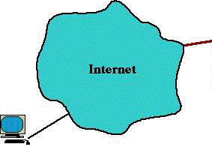
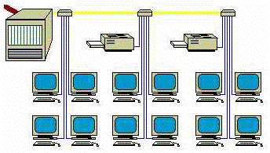
Deviation/Anomaly Detection
Detect significant deviations from normal behavior
Applications:
  Credit Card Fraud Detection
  Network Intrusion
  Detection
Typical network traffic at University level may reach over 100 million connections per day

Slide 24
Data Mining vs. Statistical Analysis
Statistical Analysis:
Ill-suited for Nominal and Structured Data Types
Completely data driven - incorporation of domain knowledge not possible
Interpretation of results is difficult and daunting
Requires expert user guidance
Data Mining:
Large Data sets
Efficiency of Algorithms is important
Scalability of Algorithms is important
Real World Data
Lots of Missing Values
Pre-existing data - not user generated
Data not static - prone to updates
Efficient methods for data retrieval available for use

Slide 25
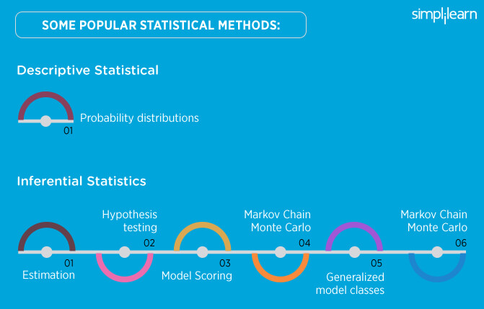

Slide 26
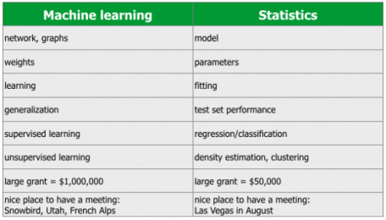

Slide 27
Data Mining vs. DBMS
Example DBMS Reports
  Last months sales for each service type
  Sales per service grouped by customer sex or age bracket
  List of customers who lapsed their policy
Questions answered using Data Mining
  What characteristics do customers that lapse their policy have in common and how do they differ from customers who renew their policy?
  Which motor insurance policy holders would be potential customers for my House Content Insurance policy?

Slide 28
Data Mining and Data Warehousing
Data Warehouse: a centralized data repository which can be queried for business benefit.
Data Warehousing makes it possible to
  extract archived operational data
  overcome inconsistencies between different legacy data formats
  integrate data throughout an enterprise, regardless of location, format, or communication requirements
  incorporate additional or expert information
OLAP: On-line Analytical Processing
Multi-Dimensional Data Model (Data Cube)
Operations:
  Roll-up
  Drill-down
  Slice and dice
  Rotate

Slide 29
An OLAM Architecture
Mining query
Mining result
Layer4
User Interface
User GUI API
OLAM
Engine
OLAP
Engine
Layer3
OLAP/OLAM
Data Cube API
Layer2
MDDB
MDDB
Meta Data
Filtering&Integration
Database API
Filtering
Layer1
Data Repository
Data cleaning
Data
Warehouse
Databases
Data integration

Slide 30
DBMS, OLAP, and Data Mining
 | DBMS | OLAP | Data Mining
Task | Extraction of detailed and summary data | Summaries, trends and forecasts | Knowledge discovery of hidden patterns and insights
Type of result | Information | Analysis | Insight and Prediction
Method | Deduction (Ask the question, verify with data) | Multidimensional data modeling, Aggregation, Statistics | Induction (Build the model, apply it to new data, get the result)
Example question | Who purchased mutual funds in the last 3 years? | What is the average income of mutual fund buyers by region by year? | Who will buy a mutual fund in the next 6 months and why?

Slide 31
Example of DBMS, OLAP and Data Mining: Weather Data
DBMS:
Day | outlook | temperature | humidity | windy | play
1 | sunny | 85 | 85 | false | no
2 | sunny | 80 | 90 | true | no
3 | overcast | 83 | 86 | false | yes
4 | rainy | 70 | 96 | false | yes
5 | rainy | 68 | 80 | false | yes
6 | rainy | 65 | 70 | true | no
7 | overcast | 64 | 65 | true | yes
8 | sunny | 72 | 95 | false | no
9 | sunny | 69 | 70 | false | yes
10 | rainy | 75 | 80 | false | yes
11 | sunny | 75 | 70 | true | yes
12 | overcast | 72 | 90 | true | yes
13 | overcast | 81 | 75 | false | yes
14 | rainy | 71 | 91 | true | no

Slide 32
Example of DBMS, OLAP and Data Mining: Weather Data
By querying a DBMS containing the above table we may answer questions like:
What was the temperature in the sunny days?
{85, 80, 72, 69, 75}
Which days the humidity was less than 75?
{6, 7, 9, 11}
Which days the temperature was greater than 70?
{1, 2, 3, 8, 10, 11, 12, 13, 14}
Which days the temperature was greater than 70 and the humidity was less than 75?
The intersection of the above two: {11}

Slide 33
Example of DBMS, OLAP and Data Mining: Weather Data
OLAP:
Using OLAP we can create a Multidimensional Model of our data (Data Cube).
For example using the dimensions: time, outlook and play we can create the following model.
9 / 5 | sunny | rainy | overcast
Week 1 | 0 / 2 | 2 / 1 | 2 / 0
Week 2 | 2 / 1 | 1 / 1 | 2 / 0

Slide 34
Example of DBMS, OLAP and Data Mining: Weather Data
Data Mining:
Using the ID3 algorithm we can produce the following decision tree:
    outlook = sunny
      humidity = high: no
      humidity = normal: yes
    outlook = overcast: yes
    outlook = rainy
      windy = true: no
      windy = false: yes

Slide 35
Major Issues in Data Warehousing and Mining
Mining methodology and user interaction
  Mining different kinds of knowledge in databases
  Interactive mining of knowledge at multiple levels of abstraction
  Incorporation of background knowledge
  Data mining query languages and ad-hoc data mining
  Expression and visualization of data mining results
  Handling noise and incomplete data
  Pattern evaluation: the interestingness problem
Performance and scalability
  Efficiency and scalability of data mining algorithms
  Parallel, distributed and incremental mining methods

Slide 36
Major Issues in Data Warehousing and Mining
Issues relating to the diversity of data types
  Handling relational and complex types of data
  Mining information from heterogeneous databases and global information systems (WWW)
Issues related to applications and social impacts
  Application of discovered knowledge
    Domain-specific data mining tools
    Intelligent query answering
    Process control and decision making
  Integration of the discovered knowledge with existing knowledge: A knowledge fusion problem
  Protection of data security, integrity, and privacy

