Slide 1
Clustering

Slide 2
k-Medoids Clustering Method
k-medoids: Find k representative objects, called medoids
  PAM (Partitioning Around Medoids, 1987)
  CLARA (Kaufmann & Rousseeuw, 1990)
  CLARANS (Ng & Han, 1994): Randomized sampling
10
9
8
7
6
5
4
3
2
1
0
0
1
2
3
4
5
6
7
8
9
10
k-means
k-medoids

Slide 3
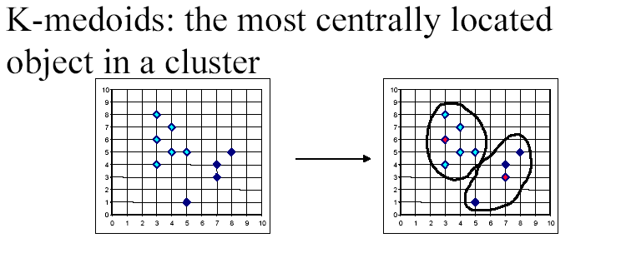
K-medoids

Slide 4
PAM
Partitioning Around Medoids (PAM) (K-Medoids)
Handles outliers well.
Ordering of input does not impact results.
Does not scale well.
Each cluster represented by one item, called the medoid.
Initial set of k medoids randomly chosen

Slide 5
PAM: Basic Strategy
First find a representative object (the medoid) for each cluster
Each remaining object is clustered with the medoid to which it is most “similar”
Iteratively replace one of the medoids by a non-medoid as long as the “quality” of the clustering is improved

Slide 6
Typical k-medoids algorithm (PAM)
10
9
8
Arbitrary choose k object as initial medoids
Assign each remaining object to nearest medoids
7
6
5
4
3
2
1
0
0
1
2
3
4
5
6
7
8
9
10
K=2
Randomly select a nonmedoid object,O_{ramdom}
Do loop
Until no change
10
10
9
Compute total cost of swapping
9
Swapping O and O_{ramdom}
If quality is improved.
8
8
7
7
6
6
5
5
4
4
3
3
2
2
1
1
0
0
1
2
3
4
5
6
7
8
9
10
0
0
1
2
3
4
5
6
7
8
9
10

Slide 7
PAM (Partitioning Around Medoids)
PAM (Kaufman and Rousseeuw, 1987)
Arbitrarily choose k objects as the initial medoids
Until no change, do
  (Re)assign each object to the cluster with the nearest medoid
  Improve the quality of the k-medoids
  (Randomly select a nonmedoid object, O_{random},
  compute the total cost of swapping a medoid with
  O_{random)}
Work for small data sets (100 objects in 5 clusters)
Not efficient for medium and large data sets

Slide 8
What is the problem with PAM?
Pam is more robust than k-means in the presence of noise and outliers because a medoid is less influenced by outliers or other extreme values than a mean
Pam works efficiently for small data sets but does not scale well for large data sets.
  O(k(n-k)² ) for each iteration
where n is # of data,k is # of clusters
Sampling based method,
CLARA(Clustering LARge Applications)

Slide 10
PAM or K-Medoids: Example
Data Objects
9
8
7
6
5
4
A1
2
3
3
4
6
6
7
7
8
7
A2
6
4
8
7
2
4
3
4
5
6
3
4
01
0₂
0₃
0₄
0₅
0₆
0₇
0₈
0₉
⁰10
1
10
9
2
6
8
3
7
5
2
3
4
5
6
7
8
9
Goal: create
two clusters
Choose randmly two medoids
08 = (7,4) and 02 = (3,4)

Slide 11
PAM or K-Medoids: Example
Data Objects
9
8
7
6
5
4
_{cluster1}
3
cluster2
A1
2
3
3
4
6
6
7
7
8
7
A2
6
4
8
7
2
4
3
4
5
6
4
01
0₂
0₃
0₄
0₅
0₆
0₇
0₈
0₉
⁰10
1
10
9
2
6
8
3
7
5
2
3
4
5
6
7
8
9
Assign each
object to the
closest representative object
Using L1 Metric (Manhattan), we form the following clusters
Cluster1 = {0₁, 0₂, 0₃, 0₄}
Cluster2 = {05, 06, 07, 08, 09, 010}

Slide 12
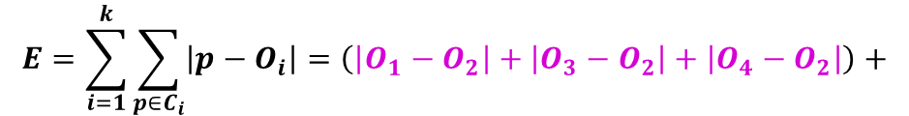
PAM or K-Medoids: Example
Data Objects
9
8
7
6
5
4
_{cluster1}
3
cluster2
A1
2
3
3
4
6
6
7
7
8
7
A2
6
4
8
7
2
4
3
4
5
6
4
01
0₂
0₃
0₄
0₅
0₆
0₇
0₈
0₉
⁰10
1
10
9
2
6
8
3
7
5
2
3
4
5
6
7
8
9
Compute the absolute error criterion [for the set of Medoids (O2,O8)]
$$E=\sum_{i=1}^{k}{\sum_{p∈C_{i}}{\left|p−O_{i}\right|=\left(\left|O_{1}−O_{2}\right|+\left|O_{3}−O_{2}\right|+\left|O_{4}−O_{2}\right|\right)+}}$$
$$\left(\left|O_{5}−O_{8}\right|+\left|O_{6}−O_{8}\right|+\left|O_{7}−O_{8}\right|+\left|O_{9}−O_{8}\right|+\left|O_{10}−O_{8}\right|\right)$$

Slide 13
PAM or K-Medoids: Example
Data Objects
9
8
7
6
5
4
_{cluster1}
3
cluster2
A1
2
3
3
4
6
6
7
7
8
7
A2
6
4
8
7
2
4
3
4
5
6
4
01
0₂
0₃
0₄
0₅
0₆
0₇
0₈
0₉
⁰10
1
10
9
2
6
8
3
7
5
2
3
4
5
6
7
8
9
The absolute error criterion [for the set of Medoids (O₂,O₈)]
E = (3+4+4)+(3+1+1+2+2) = 20

Slide 14
PAM or K-Medoids: Example
Data Objects
9
8
7
6
5
4
_{cluster1}
3
cluster2
A1
2
3
3
4
6
6
7
7
8
7
A2
6
4
8
7
2
4
3
4
5
6
4
01
0₂
0₃
0₄
0₅
0₆
0₇
0₈
0₉
⁰10
1
10
9
2
6
8
3
7
5
2
3
4
5
6
7
8
9
Choose a random object 0₇
Swap 0₈ and 0₇
Compute the absolute error criterion [for the set of Medoids (0₂,0₇)
E = (3+4+4)+(2+2+1+3+3) = 22

Slide 15
PAM or K-Medoids: Example
Data Objects
9
8
7
6
5
4
_{cluster1}
3
cluster2
A1
2
3
3
4
6
6
7
7
8
7
A2
6
4
8
7
2
4
3
4
5
6
4
01
0₂
0₃
0₄
0₅
0₆
0₇
0₈
0₉
⁰10
1
10
9
2
6
8
3
7
5
2
3
4
5
6
7
8
9
Compute the cost function
Absolute error [0₂ ,0₇ ] - Absolute error [for 0₂ ,0₈ ]
S=22-20
S> 0 => It is a bad idea to replace 0₈ by 0₇

Slide 16
PAM or K-Medoids: Example
Data Objects
9
8
7
6
5
4
_{cluster1}
3
cluster2
A1
2
3
3
4
6
6
7
7
8
7
A2
6
4
8
7
2
4
3
4
5
6
4
01
0₂
0₃
0₄
0₅
0₆
0₇
0₈
0₉
⁰10
1
10
9
2
6
8
3
7
5
2
3
4
5
6
7
8
9
C₆₈₇ = d(0₇,0₆) - d(0₈,0₆)=2-1=1
C₅₈₇ = d(0₇,0₅) - d(0₈,0₅)=2-3=-1
C₉₈₇ = d(0₇,0₉) - d(0₈,0₉)=3-2=1
C₁₀₈₇ = d(0₇,0₁₀) - d(0₈,0₁₀)=3-2=1
C₁₈₇=0, C₃₈₇=0, C₄₈₇=0
TC_{ih}=∑_{j}C_{jih}=1-1+1+1=2=S

Slide 17
Pros & Cons of PAM
PAM is more robust than k-means in the presence of noise and outliers
Medoids are less influenced by outliers
PAM is efficiently for small data sets but
does not scale well for large data sets
O(k(n-k)2 ) for each iteration
Sampling based method: CLARA

Slide 18
CLARA (Clustering Large Applications) (1990)
CLARA (Kaufmann and Rousseeuw in 1990)
  Built in statistical analysis packages, such as S+
It draws multiple samples of the data set, applies PAM on each sample, and gives the best clustering as the output
Strength: deals with larger data sets than PAM
Weakness:
  Efficiency depends on the sample size
  A good clustering based on samples will not necessarily represent a good clustering of the whole data set if the sample is biased

Slide 19
CLARA - Algorithm
Set mincost to MAXIMUM;
Repeat q times // draws q samples
  Create S by drawing s objects randomly from D;
  Generate the set of medoids M from S by applying the PAM algorithm;
  Compute cost(M,D)
  If cost(M, D)<mincost
    Mincost = cost(M, D);
    Bestset = M;
  Endif;
Endrepeat;
Return Bestset;

Slide 20
CLARANS (“Randomized” CLARA) (1994)
CLARANS (A Clustering Algorithm based on Randomized Search) (Ng and Han’94)
CLARANS draws sample of neighbors dynamically
A solution is a set of k medoids
The solutions space contains solutions in total
The clustering process can be presented as searching a graph where every node is a potential solution, that is, a set of k medoids
If the local optimum is found, CLARANS starts with new randomly selected node in search for a new local optimum
It is more efficient and scalable than both PAM and CLARA
Focusing techniques and spatial access structures may further improve its performance (Ester et al.’95)

Slide 21
Graph Abstraction
Every node is a potential solution (k-medoid)
Every node is associated with a squared error
Two nodes are adjacent if they differ by one medoid
Every node has k(n−k) adjacent nodes
{O₁,O₂,…,O_{k}}
k(n− k) neighbors for one node
…
…
{O_{k+1},O₂,…,O_{k}}
{O_{k+n},O₂,…,O_{k}}
n-k neighbors for one medoid

Slide 22
Graph Abstraction: CLARANS
Start with a randomly selected node, check at most m neighbors randomly
If a better adjacent node is found, moves to node and continue; otherwise, current node is local optimum; re-starts with another randomly selected node to search for another local optimum
When h local optimum have been found, returns best result as overall result

Slide 23
CLARANS
Compare no more than maxneighbor times
N
C
N
…
<
Local minimum
N
N
C
N
N
…
numlocal
Local minimum
…
Local minimum
…
Best Node
Local minimum

Slide 24
CLARANS - Algorithm
Set mincost to MAXIMUM;
For i=1 to h do // find h local optimum
  Randomly select a node as the current node C in the graph;
  J = 1; // counter of neighbors
  Repeat
    Randomly select a neighbor N of C;
    If Cost(N,D)<Cost(C,D)
      Assign N as the current node C;
      J = 1;
    Else J++;
    Endif;
  Until J > m
  Update mincost with Cost(C,D) if applicableEnd for;
End For
Return bestnode;

Slide 25
Density-Based Clustering
Density-based
  A cluster is a dense region of points, which is separated by low-density regions, from other regions of high density.
  Used when the clusters are irregular or intertwined, and when noise and outliers are present.
6 density-based clusters

Slide 26
DBSCAN
DBSCAN is a density-based algorithm.
  Density = number of points within a specified radius (Eps)
  A point is a core point if it has more than a specified number of points (MinPts) within Eps
    These are points that are at the interior of a cluster
  A border point has fewer than MinPts within Eps, but is in the neighborhood of a core point
  A noise point is any point that is not a core point or a border point.

Slide 28
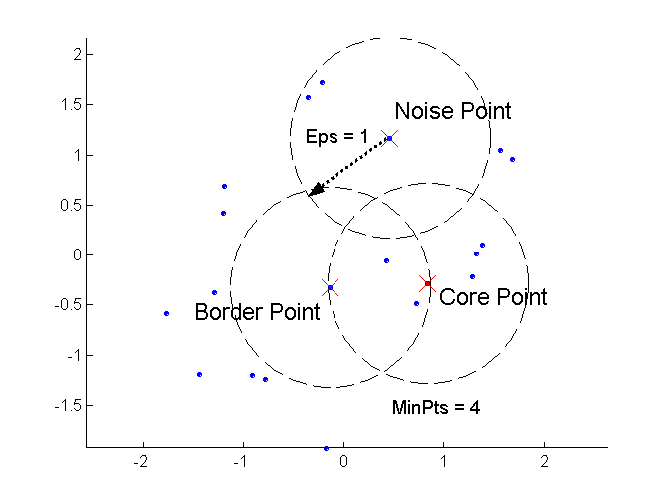
DBSCAN: Core, Border, and Noise Points

Slide 29
Density-Based Method: DBSCAN
Є-neighborhood: Points within Є distance of a point.
N_{Є} (p) :{q belongs to D | dist(p,q) <= Є}
Core point: Є -neighborhood dense enough (MinPts)
Directly density-reachable: A point p is directly density-reachable from a point q if the distance is small (Є ) and q is a core point.
1) p belongs to N_{Є} (q)
  2) core point condition:
  | N_{Є} (q)| >= MinPts
p
MinPts = 5
Eps = 1 cm
q

Slide 30
Density-Based Method: DBSCAN
Density-reachable: A point p is density-reachable from a point q wrt. Є , MinPts if there is a chain of points p₁, …,p_{n}, p₁ = q, p_{n} = p such that p_{i+1} is directly density-reachable from p_{i}
p
p₁
q
Density Reachability
Density-connected: A point p is density-connected to a point q wrt. Є , MinPts if there is a point o such that both, p and q are density-reachable from o wrt. Є and MinPts.
p
q
o
Density Connectivity

Slide 31
DBSCAN
Relies on a density-based notion of cluster: A cluster is defined as a maximal set of density-connected points w.r.t. density reachability
Every object not contained in any cluster considered as noise
Discovers clusters of arbitrary shape in spatial databases with noise
Outlier
Border
Eps = 1cm
MinPts = 5
Core

Slide 33
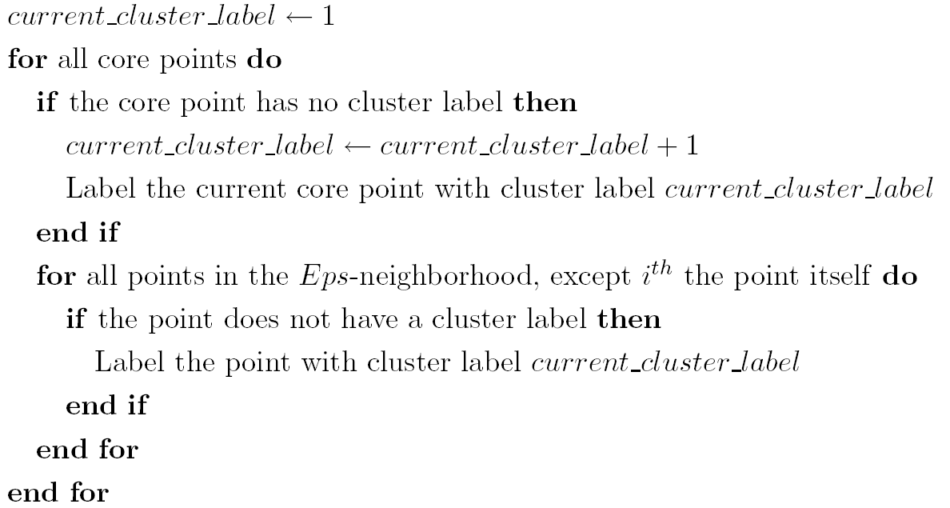
DBSCAN Algorithm
Eliminate noise points
Perform clustering on the remaining points

Slide 34
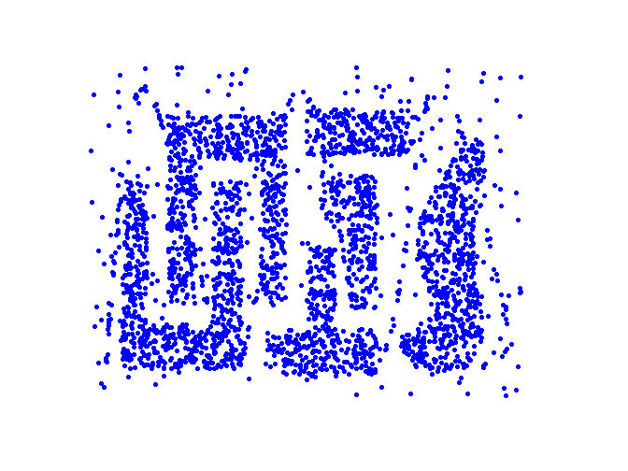
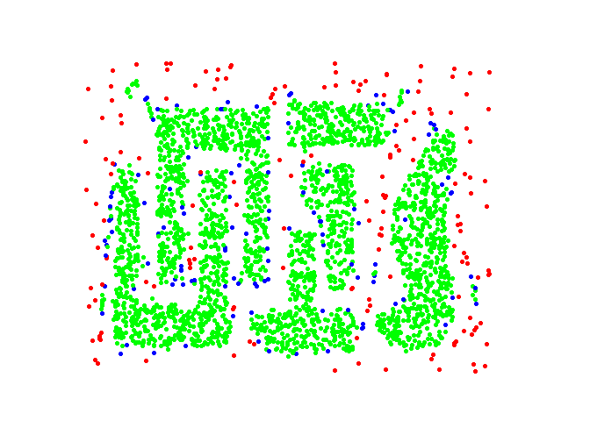
DBSCAN: Core, Border and Noise Points
Original Points
Point types: core, border and noise
Eps = 10, MinPts = 4

Slide 35
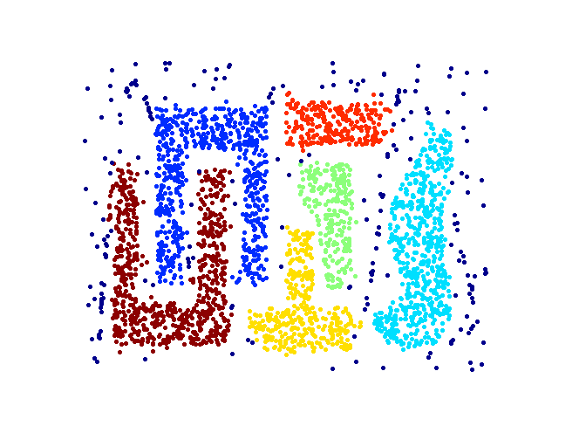
When DBSCAN Works Well
Original Points
Clusters
Resistant to Noise
Can handle clusters of different shapes and sizes

Slide 36
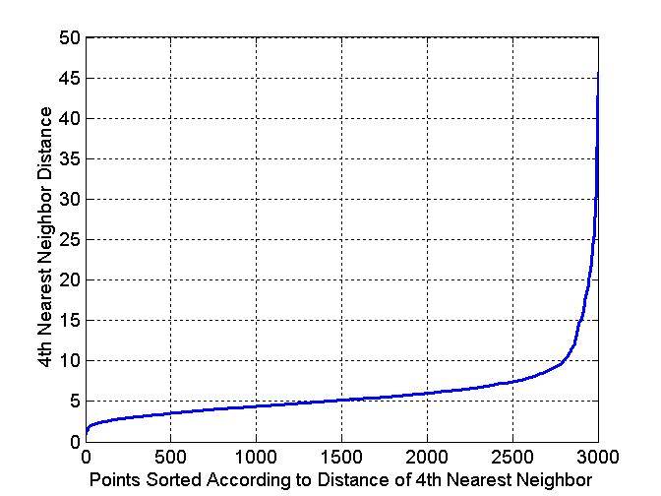
DBSCAN: Determining EPS and MinPts
Idea is that for points in a cluster, their k^{th} nearest neighbors are at roughly the same distance
Noise points have the k^{th} nearest neighbor at farther distance
So, plot sorted distance of every point to its k^{th} nearest neighbor
Original Points

Slide 37
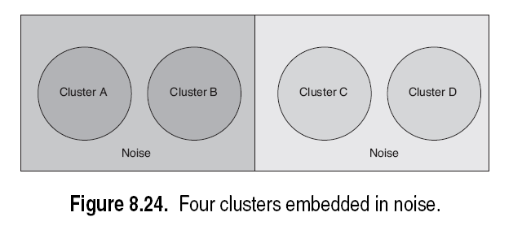
Clusters of Varying Density

Slide 38
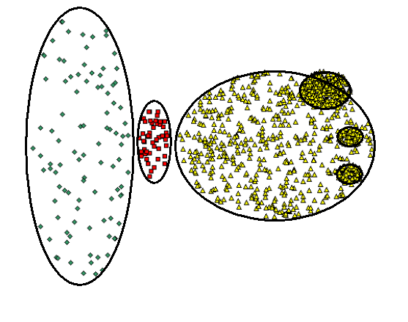
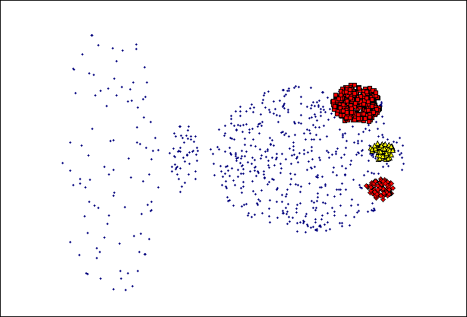
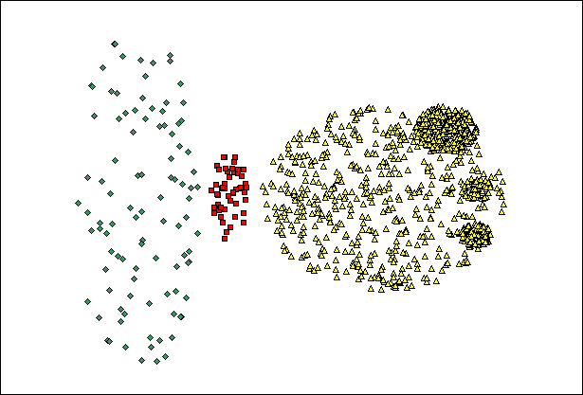
When DBSCAN Does NOT Work Well
(MinPts=4, Eps=9.75).
Original Points
Varying densities
High-dimensional data
(MinPts=4, Eps=9.62)

Slide 39
Hierarchical Clustering
Two main types of hierarchical clustering
  Agglomerative:
    Start with the points as individual clusters
    At each step, merge the closest pair of clusters until only one cluster (or k clusters) left
  Divisive:
    Start with one, all-inclusive cluster
    At each step, split a cluster until each cluster contains a point (or there are k clusters)
Traditional hierarchical algorithms use a similarity or distance matrix
  Merge or split one cluster at a time

Slide 40
Agglomerative Clustering Algorithm
More popular hierarchical clustering technique
Basic algorithm is straightforward
  Compute the proximity matrix
  Let each data point be a cluster
  Repeat
  Merge the two closest clusters
  Update the proximity matrix
  Until only a single cluster remains
Key operation is the computation of the proximity of two clusters
  Different approaches to defining the distance between clusters distinguish the different algorithms

Slide 41
Starting Situation
Start with clusters of individual points and a proximity matrix
p1
p2
p3
p4
p5
. . .
p1
p2
p3
p4
p5
.
.
.
Proximity Matrix

Slide 42
Intermediate Situation
After some merging steps, we have some clusters
C1
C2
C3
C4
C5
C1
C2
C3
C3
C4
C4
C5
Proximity Matrix
C1
C2
C5

Slide 43
Intermediate Situation
We want to merge the two closest clusters (C2 and C5) and update the proximity matrix.
C1
C2
C3
C4
C5
C1
C2
C3
C3
C4
C4
C5
Proximity Matrix
C1
C2
C5

Slide 44
After Merging
The question is “How do we update the proximity matrix?”
C2 U C5
C1
C3
C4
C1
?
C2 U C5
? ? ? ?
C3
C3
?
C4
C4
?
Proximity Matrix
C1
C2 U C5

Slide 45
How to Define Inter-Cluster Similarity
p1
p2
p3
p4
p5
. . .
p1
Similarity?
p2
p3
p4
p5
MIN
MAX
Group Average
Distance Between Centroids
Other methods driven by an objective function
  Ward’s Method uses squared error
.
.
.
Proximity Matrix

Slide 46
How to Define Inter-Cluster Similarity
p1
p2
p3
p4
p5
. . .
p1
p2
p3
p4
p5
MIN
MAX
Group Average
Distance Between Centroids
Other methods driven by an objective function
  Ward’s Method uses squared error
.
.
.
Proximity Matrix

Slide 47
How to Define Inter-Cluster Similarity
p1
p2
p3
p4
p5
. . .
p1
p2
p3
p4
p5
MIN
MAX
Group Average
Distance Between Centroids
Other methods driven by an objective function
  Ward’s Method uses squared error
.
.
.
Proximity Matrix

Slide 48
How to Define Inter-Cluster Similarity
p1
p2
p3
p4
p5
. . .
p1
p2
p3
p4
p5
MIN
MAX
Group Average
Distance Between Centroids
Other methods driven by an objective function
  Ward’s Method uses squared error
.
.
.
Proximity Matrix

Slide 49
How to Define Inter-Cluster Similarity
p1
p2
p3
p4
p5
. . .
p1
×
×
p2
p3
p4
p5
MIN
MAX
Group Average
Distance Between Centroids
Other methods driven by an objective function
  Ward’s Method uses squared error
.
.
.
Proximity Matrix

Slide 52
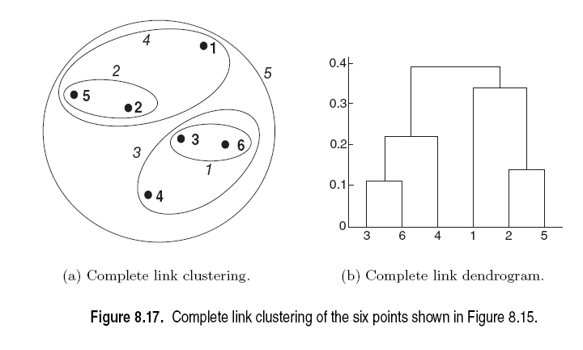

Slide 55
Single Linkage Clustering
It is an example of agglomerative hierarchical clustering.
We consider the distance between one cluster and another cluster to be equal to the shortest distance from any member of one cluster to any member of the other cluster.

Slide 56
Algorithm
Given a set of N items to be clustered, and an NxN distance (or similarity) matrix, the basic process of single linkage clustering is this:
1.Start by assigning each item to its own cluster, so that if we have N items, we now have N clusters, each containing just one item. Let the distances (similarities) between the clusters equal the distances (similarities) between the items they contain.
2.Find the closest (most similar) pair of clusters and merge them into a single cluster, so that now you have one less cluster.
3.Compute distances (similarities) between the new cluster and each of the old clusters.
4.Repeat steps 2 and 3 until all items are clustered into a single cluster of size N.

Slide 57
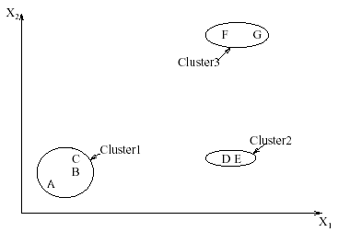
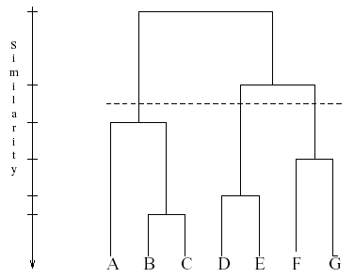
Interpreting Dendrograms
Clusters Dendrogram

Slide 58
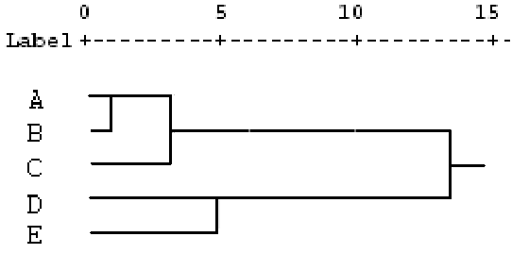
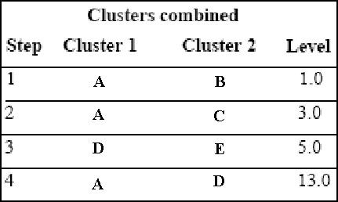
Agglomeration Schedule
 | A | B | C | D | E
A | 0
B | 1 | 0
C | 2 | 3 | 0
D | 8 | 9 | 10 | 0
E | 11 | 12 | 13 | 5 | 0

Slide 59
Advantages
Single linkage is best suited to detect lined structure
Invariant against monotonic transformation of the dissimilarities or similarities. For example, the results do not change, if the dissimilarities or similarities are squared, or if we take the log.
Intuitive

Slide 60

Problems
Do not scale well: time complexity of at least Ω(n²), where n is the number of total objects
It is not incremental. If new data is to be added, the whole analysis needs to be redone.
Can never undo what was done previously
Can lead to chaining
Data in the cluster must be compact.

Slide 61
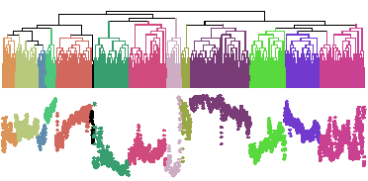
Problems with Dendrogram
Messy to construct if number of points is large.
Number of observations = 6113

Slide 62
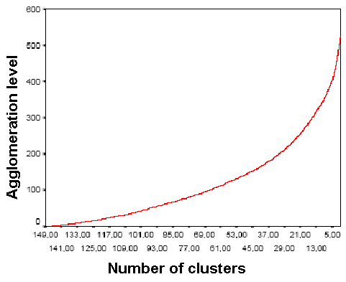
Deciding where to cut the Dendrogram can be difficult
As shown, if there are no sharp elbow knicks in the Inverse Scree Test, then it is difficult to find the number of clusters from the dendrogram
Inverse Scree test

Slide 63
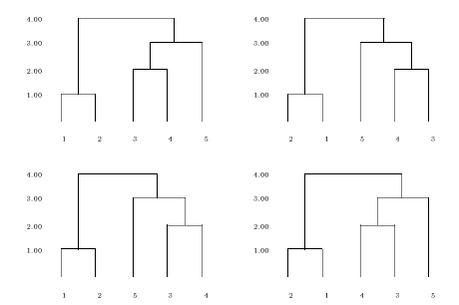

Comparing two Dendrograms is not straightforward
The four dendrograms all represent the same data. They can be obtained from each other by rotating a few branches.
H_{n} denotes the number of simply equivalent dendrograms for n objects.

Slide 64
Agglomerative Example
A
B
A
B
C
D
E
A
0
1
2
2
3
E
C
B
1
0
2
4
3
C
2
2
0
1
5
D
2
4
1
0
3
D
Threshold of
E
3
3
5
3
0
1
2
3
4
5
A
B
C
D
E

Slide 65
MST Example
A
B
A
B
C
D
E
A
0
1
2
2
3
B
1
0
2
4
3
E
C
C
2
2
0
1
5
D
2
4
1
0
3
D
E
3
3
5
3
0

Slide 66
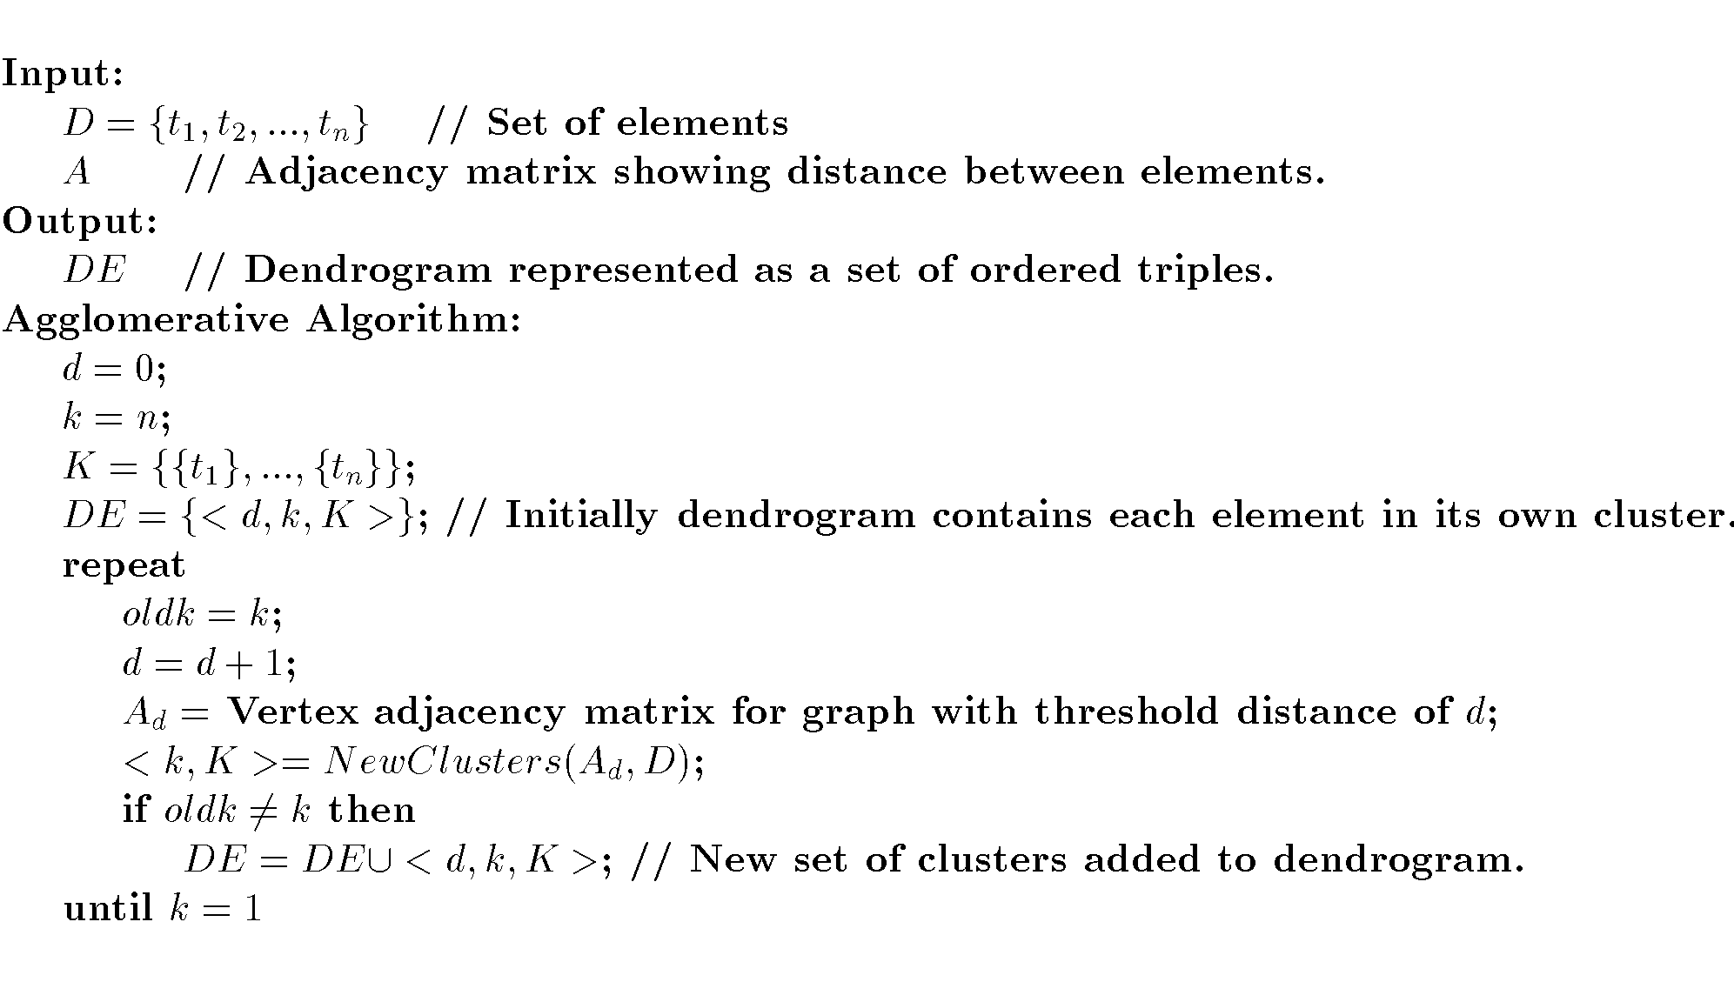
Agglomerative Algorithm

Slide 67
Single Link
View all items with links (distances) between them.
Finds maximal connected components in this graph.
Two clusters are merged if there is at least one edge which connects them.
Uses threshold distances at each level.
Could be agglomerative or divisive.

Slide 68
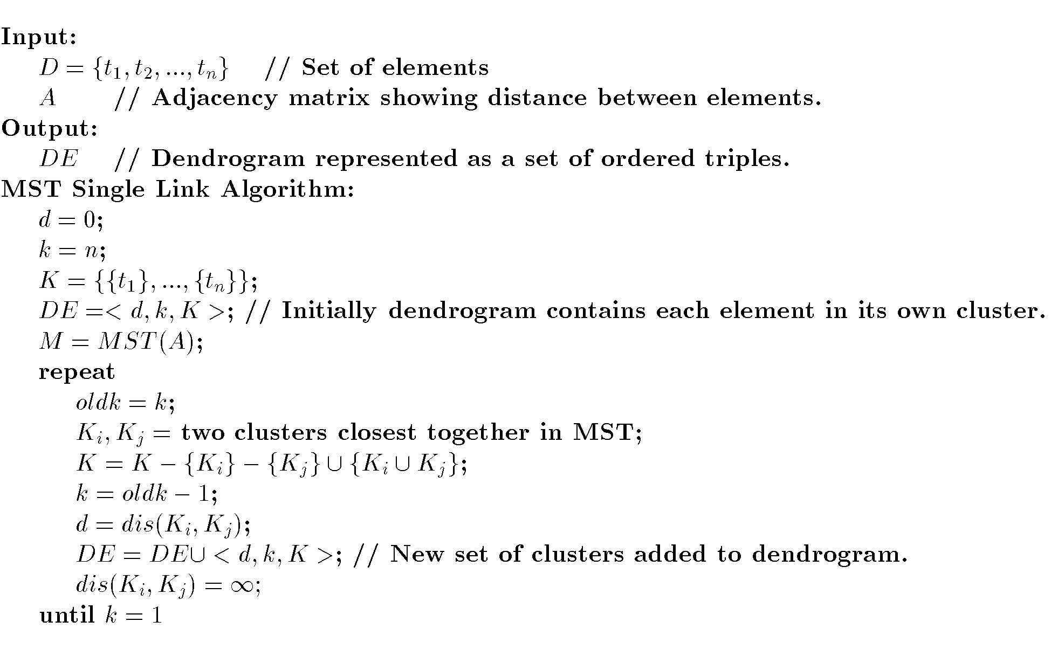
MST Single Link Algorithm

Slide 69
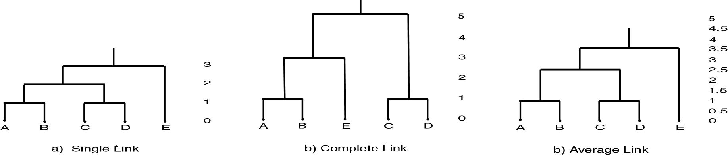
Single Link Clustering

Slide 70
How to Compute Group Similarity?
Three Popular Methods:
Given two groups g1 and g2,
Single-link algorithm: s(g1,g2)= similarity of the closest pair
Complete-link algorithm: s(g1,g2)= similarity of the farthest pair
Average-link algorithm: s(g1,g2)= average of similarity of all pairs

Slide 71
Three Methods Illustrated
complete-link algorithm
g1
g2
?
……
Single-link algorithm
average-link algorithm

Slide 72
Hierarchical: Single Link
cluster similarity = similarity of two most similar members
- Potentially long and skinny clusters
+ Fast
Notes:
I will start by motivating the work
next describe the Novel algorithm we developed
and then describe the experimental evaluation and present our results

Slide 73
Example: single link
5
4
3
2
1

Slide 74
Example: single link
5
4
3
2
1

Slide 75
Example: single link
5
4
3
2
2
1

Slide 76
Hierarchical: Complete Link
cluster similarity = similarity of two least similar members
+ tight clusters
+ Fast
Notes:
I will start by motivating the work
next describe the Novel algorithm we developed
and then describe the experimental evaluation and present our results

Slide 77
Example: complete link
5
4
3
2
2
1

Slide 78
Example: complete link
5
4
3
2
1

Slide 79
Example: complete link
5
4
3
2
1

Slide 80
Hierarchical: Average Link
cluster similarity = average similarity of all pairs
+ tight clusters
- slow
Notes:
I will start by motivating the work
next describe the Novel algorithm we developed
and then describe the experimental evaluation and present our results

Slide 81
Example: average link
5
4
3
2
1

Slide 82
Example: average link
5
4
3
2
1

Slide 83
Example: average link
5
4
3
2
1

Slide 84
Comparison of the Three Methods
Single-link
  “Loose” clusters
  Individual decision, sensitive to outliers
Complete-link
  “Tight” clusters
  Individual decision, sensitive to outliers
Average-link
  “In between”
  Group decision, insensitive to outliers
Which one is the best? Depends on what you need!

Slide 85
Hierarchical Clustering
Produces a set of nested clusters organized as a hierarchical tree
Can be visualized as a dendrogram
  A tree like diagram that records the sequences of merges or splits

Slide 86
Strengths of Hierarchical Clustering
Do not have to assume any particular number of clusters
  Any desired number of clusters can be obtained by ‘cutting’ the dendogram at the proper level
They may correspond to meaningful taxonomies
  Example in biological sciences (e.g., animal kingdom, phylogeny reconstruction, …)

Slide 87
Cluster Similarity: MIN or Single Link
Similarity of two clusters is based on the two most similar (closest) points in the different clusters
  Determined by one pair of points, i.e., by one link in the proximity graph.
1
2
3
4
5

Slide 88
Hierarchical Clustering: MIN
5
1
3
5
2
1
2
3
6
4
4
Nested Clusters
Dendrogram

Slide 89
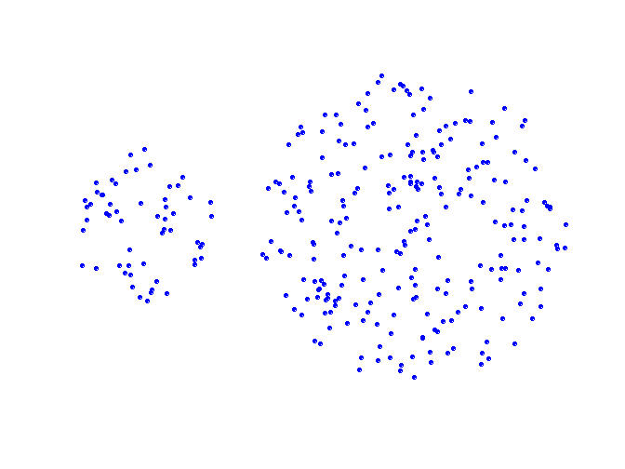
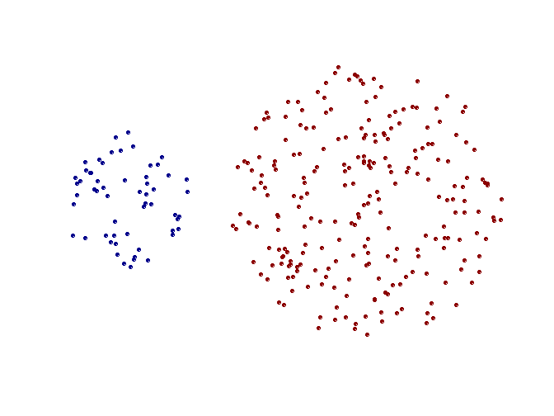
Strength of MIN
Original Points
Two Clusters
Can handle non-elliptical shapes

Slide 90
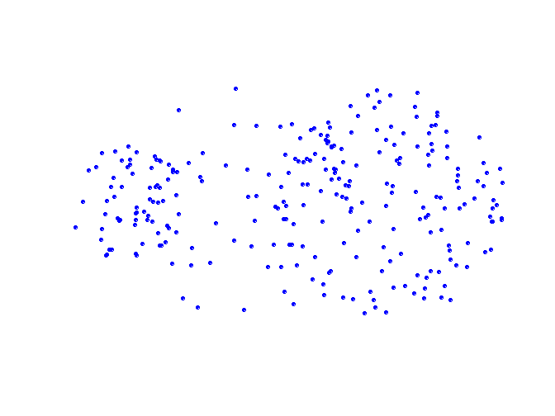
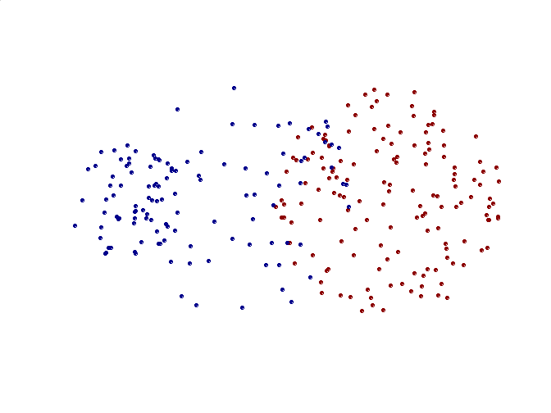
Limitations of MIN
Original Points
Two Clusters
Sensitive to noise and outliers

Slide 91
Cluster Similarity: MAX or Complete Linkage
Similarity of two clusters is based on the two least similar (most distant) points in the different clusters
  Determined by all pairs of points in the two clusters
1
2
3
4
5

Slide 92
Hierarchical Clustering: MAX
4
1
2
5
5
2
3
6
3
1
4
Nested Clusters
Dendrogram

Slide 93
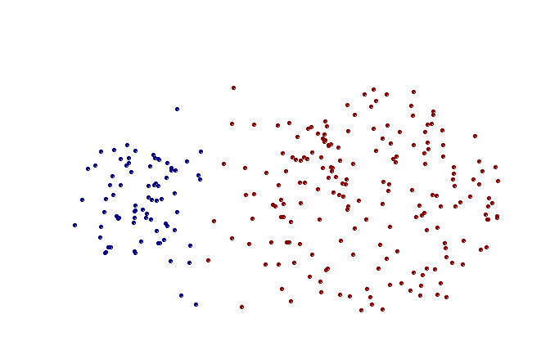
Strength of MAX
Original Points
Two Clusters
Less susceptible to noise and outliers

Slide 94
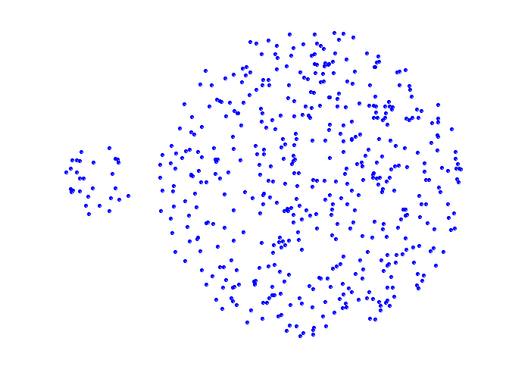
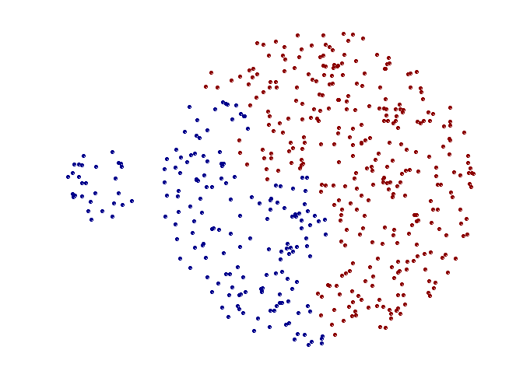
Limitations of MAX
Original Points
Two Clusters
Tends to break large clusters
Biased towards globular clusters

Slide 95
Cluster Similarity: Group Average
Proximity of two clusters is the average of pairwise proximity between points in the two clusters.
Need to use average connectivity for scalability since total proximity favors large clusters
1
2
3
4
5

Slide 96
Hierarchical Clustering: Group Average
5
4
1
2
5
2
3
6
1
4
3
Nested Clusters
Dendrogram

Slide 97
Hierarchical Clustering: Group Average
Compromise between Single and Complete Link
Strengths
  Less susceptible to noise and outliers
Limitations
  Biased towards globular clusters

Slide 98
Cluster Similarity: Ward’s Method
Similarity of two clusters is based on the increase in squared error when two clusters are merged
  Similar to group average if distance between points is distance squared
Less susceptible to noise and outliers
Biased towards globular clusters
Hierarchical analogue of K-means
  Can be used to initialize K-means

Slide 99
Hierarchical Clustering: Comparison
5
1
4
1
3
2
5
5
5
2
1
MIN
2
MAX
2
3
6
3
3
6
1
4
4
4
5
4
1
5
2
1
5
Ward’s Method
2
2
5
3
2
6
Group Average
1
3
6
4
3
1
3
4
4

Slide 100
Hierarchical Clustering: Time and Space requirements
O(N²) space since it uses the proximity matrix.
  N is the number of points.
O(N³) time in many cases
  There are N steps and at each step the size, N², proximity matrix must be updated and searched
  Complexity can be reduced to O(N² log(N) ) time for some approaches

Slide 101
Hierarchical Clustering: Problems and Limitations
Once a decision is made to combine two clusters, it cannot be undone
No objective function is directly minimized
Different schemes have problems with one or more of the following:
  Sensitivity to noise and outliers
  Difficulty handling different sized clusters and convex shapes
  Breaking large clusters

