Slide 1
Clustering Validation & Assessment
Material taken from text book (chapter 8) and from DMA book by Zaki & Meira (chapter 17)

Slide 2
Unsupervised measures of Cluster Validation
Measuring Cluster Validity via Correlation

Slide 3
Measuring Cluster Validity Via Correlation
Two matrices
  Proximity Matrix
  “Incidence” Matrix
    One row and one column for each data point
    An entry is 1 if the associated pair of points belong to the same cluster
    An entry is 0 if the associated pair of points belongs to different clusters
Compute the correlation between the two matrices
  Since the matrices are symmetric, only the correlation between
  n(n-1) / 2 entries needs to be calculated.
High correlation indicates that points that belong to the same cluster are close to each other.
Not a good measure for some density or contiguity based clusters.

Slide 4
Correlation
Correlation measures the linear relationship between objects
To compute correlation, we standardize data objects, p and q, and then take their dot product
p
′
=
(
p
−
mean
(
p
))
/
std
(
p
)
k
k
q
′
=
(
q
−
mean
(
q
))
/
std
(
q
)
k
k
correlatio
n
(
p
,
q
)
=
p
′
•
q
′

Slide 5
Measuring Cluster Validity Via Correlation
Correlation of incidence and proximity matrices for the K-means clusterings of the following two data sets.
Corr = -0.9235
Corr = -0.5810

Slide 6
Using Similarity Matrix for Cluster Validation
Order the similarity matrix with respect to cluster labels and inspect visually.

Slide 7
Using Similarity Matrix for Cluster Validation
Clusters in random data are not so crisp
DBSCAN

Slide 8
Using Similarity Matrix for Cluster Validation
Clusters in random data are not so crisp
K-means

Slide 9
Using Similarity Matrix for Cluster Validation
Clusters in random data are not so crisp
Complete Link

Slide 10
Using Similarity Matrix for Cluster Validation
DBSCAN

Slide 11
CoPhenetic Correlation Coefficient : Hierarchical Clustering Measure
Cophenetic Distance Matrix

Slide 12
Internal Measures: SSE
Clusters in more complicated figures aren’t well separated
Internal Index: Used to measure the goodness of a clustering structure without respect to external information
  SSE
SSE is good for comparing two clusterings or two clusters (average SSE).
Can also be used to estimate the number of clusters

Slide 13
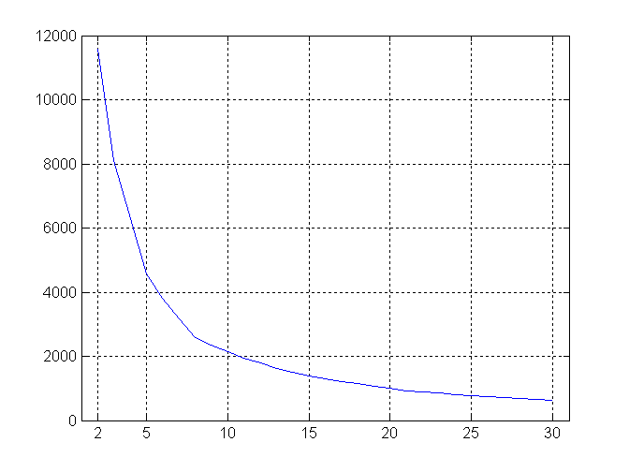
Internal Measures: SSE
SSE curve for a more complicated data set
SSE of clusters found using K-means

Slide 14
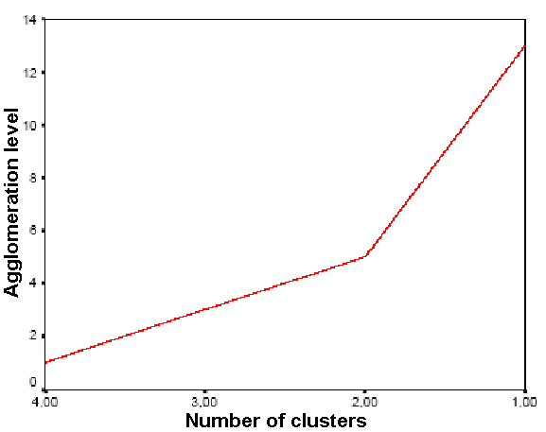
Inverse Scree Test
It is a plot with number of clusters on x-axis and agglomeration level on y-axis
Look for sharp increase – elbow knick

Slide 15
Supervised/External measures of Cluster Validation
Classification Oriented
  Entropy, Purity, Precision, Recall and F-measure
Similarity Oriented
  Involves comparison of two matrices
    Ideal Cluster Similarity Matrix
    Ideal Class Similarity Matrix

Slide 16
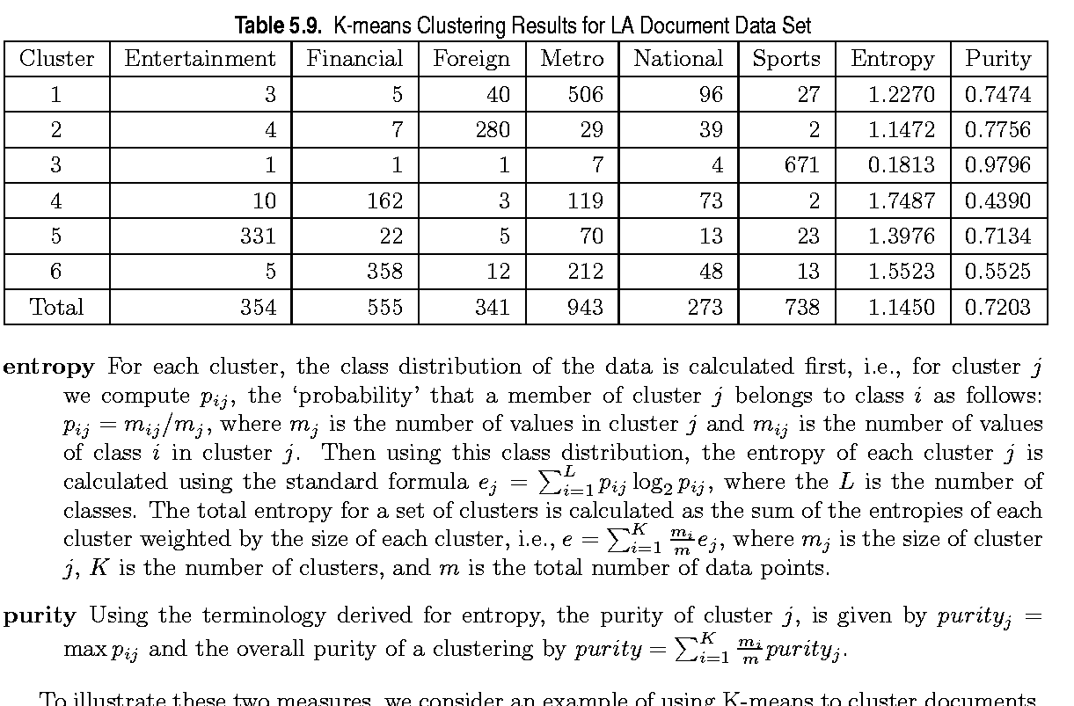
External Measures of Cluster Validity: Entropy and Purity

Slide 17
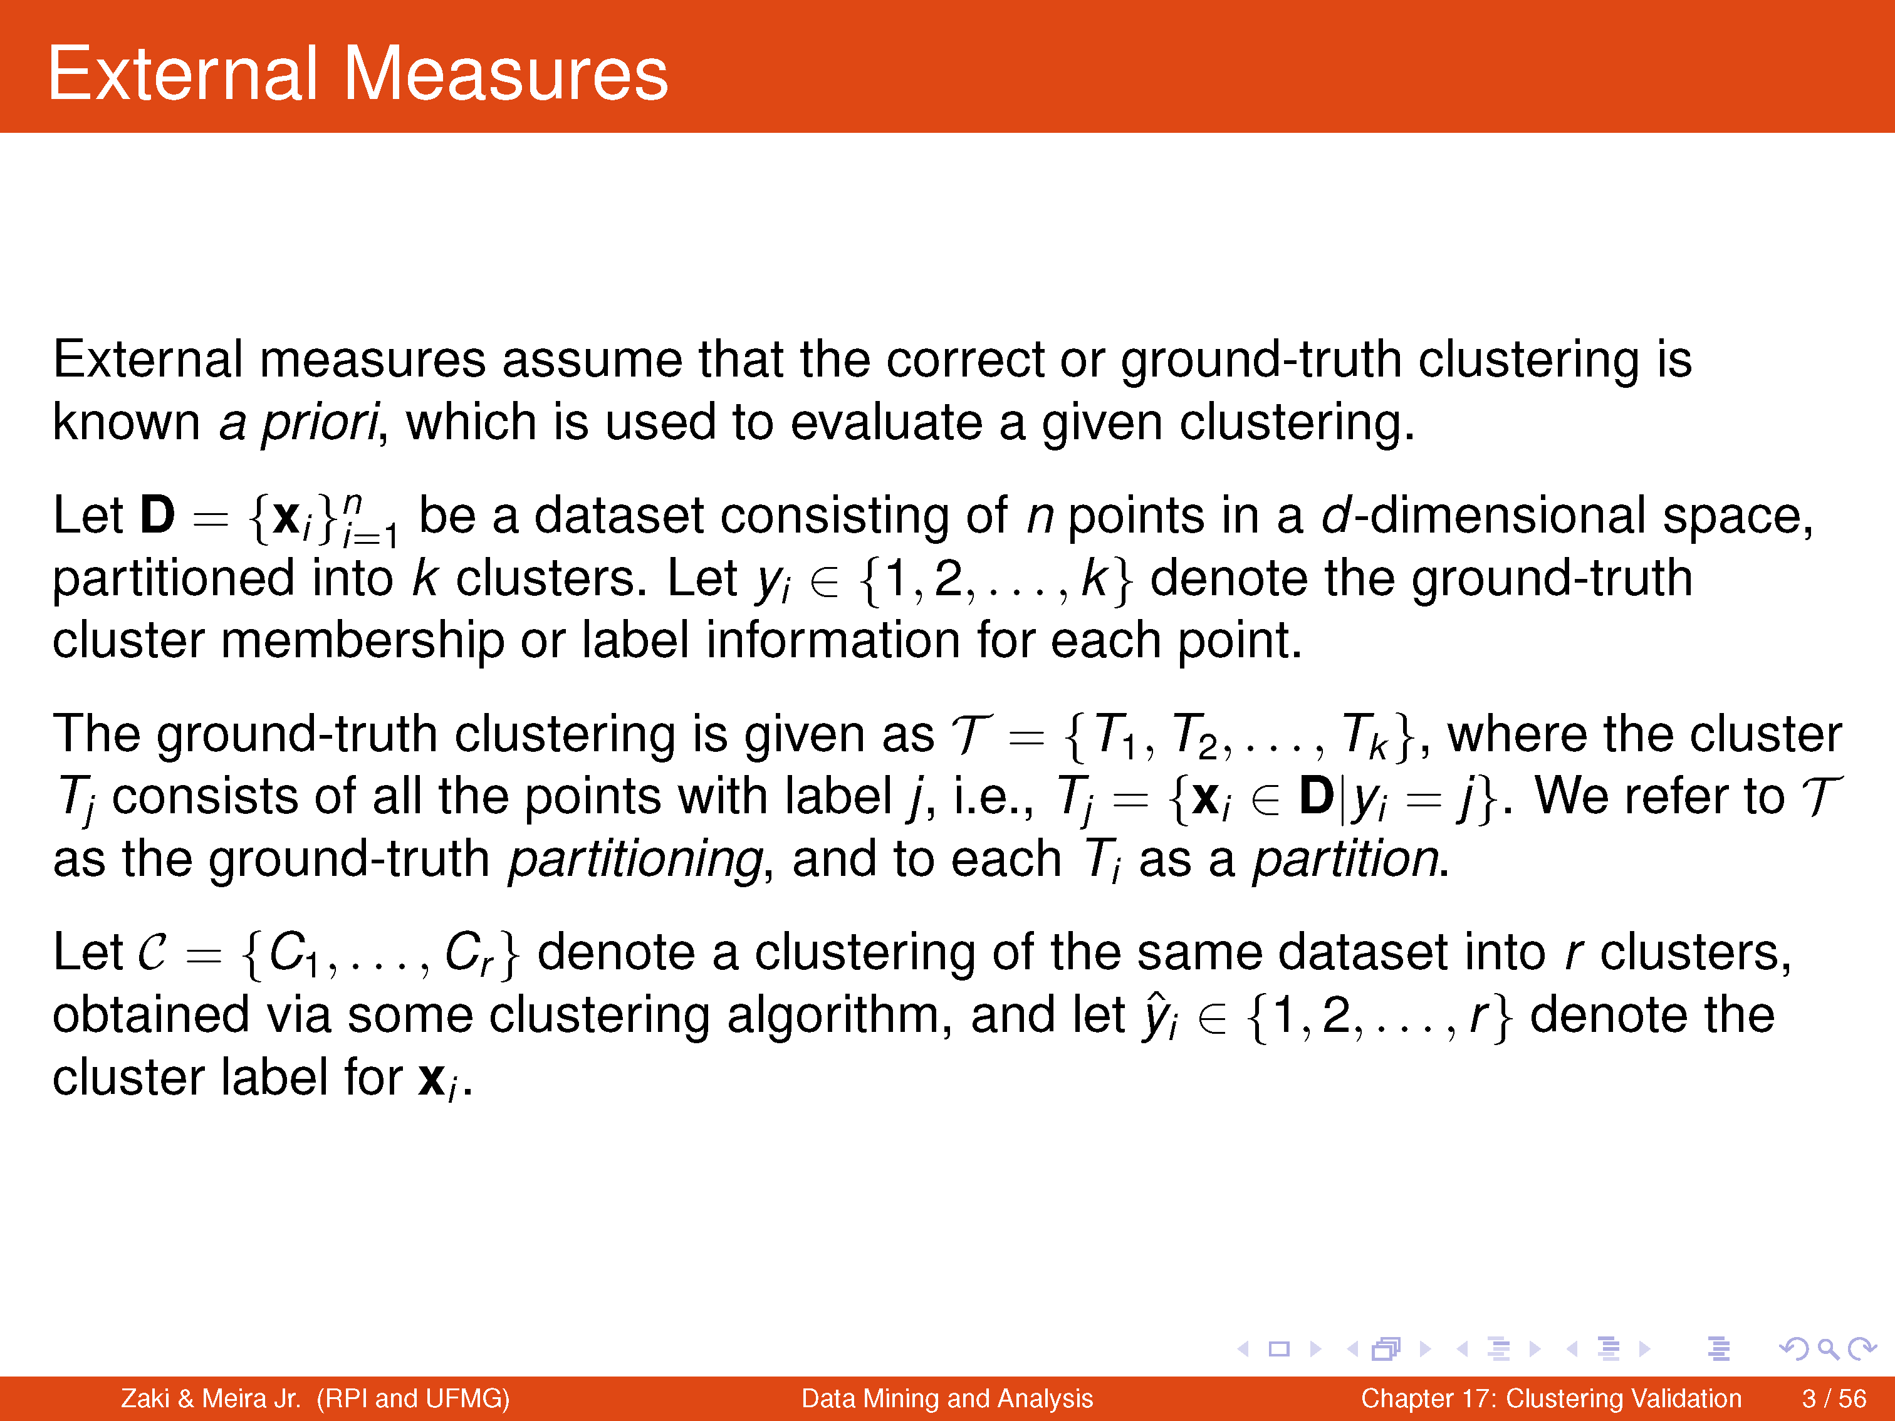

Slide 18
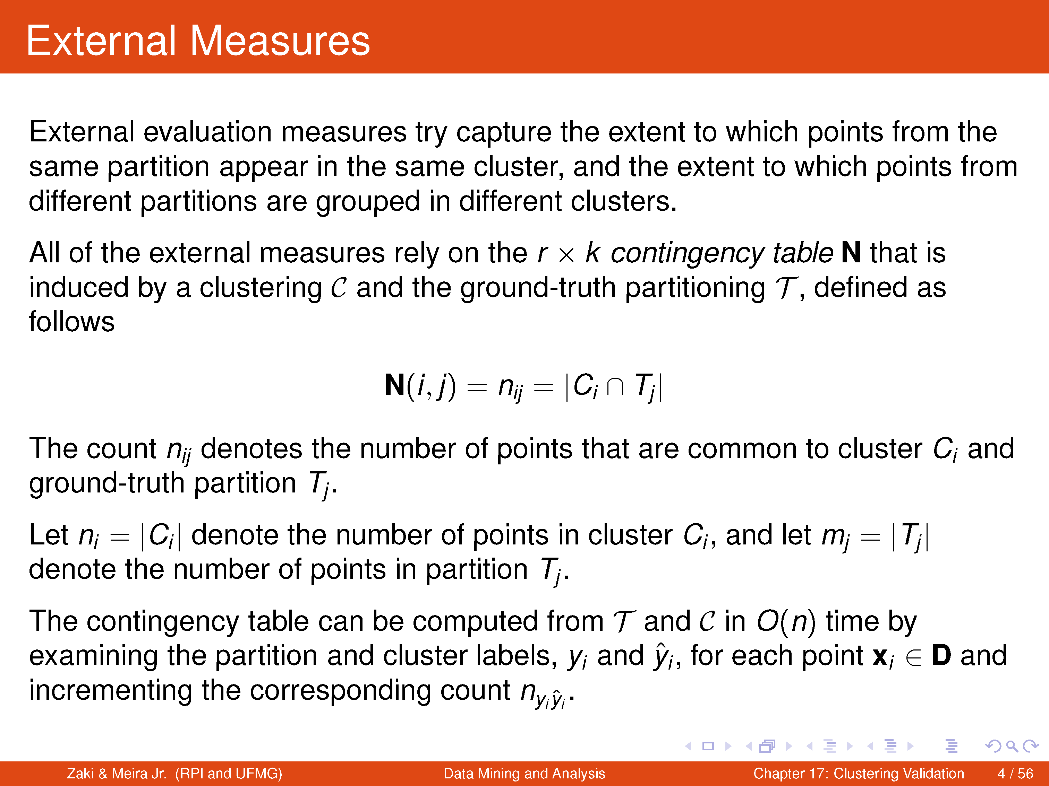

Slide 19
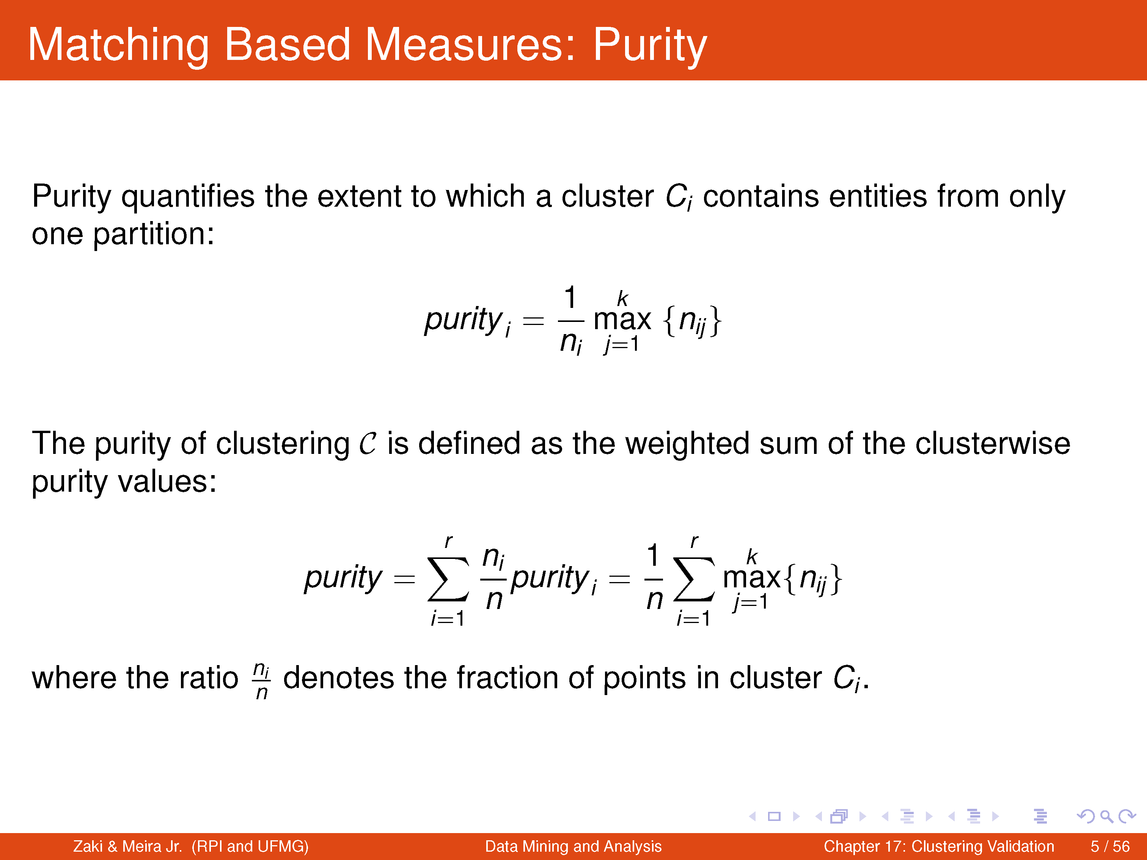
Larger the purity of C, the better the agreement with the ground truth
Max. value of purity is 1.

Slide 20
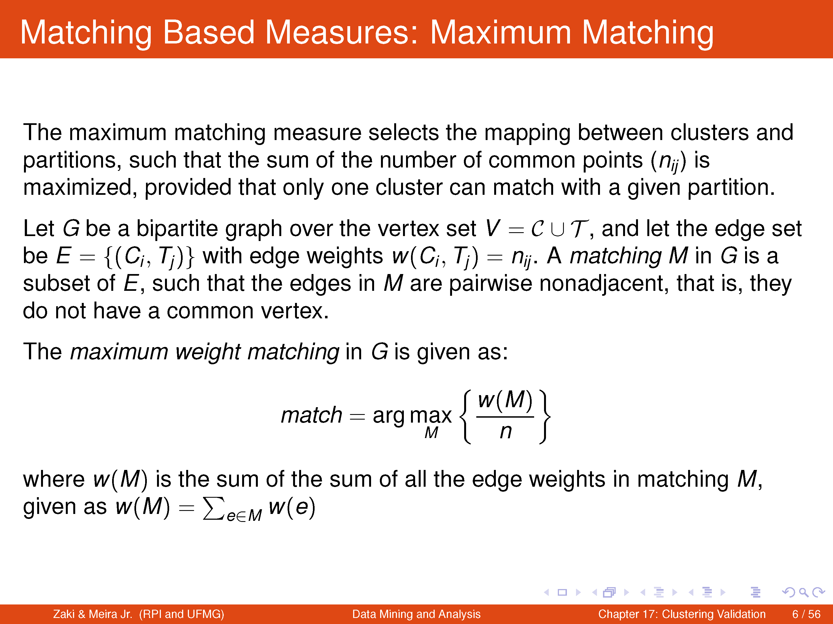

Slide 21
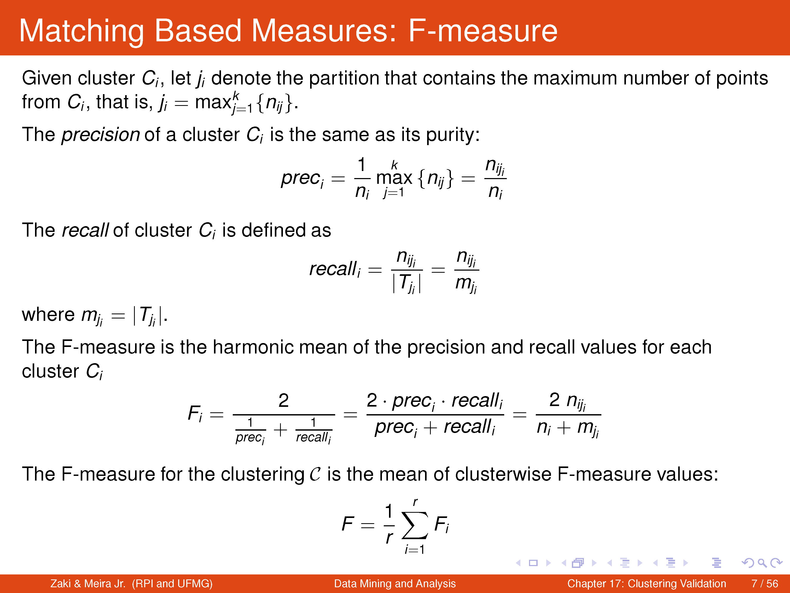

Slide 22
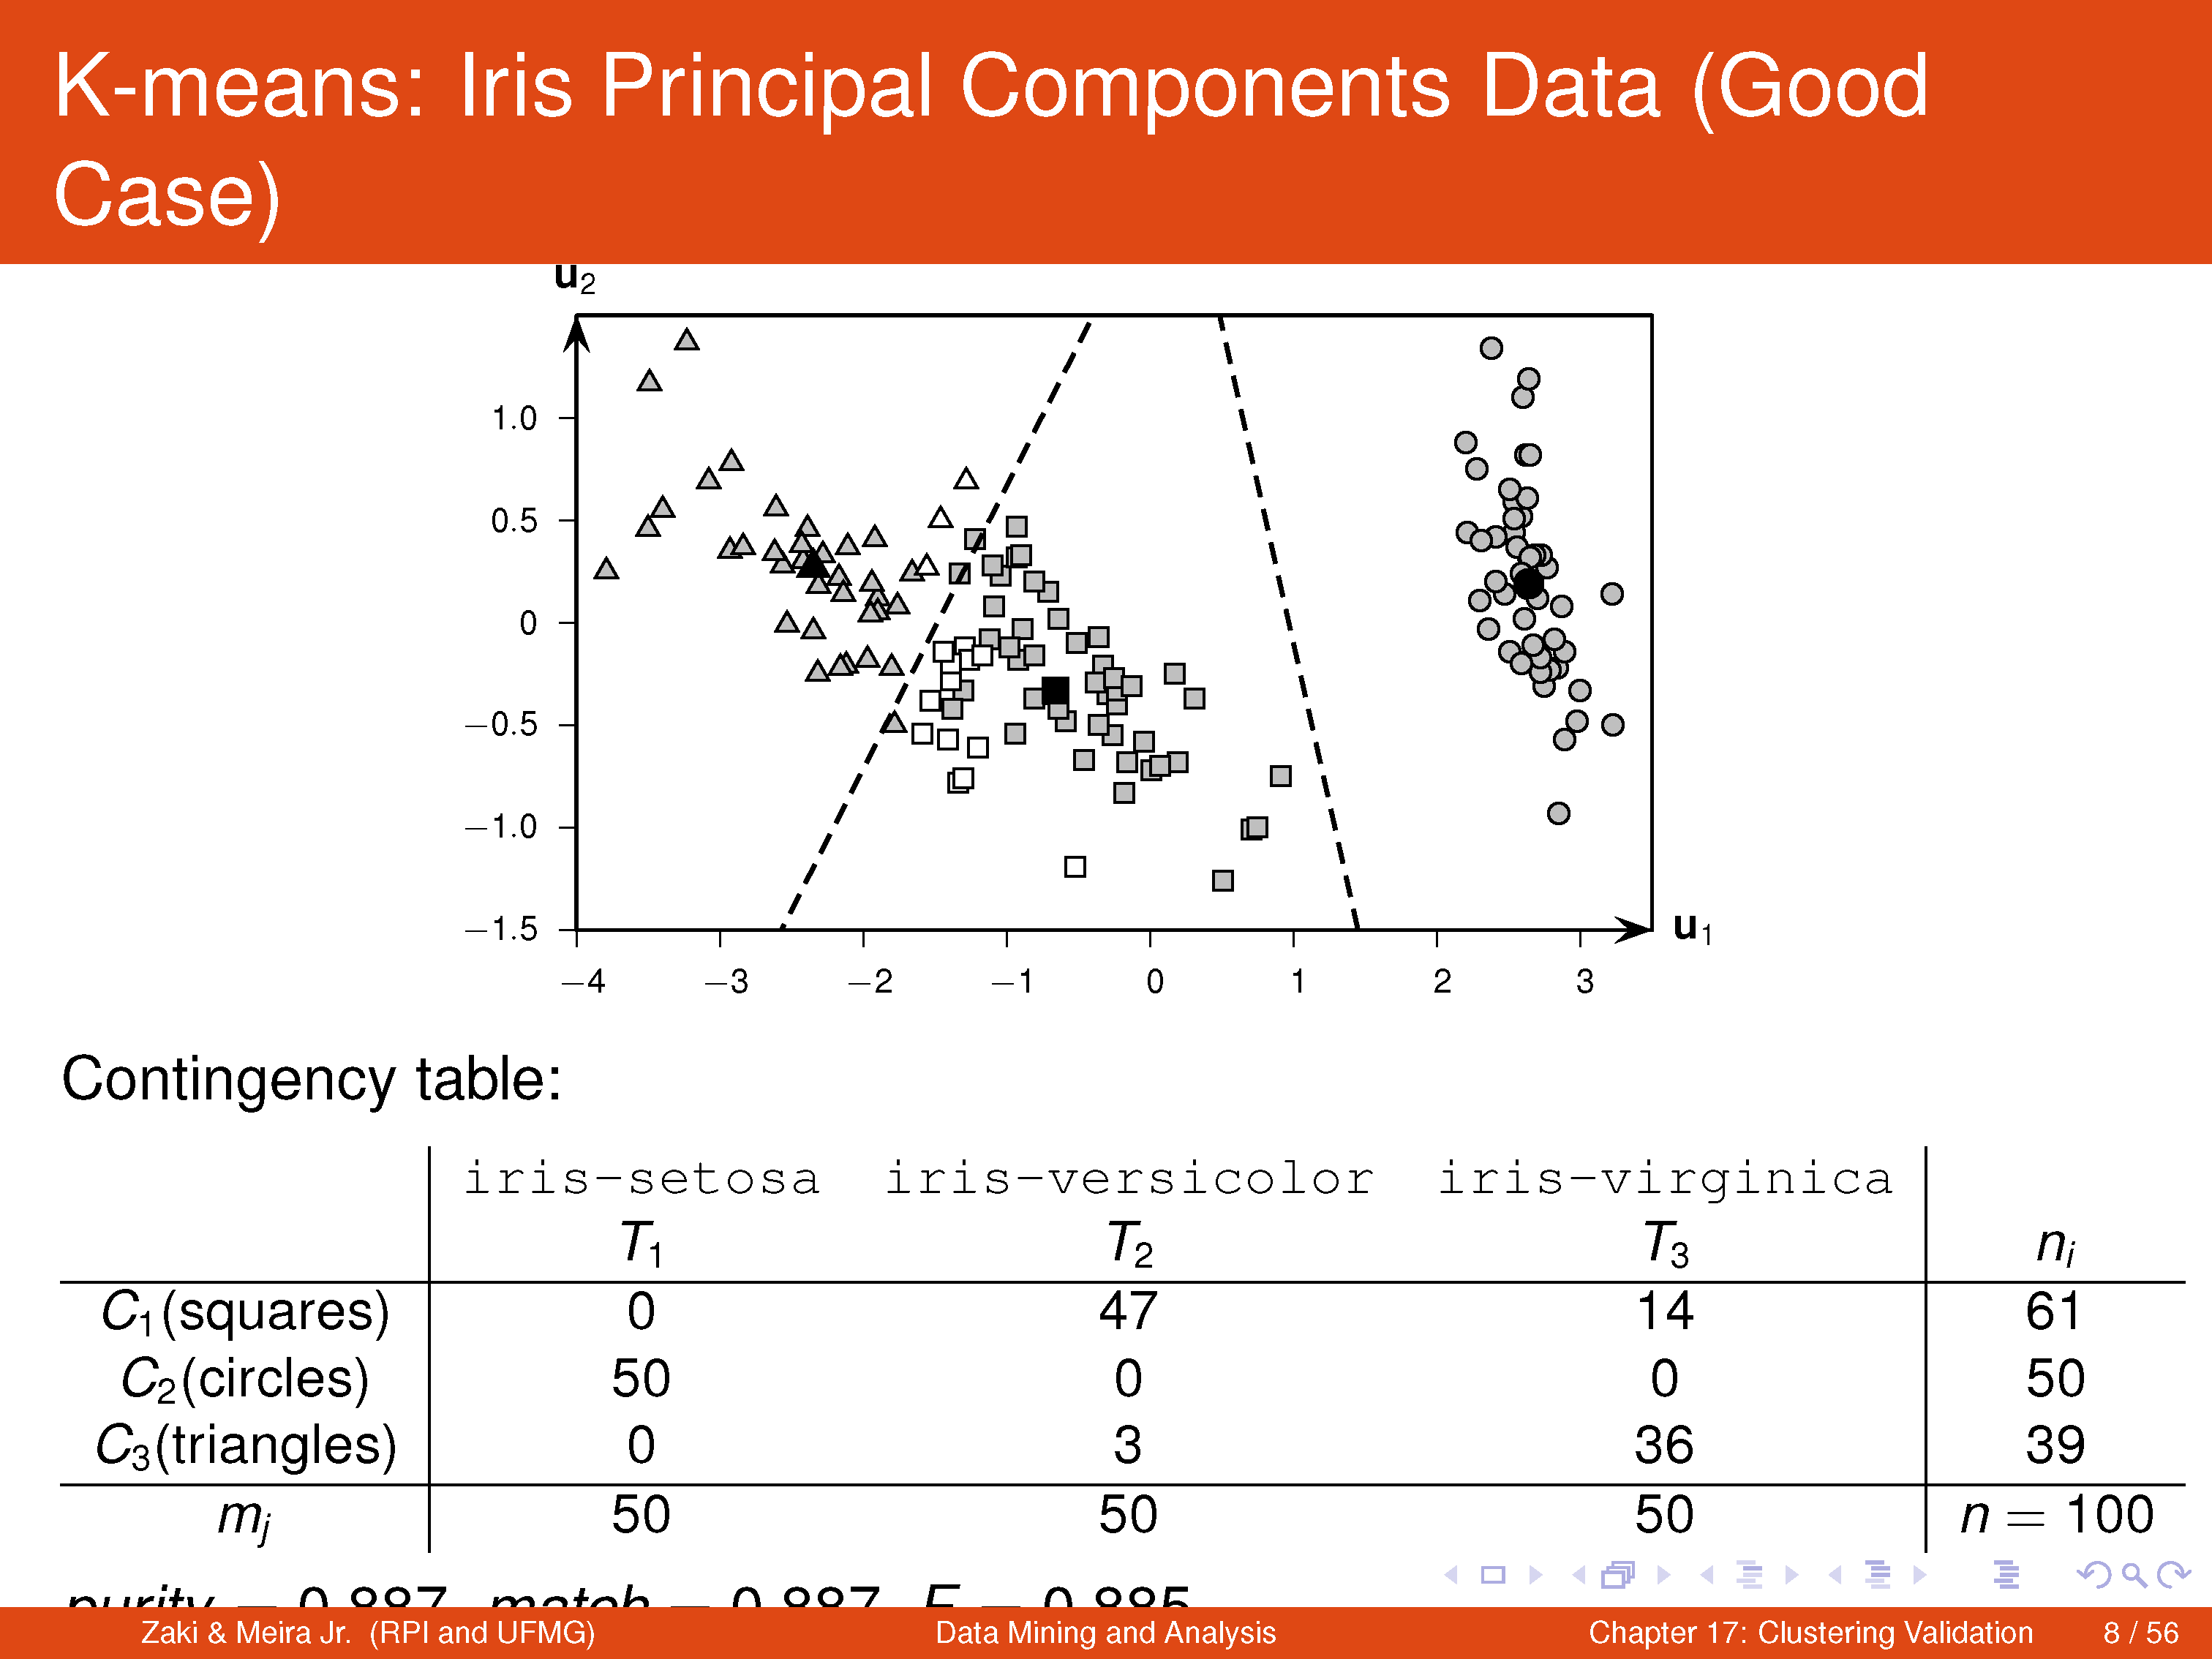

Slide 23
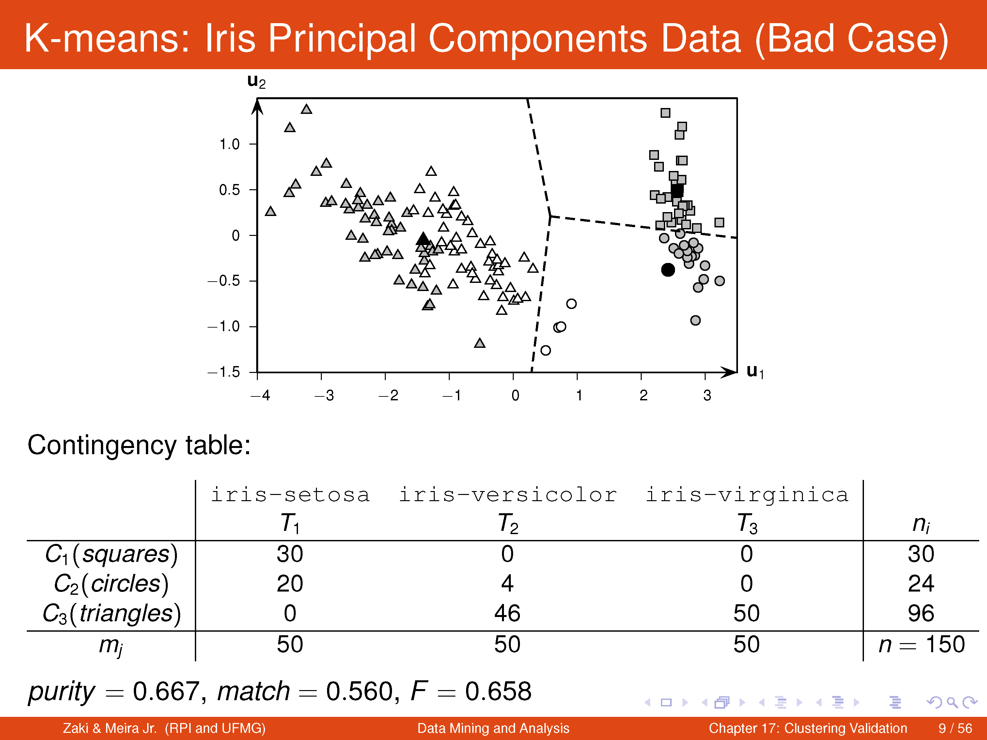

Slide 24
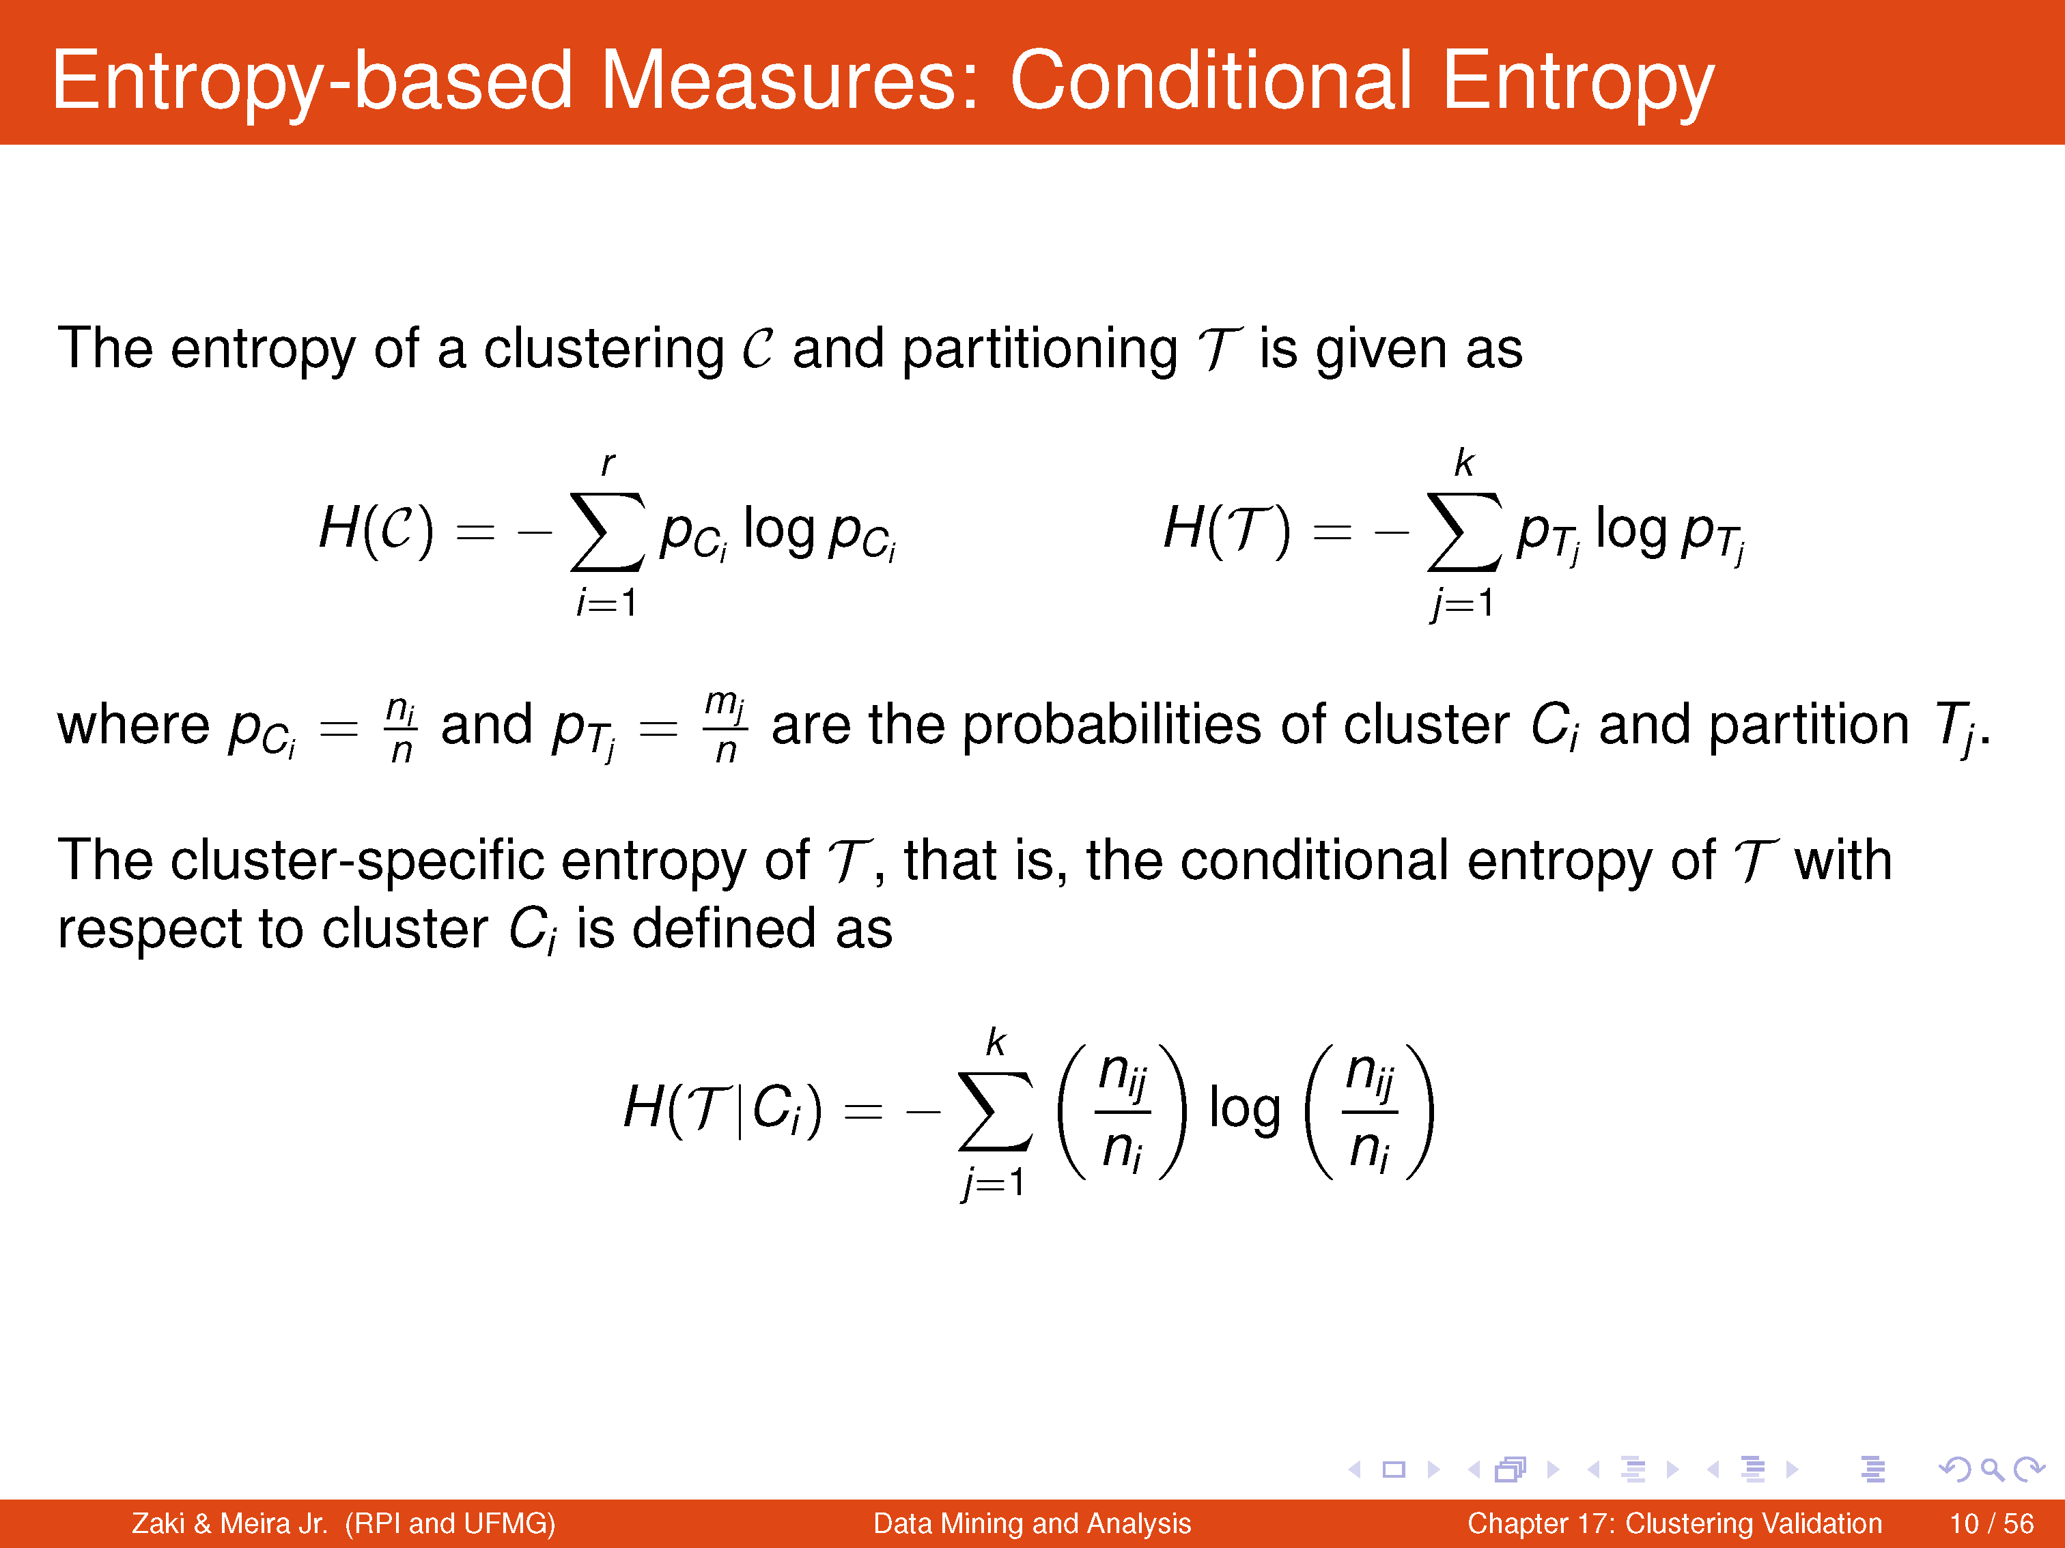

Slide 25
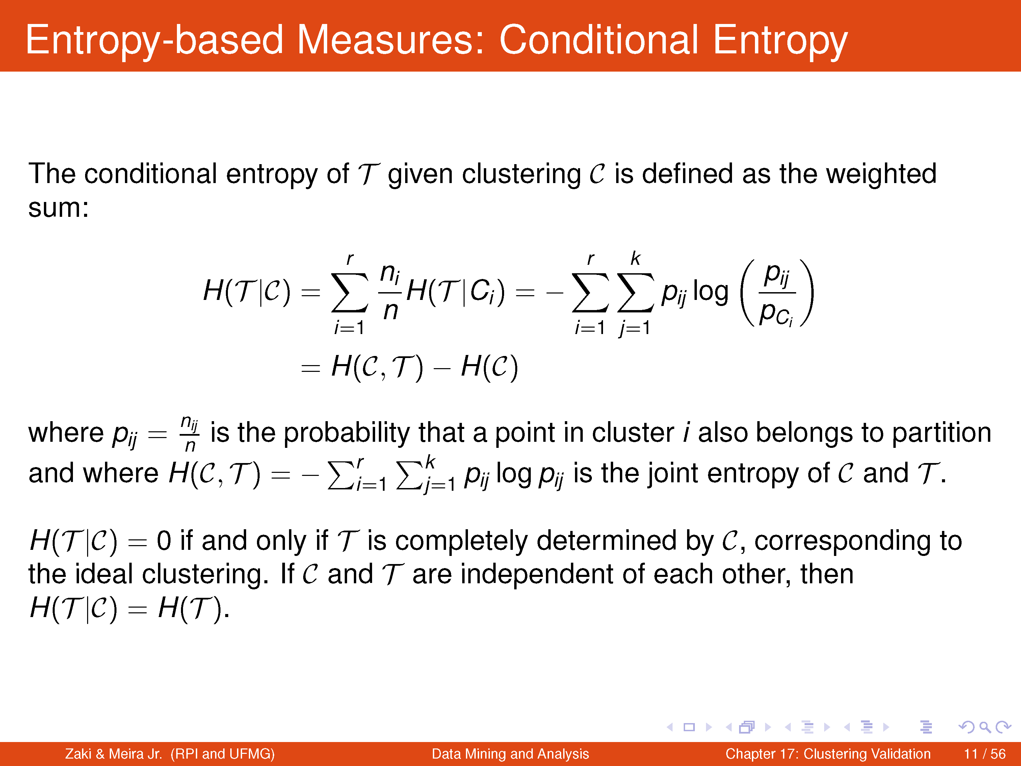

Slide 26
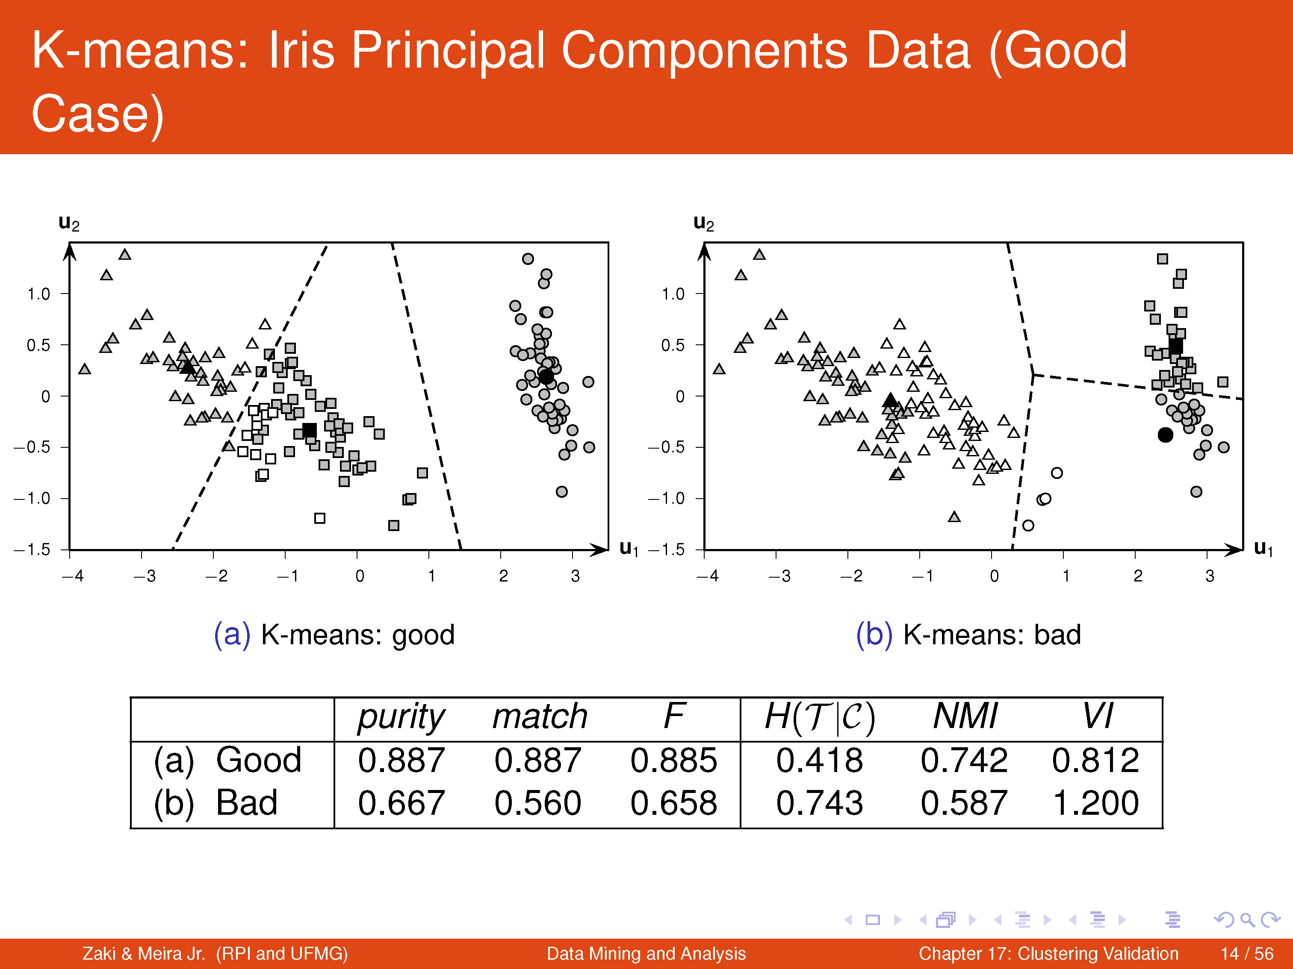

Slide 27
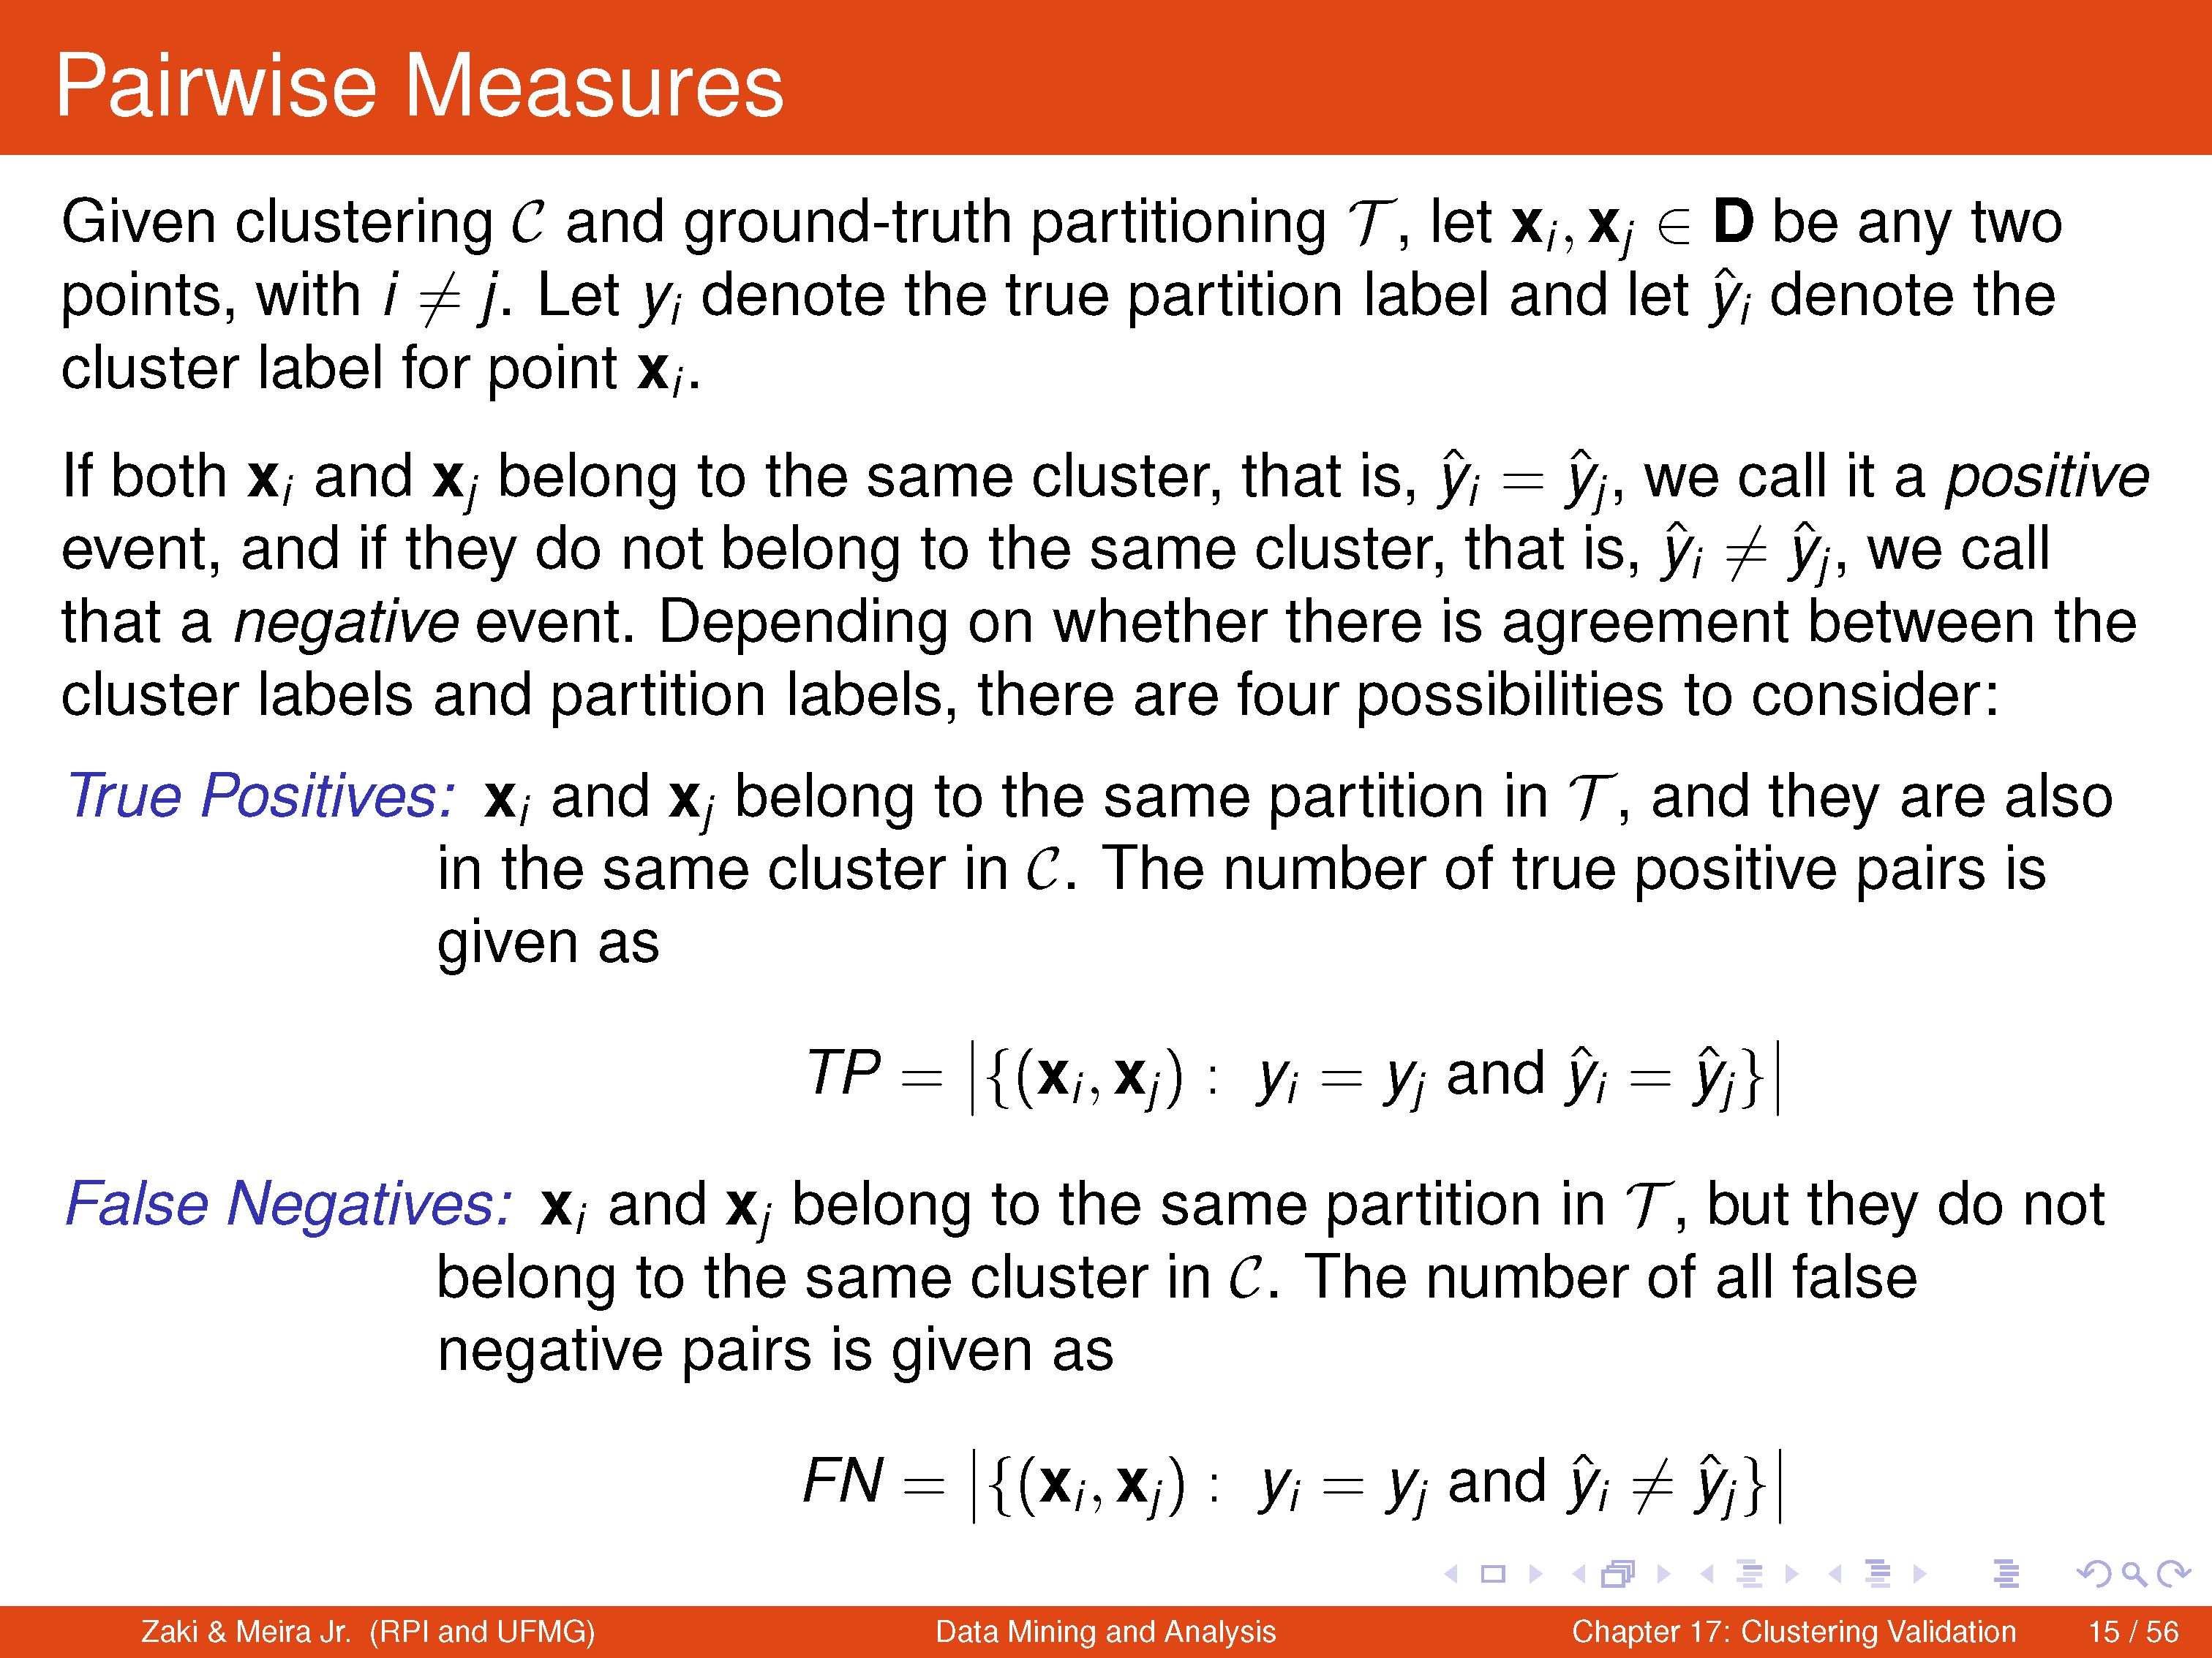

Slide 28
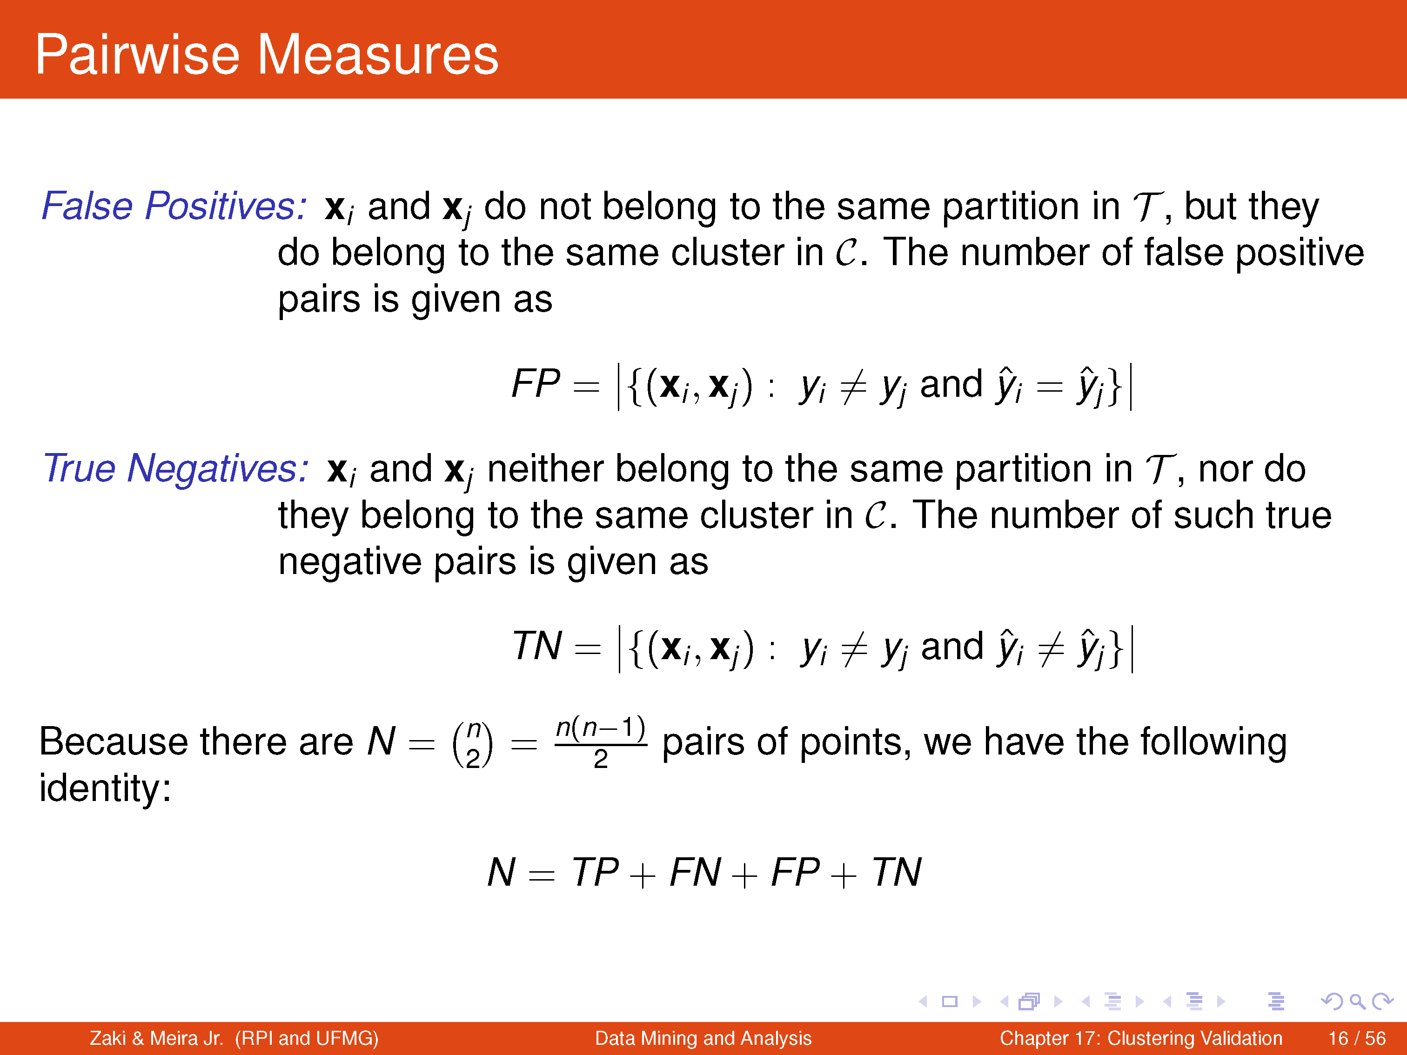

Slide 29
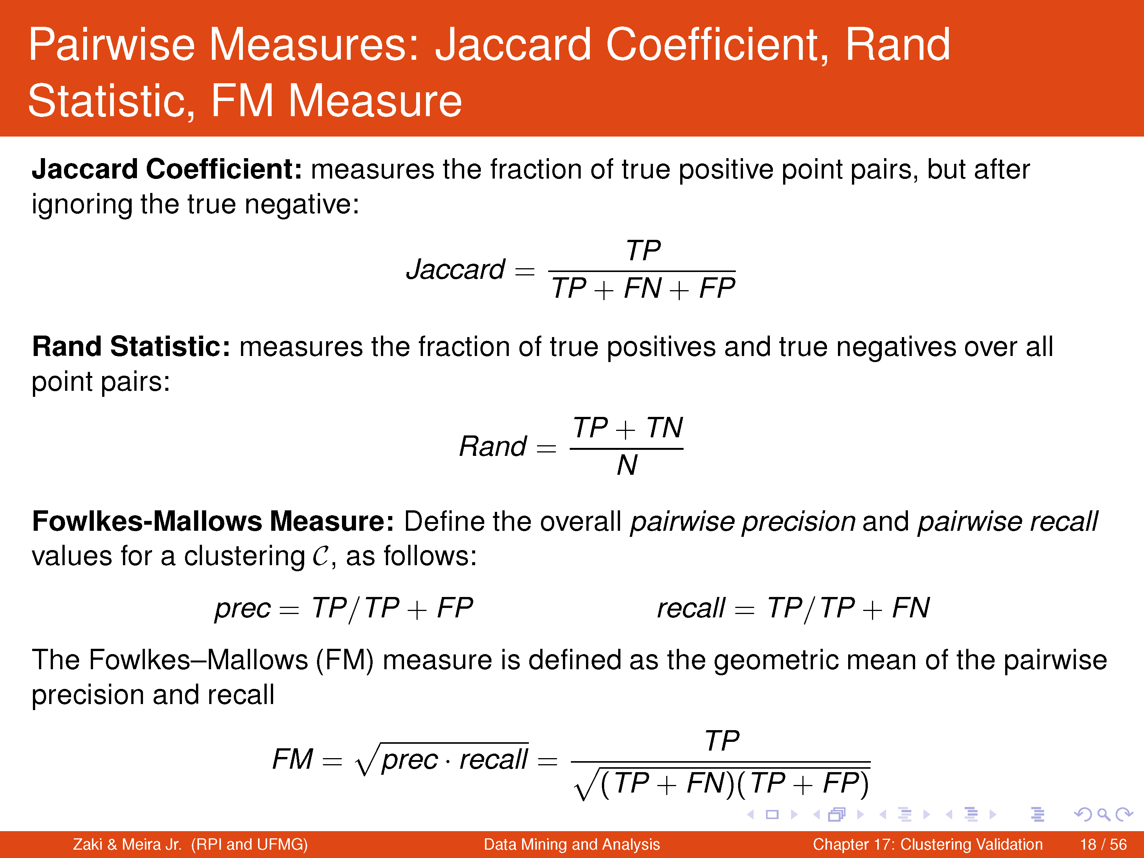

Slide 30
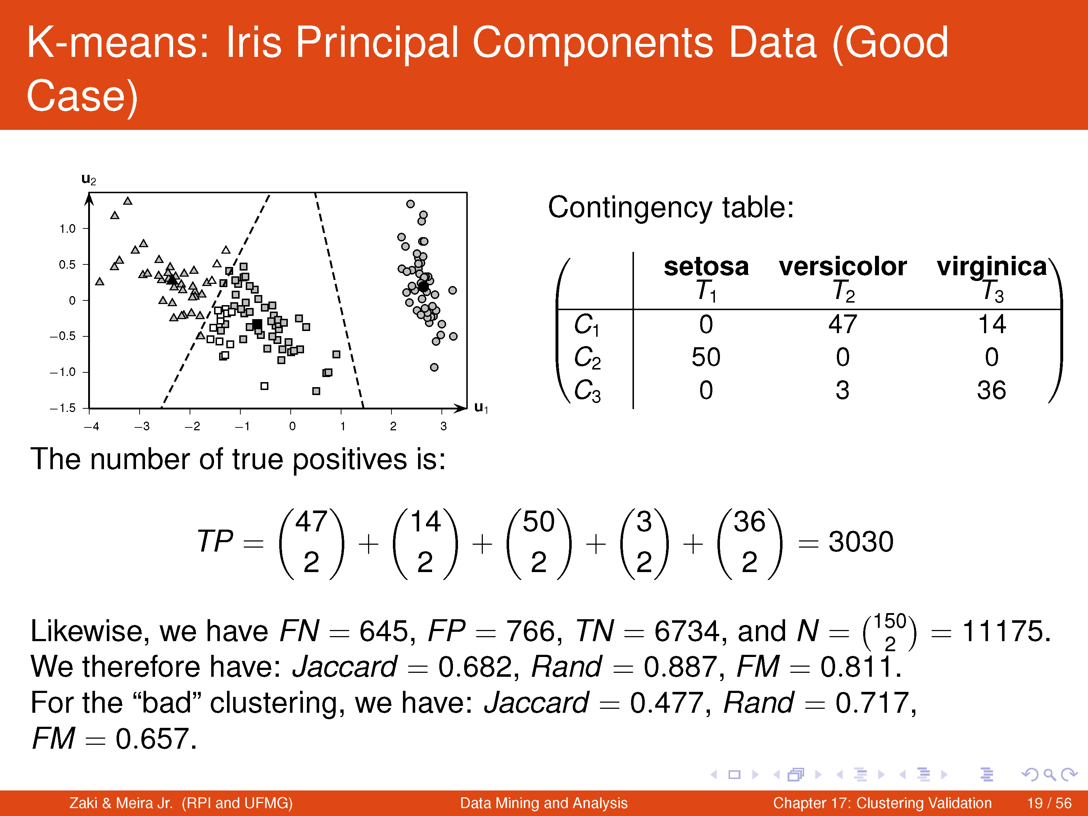

Slide 31
Correlation between Cluster and Class Matrices

Slide 32
Framework for Cluster Validity
Need a framework to interpret any measure.
  For example, if our measure of evaluation has the value, 10, is that good, fair, or poor?
Statistics provide a framework for cluster validity
  The more “atypical” a clustering result is, the more likely it represents valid structure in the data
  Can compare the values of an index that result from random data or clusterings to those of a clustering result.
    If the value of the index is unlikely, then the cluster results are valid
  These approaches are more complicated and harder to understand.
For comparing the results of two different sets of cluster analyses, a framework is less necessary.
  However, there is the question of whether the difference between two index values is significant

Slide 33
Statistical Framework for SSE
Example
  Compare SSE of 0.005 against three clusters in random data
  Histogram shows SSE of three clusters in 500 sets of random data points of size 100 distributed over the range 0.2 – 0.8 for x and y values

Slide 34
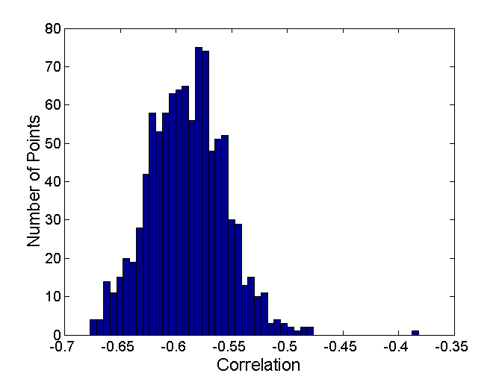
Statistical Framework for Correlation
Correlation of incidence and proximity matrices for the K-means clusterings of the following two data sets.
Corr = -0.9235
Corr = -0.5810

Slide 35
Final Comment on Cluster Validity
“The validation of clustering structures is the most difficult and frustrating part of cluster analysis.
Without a strong effort in this direction, cluster analysis will remain a black art accessible only to those true believers who have experience and great courage.”
Algorithms for Clustering Data, Jain and Dubes

Slide 36
Anomaly
Outliers
Deviation detection
Exception mining
Read the book “Outliers” by Malcolm Gladwell

Slide 37
Anomaly/Outlier Analysis
What are outliers?
Outlier (noun) : something that is situated away from or classed differently from a main or related body
A statistical observation that is markedly different in value from the others of the sample
The set of objects are considerably dissimilar from the remainder of the data
Example: Sports: Michael Jordon, Sachin Tendulkar, Tiger Woods

Slide 38
Anomaly/Outlier Analysis
Telecom fraud detection
Terrorism Prevention
An error/defect in a 6σ company
(Mumbai’s Dabbawallas)
Fraud
Intrusion
Earthquake or Tsunami
Outbreak of a disease
Rare disease
Exceptionally talented athletes
Whizkids

Slide 39
Anomaly/Outlier Detection
What are anomalies/outliers?
  The set of data points that are considerably different than the remainder of the data
Variants of Anomaly/Outlier Detection Problems
  Given a database D, find all the data points x ∈ D with anomaly scores greater than some threshold t
  Given a database D, find all the data points x ∈ D having the top-n largest anomaly scores f(x)
  Given a database D, containing mostly normal (but unlabeled) data points, and a test point x, compute the anomaly score of x with respect to D
Applications:
  Credit card fraud detection, telecommunication fraud detection, network intrusion detection, fault detection

Slide 40
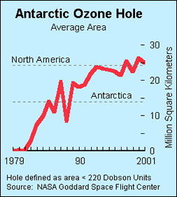
Importance of Anomaly Detection
Ozone Depletion History
In 1985 three researchers (Farman, Gardinar and Shanklin) were puzzled by data gathered by the British Antarctic Survey showing that ozone levels for Antarctica had dropped 10% below normal levels
Why did the Nimbus 7 satellite, which had instruments aboard for recording ozone levels, not record similarly low ozone concentrations?
The ozone concentrations recorded by the satellite were so low they were being treated as outliers by a computer program and discarded!
Sources:
http://exploringdata.cqu.edu.au/ozone.html
http://www.epa.gov/ozone/science/hole/size.html

Slide 41

Anomaly Detection
Challenges
  How many outliers are there in the data?
  Method is unsupervised
    Validation can be quite challenging (just like for clustering)
  Finding needle in a haystack
Working assumption:
  There are considerably more “normal” observations than “abnormal” observations (outliers/anomalies) in the data
Picture Source: Presentation slides of Prof. Jaideep Srivastava

Slide 42
Causes of Anomalies
Data from different classes
  Measuring the weights of oranges, but a few grapefruit are mixed in
Natural variation
  Unusually tall people
Data errors
  200 pound 2 year old

Slide 43
Distinction Between Noise and Anomalies
Noise is erroneous, perhaps random, values or contaminating objects
  Weight recorded incorrectly
  Grapefruit mixed in with the oranges
Noise doesn’t necessarily produce unusual values or objects
Noise is not interesting
Anomalies may be interesting if they are not a result of noise
Noise and anomalies are related but distinct concepts

Slide 44
General Issues: Number of Attributes
Many anomalies are defined in terms of a single attribute
  Height
  Shape
  Color
Can be hard to find an anomaly using all attributes
  Noisy or irrelevant attributes
  Object is only anomalous with respect to some attributes
However, an object may be anomalous even if none of its attribute values are individually anomalous.

Slide 45
General Issues: Anomaly Scoring
Many anomaly detection techniques provide only a binary categorization
  An object is an anomaly or it isn’t
  This is especially true of classification‐based approaches
Other approaches assign a score to all points
  This score measures the degree to which an object is an anomaly
  This allows objects to be ranked
In the end, you often need a binary decision
  Should this credit card transaction be flagged?
  Still useful to have a score
How many anomalies are there?

Slide 46
Other Issues for Anomaly Detection
Find all anomalies at once or one at a time
  Swamping
  Masking
Evaluation
  How do you measure performance?
  Supervised vs. unsupervised situations
Efficiency
Context
  Professional basketball team

Slide 47
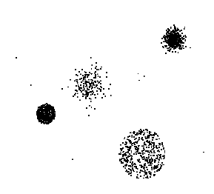
Anomaly Detection Schemes
General Steps
  Build a profile of the “normal” behavior
    Profile can be patterns or summary statistics for the overall population
  Use the “normal” profile to detect anomalies
    Anomalies are observations whose characteristics
    differ significantly from the normal profile
Types of anomaly detection
schemes
  Graphical & Statistical-based
  Distance-based
  Model-based

Slide 48
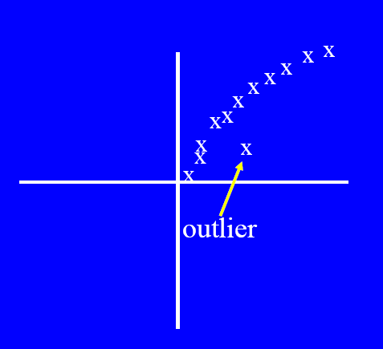
Graphical Approaches
Boxplot (1-D), Scatter plot (2-D), Spin plot (3-D)
Limitations
  Time consuming

Slide 49
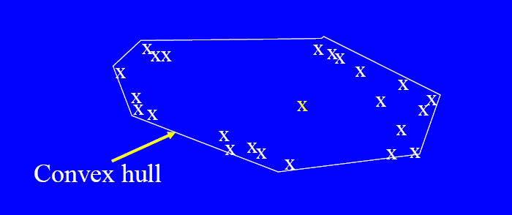
Convex Hull Method
Extreme points are assumed to be outliers
Use convex hull method to detect extreme values
What if the outlier occurs in the middle of the data?

Slide 50
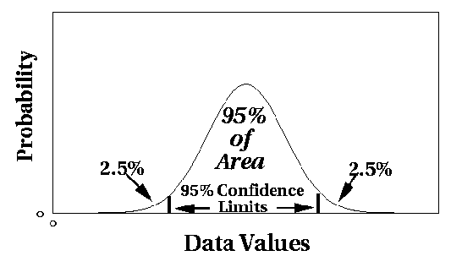
Statistical Approaches
Assume a parametric model describing the distribution of the data (e.g., normal distribution)
Apply a statistical test that depends on
  Data distribution
  Parameter of distribution (e.g., mean, variance)
  Number of expected outliers (confidence limit)

Slide 51
Grubbs’ Test
Detect outliers in univariate data
Assume data comes from normal distribution
Detects one outlier at a time, remove the outlier, and repeat
  H₀: There is no outlier in data
  H_{A}: There is at least one outlier
Grubbs’ test statistic:
Reject H₀ if:

Slide 52
Statistical-based–Likelihood Approach
Assume the data set D contains samples from a mixture of two probability distributions:
  M (majority distribution)
  A (anomalous distribution)
General Approach:
  Initially, assume all the data points belong to M
  Let L_{t}(D) be the log likelihood of D at time t
  For each point x_{t} that belongs to M, move it to A
    Let L_{t+1} (D) be the new log likelihood.
    Compute the difference, Δ = L_{t}(D) – L_{t+1} (D)
    If Δ > c (some threshold), then x_{t} is declared as an anomaly and moved permanently from M to A

Slide 53
Limitations of Statistical Approaches
Most of the tests are for a single attribute
In many cases, data distribution may not be known
For high dimensional data, it may be difficult to estimate the true distribution

Slide 54
Distance-based Approaches
Data is represented as a vector of features
Three major approaches
  Nearest-neighbor based
  Density based
  Clustering based

Slide 55
Nearest-Neighbor Based Approach
Approach:
  Compute the distance between every pair of data points
  There are various ways to define outliers:
    Data points for which there are fewer than p neighboring points within a distance D
    The top n data points whose distance to the kth nearest neighbor is greatest
    The top n data points whose average distance to the k nearest neighbors is greatest

Slide 56
Clustering-Based
Basic idea:
  Cluster the data into groups of different density
  Choose points in small cluster as candidate outliers
  Compute the distance between candidate points and non-candidate clusters.
    If candidate points are far from all other non-candidate points, they are outliers

