Slide 1
LOGISTIC REGREESION
IN
MACHINE LEARNING

Slide 2
Logistic regression:
Logistic regression is a classification algorithm ,used when the Target variable is categorical.
logistic regression is to find the relationship between features and Probability(0 or 1) of particular outcome.
Data set having labels like: Yes-No, 0-1, etc. then use logistic regression as there linear regression fails.

Slide 3
Sigmoid function:
In logistic regression we will use sigmoid function .
Sigmoid function trying to convert the independent variable(feature) into
a expression of Probability that ranges between 0-1 with respect to dependent variable and after getting the values we plot the graph.
Equation of sigmoid :
Where :
X= independent varaible
e=2.718(Eulers number)
Y=1/1+e-x

Slide 4
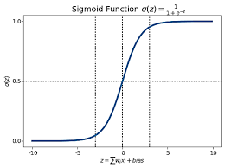
Sigmoid graph:

Slide 5
Types of logistic regression:
Binomial Logistic Regression
2. Multinomial Logistic Regression
3. Ordinal Regression
Binomial logistic regression: target variable can have only 2 possible types:
0 or 1 which may represent win or loss , pass or fail, dead or
alive, etc…….

Slide 6
Multinomial Logistic Regression:
Target variable can have 3 or more possible types which are not ordered
(i.e. types have no quantitative significance) like disease A vs disease B vs
disease C
Ordinal Logistic Regression:
it deals with target variables with ordered categories. For example, a test score
can be categorized as: very poor , poor , good, very good . Here, each
category can be given a score like 0, 1, 2, 3

Slide 7
Applications of logistic regression:
credit card spam
Fraud Detection
Disease Diagnosis
Emergency Detection

Slide 8
Thank you

