Slide 1







Philo Physics presents
Diffraction
Presented by Tanmay Borse,Sakec

Slide 2
CONTENTS
Diffraction
Fresnel and Fraunhoffer

Slide 3



What is Diffraction?
Diffraction : As waves come into contact with obstacles (or openings), they bend around the edges of the obstacles if the obstacles' dimensions are equal to the waves' wavelength. Diffraction is the bending of waves around the edges of an obstacle (or opening).
P
Slit
Screen
Q
A
From
Distant
Source
d/2
S
Po
S
θ
θ
d/2
M
B
Slit
Screen
L1
L2

Slide 4
Fresnel & Fraunhofer
Basically, the diffraction phenomenon has two main types:
P
Slit
Screen
Q
A
From
Distant
Source
d/2
S
Po
S
θ
θ
d/2
M
B
Slit
Screen
L1
L2
Fresnel Diffraction | Fraunhofer Diffraction
The source and slits are both at finite distance from the slit. | The source and slits are at infinite distance from the slit.
Wavefronts are cylindrical or spherical. | Wavefronts are plane.
The incident and diffracted rays are divergent. | The incident and diffracted rays are parallel.
Lenses are not required in actual experiment. | Two convex lenses are used in experiment to achieve parallel wavefront.
The initial phase of secondary wavelets is different at different points in the plane of the aperture. | The initial phase of secondary wavelets is same at all points in the plane of the aperture.

Slide 5





CONTENTS
Diffraction
Fresnel and Fraunhoffer

Slide 6




Hello, classmates!
WE ARE GROUP A

Slide 7




MEET THE GROUP
Anna
Tristan
Sebastian
Kelly
Group Leader
Researcher
Resource Collector
Summarizer

Slide 8
What is Diffraction?
Diffraction : As waves come into contact with obstacles (or openings), they bend around the edges of the obstacles if the obstacles' dimensions are equal to the waves' wavelength. Diffraction is the bending of waves around the edges of an obstacle (or opening).

Slide 9
INTRODUCTION
Start inspired with thousands of templates, collaborate with ease, and engage your audience with a memorable Canva Presentation.
Apply page animations and transitions to your Canva Presentation to emphasize ideas and make them even more memorable.

Slide 10



GOALS
Our First Goal
Our Second Goal
Our Third Goal
Pre-record your Canva presentation
to present anytime, anywhere.
Pre-record your Canva presentation
to present anytime, anywhere.
Pre-record your Canva presentation
to present anytime, anywhere.

Slide 11

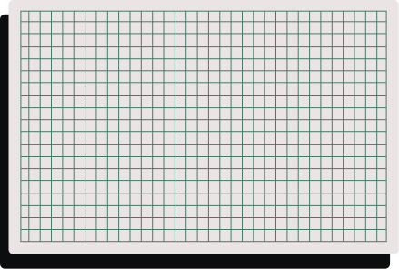
The First Concept
Pre-record your Canva presentation
to present anytime, anywhere.
MAIN CONCEPTS
The Second Concept
Pre-record your Canva presentation
to present anytime, anywhere.
The Third Concept
Pre-record your Canva presentation
to present anytime, anywhere.

Slide 12



BACKGROUND
General Overview
Present with ease and wow any audience with Canva Presentations. Choose from over a thousand templates to fit any objective or topic.
History
With Canva Presentations, you can collaborate in real-time with your teammates or co-presenters. Share tasks and work simultaneously to create a powerful presentation.

Slide 13


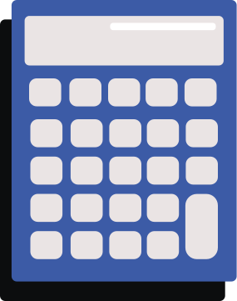

Our First Synthesis
Wow any audience with your Canva presentation. Design, plan, and present all in one place.
GROUP SYNTHESIS
Our Second Synthesis
Wow any audience with your Canva presentation. Design, plan, and present all in one place.
Our Third Synthesis
Wow any audience with your Canva presentation. Design, plan, and present all in one place.

Slide 14
RELATED VIDEO
With Canva Presentations, you can collaborate in real-time and feel like you’re in the same room as your teammates or co-presenters. Share tasks and work simultaneously to create a powerful presentation.

Slide 15
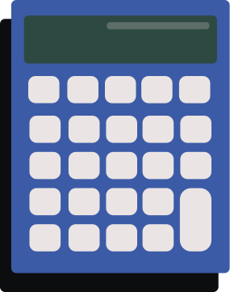
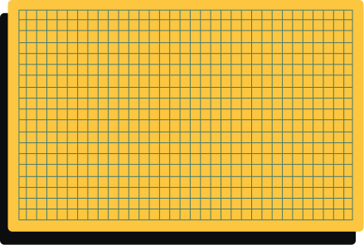
THANK YOU!
Do you have any questions for us?

Slide 16
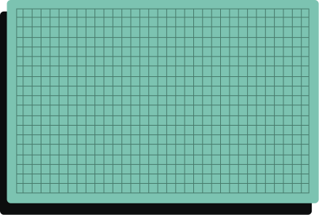
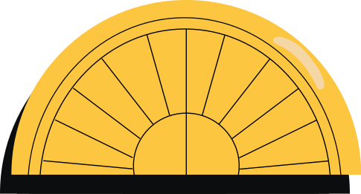





STUDENT RESOURCE PAGE
Use these icons and illustrations
in your Canva Presentation.
Happy designing!

