Slide 1

Q1. Silver has FCC structure and its atomic radius is 1.414 A⁰. Find the interplanar spacing of the (200) and (111) planes.
Given: - r=1.414 A⁰
Formula: - d_{hlk}=$\frac{a}{\sqrt{h^{2}+k^{2}+l^{2}}}$ and r=$\frac{a}{2\sqrt{2}}$ for FCC structure
Solution: -
a=2$\sqrt{2}$r=3.99Aº
d₂₀₀=$\frac{3.99}{\sqrt{2^{2}+0^{2}+0^{2}}}$=1.995Aº
d₁₁₁=$\frac{3.99}{\sqrt{1^{2}+1^{2}+1^{2}}}$=2.303Aº
Ans: - d₂₀₀=1.995A⁰
d₁₁₁=2.303A⁰

Slide 2
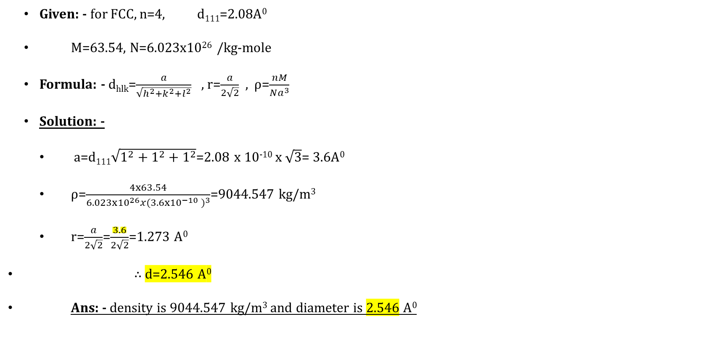
Q2. Cu has FCC structure. If the interplanar spacing for the set of (111) planes is 2.80A⁰, find the density and the diameter of the cu atom. The atomic weight of cu is 63.54.
Given: - for FCC, n=4, d₁₁₁=2.08A⁰
M=63.54, N=6.023x10²⁶ /kg-mole
Formula: - d_{hlk}=$\frac{a}{\sqrt{h^{2}+k^{2}+l^{2}}}$ , r=$\frac{a}{2\sqrt{2}}$ , ρ=$\frac{nM}{Na^{3}}$
Solution: -
a=d₁₁₁$\sqrt{1^{2}+1^{2}+1^{2}}$=2.08 x 10⁻¹⁰ x $\sqrt{3}$= 3.6A⁰
ρ=$\frac{4x63.54}{6.023x{10}^{26}{x(3.6x{10}^{−10} )}^{3}}$=9044.547 kg/m³
r=$\frac{a}{2\sqrt{2}}$=$\frac{3.6}{2\sqrt{2}}$=1.273 A⁰
∴ d=2.546 A⁰
Ans: - density is 9044.547 kg/m³ and diameter is 2.546 A⁰

Slide 3
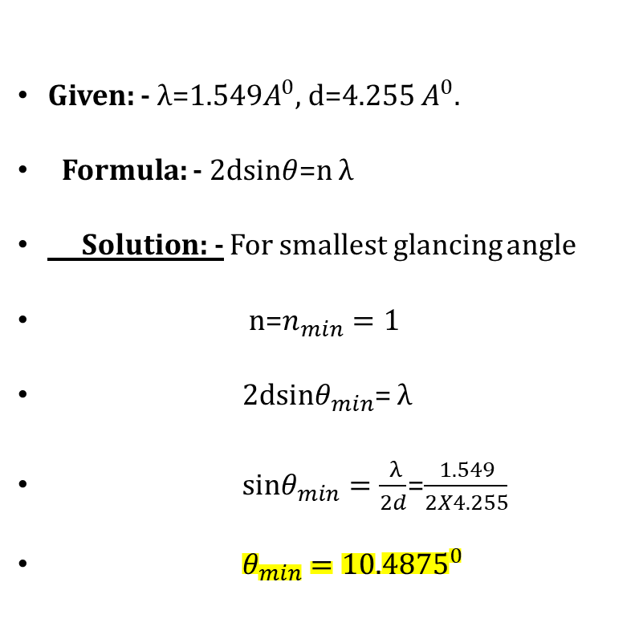
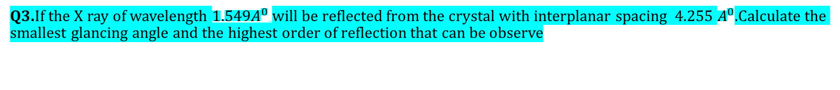
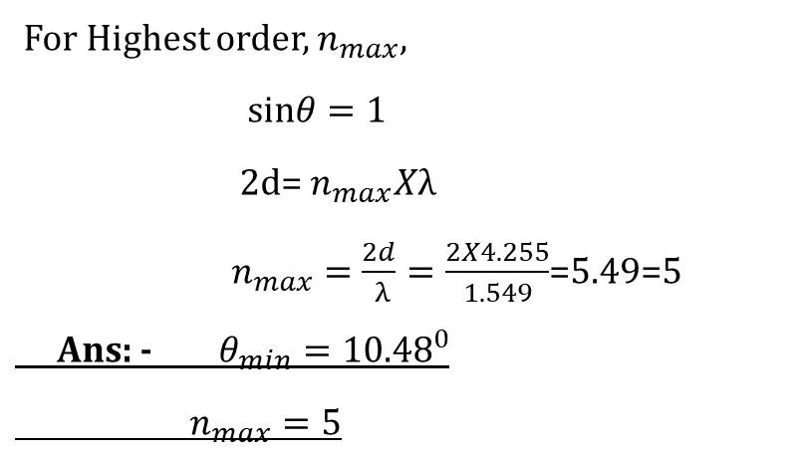
Q3.If the X ray of wavelength ${1.549A}^{0}$will be reflected from the crystal with interplanar spacing 4.255 $A^{0}$.Calculate the smallest glancing angle and the highest order of reflection that can be observe
Given: -$λ$=${1.549A}^{0}$, d=4.255 $A^{0}$.
Formula: - 2dsin$θ$=n λ
Solution: - For smallest glancing angle
n=$n_{min}=1$
2dsin$θ_{min}$= λ
sin$θ_{min}=\frac{ λ}{2d}$=$\frac{1.549}{2X4.255}$
$θ_{min}={10.4875}^{0}$
For Highest order, $n_{max}$,
sin$θ=1$
2d= $n_{max}Xλ$
$n_{max}=\frac{2d}{ λ}=\frac{2X4.255}{1.549}$=5.49=5
Ans: - $θ_{min}={10.48}^{0}$
$n_{max}=5$

Slide 4

Q4.In comparing the wavelengths of two monochromatic X-ray lines it is found that line A gives 1st order Bragg's maximum at a glancing angle of 30° to the smooth face of a crystal. Line B of known wavelength of 0.97 A° gives 3rd order reflection maximum at a glancing angle of 60° with the same face of the crystal. Find the wavelength of line A.
Given: - line A: - n₁=1, θ=30º, 𝜆₁=?
line A: - n₁=3, θ=60º, 𝜆₂=0.97Aº
Formula: - 2dsinθ=n𝜆
Solution: - 2dsinθ₁ =n₁ 𝜆₁ and 2dsinθ₂ =n₂ 𝜆₂
$\frac{sinθ1}{sinθ2}$=$\frac{n_{1}λ_{1} }{n_{2}λ_{2}}$
𝜆₁= 𝜆₂$\frac{sinθ1}{sinθ2}.\frac{n2}{n1}$ = 0.97x10⁻¹⁰ $\frac{sin30}{sin60}$x3
𝜆₁=1.68 A⁰
Ans: - wavelength of line A is 1.68 A⁰

Slide 5

Q5.In NaCl crystal, the spacing between the successive (100) plane is 2.82 Aº. X-ray incident on the surface of the crystal is found to give rise to first order Bragg reflection at glancing angle 8.8°. Calculate the wavelength of X-ray.
Given: - (hlk)=(100), d=2.82A⁰,n=1,θ=8.8º
Formula: - 2dsinθ=n𝜆
Solution: - 𝜆=$\frac{2dsinθ}{n}$=2 x 2.82 x 10⁻¹⁰ x sin8.8⁰
𝜆=8.628x10⁻¹¹m
𝜆=0.8628 A⁰
Ans: - wavelength of x-ray is 0.8628 A⁰

Slide 6

Q6.Monochromatic X-ray beam of wavelength A 5.8189 Å is reflected strongly for glancing angle of 0 75.86° in the first order by certain planes of cubic crystal of lattice constant 3 Aº. Determine Miller indices of the possible reflecting planes.
Given: -=5.8189 A⁰ ,θ=75.86º, n=1, a=3 Aº
Formula: - 2dsinθ=n𝜆
d=$\frac{a}{\sqrt{h^{2}+k^{2}+l^{2}}}$
Solution: - 2dsinθ=n𝜆
d=$\frac{nλ}{2sinθ}$=$\frac{1x5.8189x{10}^{−10}}{2x sin75.86}$=3x10⁻¹⁰m
but, d=$\frac{a}{\sqrt{h^{2}+k^{2}+l^{2}}}$
$\sqrt{h^{2}+k^{2}+l^{2}}$ =$\frac{a}{d}$ = $\frac{3x{10}^{−10}}{3x{10}^{−10}}$=1
Hence the only possible (hkl) are(100),(010),(001)
Ans: - miller indices (hkl) is (100).

Slide 7

Q7.Monochromatic high energy X-rays are incident on a crystal. If first order reflection is observed at an angle 3.4° at what angle would second order reflection be expected?
Given: - n₁=1 , θ₁=3.4º, n₂=2, θ₂=?
Formula: - 2dsinθ=n𝜆
Solution: - 2dsinθ₁ =n₁ 𝜆 and 2dsinθ₂ =n₂ 𝜆
$\frac{sinθ1}{sinθ2}$=$\frac{n_{1} }{n_{2}}$
sinθ₂=$\frac{n_{2}sinθ1 }{n_{1}}$= $\frac{2}{1}x\sin{3.4}$ = 0.1186
θ₂=$\sin^{−1}{0.1186}$=6.812º
Ans: - hence second order reflection is expected at 6.812⁰

Slide 8

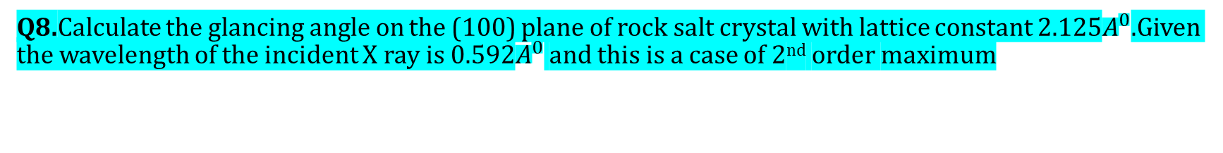
Q8.Calculate the glancing angle on the (100) plane of rock salt crystal with lattice constant 2.125$A^{0}$.Given the wavelength of the incident X ray is 0.592$A^{0}$ and this is a case of 2nd order maximum
Given : - (kl)=(100) , a= 2.125$A^{0}$, n=2, $λ=$0.592$A^{0}$
Formula: - d=$\frac{a}{\sqrt{h^{2}+k^{2}+l^{2}}}$ ; 2dsin$θ$=n $λ$
Solution: -
d=$\frac{2.125}{\sqrt{1^{2}+0+0}}=$2.125$A^{0}$
2dsin$θ$=n $λ$
Sin$θ$=$\frac{n λ}{2d}$
$Sinθ=\frac{2X0.592}{2X2.125}$
$θ=16.1{76}^{0}$
Ans: - The glancing angle is $16.1{76}^{0}$

Slide 9

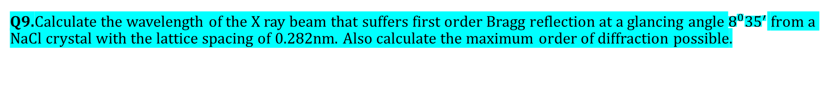
Q9.Calculate the wavelength of the X ray beam that suffers first order Bragg reflection at a glancing angle $8^{0}{35}^{′}$ from a NaCl crystal with the lattice spacing of 0.282nm. Also calculate the maximum order of diffraction possible.
Given: - n=1, $θ$=$8^{0}{35}^{′}$, d=0.282nm
Formula: - 2dsin$θ$=n λ
Solution: -
$λ=\frac{2dsinθ}{n}$=2X0.282${X10}^{−9}sin8^{0}{35}^{′}$
$λ=0.842A^{0}$
In Bragg’s law, d and $λ$are constants.Hence,for maximum order $n_{max}$,sin$θ=1$
2d=$n_{max}λ$
$n_{max}=\frac{2d}{λ}$=$\frac{{2X0.282X10}^{−9}}{{0.0842X10}^{−10}}$=6.7
Here,since $n_{max}$<7,7th order is not visible.Hence the highest order is 6
Ans: -$λ=0.842A^{0}$ , n=6

Slide 10

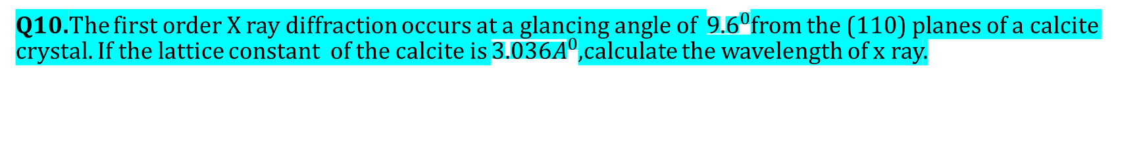
Q10.The first order X ray diffraction occurs at a glancing angle of ${9.6}^{0}$from the (110) planes of a calcite crystal. If the lattice constant of the calcite is ${3.036A}^{0}$,calculate the wavelength of x ray.
Given : - $θ={9.6}^{0}$, n=1, (hkl)=(110), a=${3.036A}^{0}$
Formula: - d=$\frac{a}{\sqrt{h^{2}+k^{2}+l^{2}}}$; 2dsin$θ$=n $λ$
Solution: -
d=$\frac{3.036}{\sqrt{1^{2}+1^{2}+0}}$=2.1468$A^{0}$
$λ=\frac{2dsinθ}{n}$=$\frac{2X2.1468Xsin9.6}{1}$
$λ=0.716A^{0}$
Ans: -The wavelength of X ray is $0.716A^{0}$

Slide 11
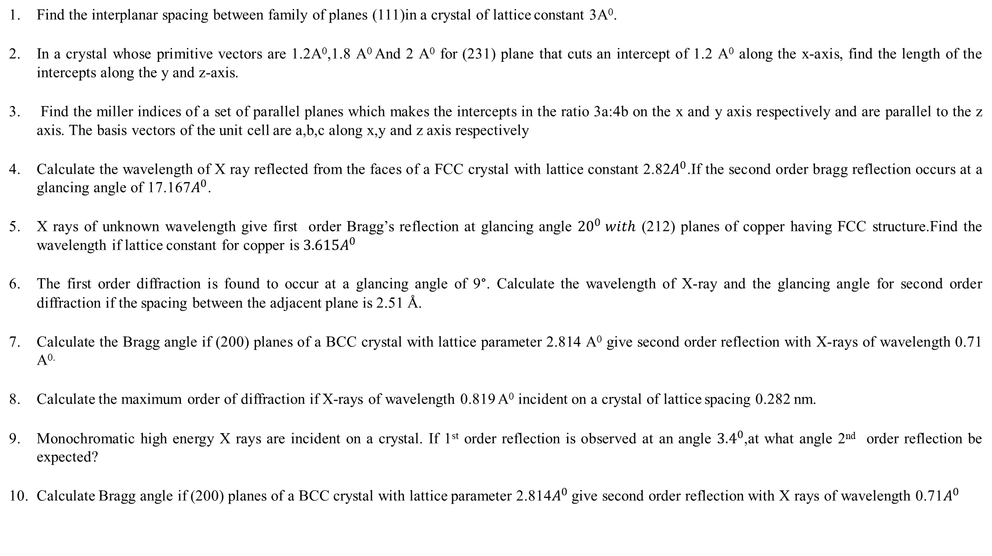
Find the interplanar spacing between family of planes (111)in a crystal of lattice constant 3A⁰.
In a crystal whose primitive vectors are 1.2A⁰,1.8 A⁰ And 2 A⁰ for (231) plane that cuts an intercept of 1.2 A⁰ along the x-axis, find the length of the intercepts along the y and z-axis.
Find the miller indices of a set of parallel planes which makes the intercepts in the ratio 3a:4b on the x and y axis respectively and are parallel to the z axis. The basis vectors of the unit cell are a,b,c along x,y and z axis respectively
Calculate the wavelength of X ray reflected from the faces of a FCC crystal with lattice constant 2.82$A^{0}$.If the second order bragg reflection occurs at a glancing angle of 17.167$A^{0}$.
X rays of unknown wavelength give first order Bragg’s reflection at glancing angle ${20}^{0} with$ (212) planes of copper having FCC structure.Find the wavelength if lattice constant for copper is ${3.615A}^{0}$
The first order diffraction is found to occur at a glancing angle of 9°. Calculate the wavelength of X-ray and the glancing angle for second order diffraction if the spacing between the adjacent plane is 2.51 Å.
Calculate the Bragg angle if (200) planes of a BCC crystal with lattice parameter 2.814 A⁰ give second order reflection with X-rays of wavelength 0.71 A^{0.}
Calculate the maximum order of diffraction if X-rays of wavelength 0.819 A⁰ incident on a crystal of lattice spacing 0.282 nm.
Monochromatic high energy X rays are incident on a crystal. If 1st order reflection is observed at an angle ${3.4}^{0}$,at what angle 2nd order reflection be expected?
Calculate Bragg angle if (200) planes of a BCC crystal with lattice parameter 2.814$A^{0}$ give second order reflection with X rays of wavelength 0.71$A^{0}$

Slide 12
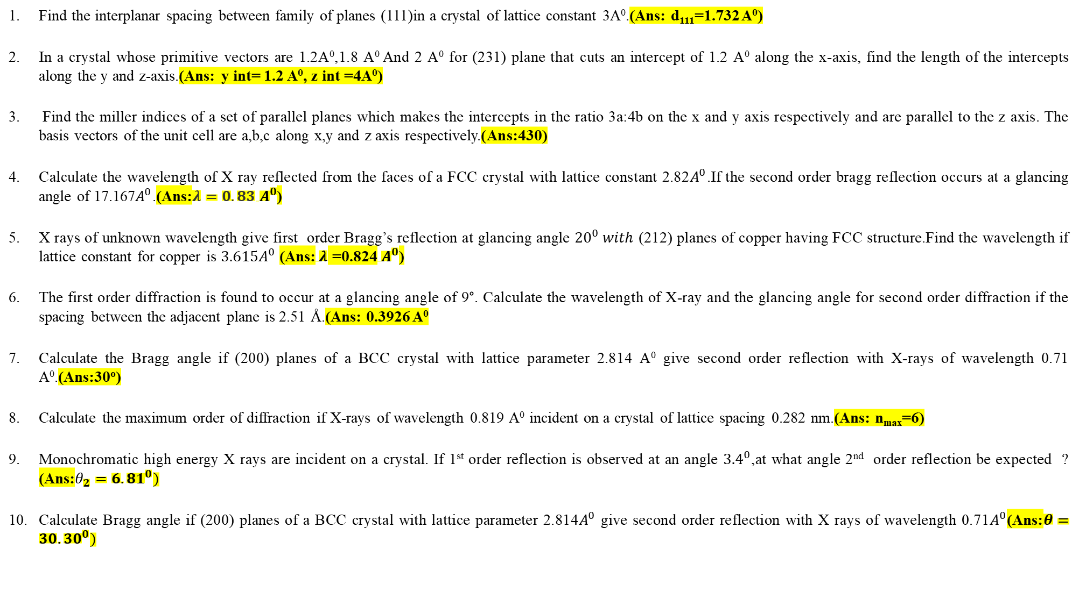
Find the interplanar spacing between family of planes (111)in a crystal of lattice constant 3A⁰.(Ans: d₁₁₁=1.732 A⁰)
In a crystal whose primitive vectors are 1.2A⁰,1.8 A⁰ And 2 A⁰ for (231) plane that cuts an intercept of 1.2 A⁰ along the x-axis, find the length of the intercepts along the y and z-axis.(Ans: y int= 1.2 A⁰, z int =4A⁰)
Find the miller indices of a set of parallel planes which makes the intercepts in the ratio 3a:4b on the x and y axis respectively and are parallel to the z axis. The basis vectors of the unit cell are a,b,c along x,y and z axis respectively.(Ans:430)
Calculate the wavelength of X ray reflected from the faces of a FCC crystal with lattice constant 2.82$A^{0}$.If the second order bragg reflection occurs at a glancing angle of 17.167$A^{0}$.(Ans:$λ=0.83 A^{0}$)
X rays of unknown wavelength give first order Bragg’s reflection at glancing angle ${20}^{0} with$ (212) planes of copper having FCC structure.Find the wavelength if lattice constant for copper is ${3.615A}^{0}$(Ans:$λ$ =0.824$A^{0}$)
The first order diffraction is found to occur at a glancing angle of 9°. Calculate the wavelength of X-ray and the glancing angle for second order diffraction if the spacing between the adjacent plane is 2.51 Å.(Ans: 0.3926 A⁰
Calculate the Bragg angle if (200) planes of a BCC crystal with lattice parameter 2.814 A⁰ give second order reflection with X-rays of wavelength 0.71 A⁰.(Ans:30º)
Calculate the maximum order of diffraction if X-rays of wavelength 0.819 A⁰ incident on a crystal of lattice spacing 0.282 nm.(Ans: n_{max}=6)
Monochromatic high energy X rays are incident on a crystal. If 1st order reflection is observed at an angle ${3.4}^{0}$,at what angle 2nd order reflection be expected ? (Ans:$θ_{2}={6.81}^{0})$
Calculate Bragg angle if (200) planes of a BCC crystal with lattice parameter 2.814$A^{0}$ give second order reflection with X rays of wavelength 0.71$A^{0}$(Ans:$θ={30.30}^{0})$

